Slide 1


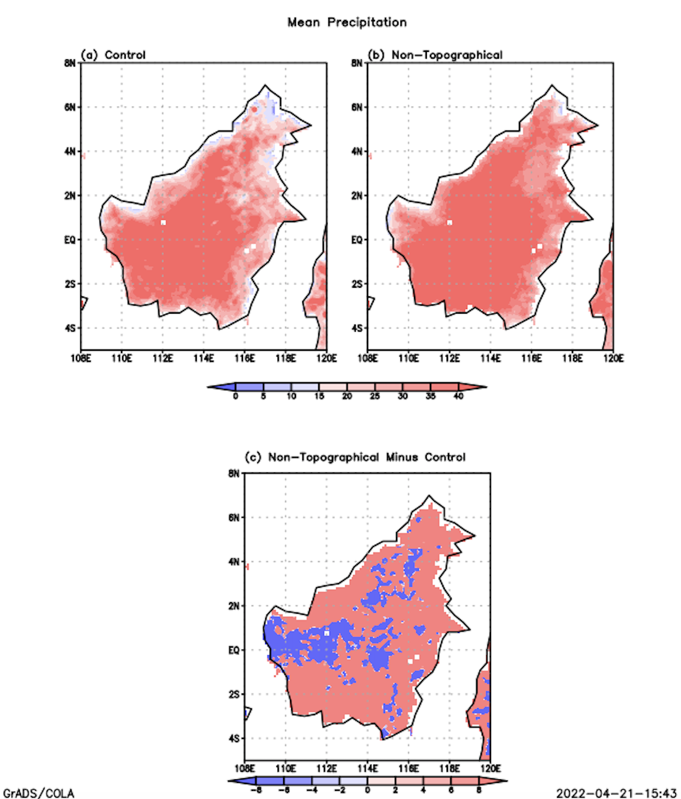
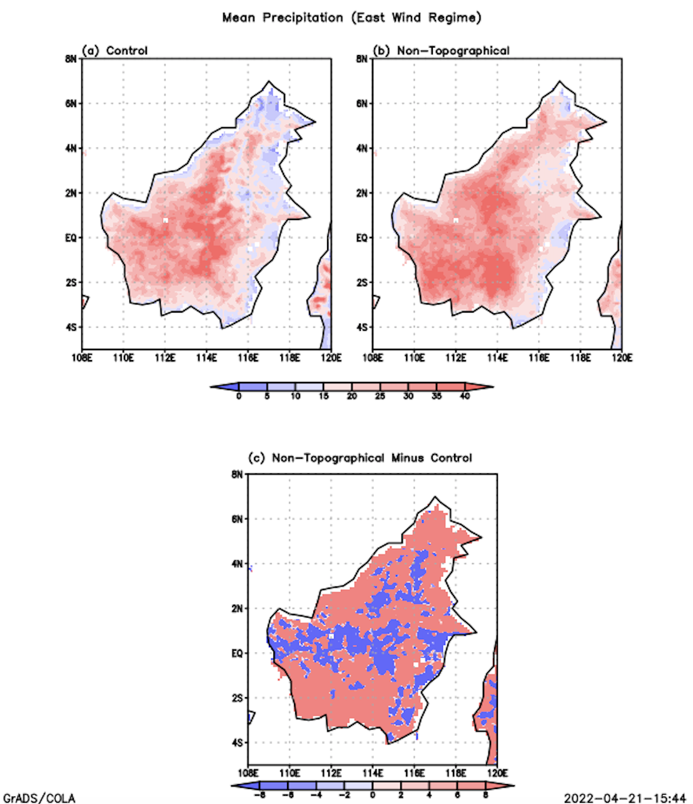
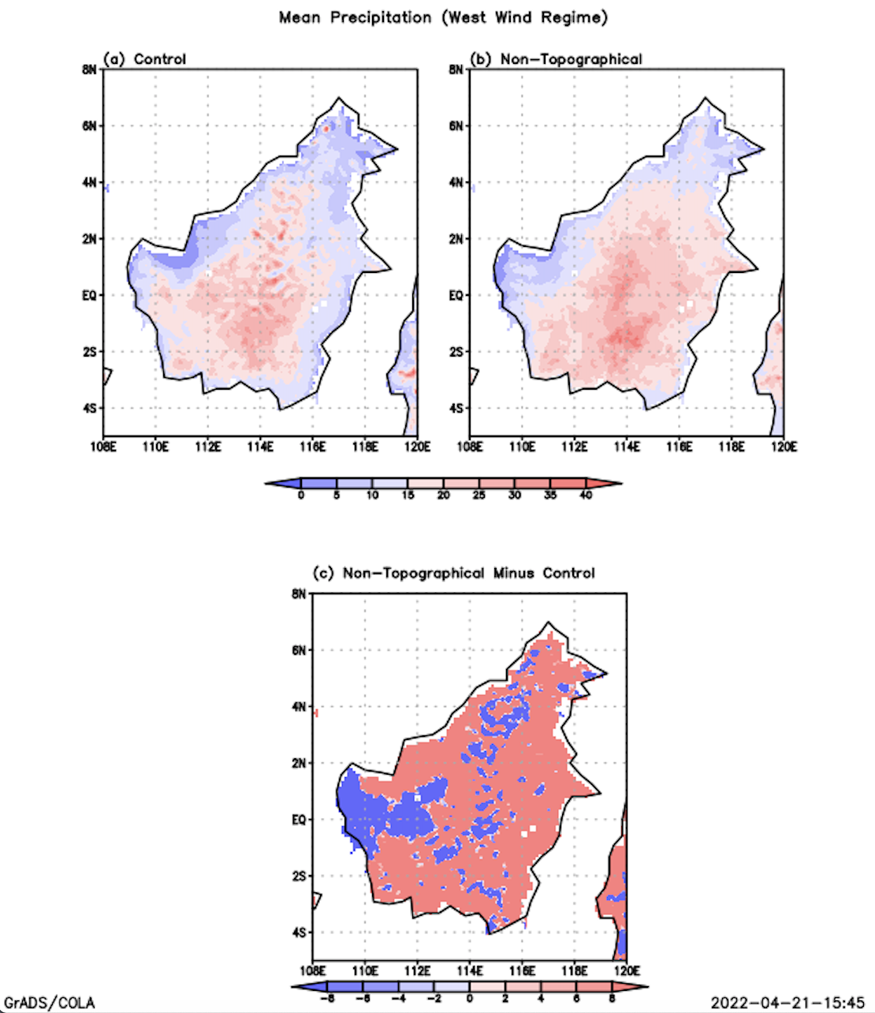
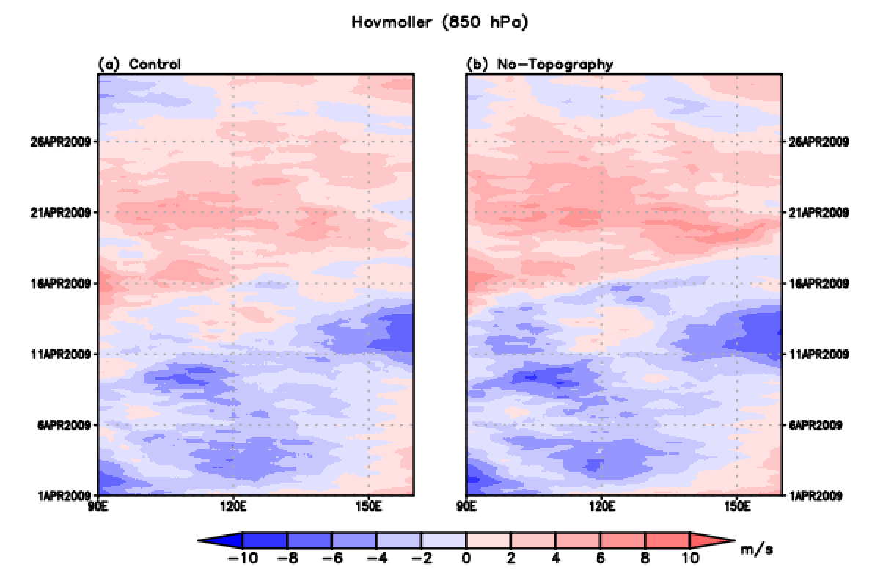
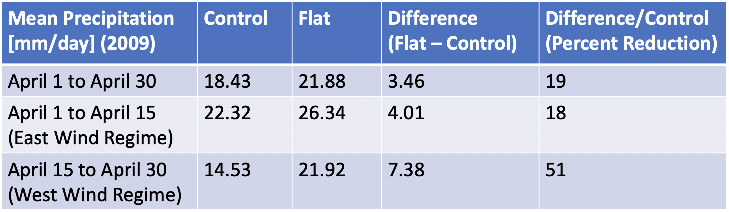
Analysis of the Effect of Elevated Topography on Precipitation over Borneo Considering the Madden-Julian Oscillation
Sean Hofmann
Dr. Pallav K. Ray, Dept. of Ocean Engineering and Marine Sciences, Florida Institute of Technology
Abstract
Using data processed with GRADs, from the Weather Research and Forecasting model (WRF), the effect of elevated topography on precipitation in Borneo during both phases of the Madden Julian Oscillation (MJO) is investigated.
Introduction
The interest is whether the presence of mountainous orography in Borneo has a net increase or decrease on model output for predicted average precipitation rates. Would a flat-terrain Borneo rain more or less than in reality? Where and when would precipitation rates be affected most?
Figure 1: Mean Precipitation from April 1, to April 30
(red: increase) (blue: decrease)
Figure 2: Mean Precipitation from April 1, to April 15
(red: increase)
(blue: decrease)
Figure 3: Mean Precipitation from April 15, to April 30
(red: increase)
(blue: decrease)
Discussion
The land mask increases the convective available potential energy (CAPE) of the MC. Given a flat MC, CAPE would be more available over Borneo via westerly inflow from active MJO or easterly inflow from inactive MJO.
Data and Methods
Using data from the WRF, the difference between modelled precipitation given normal elevated topography (control) and given flat topography (flat) is shown. Easterly (inactive MJO) and westerly (active MJO) wind regimes occurred during the first and second half of the month, respectively.
Conclusion
The WRF model indicates if the entire MC was flat, then precipitation would enhance over Borneo due to increased CAPE. The accuracy of the precipitation distribution is limited by the boundary conditions. Future research with a model of a flat Borneo with elevated MC topography could better represent the true effect of elevated topography on precipitation over Borneo.
Figure 4: Hovmoller Longitude Time Series (red westerly, blue easterly)
Acknowledgement
Dr. Pallav K. Ray. Dept. of Ocean Engineering and Marine Science, Florida Institute of Technology
Results
The land mask flattened the entire MC, not only Borneo, so precipitation was enhanced in all the flats compared to their respective controls.
References
Tan et al. (2018). Role of topography on the MJO in the Maritime Continent, Climate Dynamics.
Strachan, J. (2007). Understanding and Modelling the Climate of the Maritime Continent, Department of Meteorology.
Table: Numerical collection of precipitation values.

