Slide 1
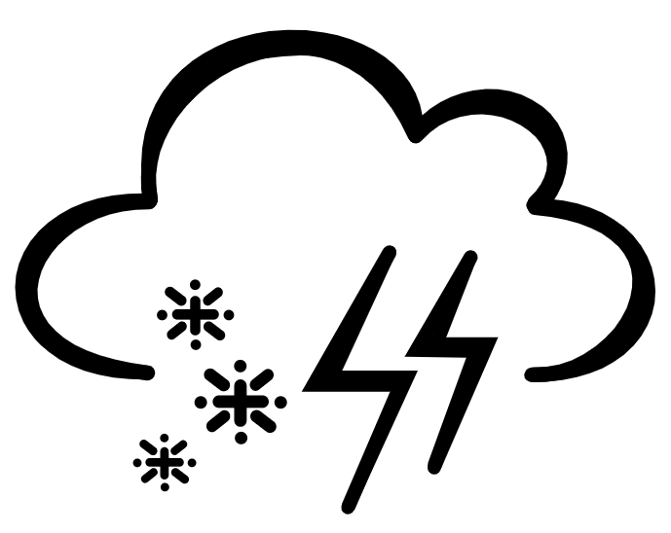
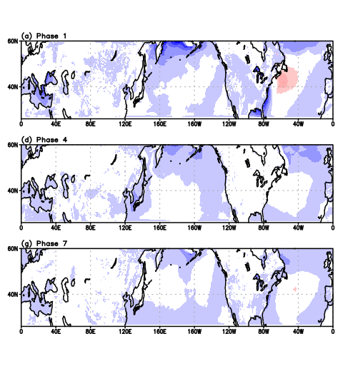
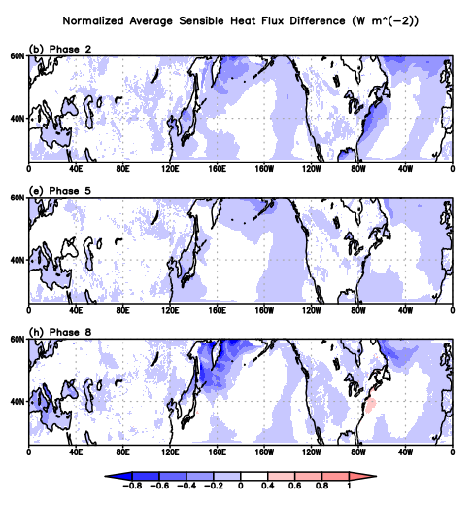
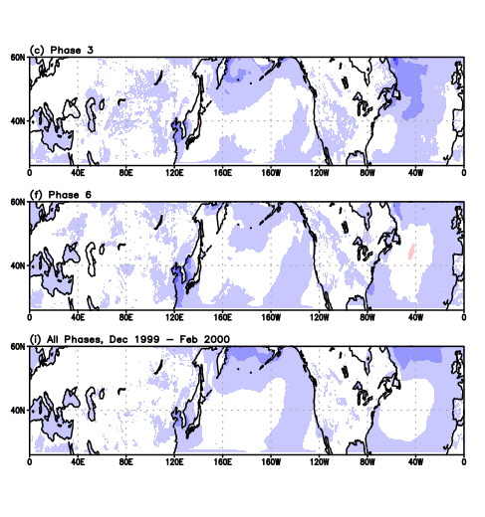
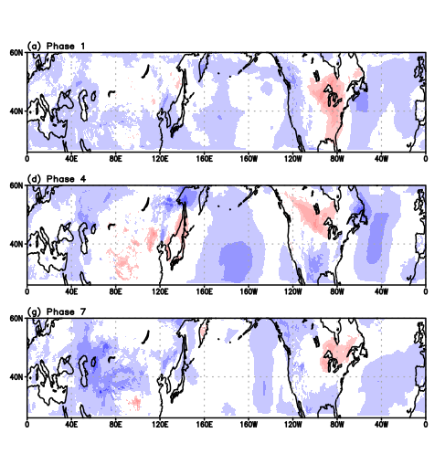
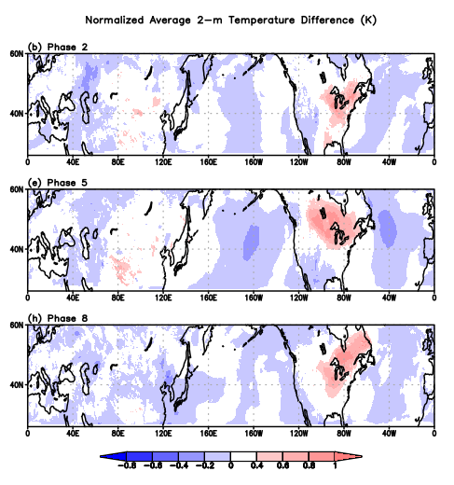
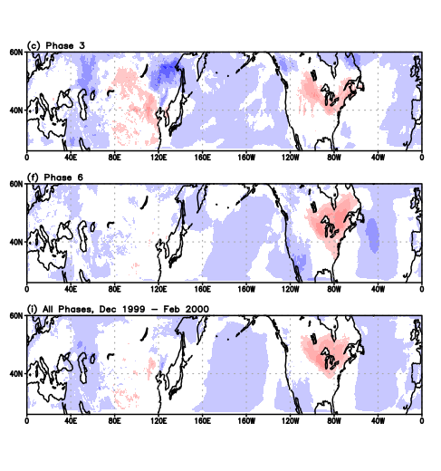
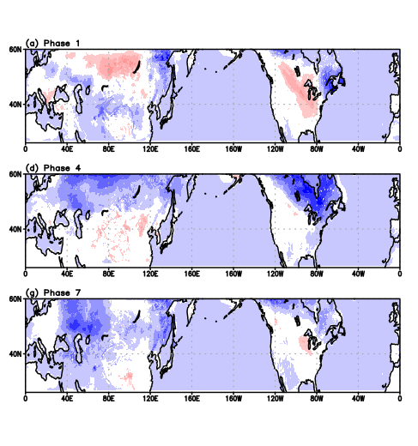
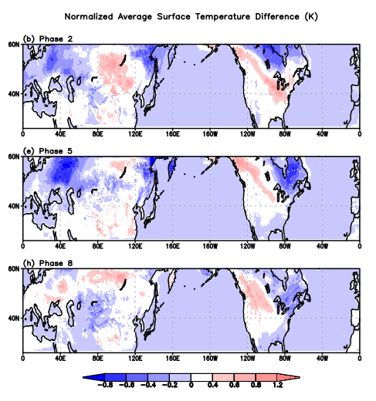
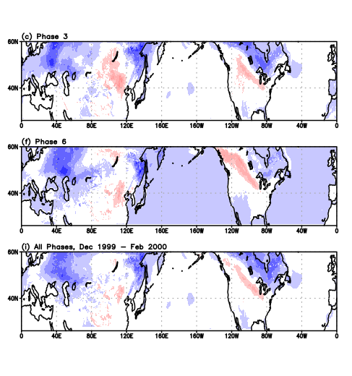
Impact of MJO on near-surface temperature in the midlatitudes
Kelly Carmer
Faculty Advisor(s): Dr. Pallav K. Ray Dept. of Ocean Engineering and Marine Sciences, Florida Institute of Technology
Abstract
The Madden-Julian Oscillation (MJO) is characterized by an eastward propagation of convection in the tropics on timescales of weeks to months. MJO typically originates over the Indian Ocean, monitored by categorizing the MJO into eight stages or phases, propagate towards the Maritime Continent, and can have many measurable meteorological impacts, to the extent of teleconnections in the midlatitudes. Previous research has shown that MJO has strong impacts in the midlatitude boreal winter. MJO covaries and contributes to forecast skill for near-surface temperature, and thus is a good predictor. Near-surface (2-m) temperature is a function of sensible heat flux and surface temperature. Thus, sensible heat flux, 2-m temperature, and surface temperature were assessed over the eight phases of MJO for the boreal winter of 1999-2000, utilizing a Midlatitude Channel Model based on the Weather Research and Forecasting (WRF) model for its better performance than many global models. The MCM is zonally global and meridionally bounded from 26°N to 60°N to isolate the influence of tropical and polar circulations, while still capturing topography and land-sea contrasts. The results show the difference in removing MJO for the three variables of interest during each phase of MJO. In northeastern North America, MJO is shown to have a cooling effect on 2-m temperature, and a warming effect on surface skin temperature, similarly found in north Asia especially in phase 5.
Introduction
The Madden-Julian Oscillation (MJO) is a tropical disturbance characterized by an eastward propagation of convection that has been shown to have impacts on temperature in the midlatitudes, with the strongest impacts in the boreal winter. MJO is divided into eight phases as it propagates from the Indian and Pacific Oceans. Channel models are advantageous when researching at specific latitudes due to their higher resolution, model physics, boundary conditions, and thus ability to better capture influences from topography and land-sea contrast. Thus, the Midlatitude Channel Model is used to measure the impacts of MJO on midlatitude surface temperature, 2-m temperature, and sensible heat flux.
Results
Sensible Heat Flux (Fig. 1)
Phases 1, 2, and 8 have the greatest differences
Regions of notable difference are along the coast southeastern and northeastern North America, as well as the northern Pacific Ocean
Only one region of positive difference located off the coast of eastern Canada
2-m Temperature (Fig. 2)
A region of positive difference lies over northeastern North America for all phases
A region of negative difference remains over the central Pacific, especially prominent in phases 4 and 5
Surface Temperature (Fig. 3)
Many phases have great differences over land
Phases 2, 4, and 5 have the most expansive regions of great difference. Many other phases show small areas of great difference.
Many phases show a large area of negative difference over Eastern Canada and parts of North Asia
Figure 1. The normalized difference between MJO Removal and MJO Controlled for sensible heat flux (W m⁻²) averaged for each phase of MJO (a-e), and the entire three months, 1 December 1999 through 29 February 2000 (f). Negative (positive) values are in blue (red).
Data & Methods
Midlatitude Channel Model zonally global, meridionally bounded 26°N to 60°N based on Weather Research and Forecasting (WRF) model
Initial and boundary conditions from ERA-Interim data
Output every 6hrs for 1 December 1999 through 29 February 2000
Relationship between 2-m temperature (T_{2-m}), surface temperature (T_{sfc}), sensible heat flux (Q_{sens}), and constants:
$$T_{2−m}=T_{sfc}−\frac{Q_{sens}}{ρ∗C_{p}∗h}$$
Used the Real-time Multivariate MJO index to classify each day by MJO phase
Subtracted simulation with MJO removed from the control
Normalized plots by dividing each by the maximum value for that phase of MJO to better compare and determine the regions that MJO had the greatest impact
Conclusion/Future Research
In the midlatitudes, northeastern North America and northern Asia are the most affected by MJO, with negative difference showing MJO acts to significantly warm temperatures
Future research should show the correlation between these three variables
More winter seasons should be included to eliminate outlier years and validate the regions of interest
Figure 2. Same as Figure 1, but for 2-m temperature (K).
References & Acknowledgements
Jenney et al. (2019), Geophys. Res. Lett., doi: 10.1029/2019GL083950; Zheng et al. (2018), J. of Clim. Doi: 10.1175/JCLI-D-17-0534.1.
Thank you Dr. Pallav Ray and Xin Zhou for preparing the data and guiding my research.
Figure 3. Same as Figure 1, but for surface skin temperature (K).

