Slide 1
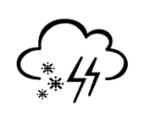
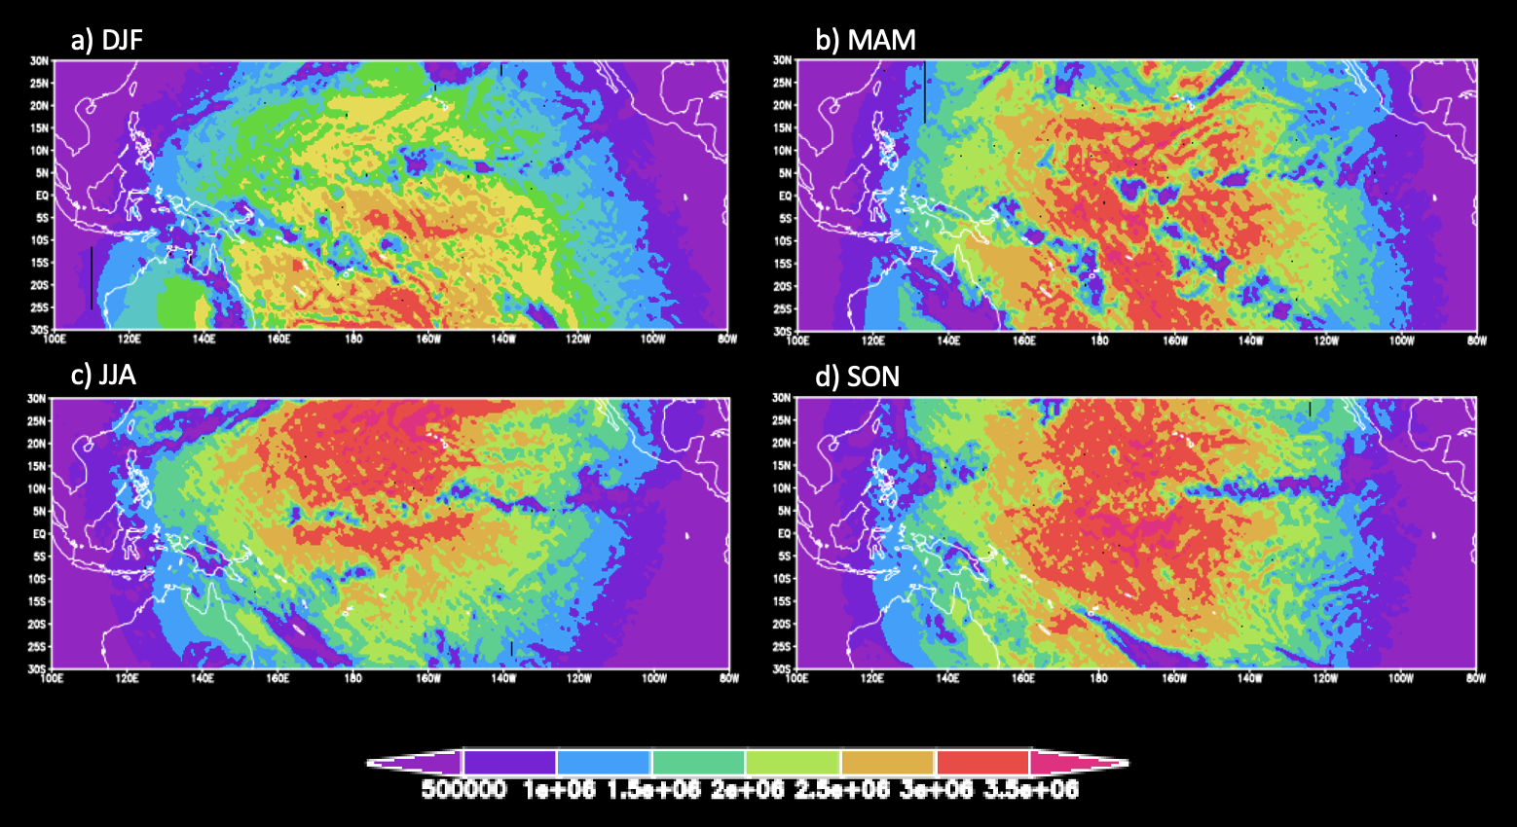
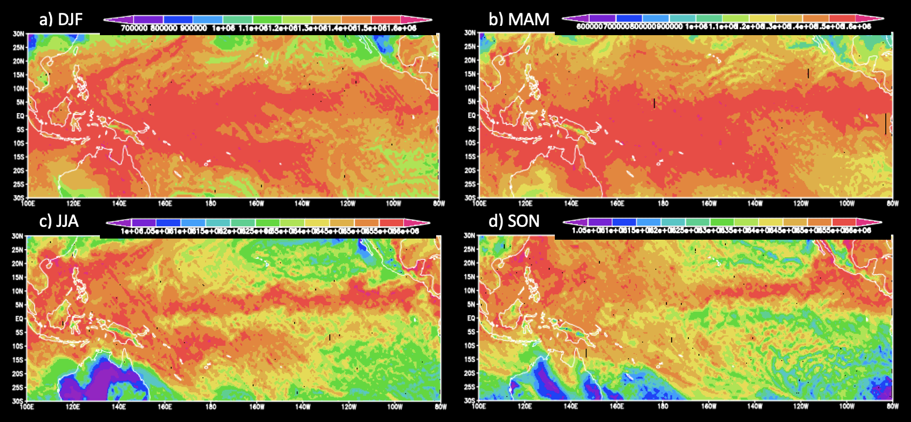
Analyzing Model Shortwave and Longwave Downward Radiation Outputs
Akarshna K. Iyer
Faculty Advisor: Dr. Pallav K. Ray, Dept. of Ocean Engineering and Marine Sciences,
Florida Institute of Technology
Abstract: The Earth’s net radiation flow has two components: solar (shortwave) and terrestrial (longwave) radiation. Downward shortwave and longwave radiation output data analyzation can help to better understand the Earth’s energy budget, which can help with understanding climate. When compared to data from the fifth generation European Centre for Medium-Range Weather Forecasts reanalysis of global climate and weather for the past 4-7 decades (ERA5 data), model data from the Weather and Research Forecasting Model Version 4 (WRF V4.0 model) shows trends indicating the March-April-May (MAM) season as most active for downward shortwave radiation, and the June-July-August (JJA) season as most active for downward longwave, trends that generally hold true for shortwave radiation in the ERA5 data, but deviate for longwave radiation (ERA5 data) where it seems activity peaks in the MAM season, but gradually declines throughout the JJA and September-October-November (SON) seasons. Additionally, values for both shortwave and longwave radiation are consistently highest closest to the equator in the Pacific Ocean. Factors such as cloud cover and the presence of the Intertropical Convergence Zone (ITCZ) can result in such seasonal patterns and repeated variations and general biases can cause different trend depictions.
Introduction
The Earth’s net radiation flow at the surface is its surface energy budget, its two components being solar (shortwave) and terrestrial (longwave) radiation. Surface energy budget has an immense impact on the Earth’s weather patterns and overall climate, making its study important. Factors such as the presence of clouds, water vapor, or greenhouse gases can affect the radiation budget. This study used both data from the Weather Research and Forecasting (WRF) V4.0 model (in W/m² ) and European Centre for Medium-Range Weather Forecasts reanalysis (ERA5) data (in J/m² ) to capture an averaged seasonal variation in both shortwave and longwave radiative flux over the Pacific Ocean. The aim of this project is to present a seasonal trend in both sets of data that is visually consistent as well as notice any stark differences between the figures produced by the different sets of data and conclude potential reasonings behind them such as unique output extraction methods or varying physics strategies in reanalysis.
Data and Methods
The WRF model used in this project is a high-resolution Tropical Channel Model (TCM) with 1° horizontal grid spacing. There is an available span of 35°S-35°N, but this project plots data from 30°S-30°N to better focus on data concentration. Data for the model spans January 1, 2010, to December 31, 2014, with output taken every three hours. The ERA5 reanalysis data used in this project is a combination of model and observational data using data assimilation where every 12 hours, forecasted data is combined with recorded data to develop a new prediction track. The spacing has been re-gridded into a latitude-longitude based grid. The ERA5 data used in this project is from the years 2010-2014 with data points downloaded for every 12 hours from the Copernicus website plotting 30°S-30°N latitude and 100°-280° longitude. Using the Grid Analysis and Display System (GraADS), both this WRF and ERA5 data was used to create figures averaging downward shortwave or longwave radiation by season for the entire model’s timespan.
Figure 1: Averaged downward shortwave flux at surface based on season in W/m² using WRF model data.
Figure 3: Averaged downward shortwave flux at surface based on season in J/m² using ERA5 model data.
Figure 4: Averaged downward longwave flux at surface based on season in J/m² using ERA5 model data.
Results and Discussion
Figure 1 shows the highest downward shortwave flux values were modeled during the MAM season, a clear high versus the other seasons. Figure 2 shows minimal seasonal variation for downward longwave flux, with a slight peak in the JJA season overall as the radiation span grows Northwest. Figure 3 also shows the greatest span of high downward shortwave flux values exists during the MAM season, but also presents a high value concentration of values in the SON season, focused on the equator. Figure 4 shows more of a seasonal variation for downward longwave flux with maximum activity achieved in the MAM season with an immediate decrease in the following two seasons: JJA and SON. For all the plotted data, the radiation values are highest close to the equator. Colder temperatures that prevailed throughout the winter season: December-January-February (DJF) can lead into the MAM season, creating an environment more suitable for cloud development. Increased cloud cover directly impacts radiation exchange, a possible explanation for the MAM activity seen in the figures. Additionally, variation in the Intertropical Convergence Zone (ITCZ) affects cloud and atmospheric activity via transport, a phenomenon that propagates Southwards during the winter season as well. Differences spotted in the trends produced by the WRF and ERA5 data analysis are due to the reanalysis’ account of actual observations in its forecasting. ERA5 data has a more detailed and accurate resolution.
Figure 2: Averaged downward longwave flux at surface based on season in W/m² using WRF model data.
Conclusions/Future Work
From this study, it can be concluded that average downward radiation has its greatest activity around the equator in the Pacific Ocean. In terms of seasonal variability, it can be concluded that the March-April-May (MAM) season seems to be the most active for average downward shortwave values. For downward longwave values, there is not much seasonal change in values for the WRF data, with a slight increase during the JJA season, but a gradual rise and decline for ERA5 data with a maximum in values during the MAM season. These seasonal trends make sense in terms of cloud cover increases and the differences in the data sets used boils down to inner model physics. For future analysis of shortwave and longwave downward radiation output, a different type of figure can be generated, different from just plotting longitude vs. latitude in order to discover other model biases.
References
Zhou, X., Ray, P., Boykin, K., Barrett, B. S., & Hsu, P.-C. (2019). Evaluation of surface radiative fluxes over the tropical oceans in AMIP simulations. Atmosphere, 10(10), 606.
Acknowledgements
Dr. Pallav Ray and Xin Zhou for assistance with data

