Slide 1
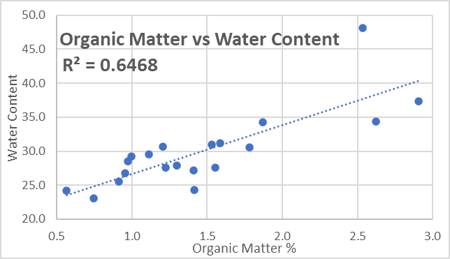
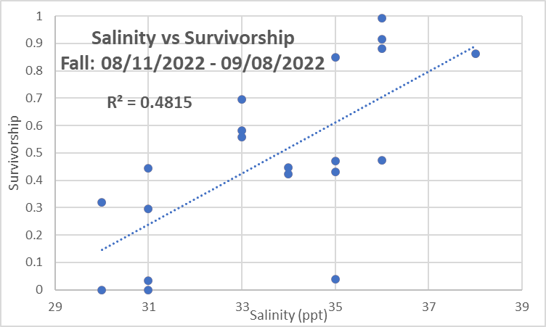
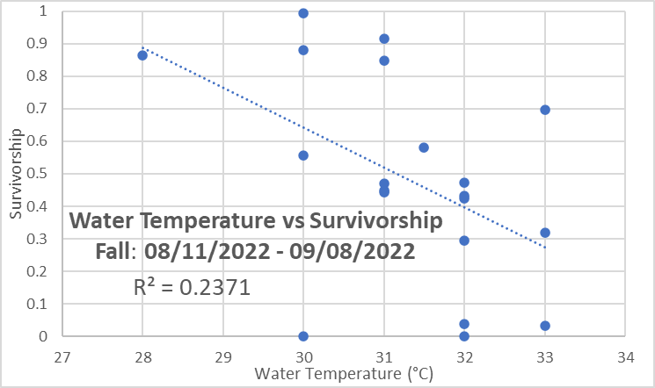
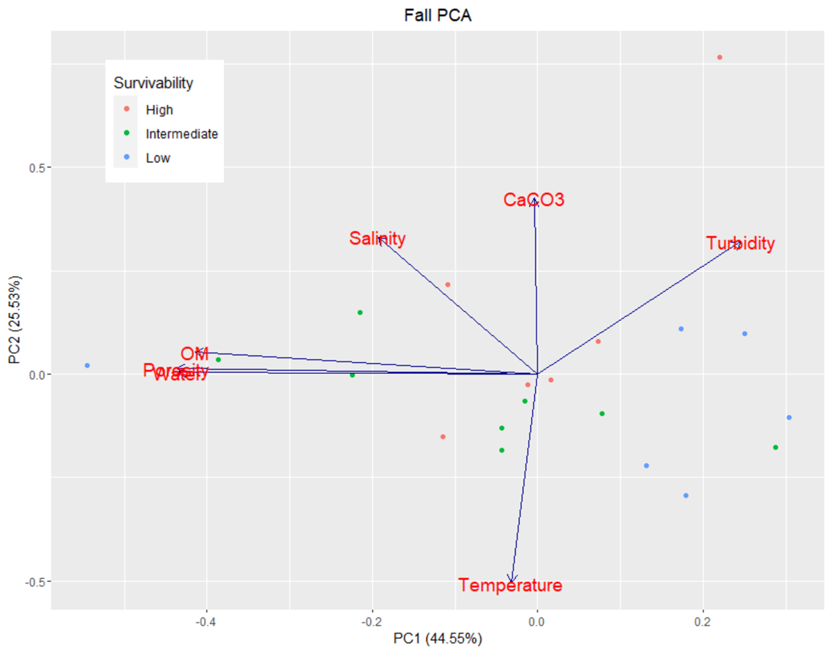
Environmental factors affecting survivorship of the hard clam Mercenaria mercenaria in the Indian River Lagoon
Alicia Perez Vargas
Faculty Advisor(s): Dr. Austin L. Fox, Dr. Kevin B. Johnson, Dept. of Ocean Engineering and Marine Sciences, Florida Institute of Technology
ABSTRACT
This project investigates the impact of environmental (water and sediment) conditions on the survivorship of the hard clam Mercenaria mercenaria in the Indian River Lagoon (IRL) during the Fall of 2022. Restore Our Shores planted 3 million adult clams throughout the IRL in Brevard County. Results showed a positive correlation between salinity and clam survivorship, and a negative correlation between temperature and clam survivorship. No significant correlation was found between sediment % organic matter (OM) and clam survivorship.
INTRODUCTION
The Indian River Lagoon (IRL) suffers from eutrophication and degradation due to high nutrient accumulation (Qian et al. 2007). This has contributed to the loss of fisheries species, including the hard clam Mercenaria mercenaria. The objective of this experiment is to explore the potential correlation between the survival of M. mercenaria and selected environmental conditions (i.e., estuarine salinity, temperature, or sediment % organic matter content or OM). These data could help with clam restoration and management by helping define the ideal conditions for survival.
Water temperature was measured in the boundary layer immediately above the clam beds.
Clam bed sediment samples were collected, transported back to the lab, and frozen. The sample was then baked at 400°C, allowing water content determination by contrasting the pre- and post-drying weights. Sediment % OM content was determined via the loss-on-ignition (LOI) method (Heire et al. 2001).
Three sediment samples were collected at each station to determine clam survivorship (ratio of living clams to total). Graphs were created, and statistics conducted, in Microsoft Excel and R.
DISCUSSION/CONCLUSION
Sediment % OM and % water content accounted for 44.6%, and water temperature accounted for 25.6% of the variation in hard clam survivorship. Levels of survivorship were classified as follows: low: 0.00 - 0.33; Intermediate: 0.34 - 0.66; High: 0.67-1.00 (Fig. 1). Sediment % OM and water content are significantly correlated (Fig. 2, R²=.64, p<<0.001), which likely explains why they fall out together as a factor in the PCA. Salinity and survivorship had a statistically significant positive correlation of 0.48 (Fig. 3, p<.001), with salinities of 35-39 ppt associated with high survivorship, consistent with a study by Santos et al. (2020). Water temperature and survivorship had a statistically significant negative correlation of 0.24 (Fig. 4, p=.029). Other studies show that a temperature
range from 16-27°C is optimal for hard clams (Weber et al. 2019). Outside of this range, clams show signs of stress and may die. The highest survivorship (average of 65%) was observed at sites where the sediment % OM was between 1.1% -1.8%. This intermediate OM level may indicate food availability without driving low oxygen through organic degradation.
CITATIONS
Heire, O., Lotter, A. F., & Lemcke, G. (2001). J. Paleolim, 25:101-110.
Qian, Y., et. al. 2007. Water, Air, and Soil Pollution, 186(1), 195-208.
Santos J.S et. al. 2020. Anais da Academia Brasileira de Ciências, 92.
ACKNOWLEDGEMENTS
I’d like to thank Dr. Fox and Dr. Johnson for advising on the project. I’d also like to thank Hope Leonard and the Restore Our Shores team for helping me collect data. I’d also like to thank Connor Wong for helping with the data analysis.
p-value = 0.000019
Figure 2: Benthic sediment & organic matter content vs. benthic sediment water content in the northern IRL (Fall 2022).
p-value = 0.0007
Survivorship
p-value = 0.0294
Figure 4: Hard clam (M. mercenaria) survivorship vs. bottom water temperature in the IRL (Fall 2022).
Figure 3: Hard clam (M. mercenaria) survivorship vs. bottom water salinity in the IRL (Fall 2022).
Figure 1: Principle Components Analysis (PCA) of hard clam (M. mercenaria) survivorship as a function of water column salinity, water column temperature, and benthic sediment % organic matter (OM).
METHODS
Twenty clam beds in the Brevard County portion of the IRL (Florida) were randomly selected. Bottom water samples were analyzed for salinity via a refractometer.

