Slide 1

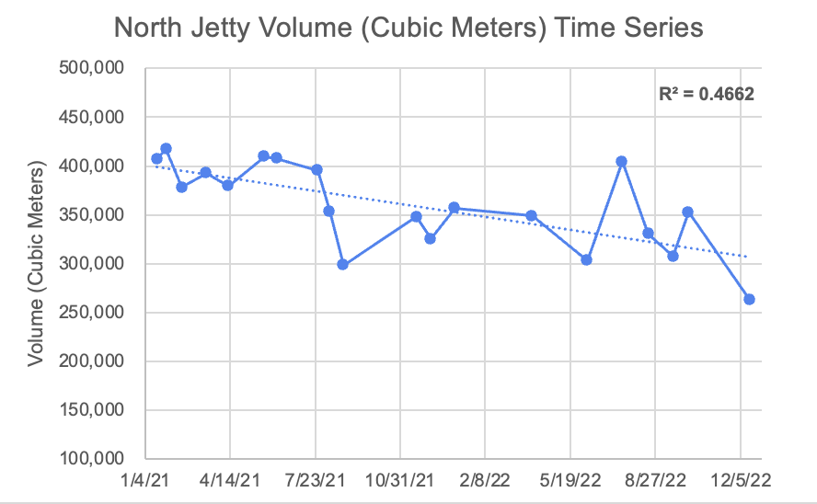
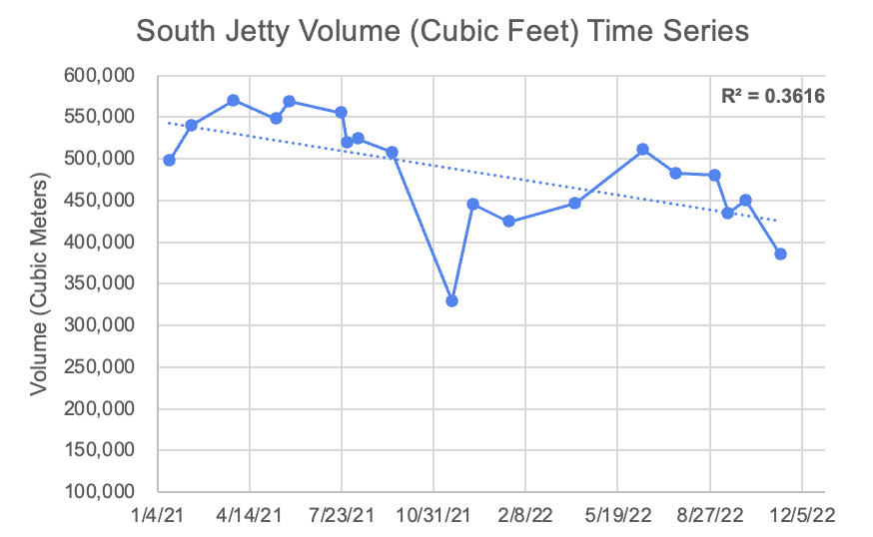
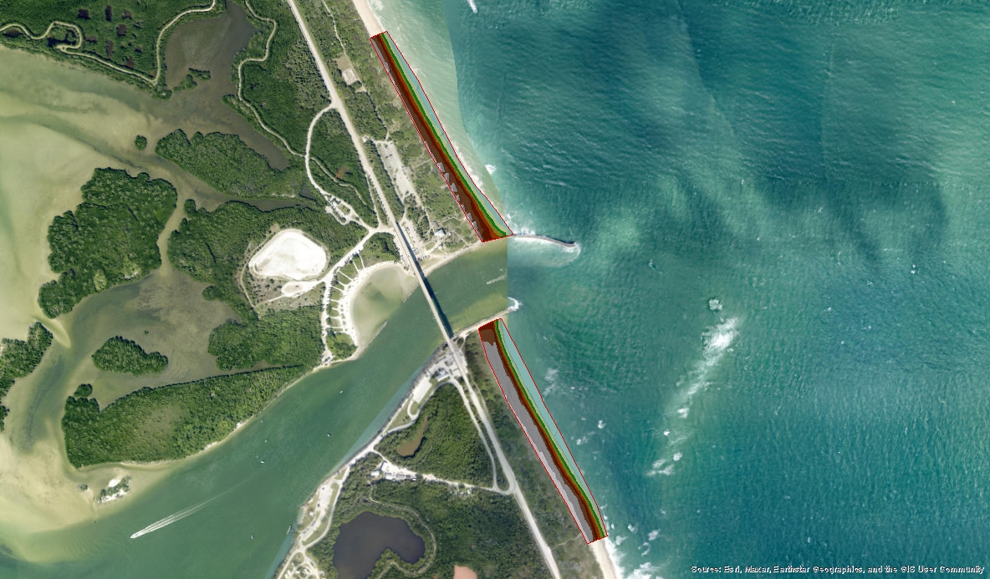
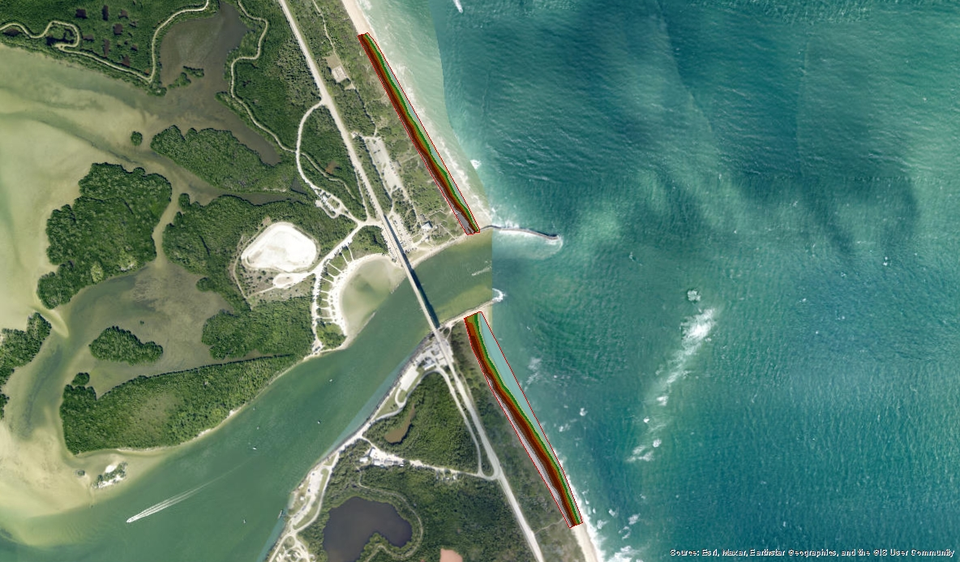
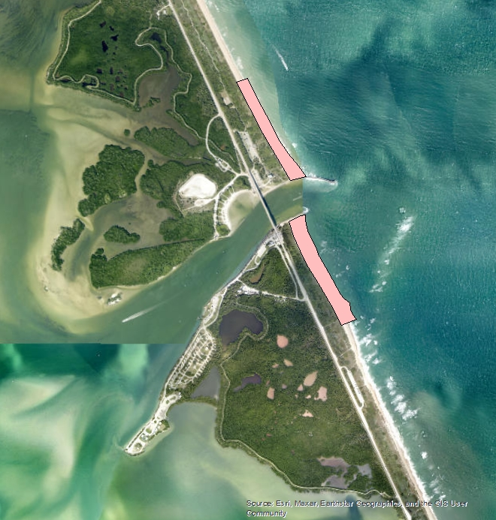
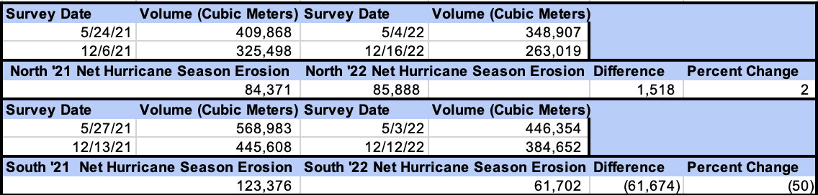
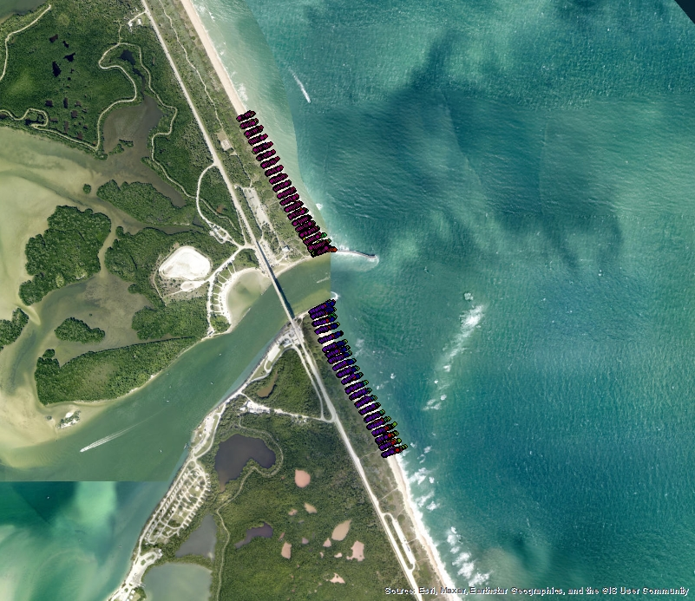
Erosion Variability and Stabilization Across Sebastian Inlet During 2021 and 2022 Hurricane Seasons
Benjamin Crews
Faculty Advisor: Dr. Gary Zarillo, Department of Ocean Engineering and Marine Sciences, Florida Institute of Technology
INTRODUCTION
Net Hurricane Hurricane Season Erosion was calculated by subtracting the volume of sand estimated in December from that estimated in May; this acts to normalize cumulative erosions and accretion and provides Net Erosion over the hurricane season (Table 1.).
Erosion(NHSE). NHSE for the 2021 and 2022 seasons shows a loss of beach face sand volume (Table 1.). However, the 2022 season had more direct storm hits. The North Beach had only a 2 % increase in erosion in 2022 compared to 2021 (Table 1.). In contrast, the South Beach had a 50% decrease in erosion in 2022 compared to 2021 (Table 1.).
The Sebastian Inlet system is a dynamic beach face characterized by a stabilized narrow channel connecting the Indian River Lagoon to the Atlantic Ocean (Figure 1.). The abundance and distribution of sand across this system impact the tourism economy. Changes in sand distribution have implications for the inlet and park management. Thus, these changes are being studied through a detailed sand budget analysis. Since 2021 monthly Real Time Kinetic (RTK) surveys have been completed on the beaches North and South of the channel. These surveys collect location and elevation data along transects perpendicular to the shore every 100 feet (Figure 2.). The beach face in this system constantly shifts, undergoing seasons of accretion and erosion. This study aimed to determine how the 2022 Hurricane Season affected the beach faces (North and South) compared to the previous light Hurricane Season in 2021.
RESULTS
This two-year dataset documents beach face erosion in North and South Systems. The TINs serving as volumetric estimates display an overall loss of sand from the beach face system across the entire two years. The overall shape and elevation of the beach change significantly over the course of the study.
Jan. ‘21
Dec. ‘22
Figure 5.
Figure 4.
The time series of both the North and South beaches in the system shows a net loss of sand volume over the two years (Figure 4.; Figure 5.). The data also reveal extensive temporal variability over the two-year study. (Figure 4.; Figure 5.).
Figure 3.
METHODS
The beach face in January 2021 is characterized by higher elevations (denoted as darker to grey colors). This is illustrated by the top layer of the first and last survey TIN to provide some topographical context (Figure 3.). The January 2021 beach profile extends out further than the profile from December 2022 (Figure 3, overall plot sizes). The December 2022 profile had a receded beach face with less elevation (Figure 3.).
CONCLUSIONS
For two years, monthly RTK Surveys have been completed at both beaches at the Sebastian Inlet (Figure 1, red highlights). These surveys included ~ 60-80
The data suggest two main takeaways: the first is the basic observation that both beach faces have eroded during both years of the study. Second, both beach faces counterintuitively displayed erosion “stabilization” during the 2022 Hurricane Season when storms were more abundant and intense; meaning that the beaches show less or no significant increases in erosion during the more intense Hurricane Season. It is possible that apparent stabilization in the heavier storm season is due to dune erosion that is not captured within the data. It is hypothesized that dune sand shifted down to the beach and onto the beach face in 2022 due to dune erosion resulting from higher-reaching storm impacts in 2022.
Figure 1.
Table 1.
~elevation data points. The data were collected for Northing, Easting, and Elevation within the State Coordinate System, Florida East 0901. The data
were plotted in ArcGIS to create a Triangulated Irregular Network (TIN) to represent the 3D surface of the beach face. A floor of -40 feet was used to estimate the sand volume within the TINS. The sand volume
The erosion and accretion variability across the entire time series(Figure 4.; Figure 5.) was immense, accounted for by low R-squared values for the data with its trend line. Net hurricane season erosions were calculated by simply subtracting the December Volume from the May Volume; this accounted for all erosion and accretion of the beach face over the hurricane season to allot Net Hurricane Season
ACKNOWLEDGMENTS
I would like to thank Dr. Gary Zarillo for his continued support along with everyone in the Coastal Processes Research Group and the Sebastian Inlet Tax District.
Figure 2.
estimates were then
converted from cubic feet into cubic meters.

