Slide 1


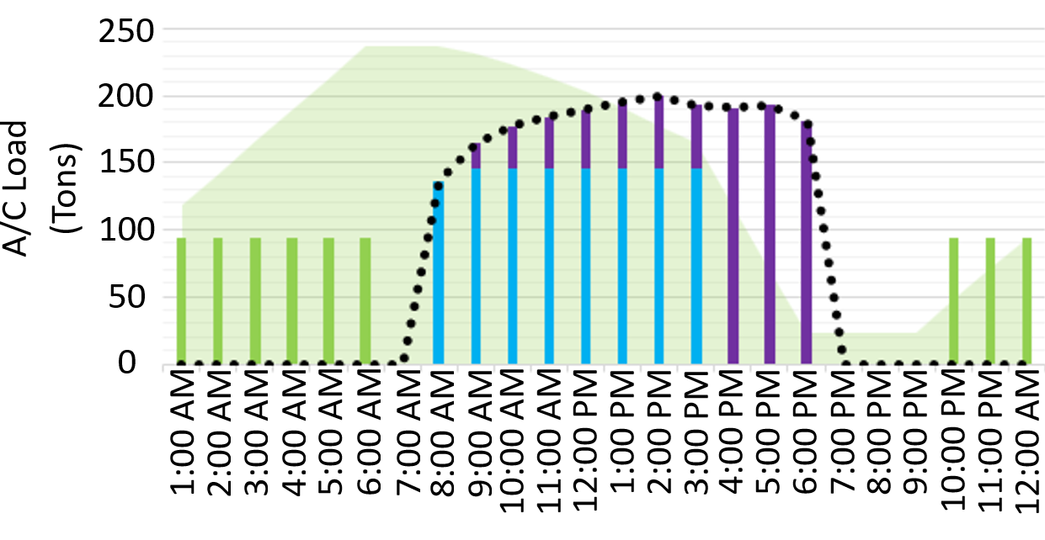
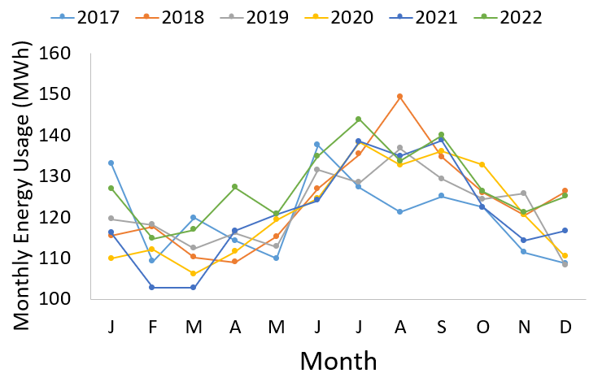
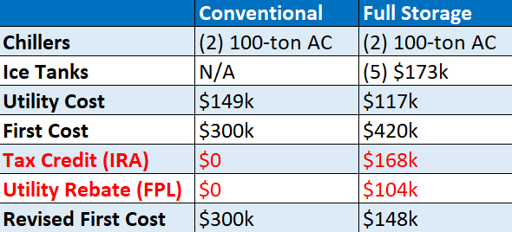
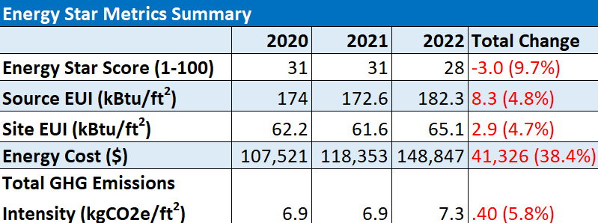
Evaluation of Energy Engineering Upgrades to Reduce Expenses and Improve Resilience, City of Melbourne, FL
Mason Greene
Faculty Advisor: Dr. Ken Lindeman, Dept. of Ocean Engineering & Marine Sciences, Florida Tech
Introduction
Working alongside the City of Melbourne Beautification & Energy Efficiency Board (BEEB) and Trane Heating & Air Conditioning, this project aims to incentivize the installation of thermal ice storage systems to reduce energy costs, using the Inflation Reduction Act of 2022 (IRA)¹. By targeting a prominent building in the area, the expectation is for others to follow the example of implementing energy efficient systems. Thermal energy storage works as a “battery” which can store energy for a later use. The system is charged when the energy is cheaper during off-peak hours and discharges the energy when needed.
Objectives
To conduct a benchmarking study and develop a summary of current and projected energy efficiency in City Hall.
To analyze the feasibility of installing a thermal ice storage system in City Hall.
Methods
Benchmarking Study
The current energy efficiency of Melbourne City Hall was determined utilizing recent utility and energy usage data. Evaluation of the building’s efficiency was completed using the EPA’s Energy Star Portfolio Manager. The engineering data collected throughout this study will be used to apply for a BEEB Clean Energy Award.
Feasibility of Thermal Ice Storage Installation
A walkthrough of Melbourne City Hall was conducted in November 2023, to determine metrics including square footage, building capacity, and AC load. Using Trane’s FirstPass software, traditional AC and thermal ice storage system options for City Hall were assessed².
Results
Benchmarking Study
Fig. 1 shows monthly megawatt-hour usage in City Hall, 2017-2022. Along with seasonal trends, there is a general increase in MWh in recent years. This increase over time was caused by an increase in capacity post-pandemic (2020) and the lack of a capacity sensor to regulate the AC system.
Figure 1: 2017-2022 city hall monthly energy usage
Table 1 lists the metrics determined using Energy Star between 2020-2022.
Table 1: Energy Star metrics for Melbourne City Hall
Feasibility of Thermal Ice Storage Installation
Fig. 2 displays the expected daily energy usage of City Hall if thermal ice storage was installed. The green bars represent the energy usage while the system stores ice overnight. The blue and purple bars represent the chiller and ice bank energy usage while cooling the building. These data show how the system will save money, by dispersing energy consumption evenly throughout the day.
Results (cont).
Figure 2: Expected city hall thermal ice storage loads, daily
Table 2 inventories the ice storage options for City Hall. This table shows the significance of the IRA tax credit and Florida Power and Lighting (FPL) utility rebate on cost of the system.
Table 2: Comparison of ice storage and conventional options
Conclusions
Based on the results of the benchmarking (Table 1), City Hall requires a more efficient cooling system. The IRA with the FPL tax rebates greatly reduces the overall cost of the thermal ice storage system (Table 2). By implementing this system, a precedent could be established for other cities in the county.
References
[1] U.S. Senate. (2022). The Inflation Reduction Act of 2022.
[2] Trane Heating & Air Conditioning. (2023). Thermal Energy Storage Systems.
Acknowledgements
Trane Team Leader Bruce Lindsay, Sarah Brooks,
Jennifer Wilster

