Slide 1


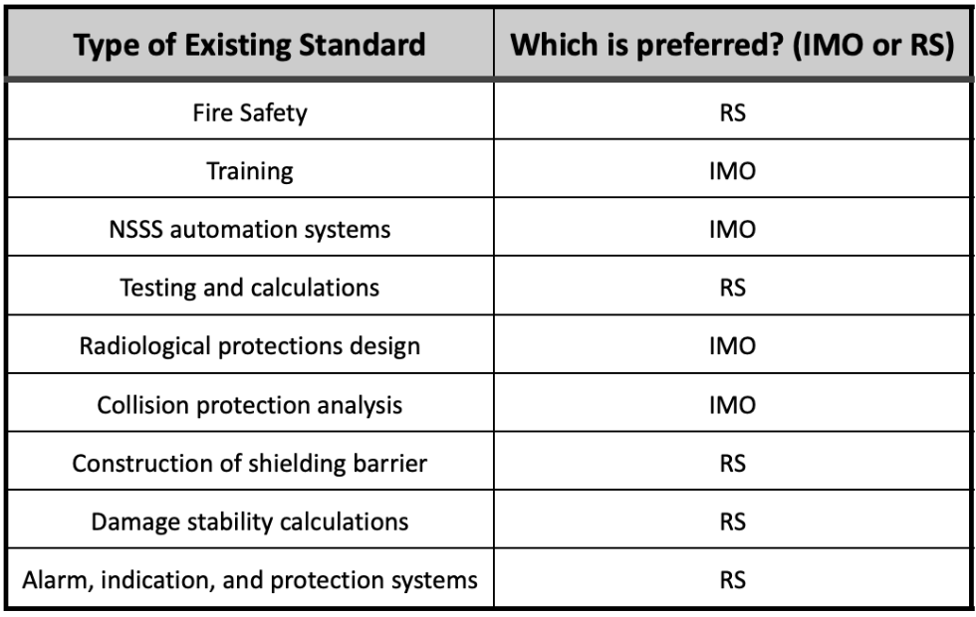
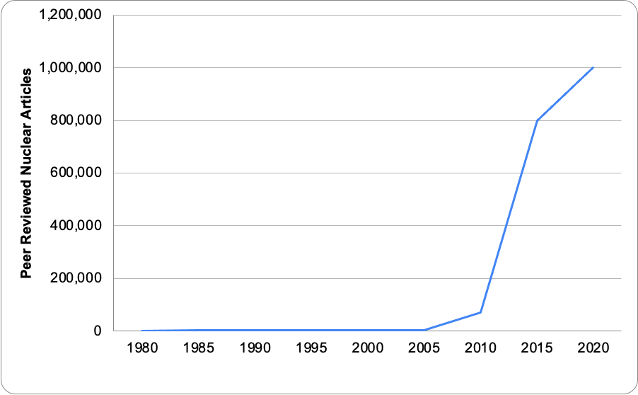
Categorization of Nuclear-Powered Safety Incidents for the Development of Standards for the Maritime Shipping Industry
An Edwards and Kara Perkins
Faculty Advisor: Dr. Ken Lindeman, Dept. of Ocean Engineering & Marine Sciences, Florida Tech
Introduction
The American Bureau of Shipping (ABS) has been tasked with the International Maritime Organization’s (IMO) goal of reducing carbon emissions from shipping 45% by 2030¹. One fuel alternative is nuclear energy.
The US Navy has been using nuclear energy within its submarines since the Cold War with no major safety incidents² .There have been several attempts to integrate nuclear energy into the commercial maritime industry³ . However, due to public safety concerns, all attempts have failed. The goal of this project is to investigate nuclear safety incident cases and regulations in order to make informed suggestions for the implementation of nuclear energy in the commercial maritime shipping sector.
Objectives
Conduct a literature review of safety incident cases on nuclear power and the maritime shipping industry
Develop a report and presentation for ABS outlining safety incident cases, recommendations, and lessons learned based on existing safety standards
Methods
Literature Review
A review of academic, corporate and military literature on nuclear safety incidents on marine shipping incidents was conducted.
Error types were categorized as: human, design, and collision.
Safety incidents involving nuclear power were reviewed (both land-based and sea-based).
Based on categorization of the safety incident cases, specific lessons learned were compiled and relevancy was determined.
Existing Safety Standards
We comparatively analyzed safety standards of the IMO & Russian Maritime Registrar of Shipping (RS).
Recommendations for future standards were created based on consultations with ABS engineers.
A report and presentation were prepared on the safety standards based on the literature review.
Results
Literature Review
The main contributors to nuclear safety incidents were human and design error (Fig. 1). An analysis was also conducted solely on submarine incidents finding that the main contributors are the same, with the addition of collisions. Suggestions for best practices were made based on case studies.
Fig. 1: Distribution of Nuclear Incident Causes
The number of peer reviewed articles related to nuclear energy has increased exponentially (Fig. 2).
This research is relevant because interest in nuclear energy has increased over the past decade.
Fig. 2: Google Scholar Articles/yr. on “Nuclear Energy”
This rise in interest reflects an increasing research focus on nuclear energy and safety. This increase in available knowledge can help improve public opinion.
Existing Safety Standards
Figure 3: Identification of Preferred Standards
When comparing the IMO to the RS standards, preferences were based on the level of detail and clarity provided. Fig. 3 demonstrates the preferred existing standards based on standard type. Five of the preferred standards were based on the RS and four on the IMO, reflecting differences on level of detail.
Discussion / Conclusions
Many lessons can be learned for the implementation of marine nuclear technology by evaluating past mistakes. Currently, the majority of safety incidents are caused by human error. The best way to combat this via detailed safety standards regarding training, materials testing, and overall systems testing. The next step include gathering more quantifiable research to determine which types of nuclear reactors would we best suited for implementation in commercial maritime shipping.
References
[1] Index of Imo Resolutions. International Maritime Organization. (n.d.).
[2] The Nuclear Navy. Naval History and Heritage Command. (n.d.)
[3] IAEA. (2022, November 15). What is nuclear energy? The Science of Nuclear Power. IAEA
Acknowledgements
ABS Team: Meg Dowling and Shania Suarez.
Sarah Brooks, Florida Tech.

