Slide 1

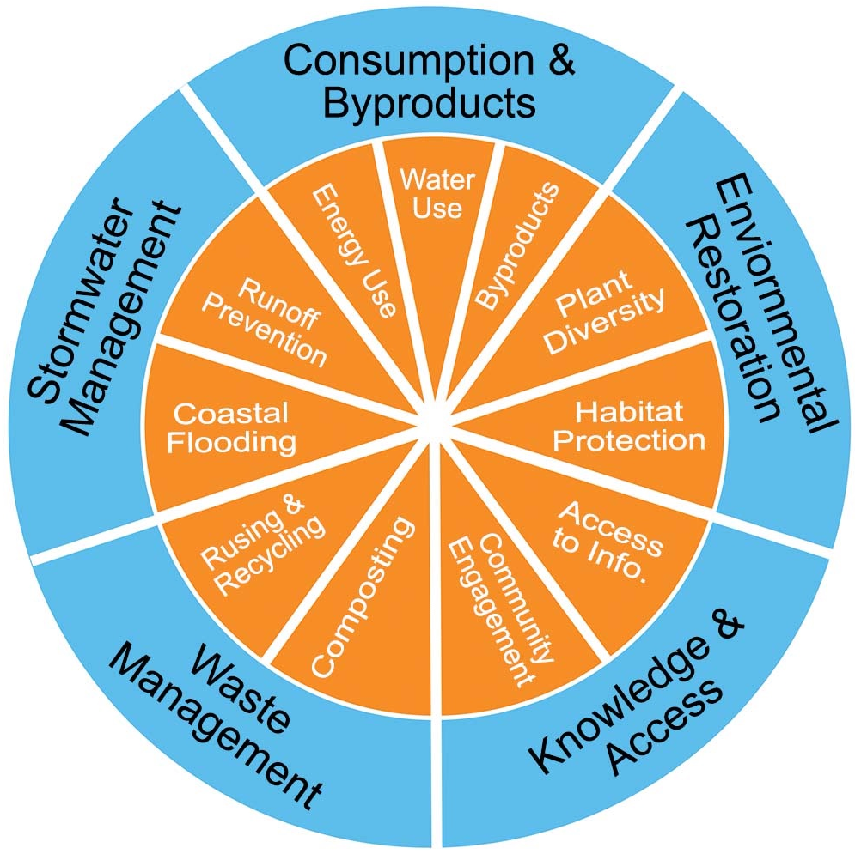
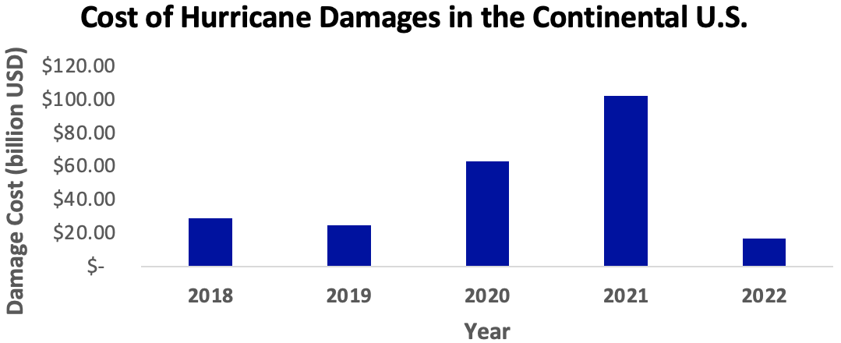
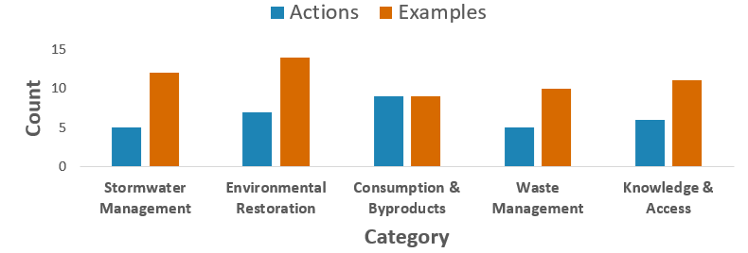
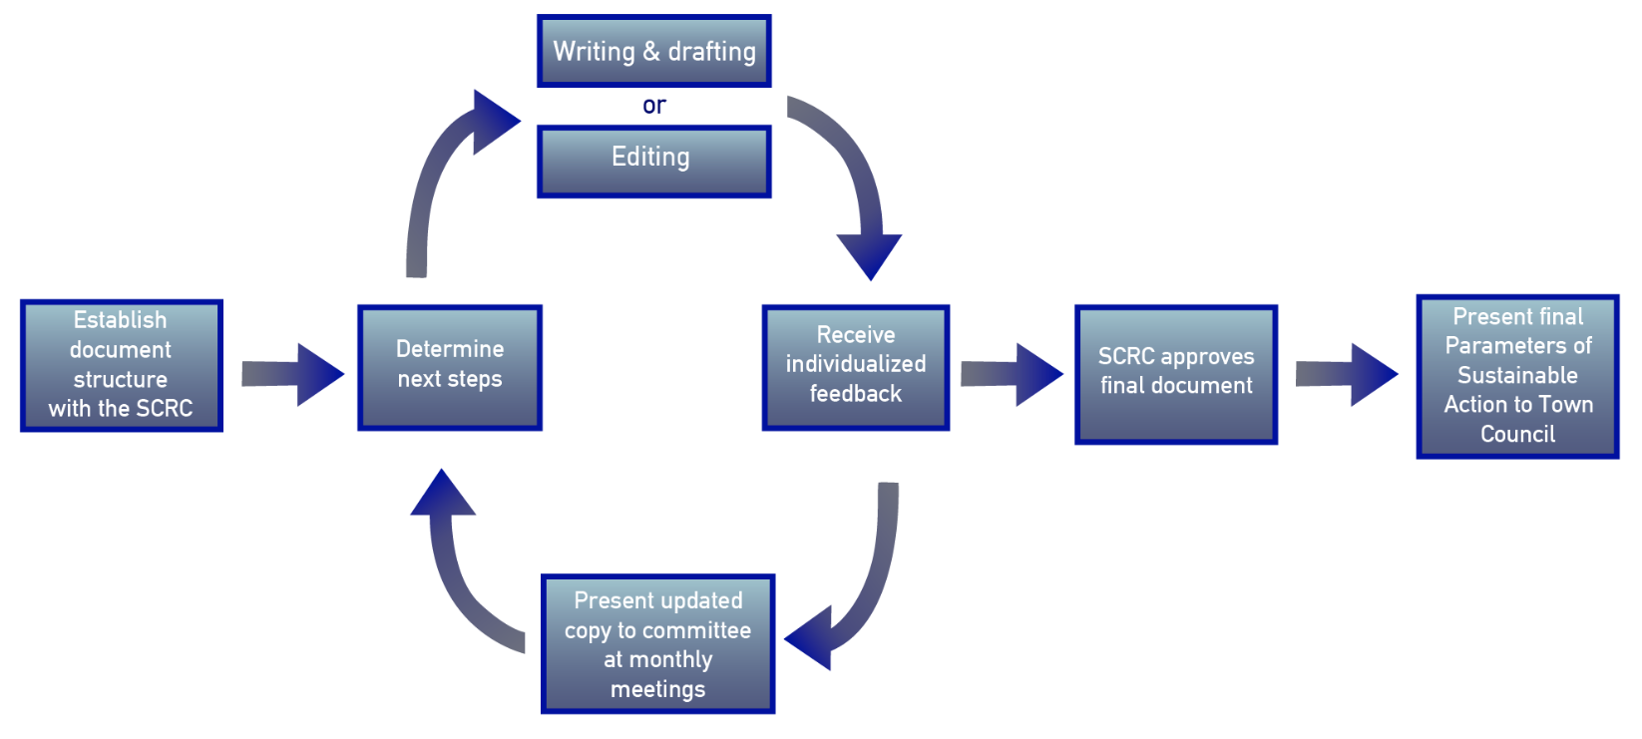
Developing the First Sustainability Plan for the Town of Indialantic, FL.
Emily Flint, Trinity DiNunzio
Faculty Advisor: Dr. Ken Lindeman, Dept. of Ocean Engineering & Marine Sciences, Florida Tech
Introduction
Coastal communities face challenges due to increasing population density and resource limitations. The Town of Indialantic has developed a Sustainable Communities and Resiliency Committee (SCRC) to work on mitigating these impacts¹. For this project, our internships focused on creating the town’s first Sustainability Plan to guide and implement actions in categories such as Stormwater and Knowledge and Access.
Objectives
Construct a framework for first town sustainability plan with town stakeholders
Develop a full sustainability plan for Committee and then Town Council approval
Methods
Plan Framing and Drafting
Organize and expand information from previous interns and other relevant sources
Collaborate with the SCRC on document structure and establish tiers of key categories
Draft sections of the document for review
Process SCRC feedback from monthly meetings
Design graphics and gather other visual content to be included in the final product
Plan Completion
Collaborate with SCRC members to finalize text and convert into a fully formatted document
Prioritize committee members on areas of interest and need in the document
Transition the document to a slide deck format that can be accessed by the public
Present to the committee for internal review and approval prior to Town Council review
Results
Plan Framing and Drafting
Analysis of previous SCRC documents resulted in the establishment of five key project categories with nested subcategories (Fig. 1).
Fig. 1. Categories &
subcategories of plan.
Within each category,
there were a unique
number of aspired
actions and example
projects to be carried
out by the committee
in the future (Fig. 2).
Fig. 2. Distribution of actions & examples per category.
Plan Completion
Transitioning the document to a complete state required many rounds of review feedback (Fig. 3).
Fig. 3. Select system structures & flows.
Results, Plan Completion, cont.
During the process, the committee decided to prioritize the Stormwater and Flood Management category. We analyzed the damage cost of hurricanes (Fig. 4). We iteratively reviewed plan text with the SCRC, beginning at the December 2022 meeting. The SCRC will vote to send the plan to the Town Council on April 26. The council vote will occur at a later date.
Fig. 4. Economic impact of hurricanes, continental U.S.²
Discussion
The creation of this plan gives the SCRC established goals and parameters that will guide their work in the future. This creates a valuable opportunity for the SCRC and the Town Council to codify sustainability priorities within the town. Future interns will oversee the implementation of priority actions in the plan. By working with the SCRC, town staff and the citizens, future interns can complete and expand upon outlined goals.
References
1. Boards & committees | the town of indialantic florida | official web site. (n.d.). Retrieved April 2, 2023, from https://www.indialantic.com/boards-committees/
2. Center, N. H. (n.d.). National hurricane center. Retrieved April 2, 2023, from https://www.nhc.noaa.gov/
Acknowledgments
V. Taranto, M. Casey, the town Sustainable Communities and Resiliency Comm.; S. Brooks; A. Paluzzi, N. Al Ghaithi

