Slide 1


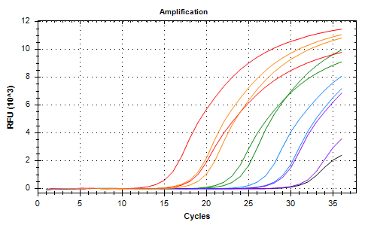
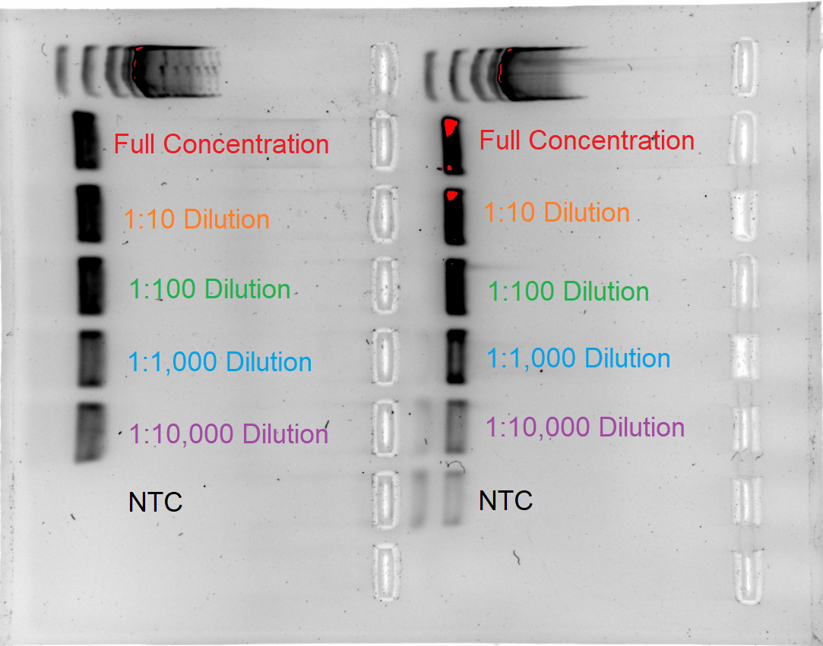
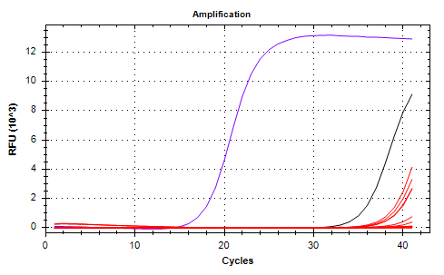
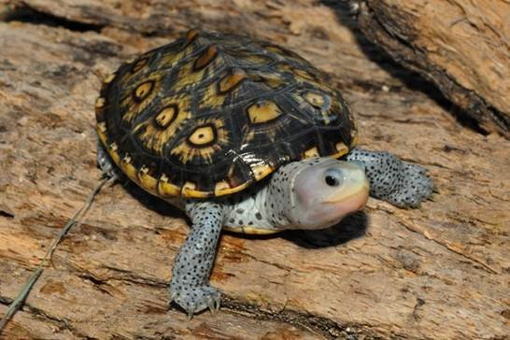
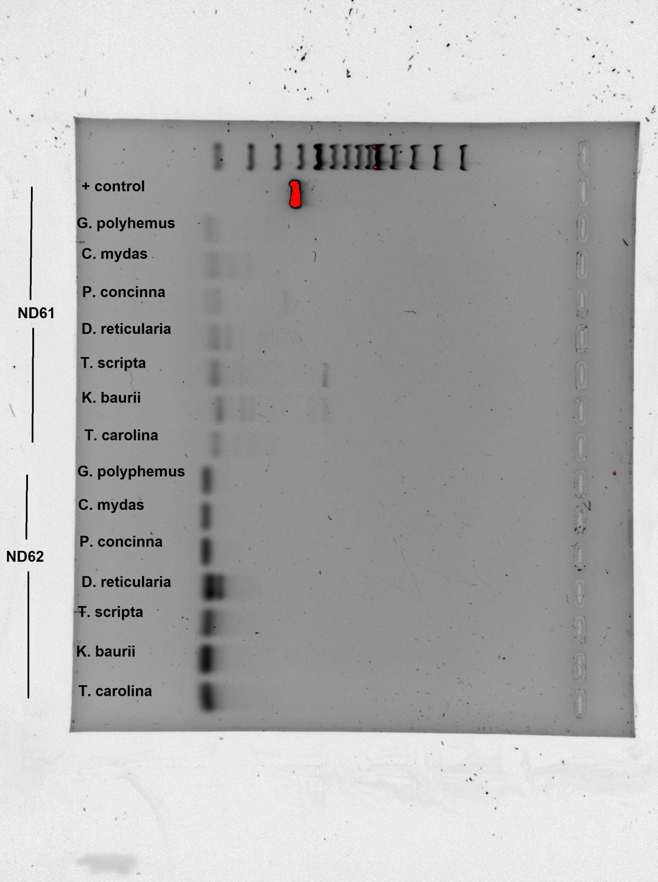
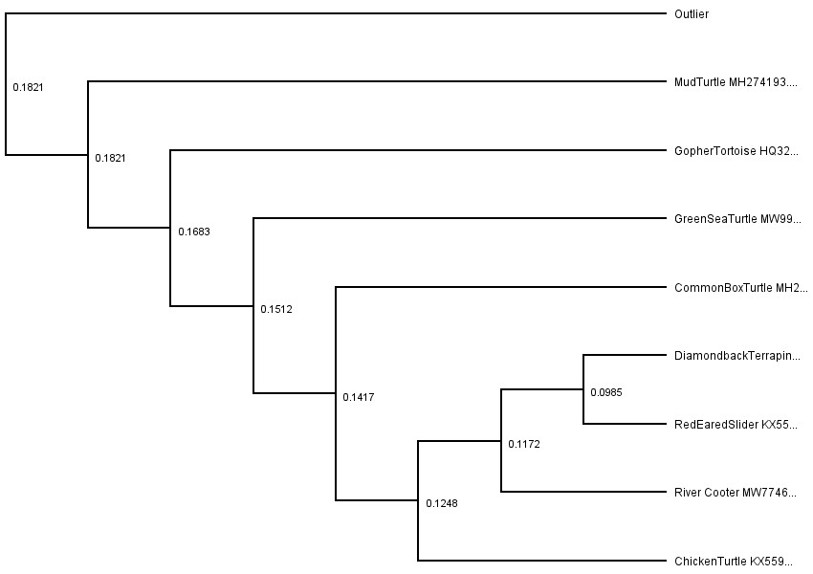
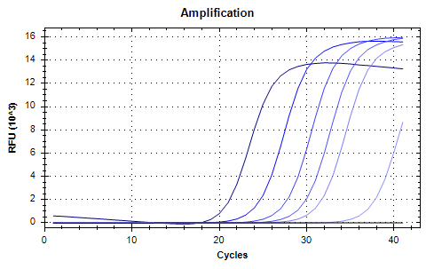
Procedures for Detecting and Quantifying Diamondback Terrapin (Malaclemys terrapin) eDNA
Gabriella Hammer
Faculty Advisors: Dr. Jeff A Eble, Dr. Toby Daly-Engel, Dept. of OEMS, Florida Institute of Technology
Introduction
The Diamondback Terrapin (Malaclemys terrapin) is a brackish water turtle native to the east and Gulf coasts of the United States¹. Currently, the Diamondback Terrapin is listed as a Species of Special Concern in the US, and is a protected species in Florida². Historically, protected species are monitored using direct observation, which is labor-intensive and requires on-site taxonomic expertise, limiting data availability for conservation resource managers³.
This study aims to complement ongoing terrapin monitoring with an efficient and accurate detection method utilizing environmental DNA (eDNA). eDNA techniques rely on the capture and identification of DNA passively shed into the environment in the form of skin cells, scales, gametes and metabolic waste⁴. Many single-species protocols are dedicated solely to the detection of a species⁴. The goal of the developed protocol is to detect and quantify Diamondback Terrapin DNA from water samples collected from the Indian River Lagoon.
Methods
Primer and Probe Specificity
Primers were designed using the Geneious Prime software and ND6 mt gene data from NCBI. Diamondback Terrapin DNA was extracted from tissue samples with an E.Z.N.A.® Tissue DNA Kit. Primer binding to terrapin DNA was confirmed using PCR under optimized conditions and gel electrophoresis. This process was repeated for testing on non-target turtle species (Fig. 2).
DNA Quantification
A SYBR Green qPCR protocol measured fluorescence as DNA amplified. Standard curves were developed using serial dilutions of synthetic ND6 sequence (Fig. 3). Amplification of eDNA samples was compared to the standard curves for quantification.
Environmental Sample Collection
8 oz water samples were collected from the Indian River Lagoon, FL at various locations. Vacuum filtration with a cellulose filter isolated DNA from the samples. DNA was extracted from filters using an E.Z.N.A.® Tissue DNA Kit.
Results
The ND6 primers were shown to be species specific. All DNA dilutions were detectable, but primer dimerization is inversely related to DNA concentration.
Figure 5. Amplification curves of Diamondback Terrapin DNA dilutions during qPCR with ND62 primers (left) and gel electrophoresis post-qPCR (right)
Figure 6. Amplification curves of Terrapin DNA (purple), eDNA samples (red), and NTC (black) during qPCR with ND62 primers
Discussion
This experiment was successful in the development of a species-specific eDNA protocol for detection. Presence of Diamondback Terrapins can be determined using ND6 primers. Quantitative data was offset by primer dimerization, which showed variable false-positive results in negative controls.
Ongoing experiments in the lab utilize a TaqMan probe to quantify amplified DNA and eliminate fluorescent readings from primer dimer. The probe contains its own fluorescent tag, and so fluorescence will only be detected following the polymerization of the target sequence.
Figure 1. Ornate Diamondback Terrapin courtesy of Daniel Parker/USARK.
Figure 3. Gel Electrophoresis of target (+control) and non-target samples post-PCR with ND62 primers
Figure 2. Phylogenetic tree of the COI mt gene from Diamondback Terrapin and non-target species in Florida
References
Roosenburg, W.M. et al. (2019). Malaclemys terrapin. The IUCN Red List of Threatened Species 2019: e.T12695A507698. https://dx.doi.org/10.2305/IUCN.UK.2019-1.RLTS.T12695A507698.en
Conan, T. (2008). Diamondback Terrapin. N.C. Wildlife Resources Commission, Division of Conservation Education. https://www.ncwildlife.org/Portals/0/Learning/documents/Profiles/diamondback_091611.pdf
Thomsen, P. T., Willerslev, E. (2015). Environmental DNA – An emerging tool in conservation for monitoring past and present biodiversity. Biological Conservation (Vol. 183, pp. 4-18). https://doi.org/10.1016/j.biocon.2014.11.019.
Eble, J. A. et al (2020). Marine environmental DNA: Approaches, applications, and opportunities. Advances in marine biology (Vol. 86, No. 1, pp. 141-169). Academic Press. https://doi.org/10.1016/bs.amb.2020.01.001.
Acknowledgements
With thanks to the members of the Conservation Genetics Lab. Tissue samples courtesy of the Brevard Zoo, FL Museum of Natural History, and Sternberg Museum of Natural History.
Figure 4. Standard amplification curves of serial dilutions of synthetic ND6 gene during qPCR
Notes:
Keep all content within the gold lines and blue and crimson bars (other than title block and icons)
Please keep the text readable. The only font allowed is “Calibri”. Minimum font size is 48 pts.
The size is already set to exactly the print size. Please arrange and size all the images and text properly.
Ensure that all images are at least 300 dpi
The name of any faculty should be put in as “Dr. [First Name] [Middle Initial]. [Last Name], Dept. Of [name of department], [name of institution]
Names of any sponsors, mentors, volunteers, helpers, etc. can be put in the acknowledgements section. Put in text only. Do not put in any additional logos in the poster other than the ones already in the template.
Your Poster file should be named as follows:
SHOWCASE_SPRING2023_POSTER_CAPSTONE MAJOR_YOURTEAMNAME*
(Example: SHOWCASE_SPRING2023_POSTER_ME_SUNNUCLEAR)
Note: The project name should be exactly as the registered project name. *If this is an individual project, please place the title of your project instead of the team name

