Slide 1
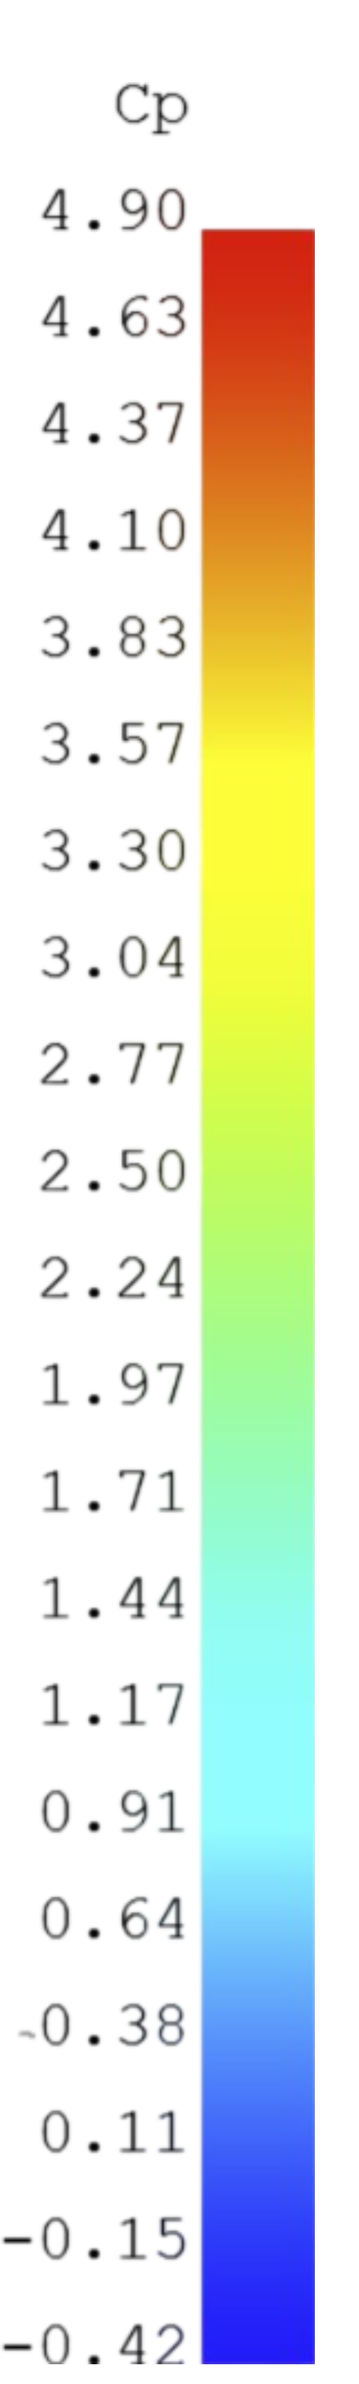
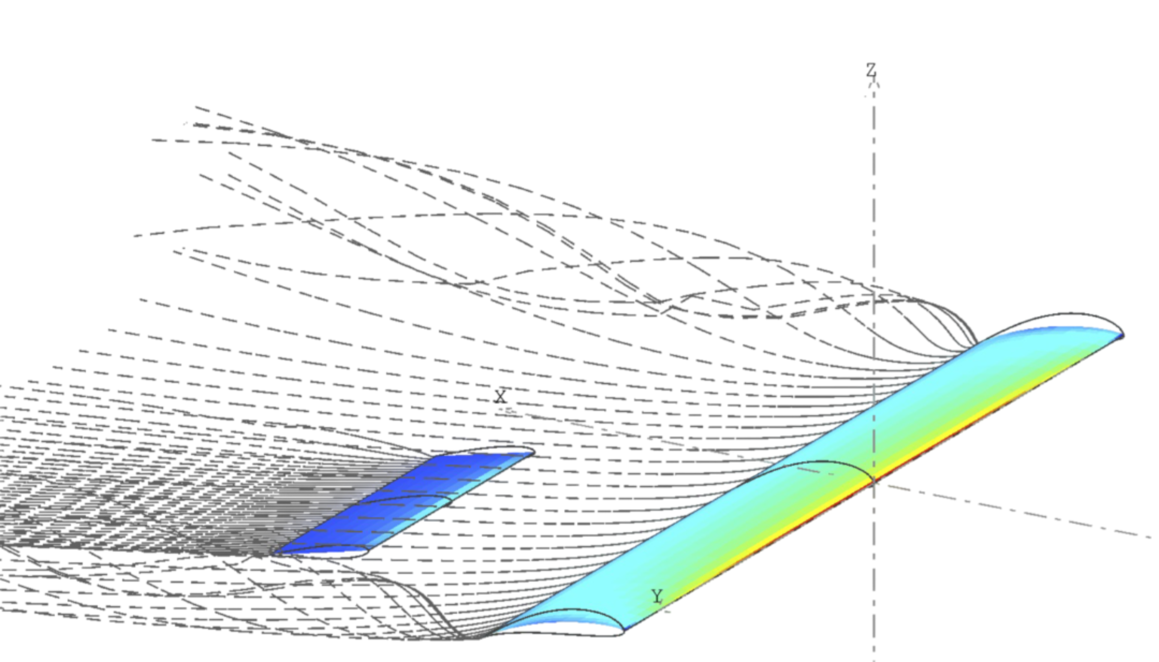
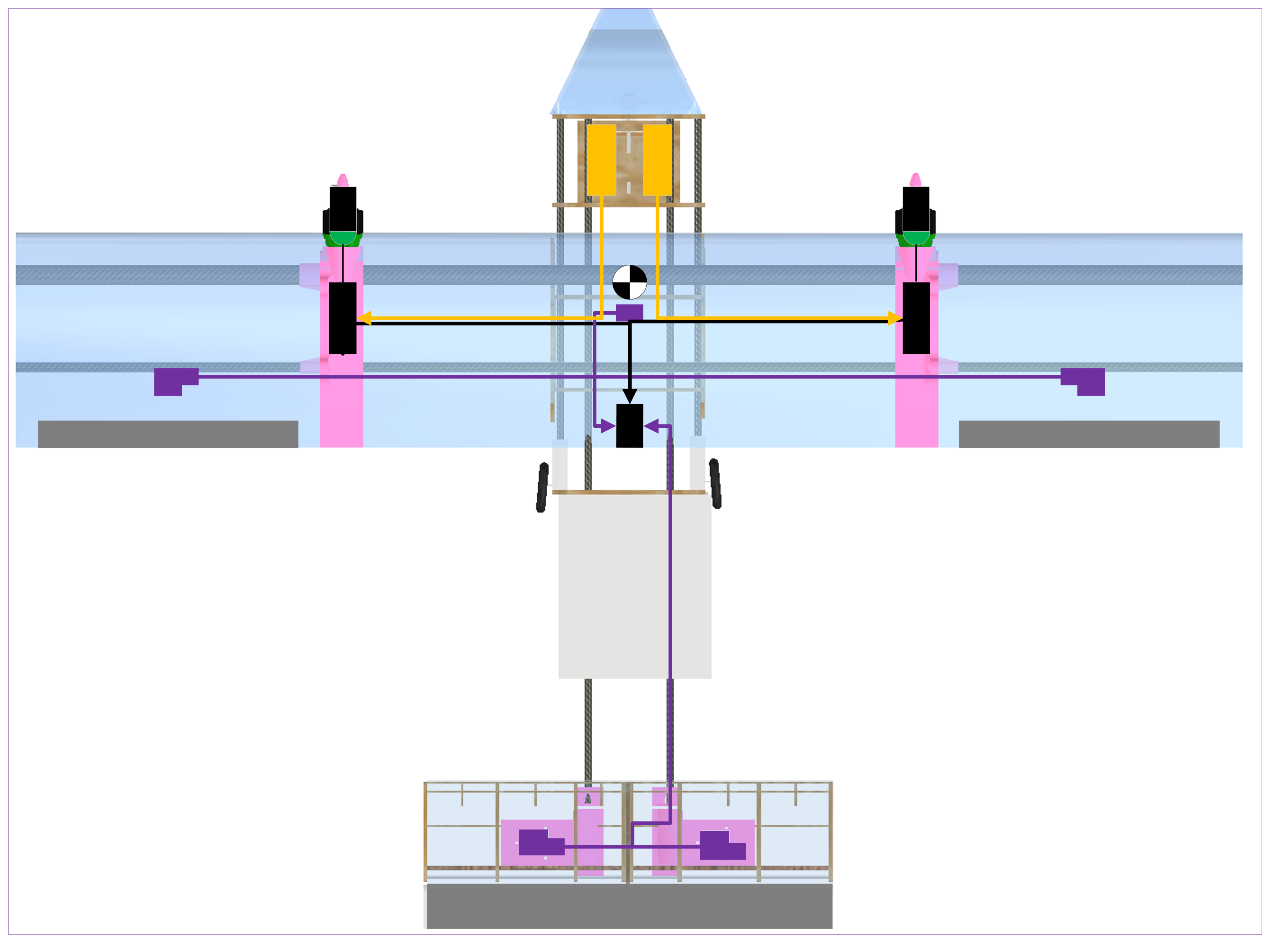
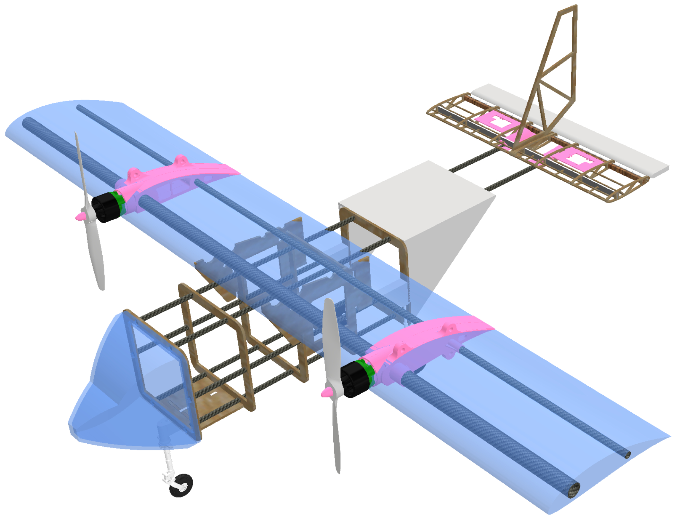
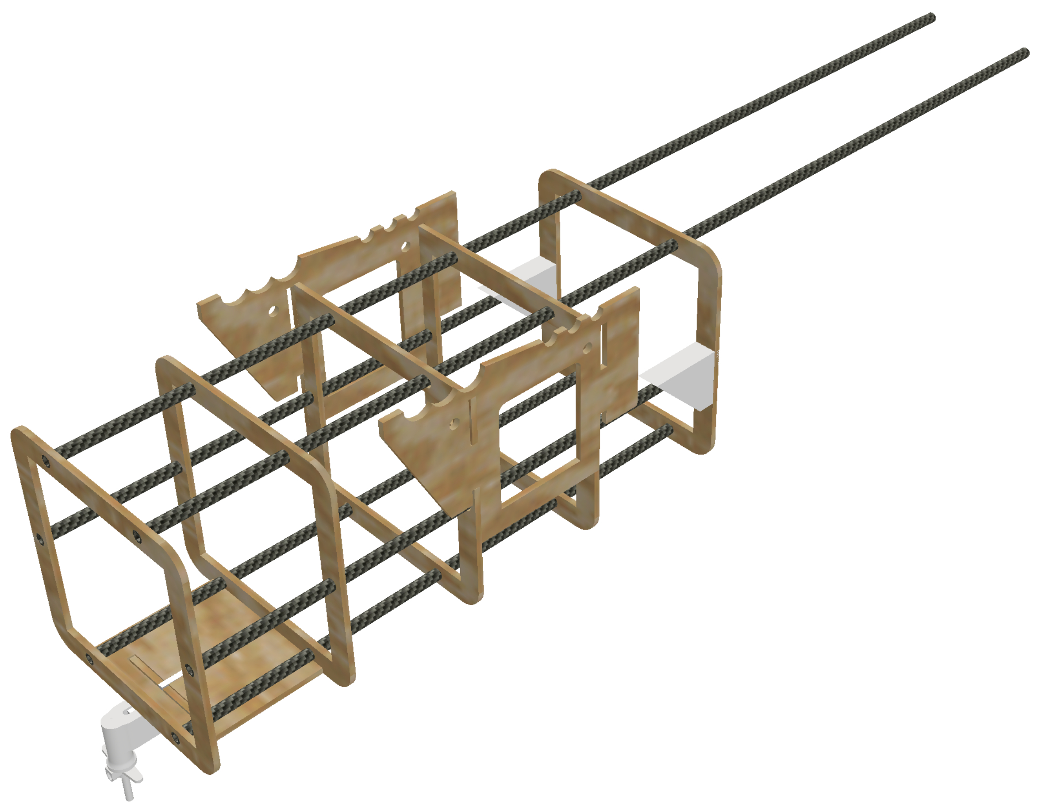
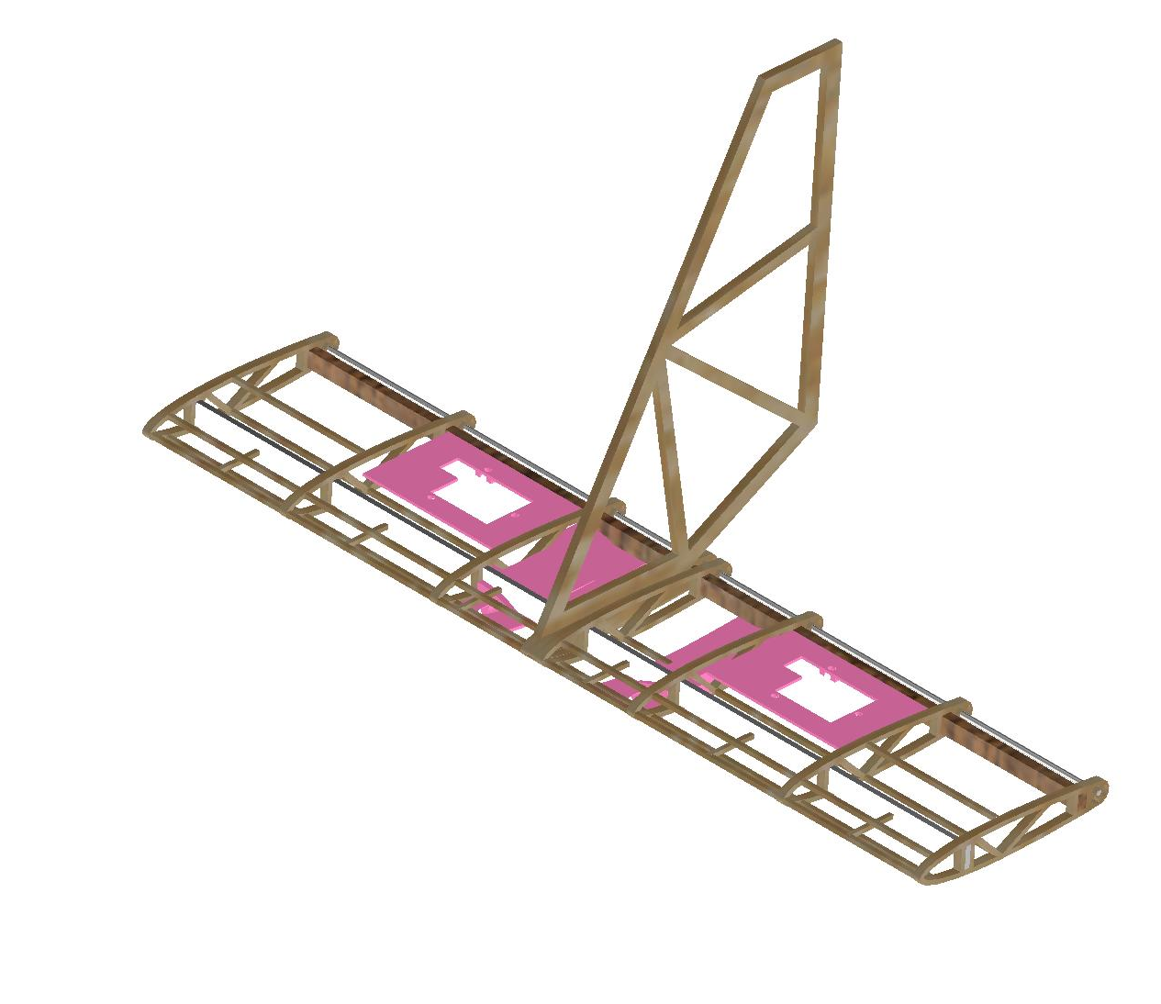
AIAA – Design, Build, Fly (DBF)
Team Members: MK Shultz, Nicolas Street, Kanon Hotta, Jordan Tibbetts, Anas Alhubayshi, Abdullah Alanazi, Nawaf Aldhawyan, Ibrahim AlMurdhimah, Hussain Maqbul​
Faculty Advisors: Dr. Ratneshwar Jha and Dr. Eric Swenson, Dept. of Aerospace, Physics, and Space Sciences, Florida Institute of Technology
MISSION STATEMENT
AIAA - DBF aims to design a remote-controlled aircraft that complies with 2024 AIAA-DBF competition rules centered around Urban Air Mobility applications. The project focuses on designing, fabricating, and testing a scale aircraft that meets competition requirements while incorporating innovative design principles.
MISSION REQUIREMENTS
  Ground Mission: Configuration Demonstration
    Timed mission to demonstrate efficiently changing mission configurations.
    Parking configuration shall not exceed 2.5 ft across the wingspan.
M1: Delivery Flight
3 Laps in 5 minutes
20 ft Takeoff
Payload: Pilots
M2: Medical Transport Flight
3 Timed Laps with Weighted Cabinet
Payload: Weighted Medical Supply Cabinet, 2 EMTs, Patient, Gurney, and Pilots
M3: Urban Taxi Flight
Maximum laps in 5 minutes
Payload: Passengers and Pilots
AERODYNAMICS SUBSYSTEM
ELECTRONICS SUBSYSTEM
Table 1: Aerodynamics Data
Two 4s LiPo Batteries
Max Thrust: 12.5 lbf
Flight Duration: 9 minutes
Prop Size: 13” x 6.5”
Cruise Speed | 30​ mph
Alpha @ T/O | 12.5°
CL | 1.585​
CD | 0.225
CL/CD | 7.029
Figure 1: Aerodynamics Analysis
Figure 2: Electronics Layout
STRUCTURES SUBSYSTEM
Figure 3: Fuselage Structure
Figure 4: Tail Structure
Specifications:
  Empty Weight: 8.1 lbs
  Carbon Fiber Fuselage Stringers
  Laser Cut Wood Frame
  Hotwire CNC Cut Foam Wing
  3D Printed Mounts
Design Methodology:
Rapid on-site repair capability
Mission adaptability
Semi-monocoque fuselage and tail design
Detachable wing mechanism to optimize spatial efficiency
Figure 5: Complete CAD Model
ACKNOWLEDGEMENTS
We extend our gratitude to Felix Gabriel, Zac Gross, and the staff at the L3Harris Design Center for their invaluable support. The team also expresses appreciation to our GSA, George Nehma, and Mattea Cheung, who has volunteered her time to this project.

