Slide 1
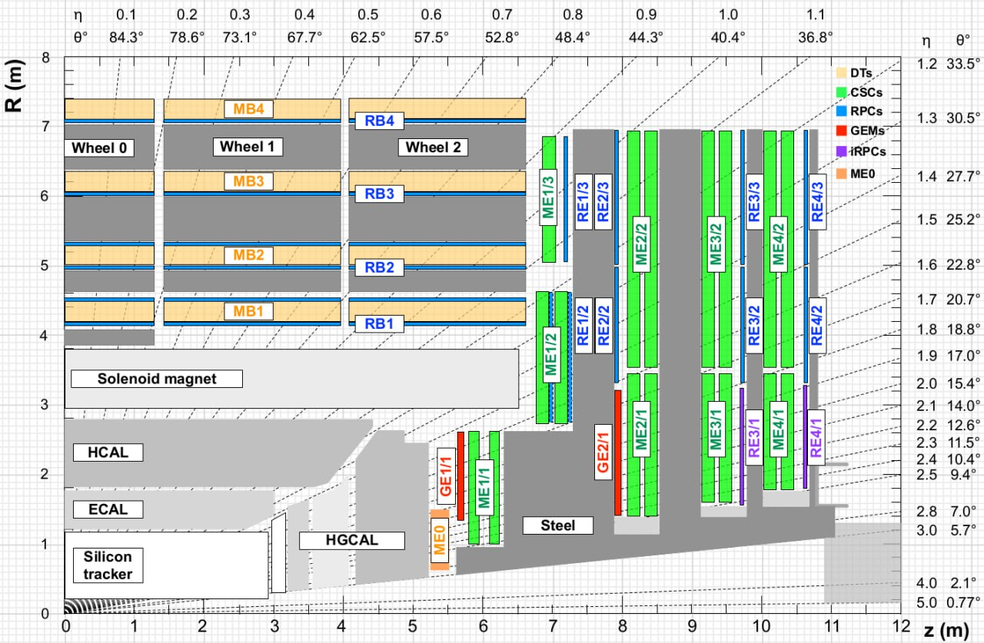
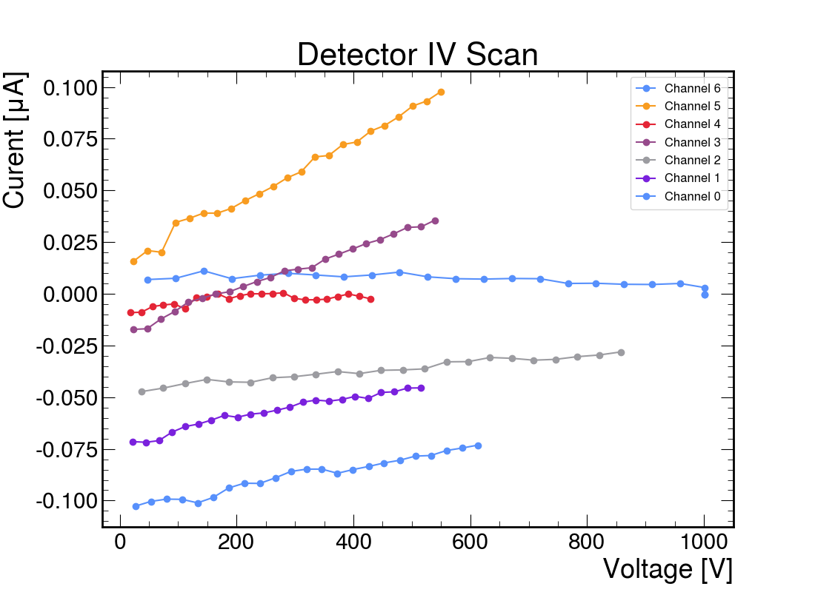
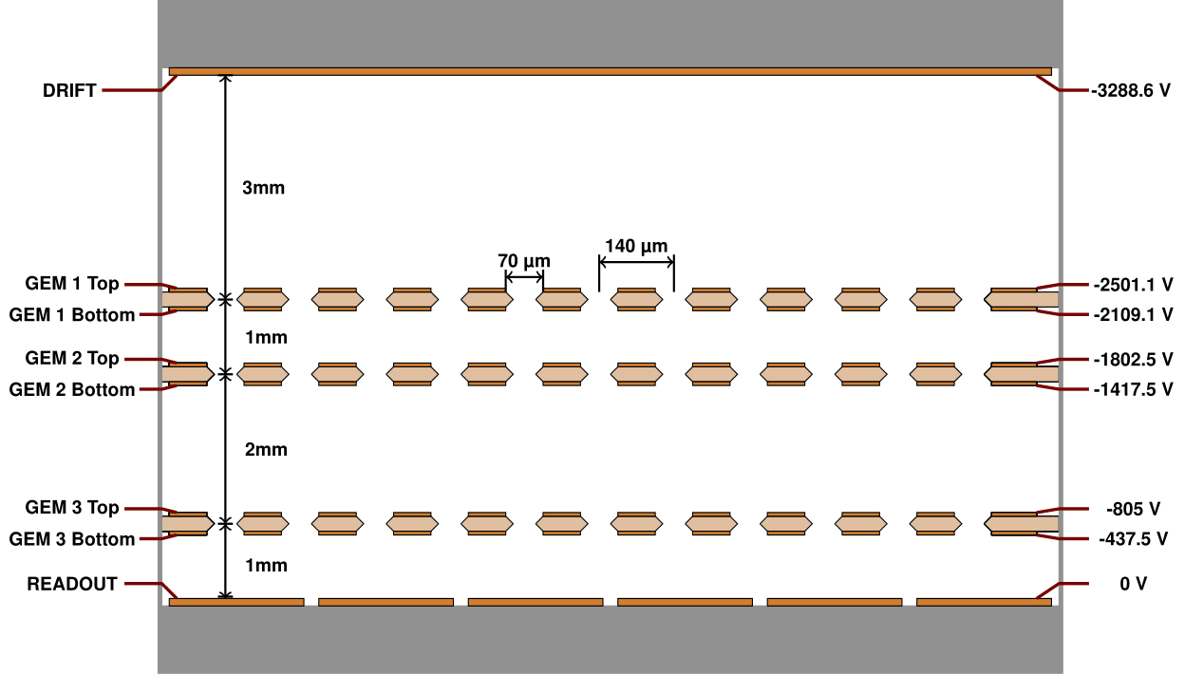
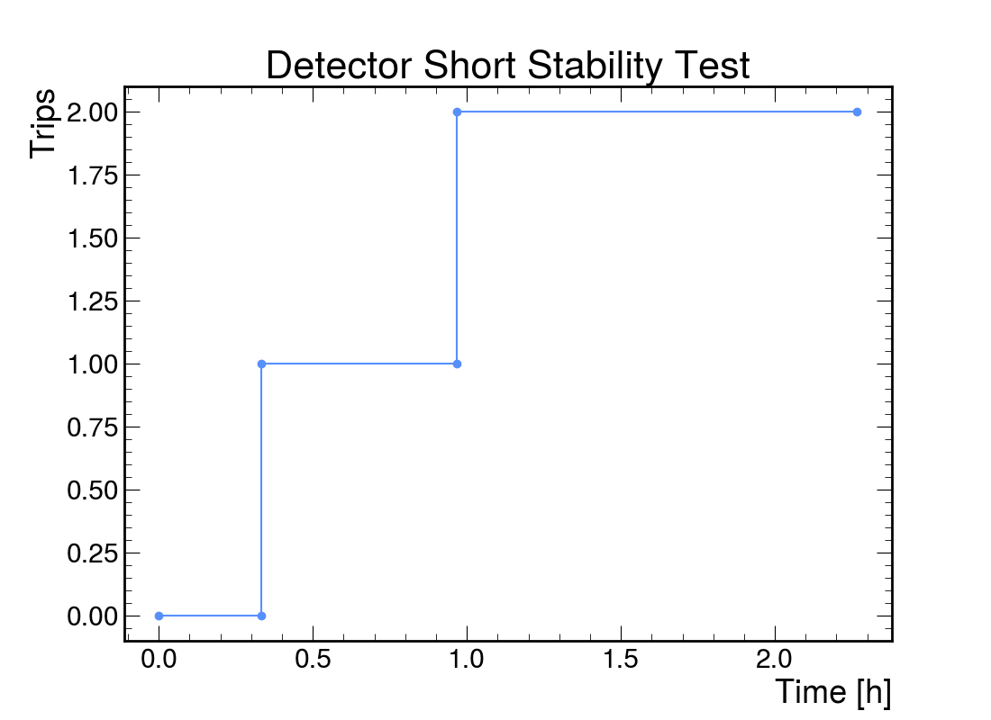
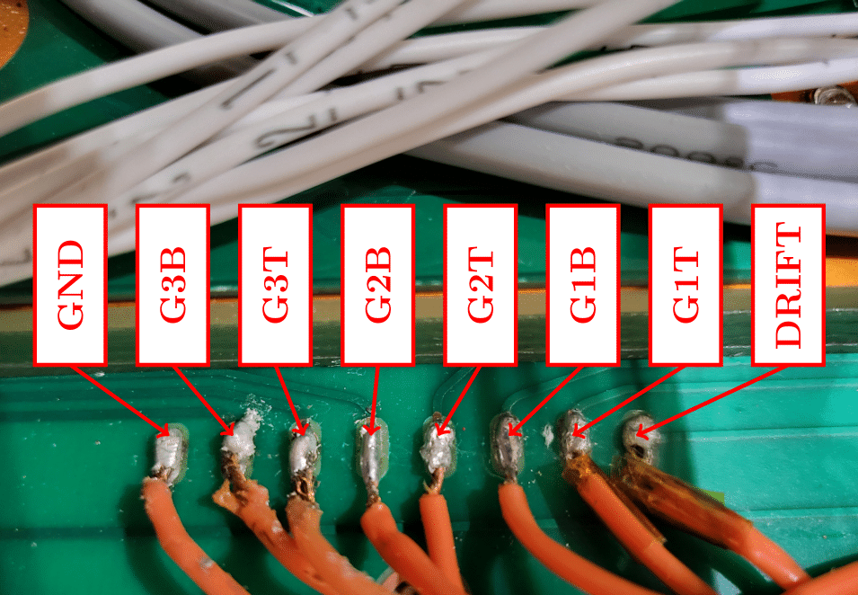
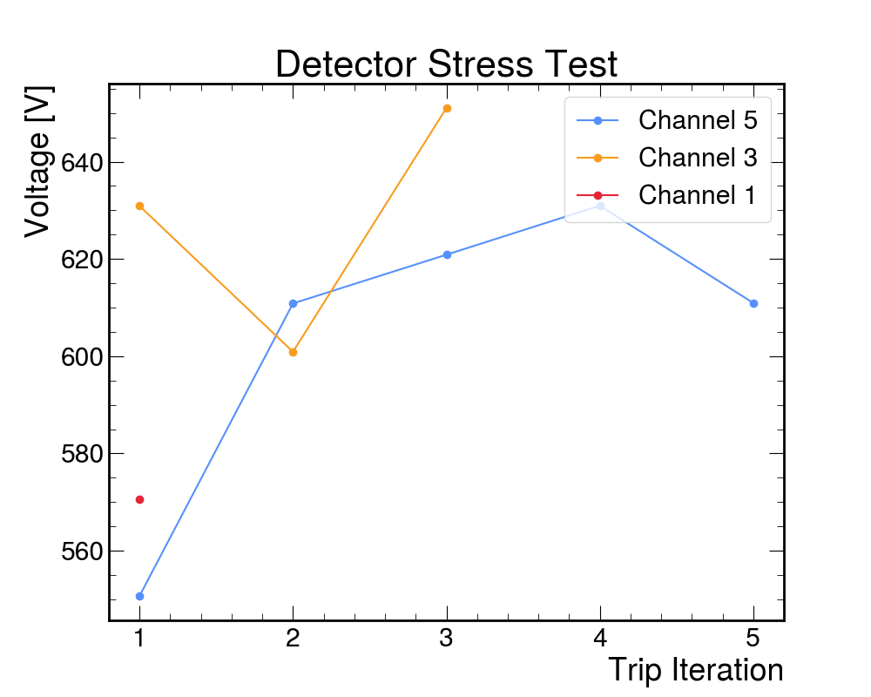
Implementation of Python Based
High Voltage Tests for GEM Detectors
John Hernandez
Faculty Advisor: Dr. Marcus Hohlmann, Dept. of APSS, Florida Institute of Technology
Graduate Student Advisor: Erick Yanes, Dept. of APSS, Florida Institute of Technology
INTRODUCTION & BACKGROUND
The Compact Muon Solenoid, CMS, and other detectors at LHC are in the process of being upgraded for the HL-LHC (High-Luminosity Large Hadron Collider) which will produce more than 5 times the particle interactions than of the current LHC
One upgrade to CMS is the introduction of new GEM detectors (Gaseous Electron Multiplier), GE2/1 and ME0 shown at right are new detectors to CMS and therefore must be tested thoroughly prior to being installed.
IV SCAN
Raises voltage incrementally to 4600V split across all 7 channels
Records current and voltage every 200V up to 4600V
PROBLEM STATEMENT
Each of the new detectors must undergo a series of 8 quality control tests prior to installation
Quality Control 6 or QC6 tests for High Voltage stability uses LabView scripts to run its subtests
LabView is a Windows only program & some QC6 scripts currently have bugs; would it be possible to replace those LabView scripts using Python?
Figure 2: GE1/1 installed currently, while ME0 and GE2/1 will be new additions to the HL-LHC (1)
Figure 6: A plot of the IV Scan must be linear to pass
Figure 3: Depicts a GEM cross-section & shows where each ‘Channel’ is
SHORT STABILITY TEST
Combined test with IV Scan
Holds 4600V across the chamber for a period of 2 hours
Allowed 3 trips prior to test failure
METHODOLOGY
Python scripts were written from scratch to perform the necessary QC6 subtests
4 Python Scripts + 1 TOML configuration file to run 3 subtests
CAEN SY5527 HV Power Supply
Pycaenhv Wrappers
STRESS TEST
Increases voltage across each of 3 foils, one at a time until there are 5 discharges or until the final voltage of 650V is held for 60 seconds on each foil
Figure 7: Short Stabilty Test Plot
LONG STABILITY TEST
Similar to Short Stability Test, ramps up the same way
3 top foils held at 580V for a period of 15 hours
Must have less than 1 discharge per hour
Figure 4: HV Monitoring through Grafana program during Stress test
SIGNIFICANCE & FUTURE WORK
Writing QC6 tests in Python provides a streamlined approach to QC testing as plots are made with Python anyway
These Python based QC6 tests could also be applied detectors other than GEMs
Figure 1: Shows the HV Pads on M8 corresponding to the Channels above
QC6-OVERVIEW
Meant to clean each foil of any potential imperfections
Ensures the foil can not only handle HV but also remain stable at HV for long periods of time; hours & sometimes even days
REFERENCES
1) The Phase-2 Upgrade of the CMS Muon Detectors. Technical report, CERN, Geneva, 2017. URL
https://cds.cern.ch/record/2283189. This is the final version, approved by the LHCC.
Figure 5: Plot of Stress Test

