Slide 1
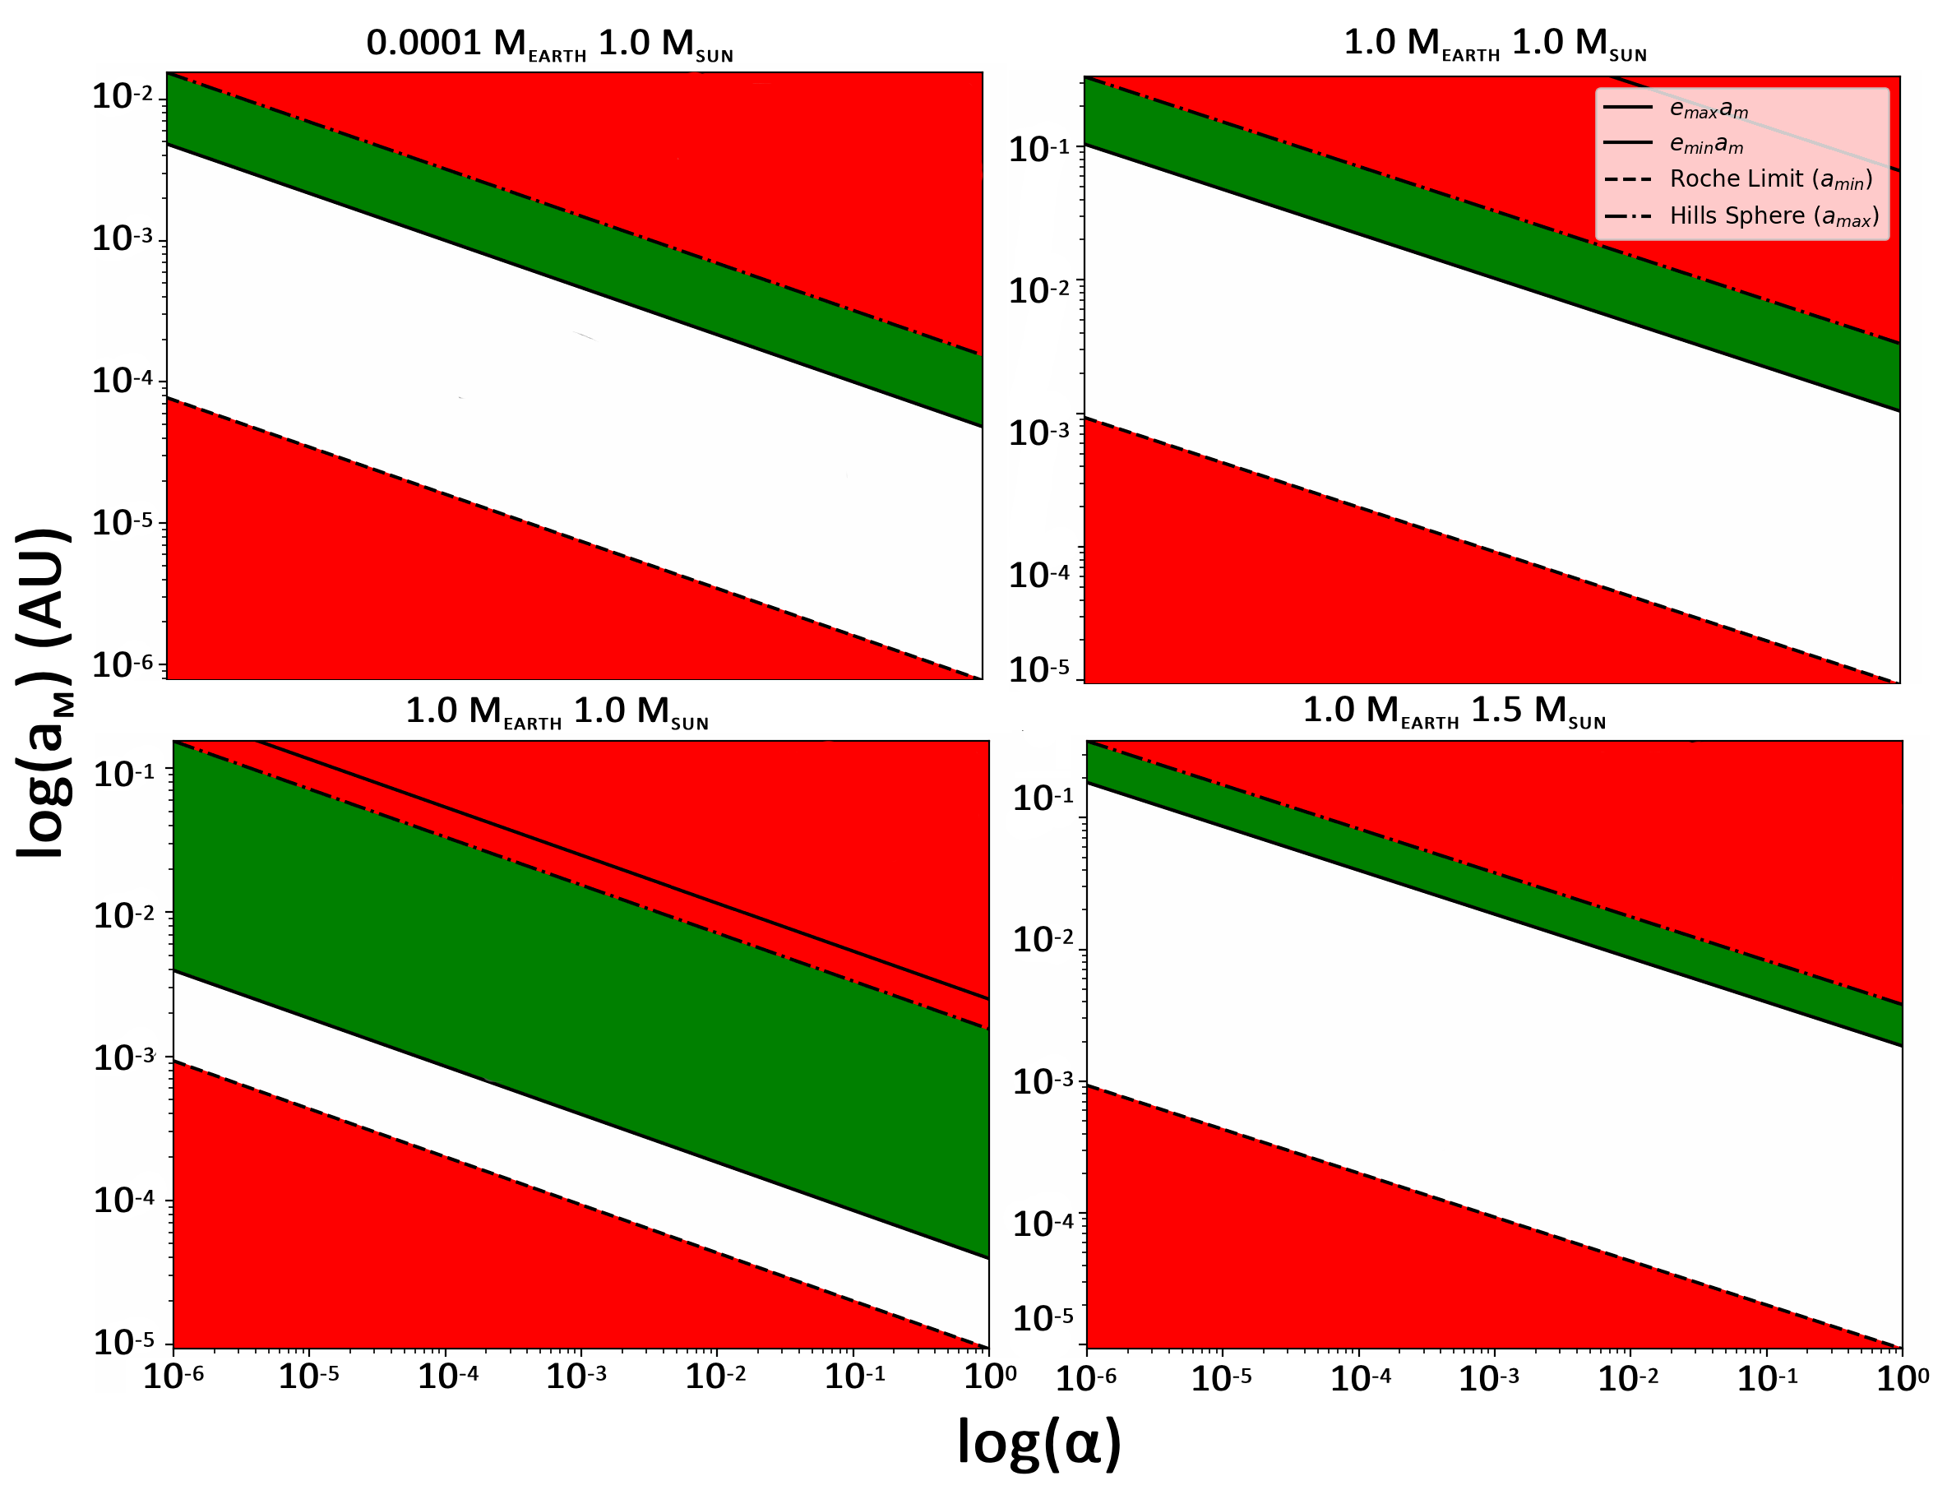
Tidal Modulations on Exomoons within Planetary Systems
Mitchel McKenrick
Faculty Advisor: Dr. Manasvi Lingam, Dept. of APSS, Florida Institute of Technology
Faculty Observer: Dr. Luis H. Quiroga-Nunez, Dept. of APSS, Florida Institute of Technology
Introduction:
The Earth’s Moon is the primary source of tides in the oceans
It is one of the main contributors to the origin of life.
Yet, the Moon only achieves the maximum tidal modulations due to its exact size and distance.
No other moon discovered has these exact properties
How does a variable tidal force affect the possibility of life?
Results:
Principles of the Model:
An upper and lower limit of the semi-major axis:
The Hill Sphere
The Roche Limit
Eccentricity (0.0001 ≤ e ≤ .25)
Implications and Conclusion:
The mass of the host star extensively affects the area of tidal modulation
Above 1.5 M_{SUN} at 1 AU, there can be no tidal modulation
A star's mass is directly proportional to the temperature, so this also affects habitability at this radius
The moon's mass has a negligible effect.
The upper limit is consistently the Hill Sphere, unlike the lower limit
If a Sun-like Star is found, and an exomoon is found orbiting near an exoplanet’s Hill Sphere, this will require more research
A next step in research could focus on how the star's mass affects the range of tidal modulation compared to the distance from the star
$\frac{M_{∗}}{{a_{∗}}^{3}}=e\frac{M_{P}}{{a_{M}}^{3}}$
References:
Lingam, M., & Loeb, A. (2021). Life in the cosmos: From biosignatures to technosignatures. Harvard University Press.
Lingam, M., Pryor, S., & Ginsburg, I. (2022). Tidal modulations and the habitability of exoplanetary systems. Monthly Notices of the Royal Astronomical Society, 510(4), 4837-4843.

