Slide 1
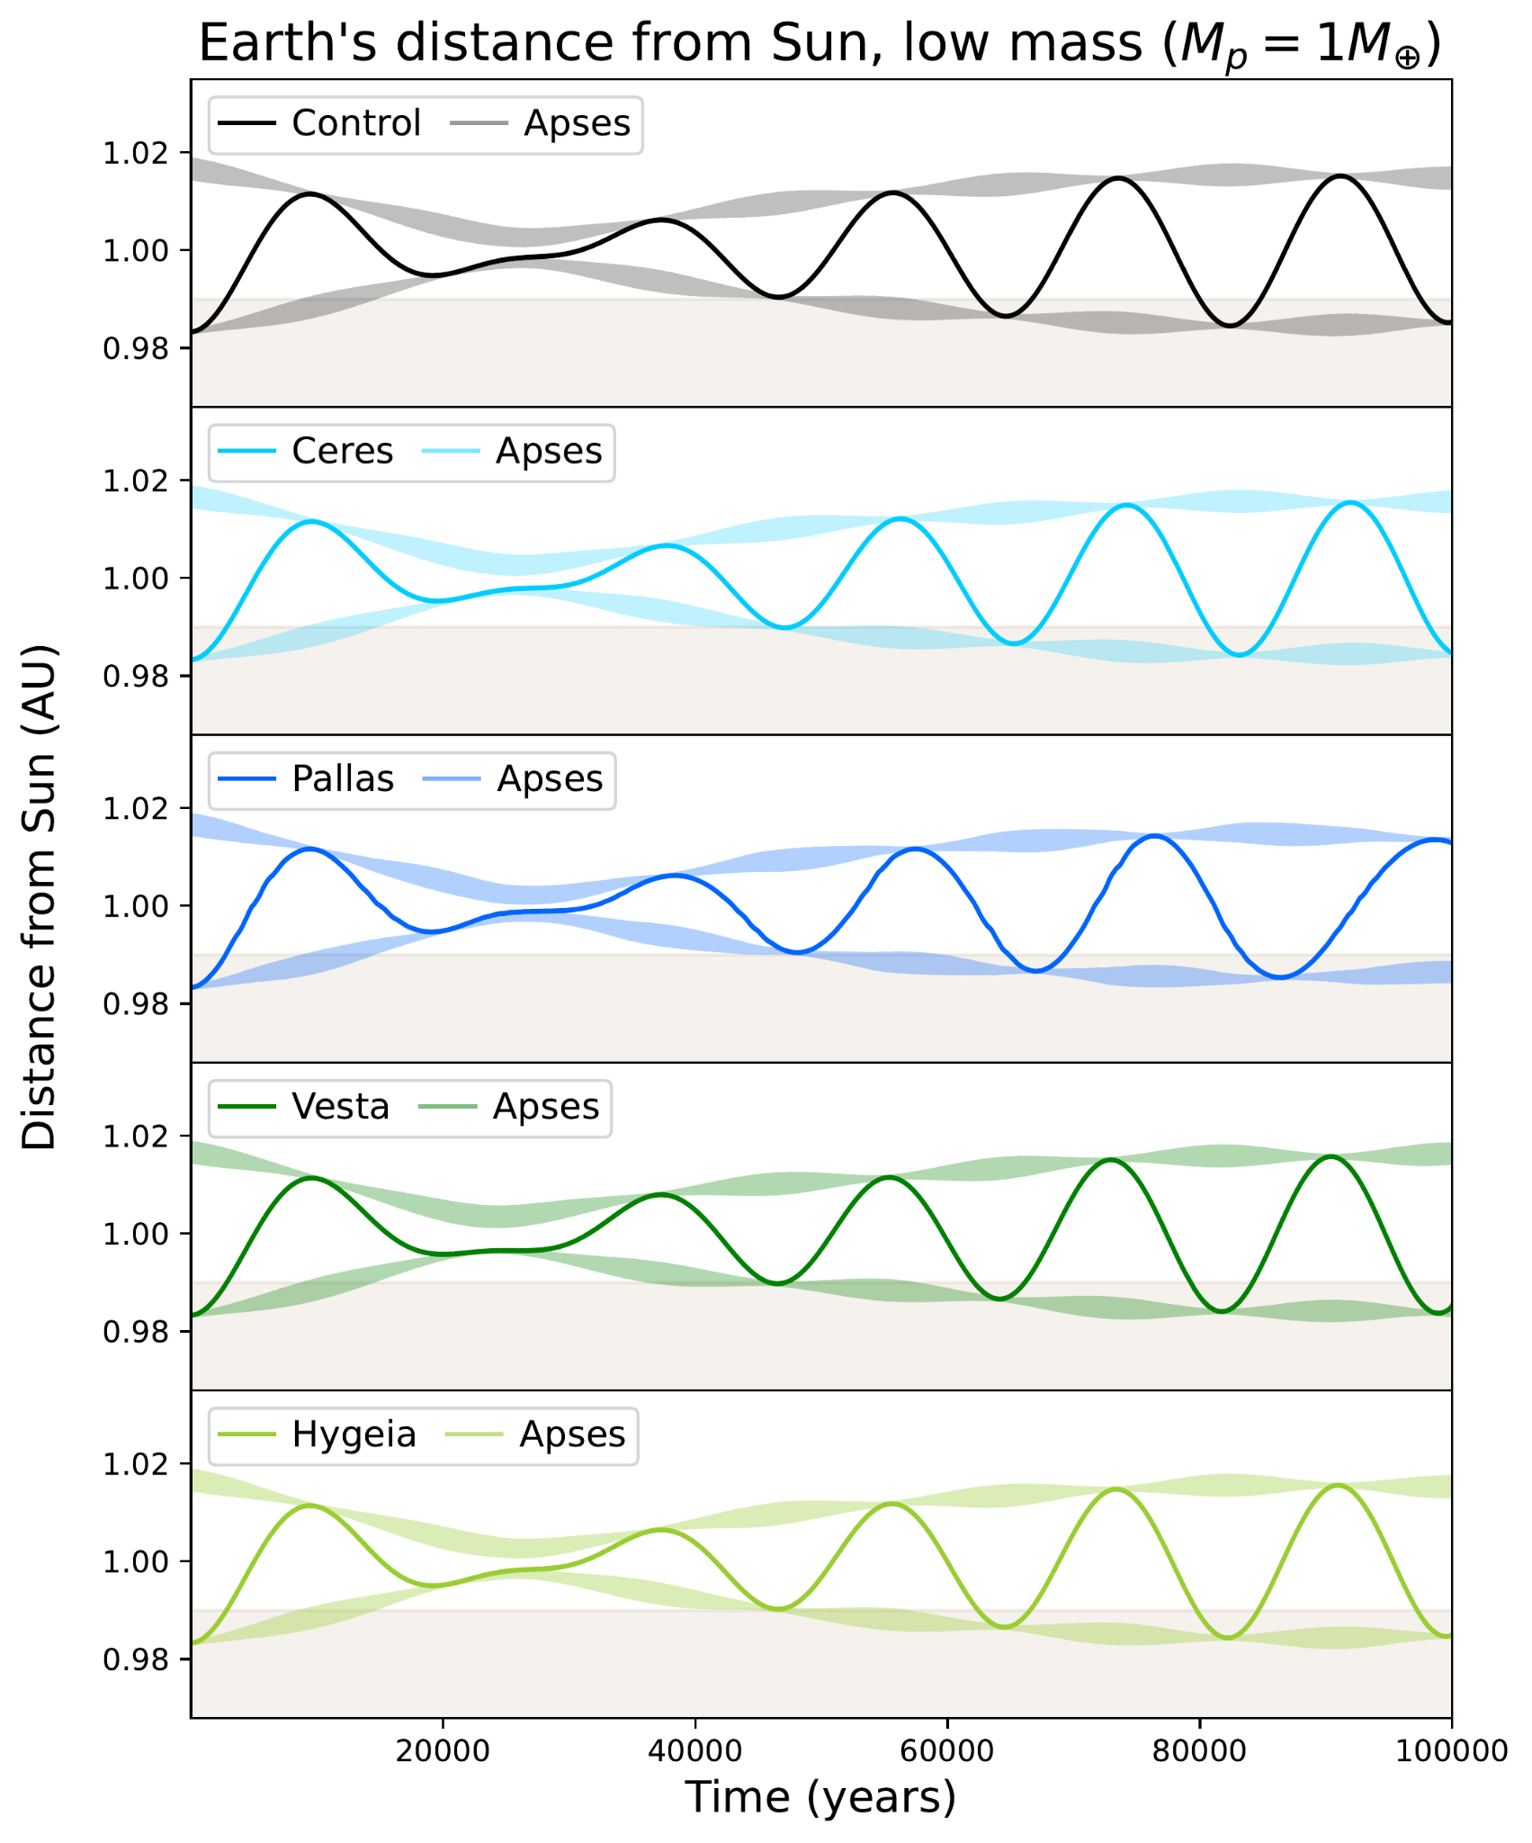
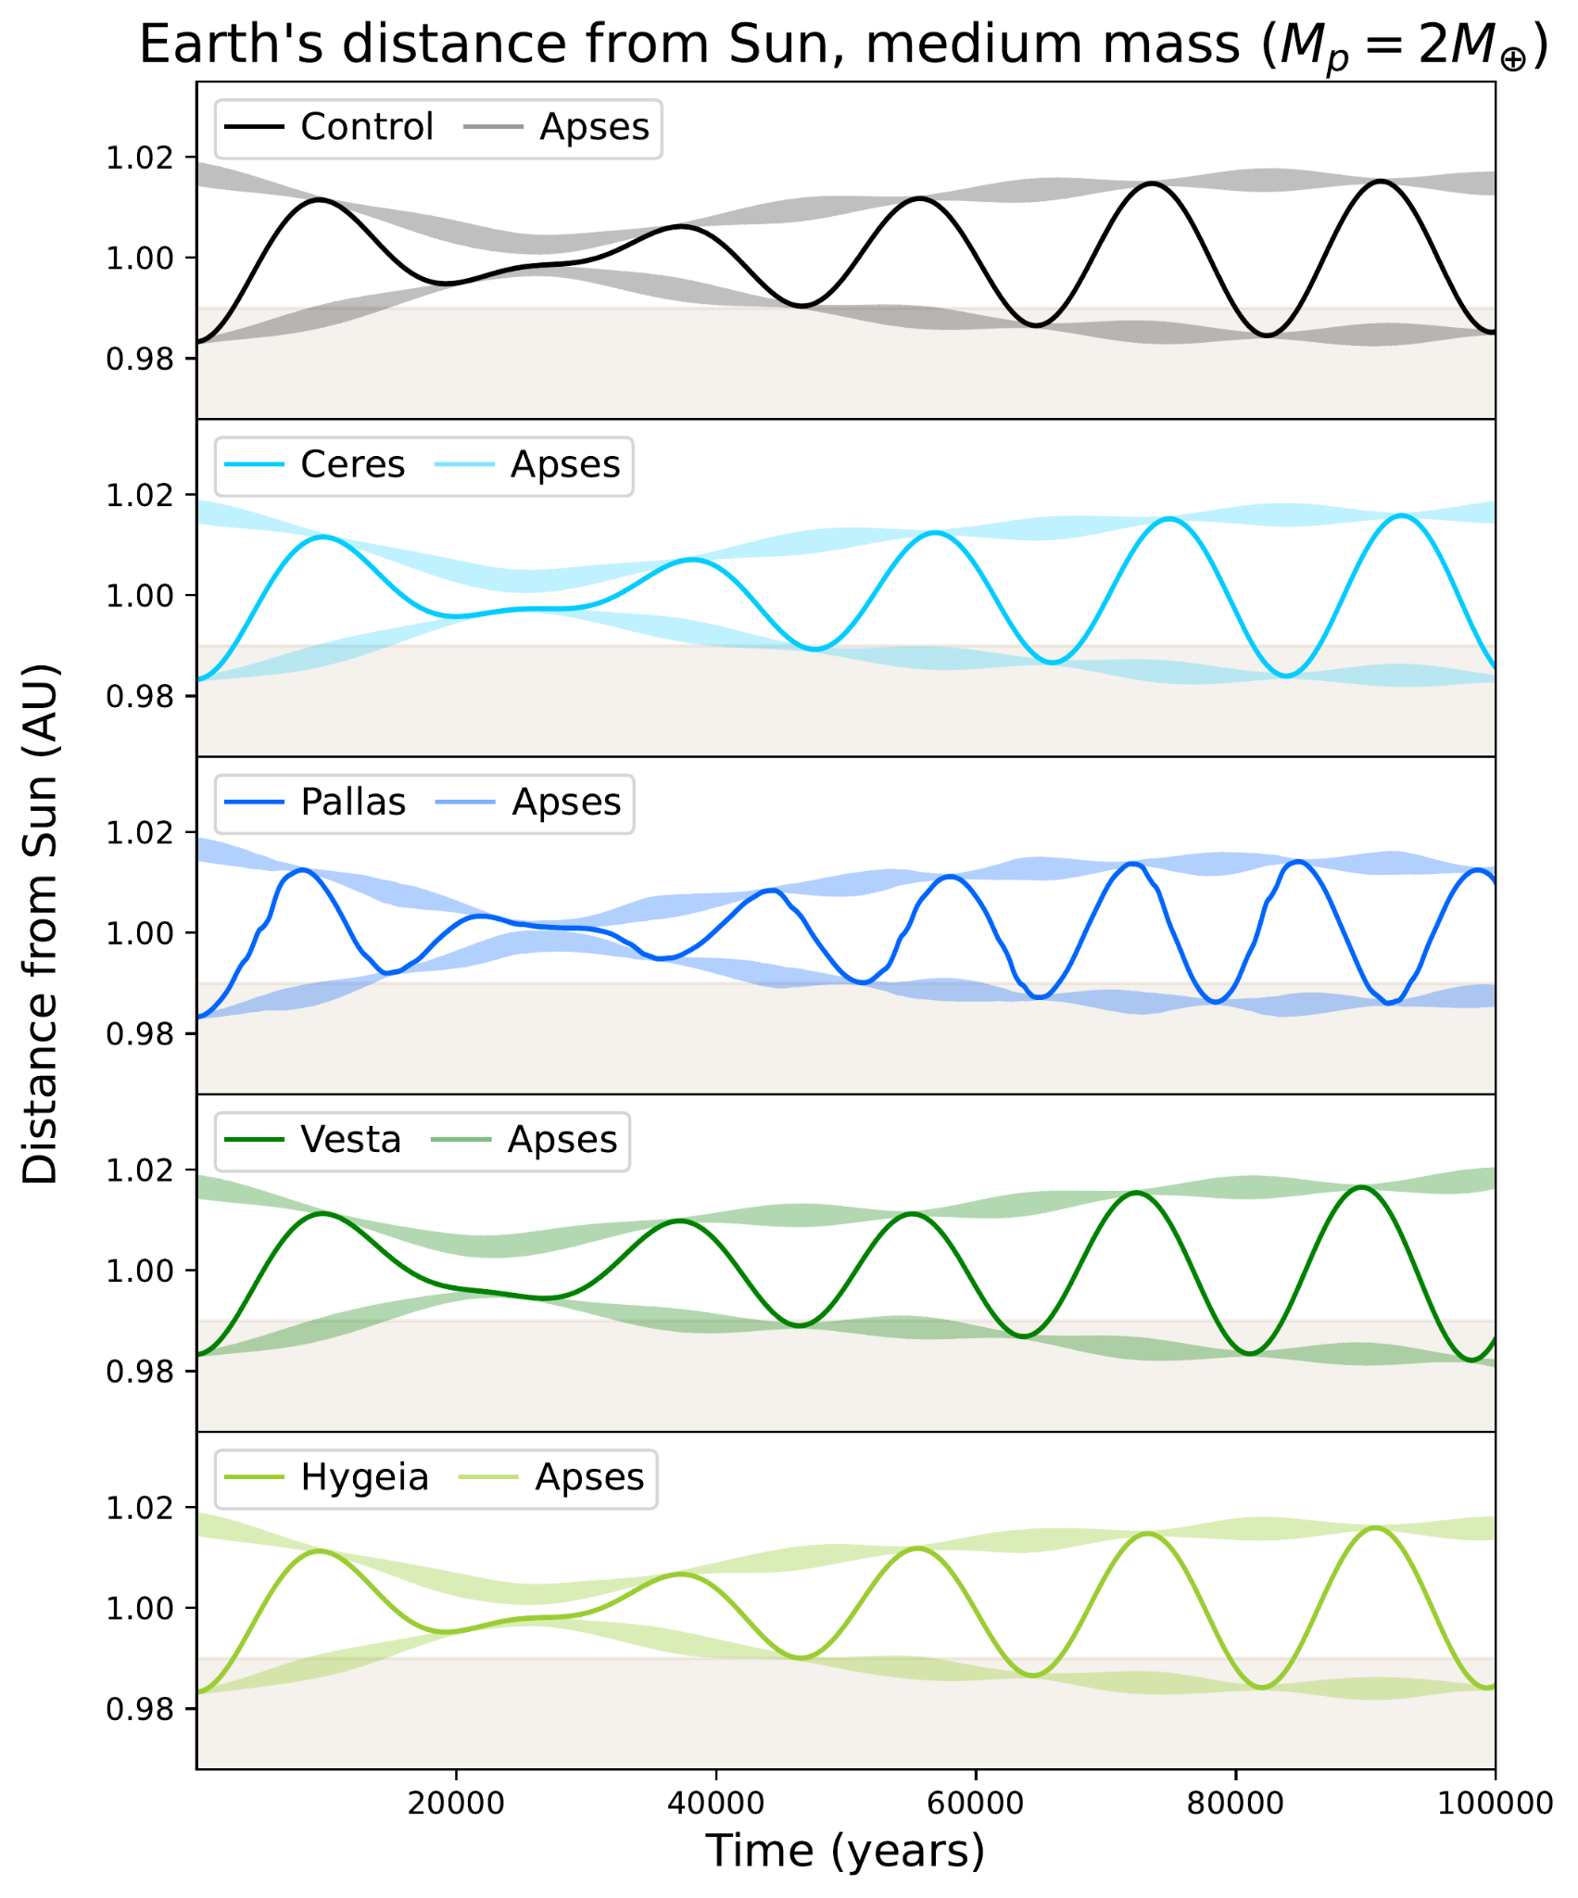
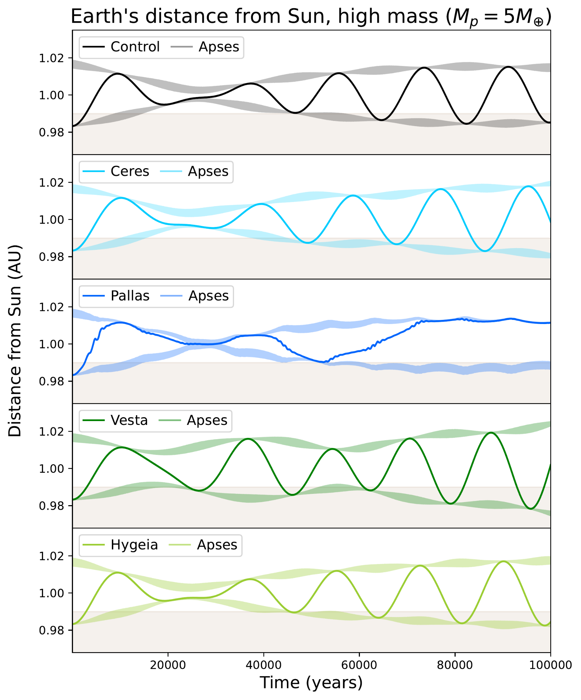
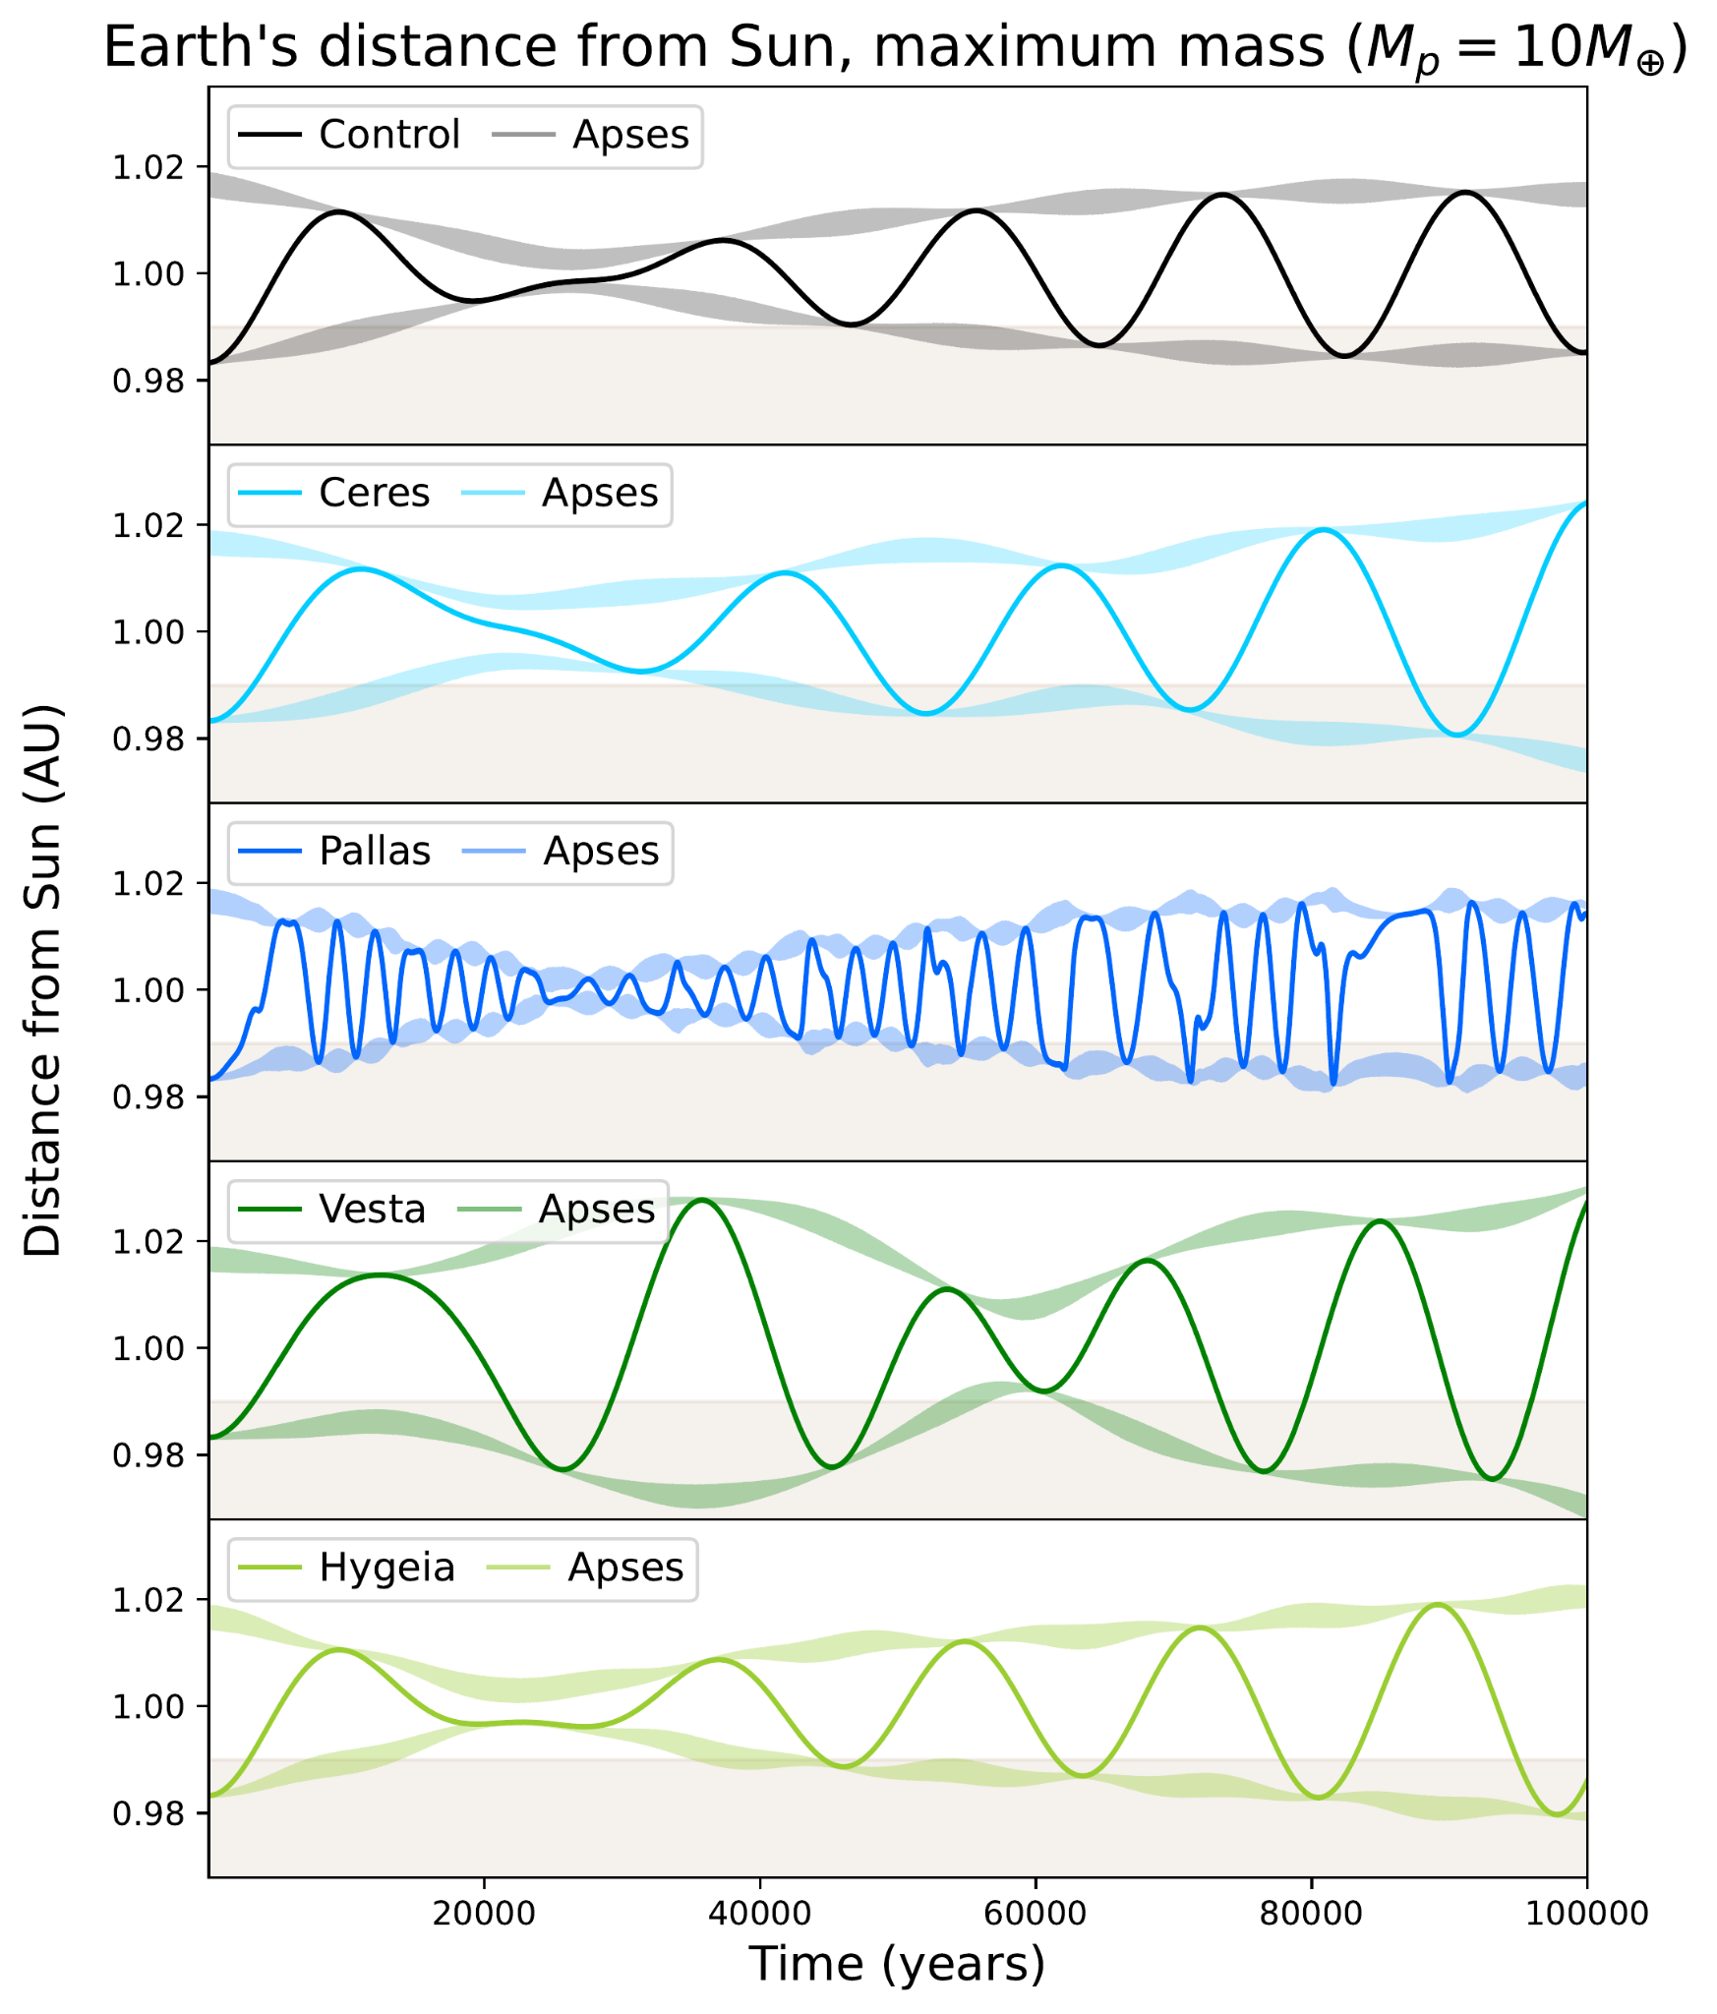
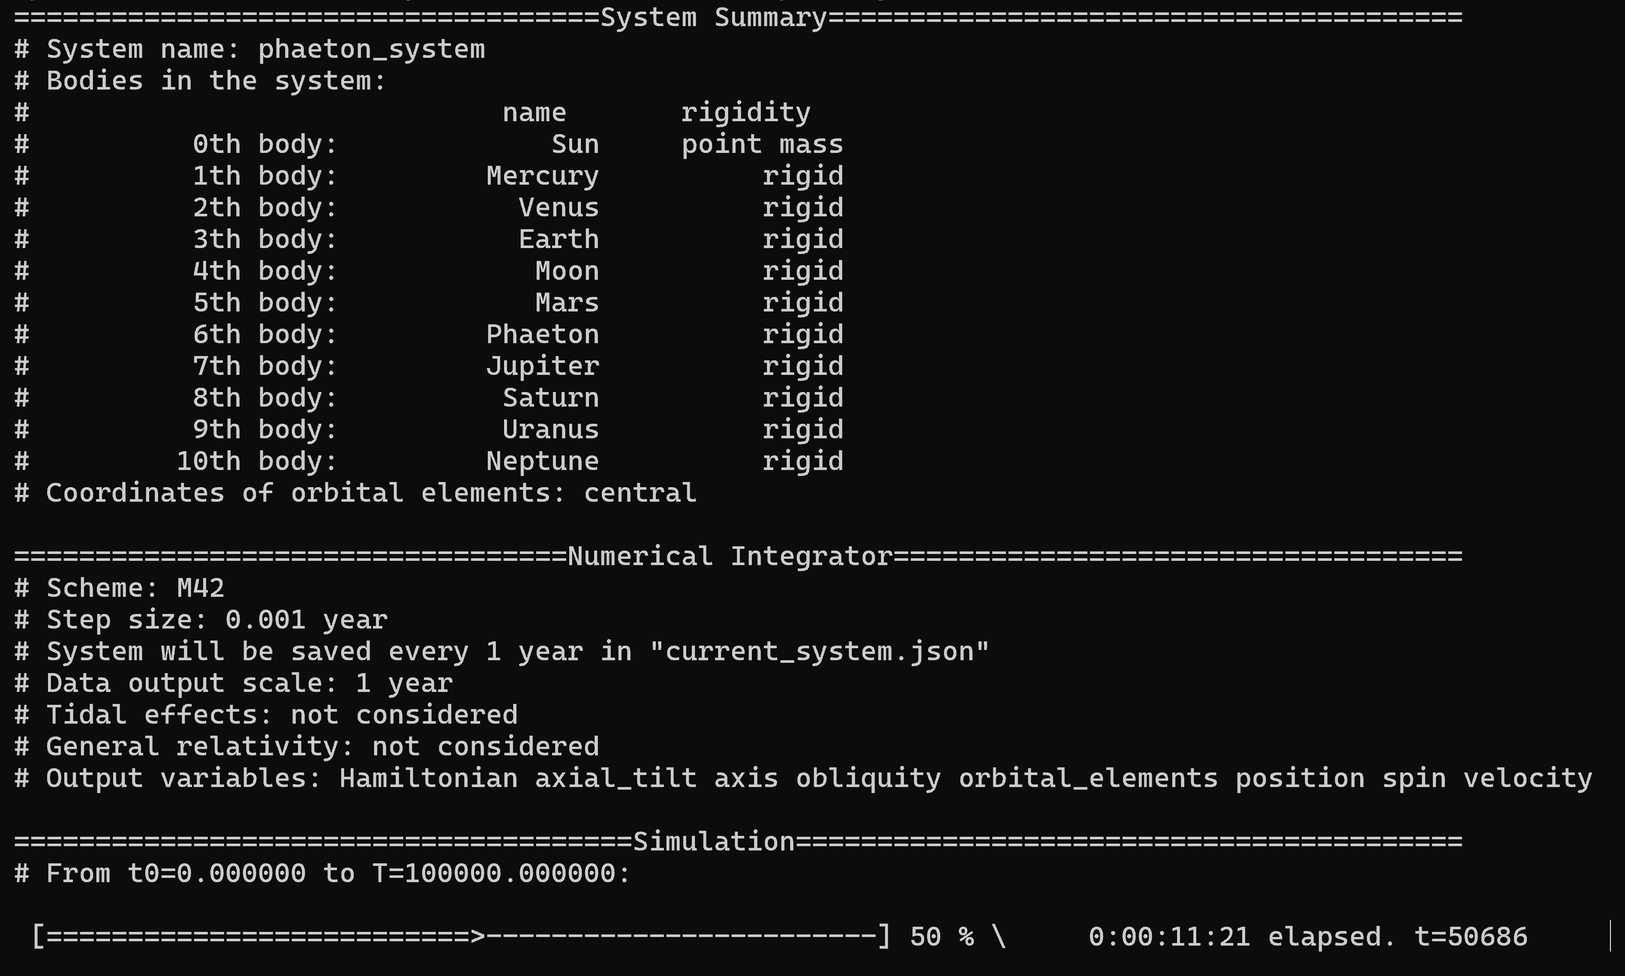
Modeling an Extra Planet’s Effects on Earth
Emily Simpson
Faculty Advisor(s): Dr. Howard Chen, Dept. of APSS, Florida Institute of Technology
Introduction
Results
 | 0.01 M⊕ | 1 M⊕ | 2 M⊕ | 5 M⊕ | 10 M⊕
Control | 77% | 77% | 77% | 77% | 77%
Ceres | 77% | 78% | 78% | 78% | 74%
Pallas | 77% | 79% | 78% | 91% | 80%
Vesta | 77% | 76% | 75% | 66% | 65%
Hygeia | 77% | 77% | 77% | 76% | 75%
The orbit of a planet impacts its climate and habitability, and many models have been developed to study the impacts of planetary system structure on climatic evolution.
If the Asteroid Belt (AB) had accreted into a single planet, what effects would that extra planet have on Earth’s orbit and habitability?
Table 1: Percent of recorded distances for each trial that fell within the cloud-free habitable zone. Green values are lower than the control, and blue values are larger than the control.
Methods
Simulated the orbital evolution of the Solar System over 100,000 years using the Gravitationally Interacting Rigid Body Integrator (GRIT) [1]
Extra planet parameters varied: mass and initial conditions
Mass of planet - 5 values based on early Solar System AB mass estimates [2]: 0.01 (current AB mass), 1, 2, 5, and 10 M⊕
Initial conditions - 4 trials each, based on the orbital parameters of the 4 most massive asteroids: Ceres, Pallas, Vesta, and Hygeia [3]
Examine new Earth orbit’s potential for habitability, compare to control
All Earths stayed within the outer distance limit of the habitable zone (∼1.67 AU) at all times [4]
All runs also approached closer to the Sun than the cloud-free water loss limit (∼0.99 AU) at some point in its orbit, meaning that for all trials, an atmosphere is necessary for the presence of liquid water at its surface [4]
Conclusions
Many stable configurations of a Solar System with an extra planet that preserve Earth’s habitability for at least 100,000 years are possible
However, habitable zone limits are highly dependent on atmospheric effects, and with an atmosphere Earth’s habitability zone could be much larger [4]
Future work: simulating climate & atmospheric effects with these orbital parameters as initial conditions
Figure 2: Earth’s distance from the Sun for 4 different AB planet mass estimates and 4 different AB planet initial conditions. The beige areas mark the region outside of the habitable zone, and the transparent segments denote the perihelion (bottom) and aphelion (top) for each orbit.
References
[1] Renyi Chen et al 2021 ApJ 919 50
[2] Matthew S. Clement et al 2019 AJ 157 38
[3] Lissauer et al 2001 Icarus 154 449
[4] Ravi Kumar Kopparapu et al 2013 ApJ 770 82
Figure 1: Running a simulation using the GRIT N-rigid body integrator package.
Total of 21 simulations run, including 1 control trial of the unaltered Solar System

