Slide 1
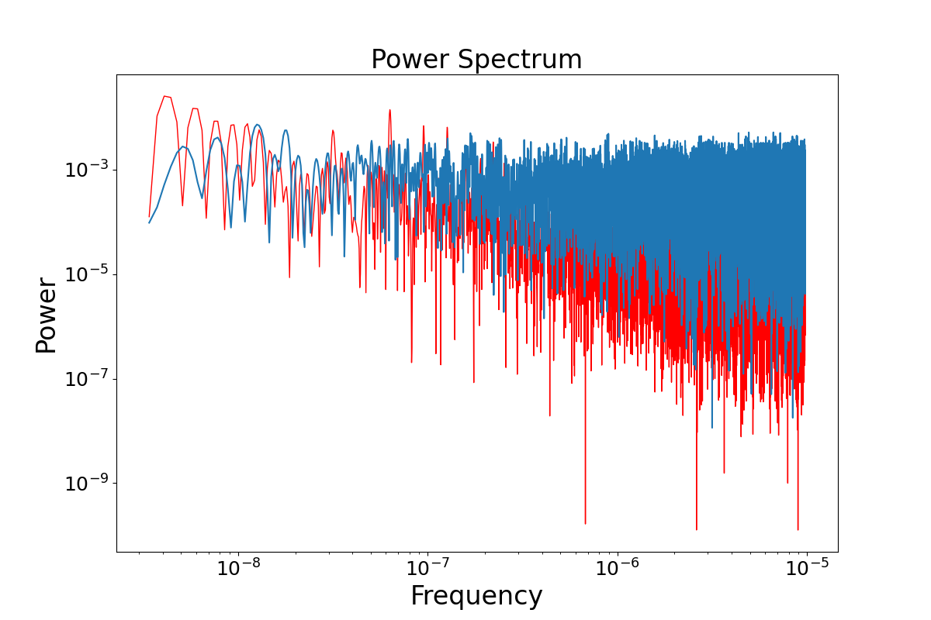
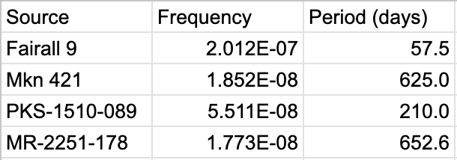
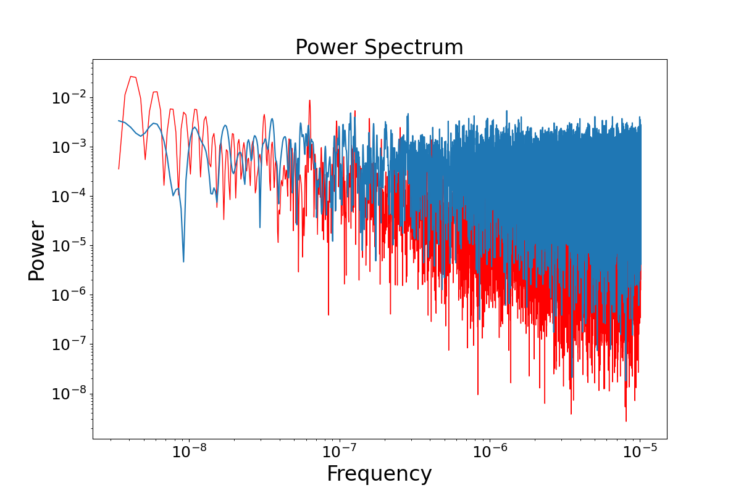
Timing Analysis of AGN Curves using SWIFT-BAT
Brianna Coffelt
Faculty Advisor(s): Dr. Evan A. Smith, Dept. of Space Sciences, Florida Institute of Technology
Introduction
Future Work
SWIFT BAT is a satellite launched in 2004 for the purpose of studying gamma ray bursts. For the purposes of this project we are utilizing its ability to serve as an all-sky monitor. Our purpose is to use this all-sky monitor to look at various AGN (Active Galactic Nuclei) and understand their periodicity. The goal is to use this gathered data to determine attributes of various AGN.
In regard to what the plan is for the future, we hope to take the estimated periods gathered from the SWIFT satellite and compare the results to those of other satellites. The end goal is to get multiple satellites to agree within reasonable statistical significance about the period of these objects, and hopefully once we get confirmed periods we will be able to make inferences about what is happening within these AGN.
Methods
First we began by gathering information about which AGN we wanted to learn more about. This was done through evaluating AGN that qualified as good sources meaning they had a minimum of 500 good observations with the SWIFT satellite.
Figure 1: Lomb-Scargle (Red) and Power Spectrum (Blue) for AGN MR-2251-178
Table 1: Frequency and Period from key sources [1]
Next we ran these AGN through a Python script which produced their power spectrum (power vs. frequency). This produced power spectrum was then compared to a Lomb-Scargle periodogram. From the overlapping graphs we were able to determine which frequency values were true.
References
[1] Krimm, H. A., et al. “The SWIFT/Bat Hard X-ray Transient Monitor.” The Astrophysical Journal Supplement Series, vol. 209, no. 1, 25 Oct. 2013, p. 14, https://doi.org/10.1088/0067-0049/209/1/14.
Once we had the most accurate frequency, the code would spit out a large string of data values where we were able to obtain the generated period of each AGN.
Reference to the data used in throughout the entire experiment gathered by the SWIFT BAT all sky monitor.
Figure 2: Lomb-Scargle (Red) and Power Spectrum (Blue) for AGN PKS-1510-089

