Slide 1
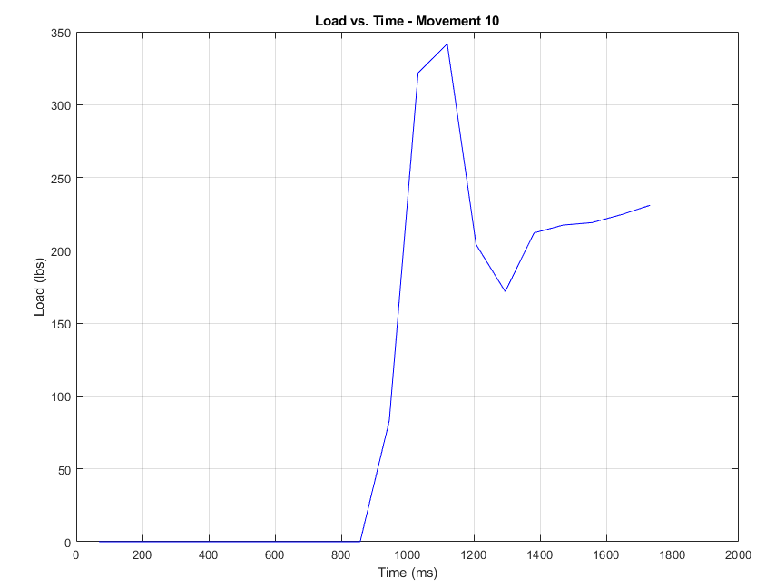
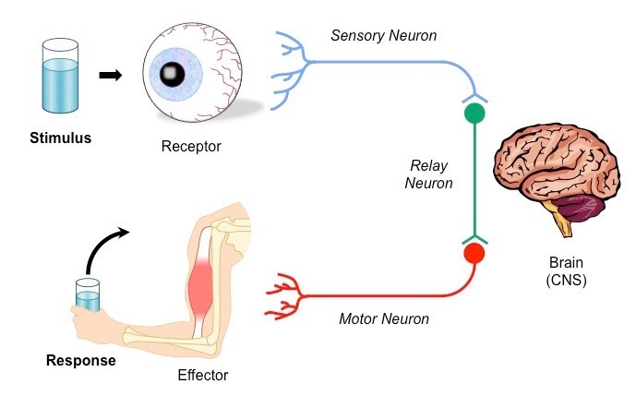
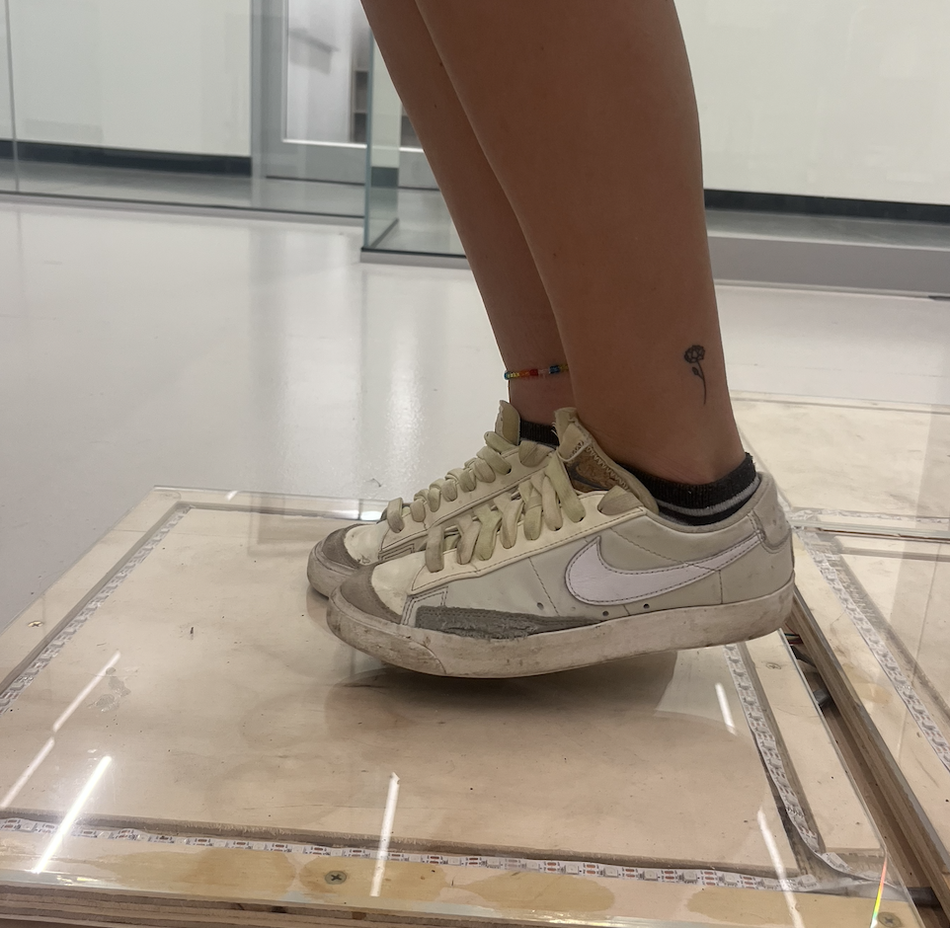
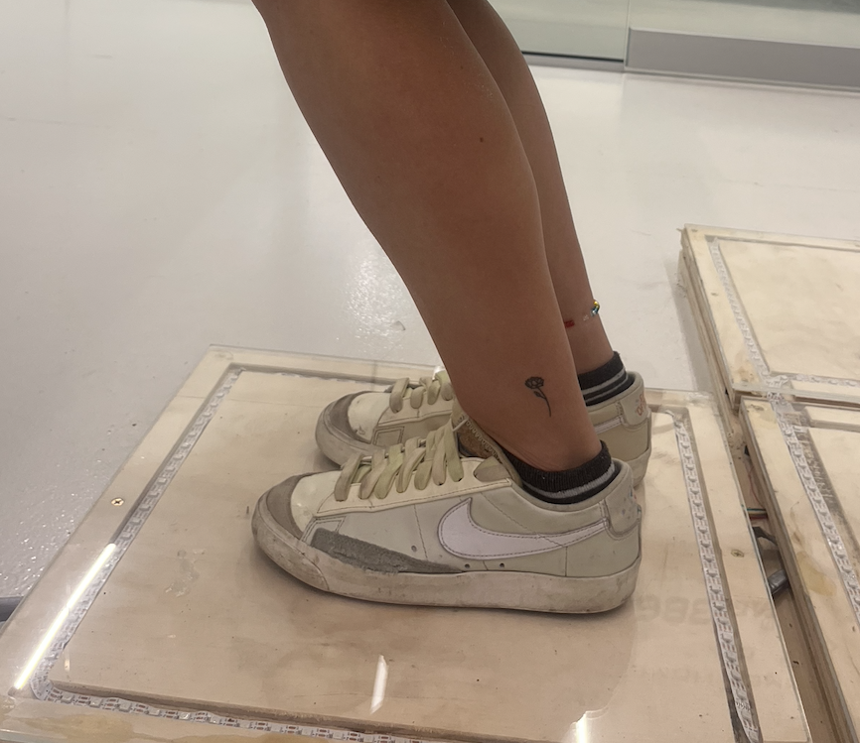
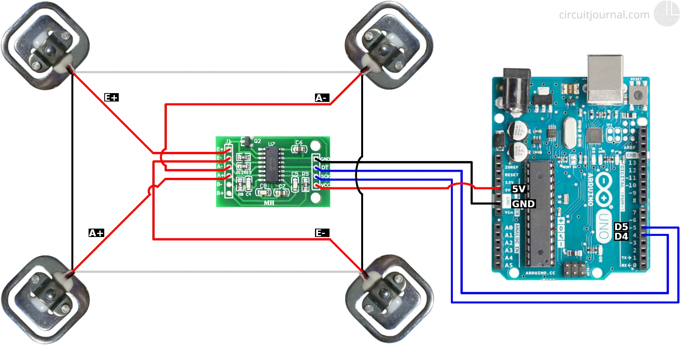
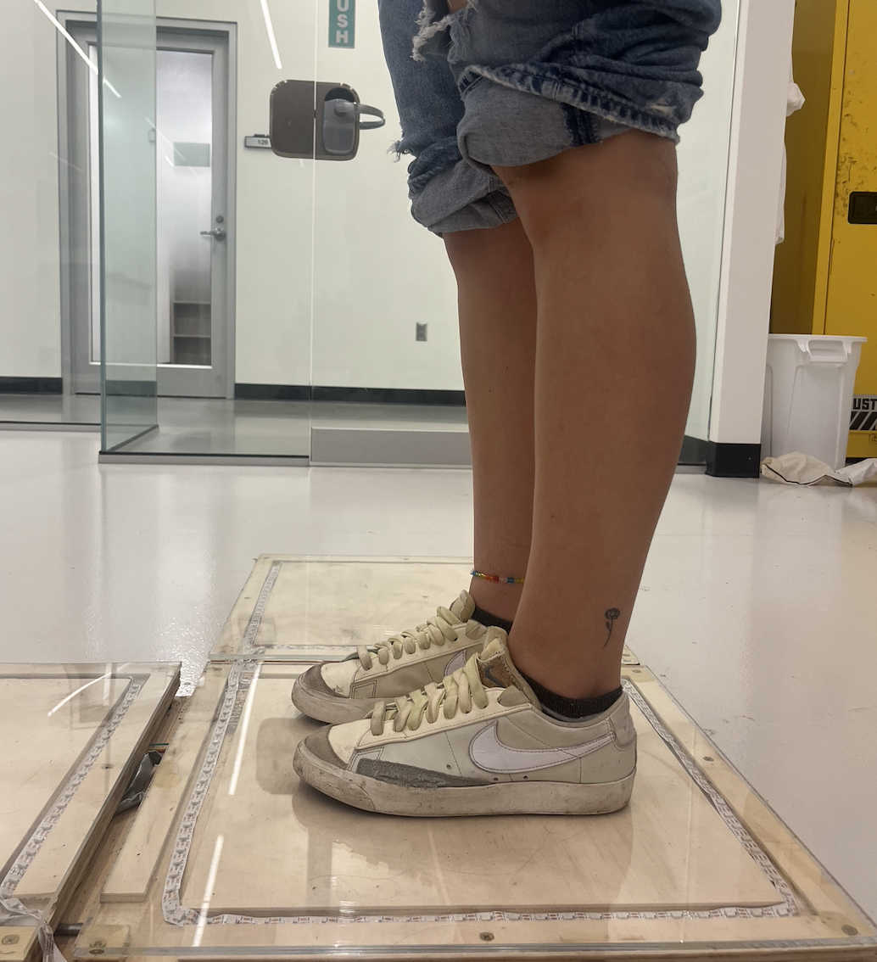
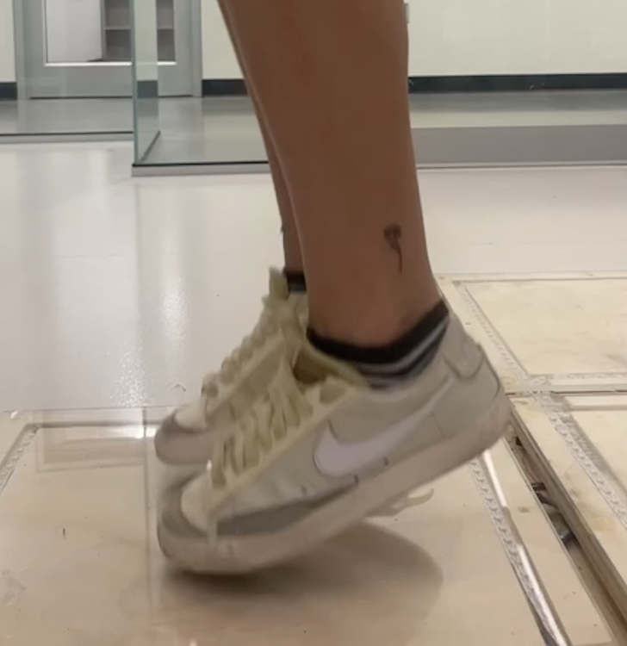
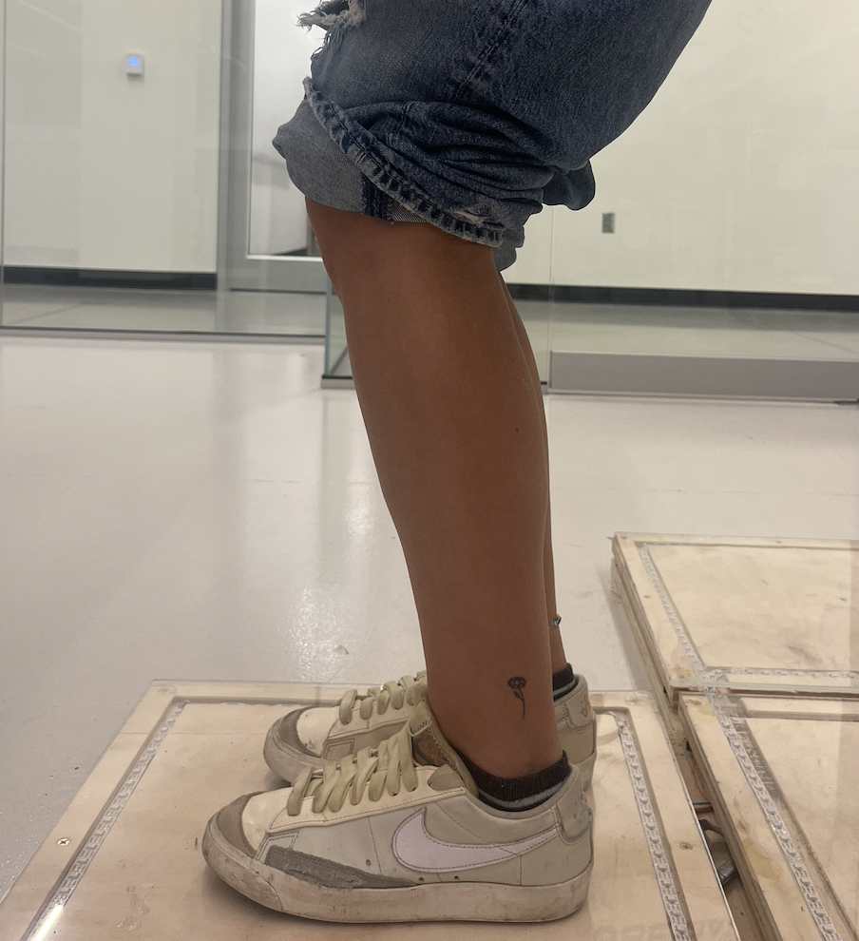
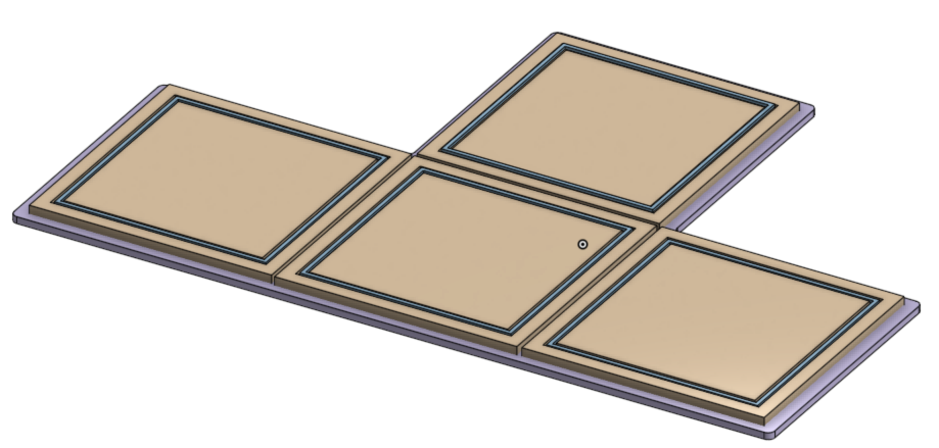
Dance Dance Rehabilitation
Elizabeth Christ, Natalie Eustis, Griffin Martin, Collin Stewart
Dr. Linxia Gu Dept. of Biomedical Engineering, Florida Institute of Technology
INTRODUCTION
Injuries, specifically concussions, may disrupt an athlete’s neuromuscular control and not only hinder their ability to return to sport but may also put them at risk for future injury.¹
RESULTS: Single Sequence Force vs Time Graph
METHODS
Physical Components: Beneath the acrylic layer is ¾ inch plywood, with laser cut squares to hold LED lights, the stimulus for the reaction time tests. Four load cells, each serving as transducers, are positioned underneath each board. The load cells are connected to an Arduino Uno, which acts as the central control unit.
Response time is a component of neuromuscular control that can be defined as the amount of time it takes for an individual to respond to a stimulus.
C_{a}: Max Load Applied
C_{b}: Max Load Applied
Response time has been shown to recover slower post-injury than any other symptoms.³
There is a need for a device that can efficiently measure neuromuscular response time.
Test Control, Data Collection, and Analysis: IDE code controls the tests, including stimuli cues using LED lights. At intervals of 250 milliseconds, load cell data is collected and transferred to MATLAB to generate load vs time graphs showing reaction time.
E: Ready for next Cue
OBJECTIVES
This project seeks to enhance the understanding of neuromuscular control during dynamic activities.
This information may provide valuable insights for optimized rehabilitation and training protocols.
A device that accurately measures response time may help to provide insight into the area of neuromuscular control, specifically after a concussion.
Visual cues to trigger jumping activities can provide an understanding of how cognitive processing influences neuromuscular response time.
This device seeks to create advancements from other reaction time and force plate technologies through integrating interactive visual cues and neuromuscular measurements during dynamic activities.
TESTING AND VALIDATION
Participants: 10 members from the Florida Tech Men’s Lacrosse Team, ranging from ages 18 to 24 who remain anonymous.
Protocol: Each subject performed a programmed response time test comprising of 10 a movement sequence. Response times from these steps are averaged to determine a comprehensive response time value for the entire test.
Validation: Each test was recorded with slow motion video, and from that response time for each movement was deduced. They were averaged and compared to the response times from the device.
Ethical Considerations: This study has been approved by the Florida Institute of Technology Internal Review Board. All participants have given their informed consent before participation.
A: Stimulus applied
D: Standing up
B: First contact
DESIGN
Device Configuration: Inspired by the popular video game Dance Dance Revolution, four force plates are connected in a “T” configuration. Each board features a top layer of clear acrylic.
ACKNOWLEDGEMENTS
We extend our sincere gratitude to Dr. Linxia Gu, Mohammad Ahmed, Dr. Scot Abbott, and Dr. RobRoy Martin for their invaluable contributions to the project. Their expertise and support were instrumental.
Comparing Device RT & Video RT Per Movement in a Sequence
Movement | Device RT (s) | Video RT (s) | % Diff | Movement | Device RT (s) | Video RT (s) | % Diff
1 | 1.119 | 1.12 | 0.089 | 6 | 1.294 | 1.12 | 1.094
2 | 1.208 | 1.16 | 4.138 | 7 | 1.032 | 1.16 | 1.176
3 | 1.020 | 0.98 | 4.082 | 8 | 1.106 | 0.98 | 2.982
4 | 1.119 | 1.08 | 3.611 | 9 | 1.382 | 1.08 | 1.986
5 | 1.245 | 1.27 | 1.969 | 10 | 1.12 | 1.27 | 1.754
REFERENCES
¹Eckner, James T., et al. “Effect of Concussion on Clinically Measured Reaction Time in 9 NCAA Division I Collegiate Athletes: A Preliminary Study.” PM&R, vol. 3, no. 3, Mar. 2011, pp. 212–18. DOI.org (Crossref), https://doi.org/10.1016/j.pmrj.2010.12.003.
²Smulligan, Katherine L., et al. “Increased Risk of Musculoskeletal Injuries After Concussion.” Operative Techniques in Sports Medicine, vol. 30, no. 1, Mar. 2022, p. 150896. DOI.org (Crossref), https://doi.org/10.1016/j.otsm.2022.150896.
³Del Rossi, Gianluca. “Evaluating the Recovery Curve for Clinically Assessed Reaction Time After Concussion.” Journal of Athletic Training, vol. 52, no. 8, Aug. 2017, pp. 766–70. DOI.org (Crossref), https://doi.org/10.4085/1062-6050-52.6.02.

