Slide 1

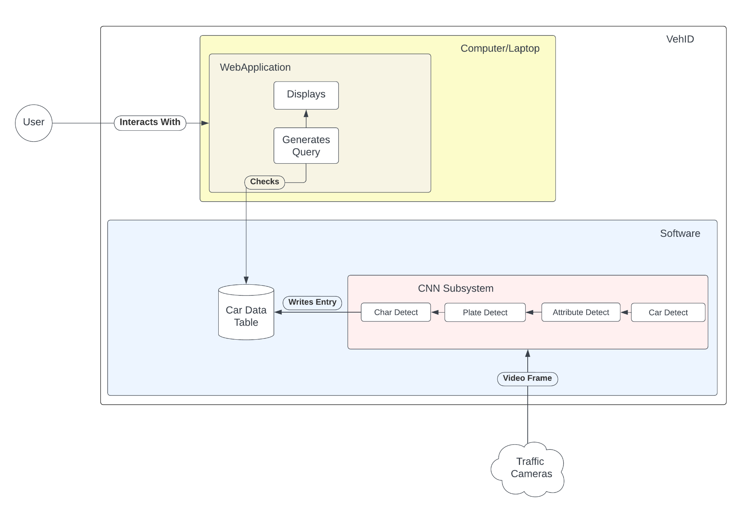
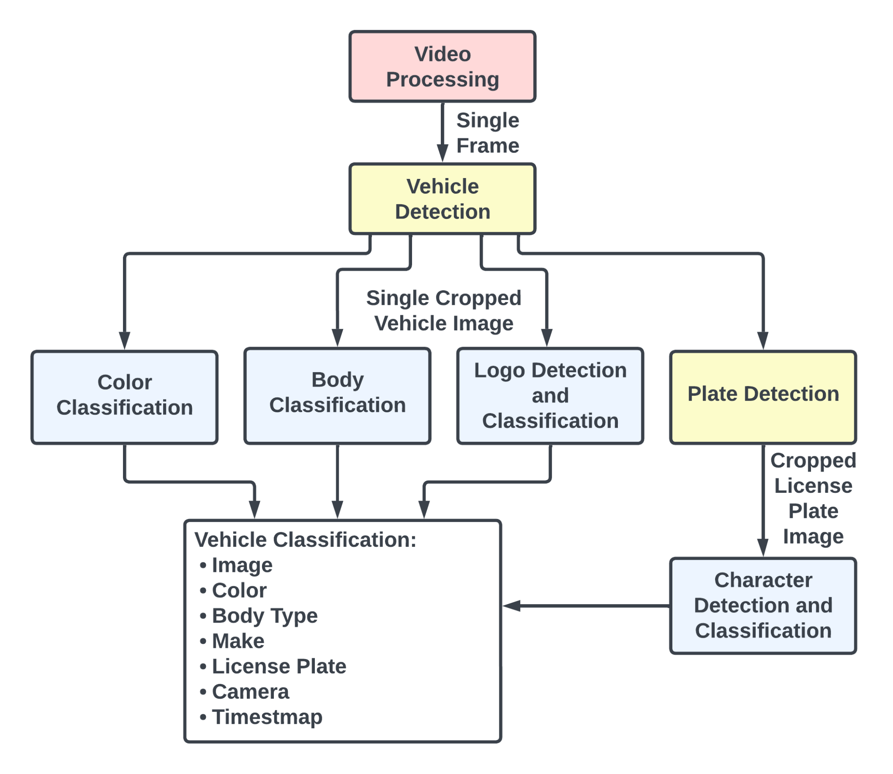
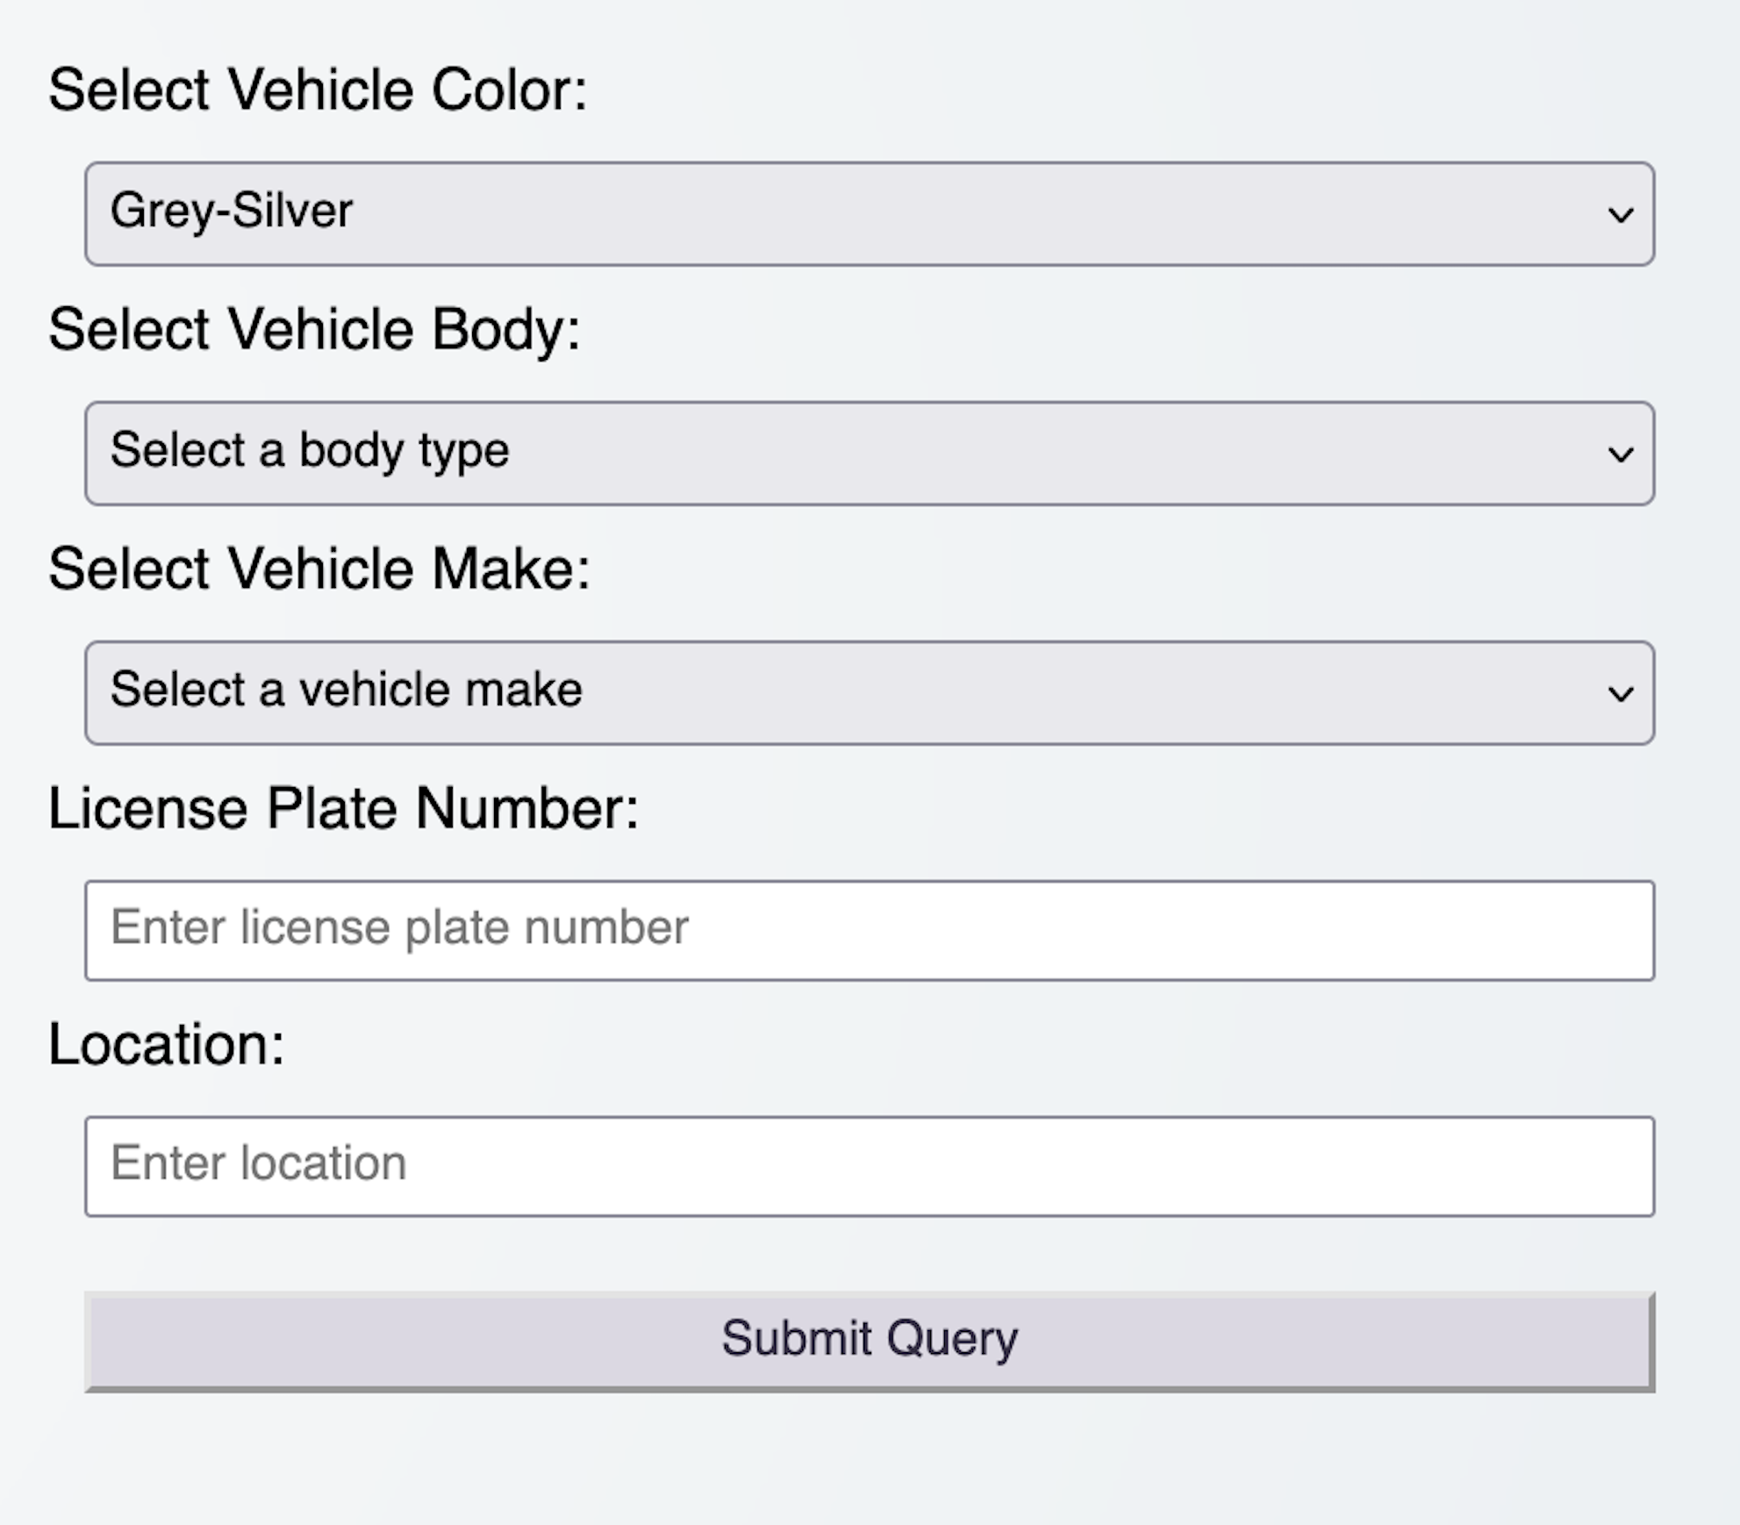
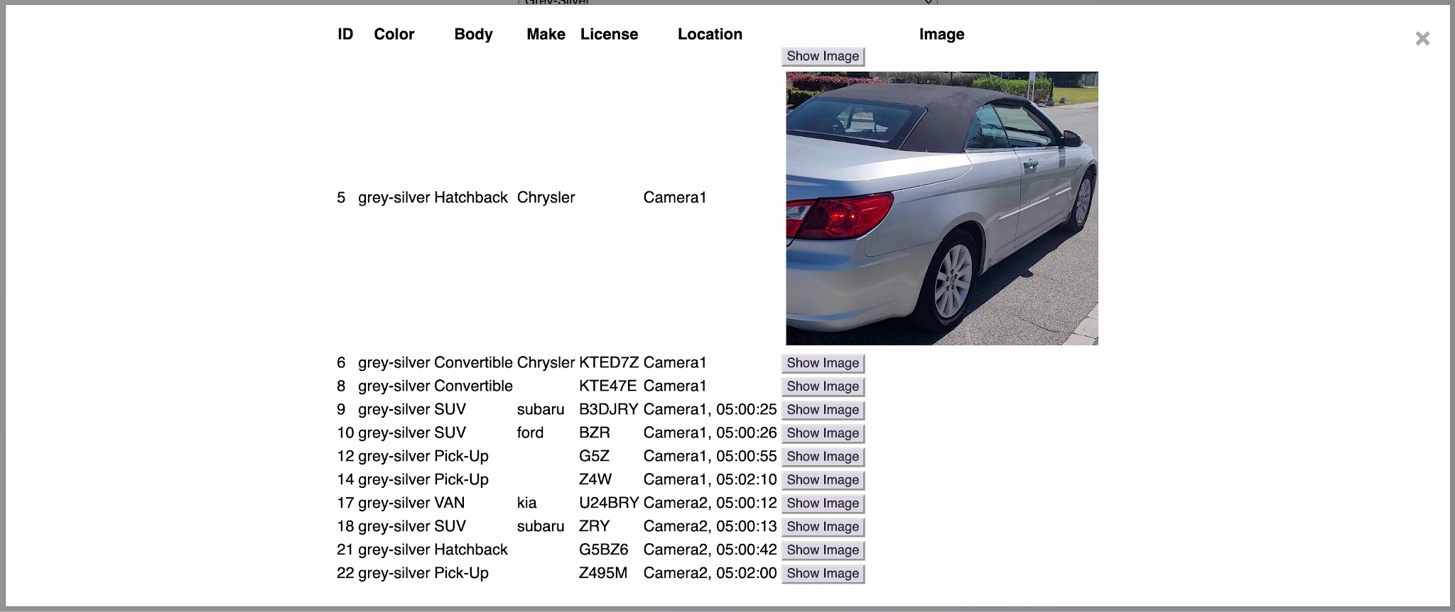
VehID
Remington Greko, Spencer Hirsch, Thomas Johnson, Alexis Nagle
Faculty Advisor(s): Marius Silaghi, Dept. of Electrical Engineering and Computer Science, Florida Institute of Technology
Goal
Motivation
Implementation
To improve public safety by utilizing machine learning to recognize vehicles based upon a variety of characteristics such as color, body type, make, and/or license plate.
Aid in AMBER alerts, stolen vehicles, and criminal offenses, which tend to rely on pure human interaction to spot and report the specified vehicles.
Existing automation only identifies license plate numbers and is not beneficial when only other characteristics are available.
Neural Network Subsystem Tools:
  Utilized various Python libraries
    OpenCV
    Tensorflow: Keras, Mini VGGNet Model
    Ultralytics: YoloV8 models
Web Application Tools:
  HTML/CSS, JavaScript, Node
Design
Database
Evaluation Results
Stores vehicle entries detected by the NN subsystem into a JSON format hosted on JBIN.
  Includes image path, color, body type, make, plate, camera ID, and timestamp.
Neural Network Subsystem Evaluation:
  95% positive vehicle predictions
  45% positive color predictions
  32% positive body type predictions
  47% positive make predictions (out of the ones that had predictions)
  71% had 1 or more attributes correctly predicted
  28% had 2 or more attributes correctly predicted
Web Application Evaluation:
  Accurate and timely query results
  Accurate and timely filter results
  Timely table population
Web Application
Allows for users to interact with the data in a tabulated display serving as the user interface
User functionalities:
  Perform queries to search for vehicles with desired characteristics
  Filter detected vehicle entries to be displayed in the user interface
  Edit and delete detected vehicle car entries
  View saved images for each car entry for manual verification
Example Query
for any detected
Grey-Silver
vehicles and
corresponding
results displayed
in the modal.
Neural Network (NN) Subsystem
Utilized pre-existing NN architectures
  Mini VGGNet (Body and Color Classifications)
  YoloV8 (Vehicle, Logo, Plate, and Character Detection)
Exports results to a JSON file for use in the database
Limitations
Image/Video Quality - Lack of access to higher quality images, and quality discrepancy
Weather/Environmental Factors - Lack of testing in unideal weather conditions / lack of diverse data
Website speed - Response time may be slow due JBIN restrictions
Improvements
Further training and tuning on select models with broader datasets to improve performance.
Implement web scraping to automatically populate the database with queries from sources such as AMBER alerts.
In web application implement timed queries to be rechecked against the database automatically.
Incorporate into a network of existing cameras.
Notes:
From Dr. Chan’s site:
Generally use bullets/figures/pictures, instead of long sentences--think what a judge would want to see/know. I suggest:
a. Motivation and Problem/Goal: Why is your project interesting/useful/important potentially for a large group of people (not just you)? What are the "pains"/problems that your system is designed to help solve?
Goal: Utilize machine learning to recognize vehicles based upon a variety of characteristics such as color, body type, make, and/or license plate. To aid in public safety in a variety of situations such as AMBER alerts, stolen vehicles, and criminal offenses.
Motivation: To improve the current systems used in emergency situations which often rely on pure human interaction to spot and report the specified vehicles. To expand upon license plate recognition to allow vehicles to be identifies upon other characteristics when license plate information is not provided.
b. Approach/Features: With your system, what can the users do (ie. accomplished key features/functionalities)? Bullets with screenshots/pictures/plots/…
c. Design/Implementation: How did you accomplish your system? System architecture, algorithms, tools, …
Include system architecture diagram and description
d. Evaluation Results: How well does your system function? "measurement of success"--performance/speed/accuracy/userSurveys/…
e. Limitations and Improvements: What can't the system do? How can the system be improved?
Limitations:
Image quality
Weather/Environment factors
Improvement:
Further training and tuning on some of the models to improve individual performances.
Implement web scraping to automatically populate the database with queries from sources such as AMBER alerts.
Incorporate into a network of existing cameras.

