Slide 1
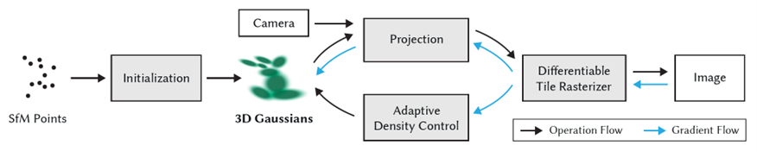
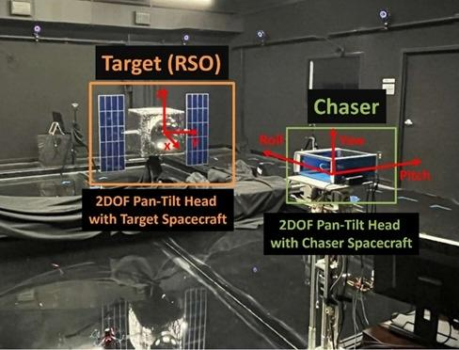

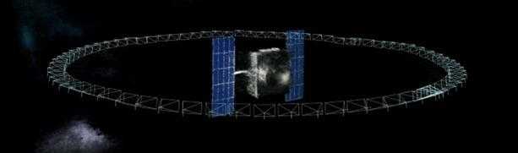
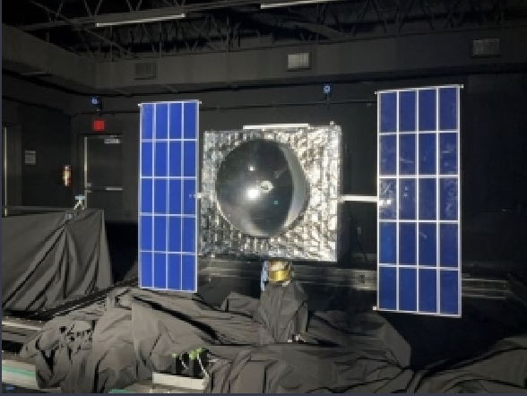
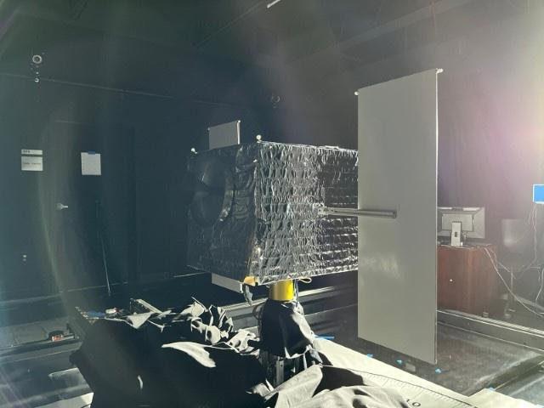
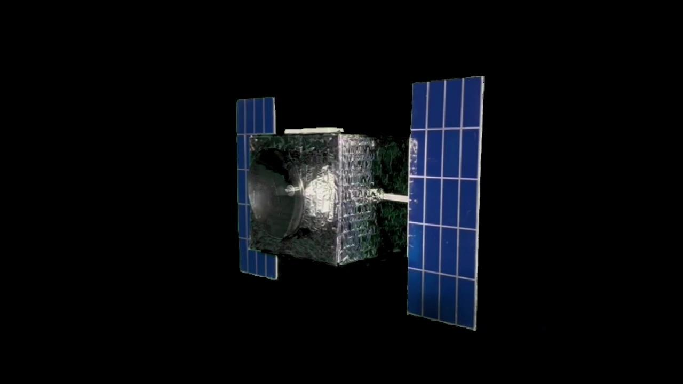
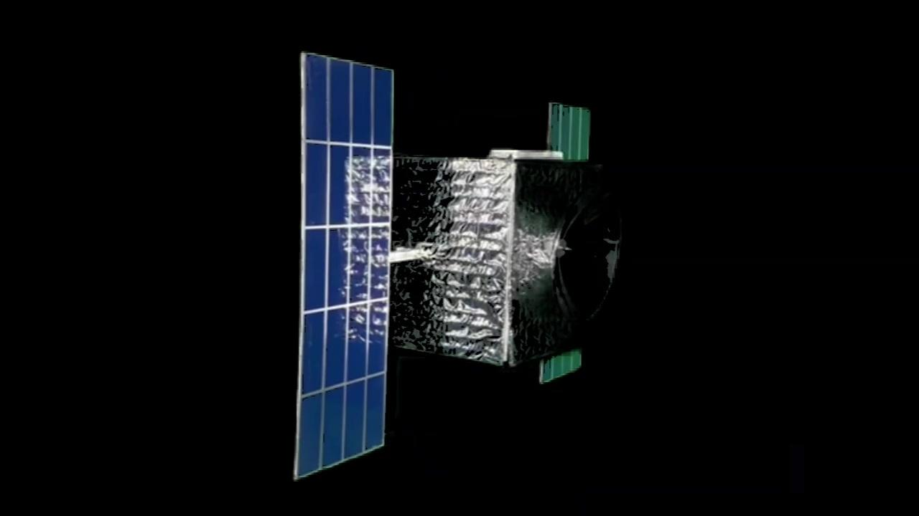
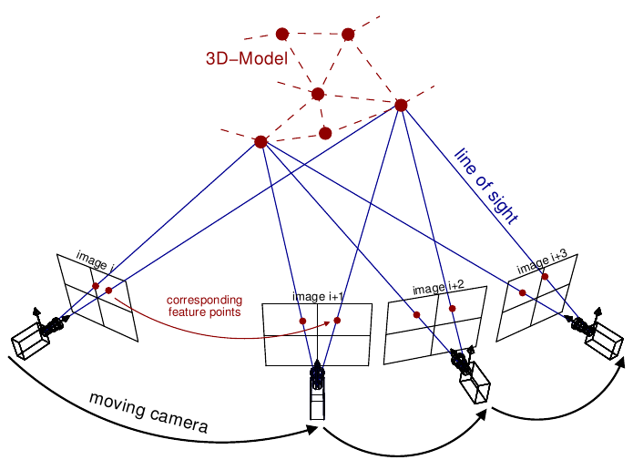
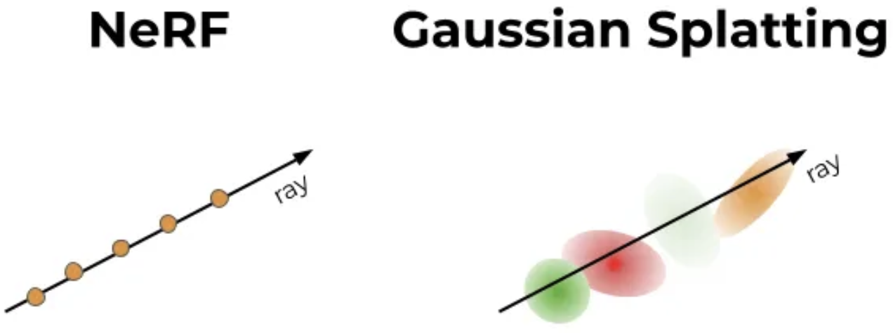
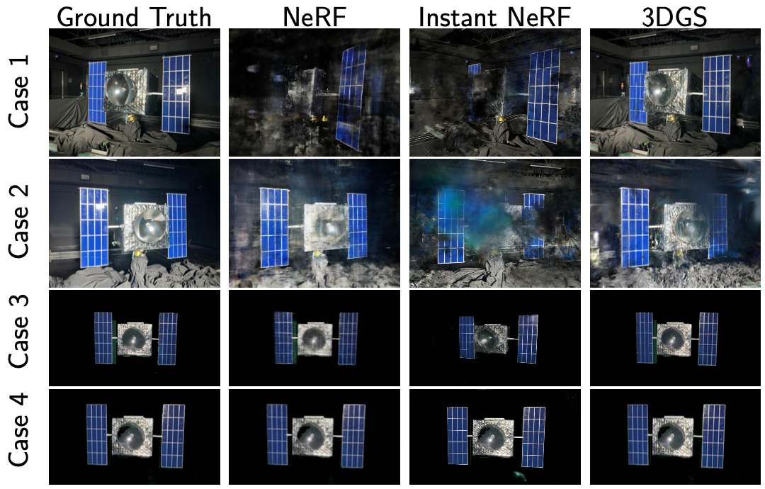
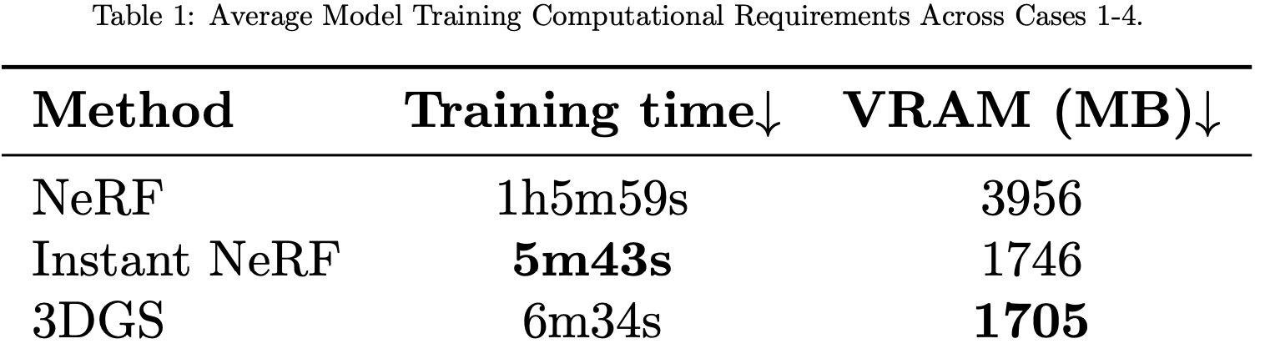
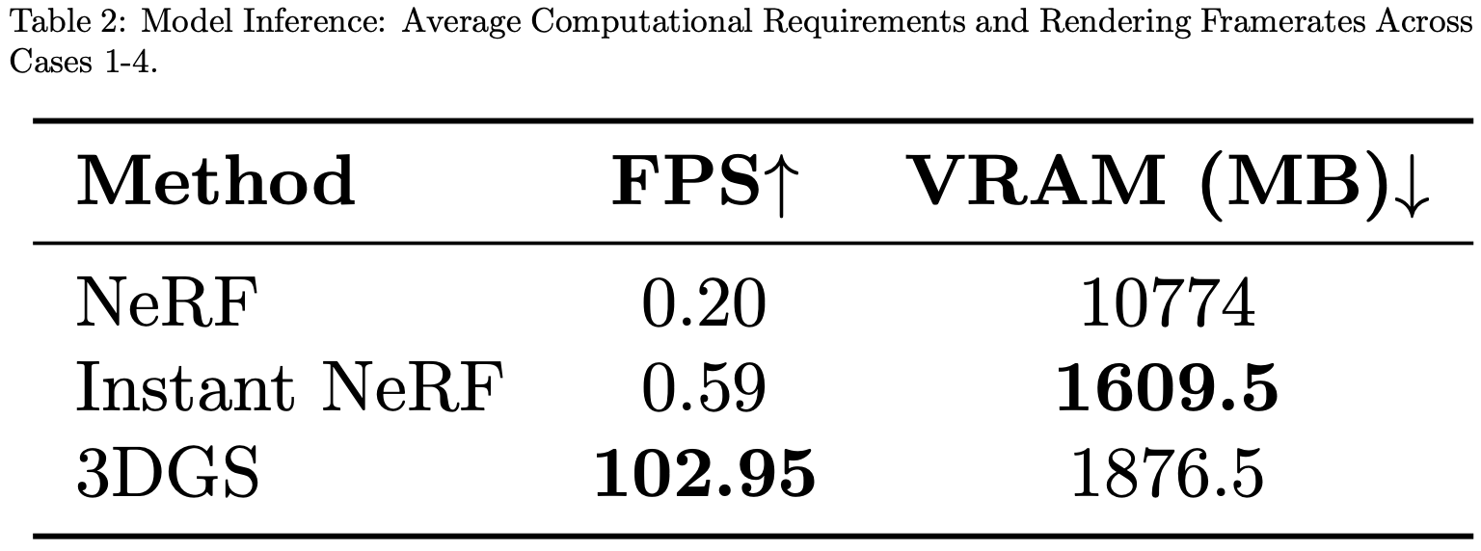
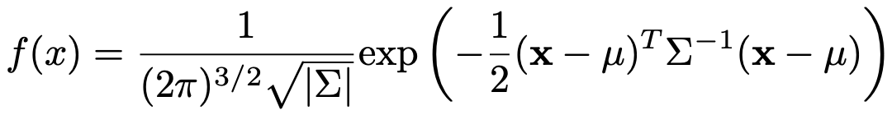
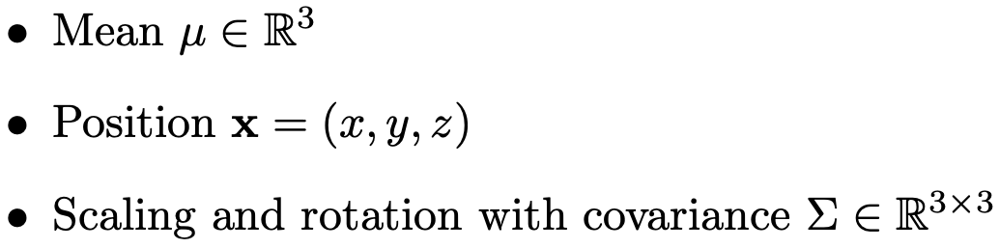
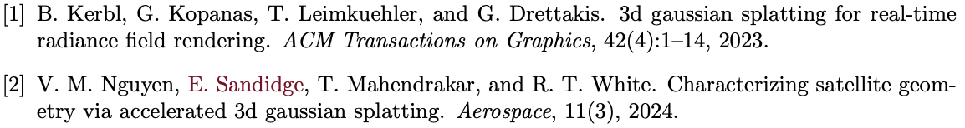
An Implementation of 3D Gaussian Splatting for Characterizing Satellite Geometries
Emma Sandidge
Faculty Advisor(s): Dr. Ryan T. White, Dept. of Mathematics and Systems Engineering, Florida Institute of Technology; V. Minh Nguyen
INTRODUCTION
MODEL PIPELINE
OPTIMIZING & RENDERING
As numbers of satellites in orbit increase, we need to develop mechanisms for on-orbit servicing and active debris removal to inspect and service non-cooperative spacecraft. This requires robust characterization of the target’s geometry. Our goal is to Identify the geometry of an unknown satellite using a single video feed with a low-compute algorithm. We show an implementation of 3D Gaussian Splatting (3DGS) [1] along with a comparison of model performance to past techniques.
The entire 3DGS pipeline is differentiable from end-to-end, so we use gradient-based methods to optimize the Gaussians. We use the loss function below, where the first term minimizes the difference between predicted and ground truth pixels, and the second increases the structural similarity between the two images:
DATA CAPTURE
Images were collected using a satellite mock-up model at the ORION Laboratory. Either a camera was positioned as a chaser satellite viewing the spinning target, or the chaser circled around the stationary target.
The rendering process uses a differentiable Gaussian rasterizer, which involves projecting the Gaussians into 2D space, sorting by depth, and 𝛼-blending from back to front. Rendering for NeRF based methods involves tracing a continuous path along each point in the scene, while 3DGS uses a discrete number of ellipsoids to represent the scene.
We used two different lighting conditions (10% or 100% intensity) and placed a green screen behind the cases where the target is spinning:
STRUCTURE FROM MOTION
Structure from motion (SfM) takes 2D images and generates a 3D point cloud representation of them. We apply this to our training images before initializing 3D Gaussians.
Case 1
Case 2
Case 3
Case 4
3D RENDERING RESULTS
MODEL METRICS
3D GAUSSIANS
Each point on the SfM point cloud is initialized to the mean of a 3D Gaussian random variable with probability density
Images taken from [2].
Tables taken from [2].
Sources:
ACKNOWLEDGEMENTS
I would like to thank Trupti Mahendrakar, Mackenzie Meni and both the Autonomy and NETS Labs at Florida Institute of Technology for their support in the completion of this project.
The 3D Gaussians appear as small ellipsoids that can be stretched or compressed and assigned a RGB color and saturation factor 𝛼.

