Slide 1
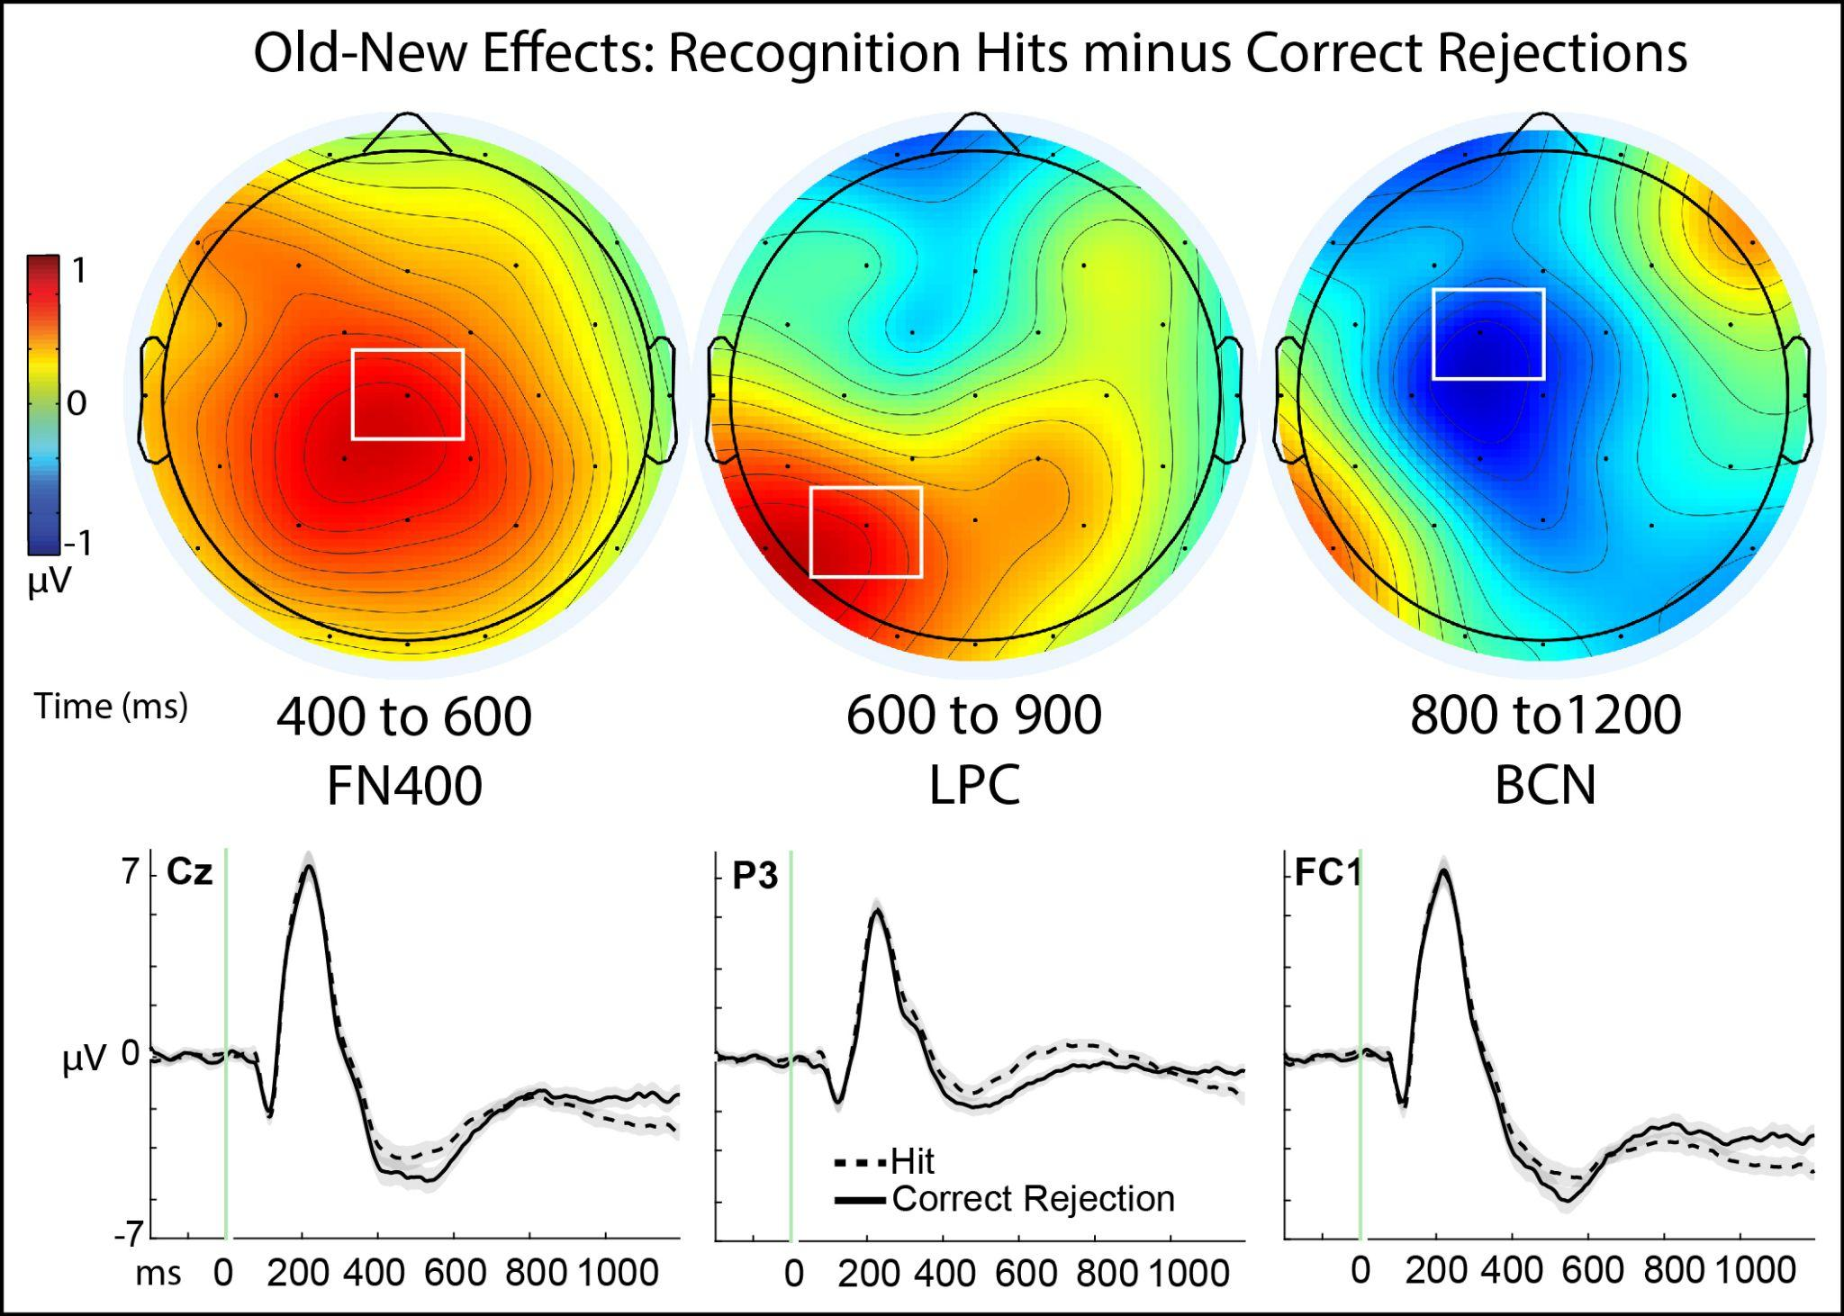
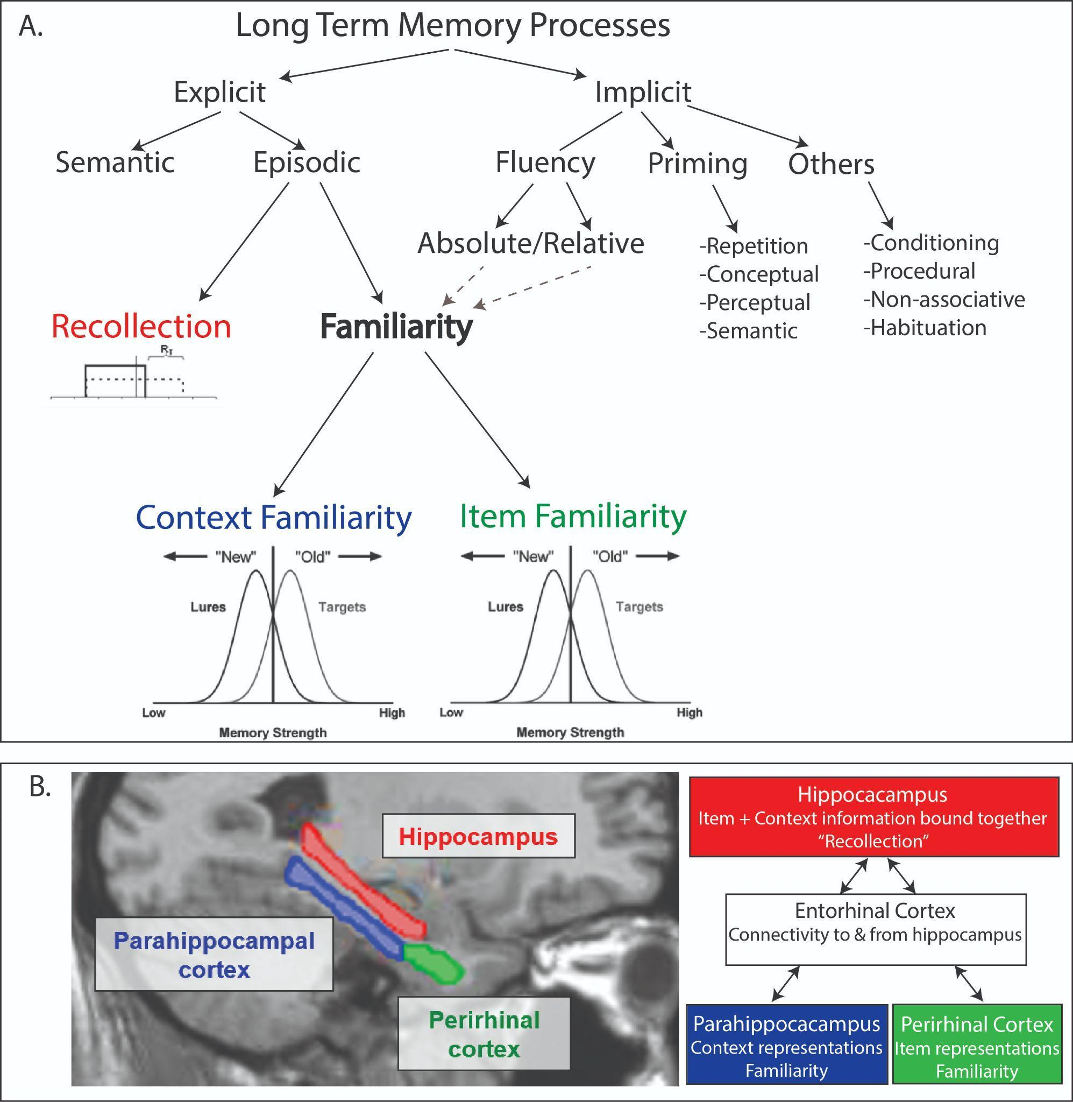
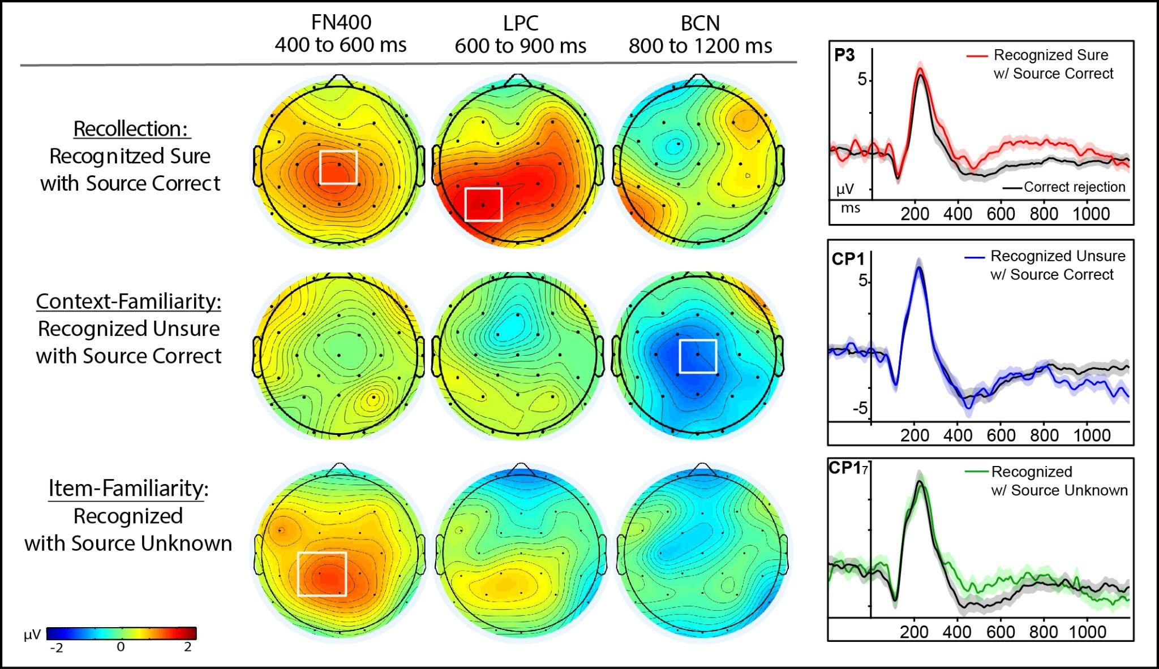
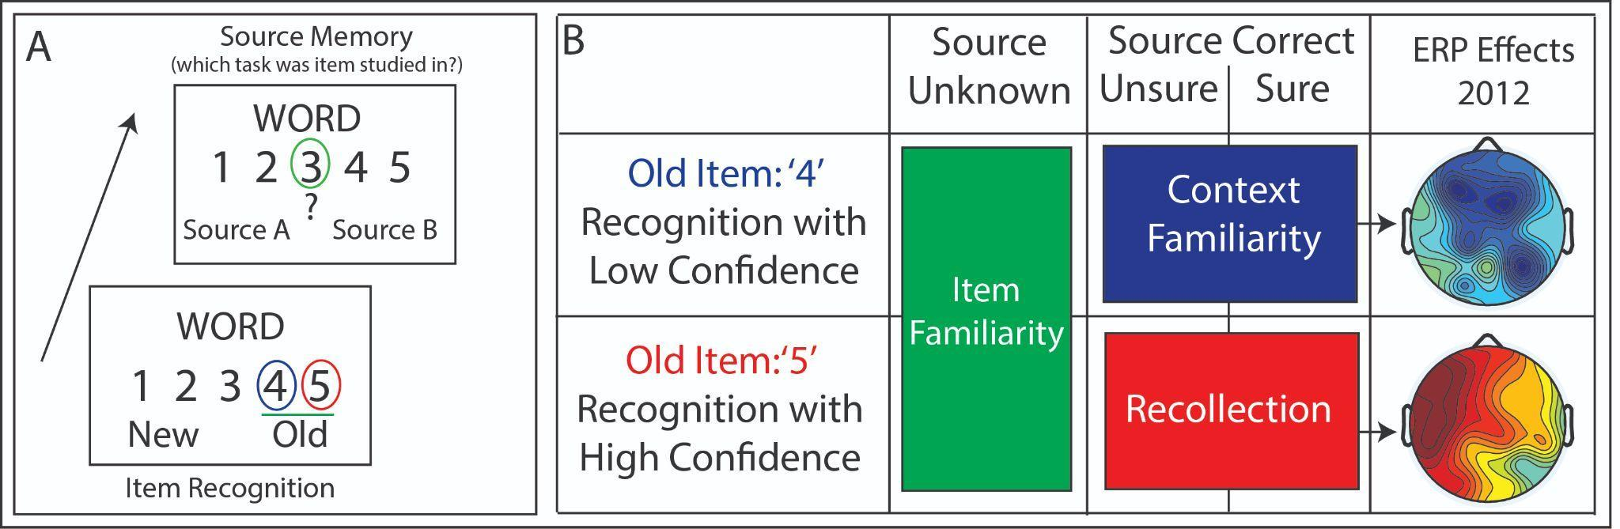
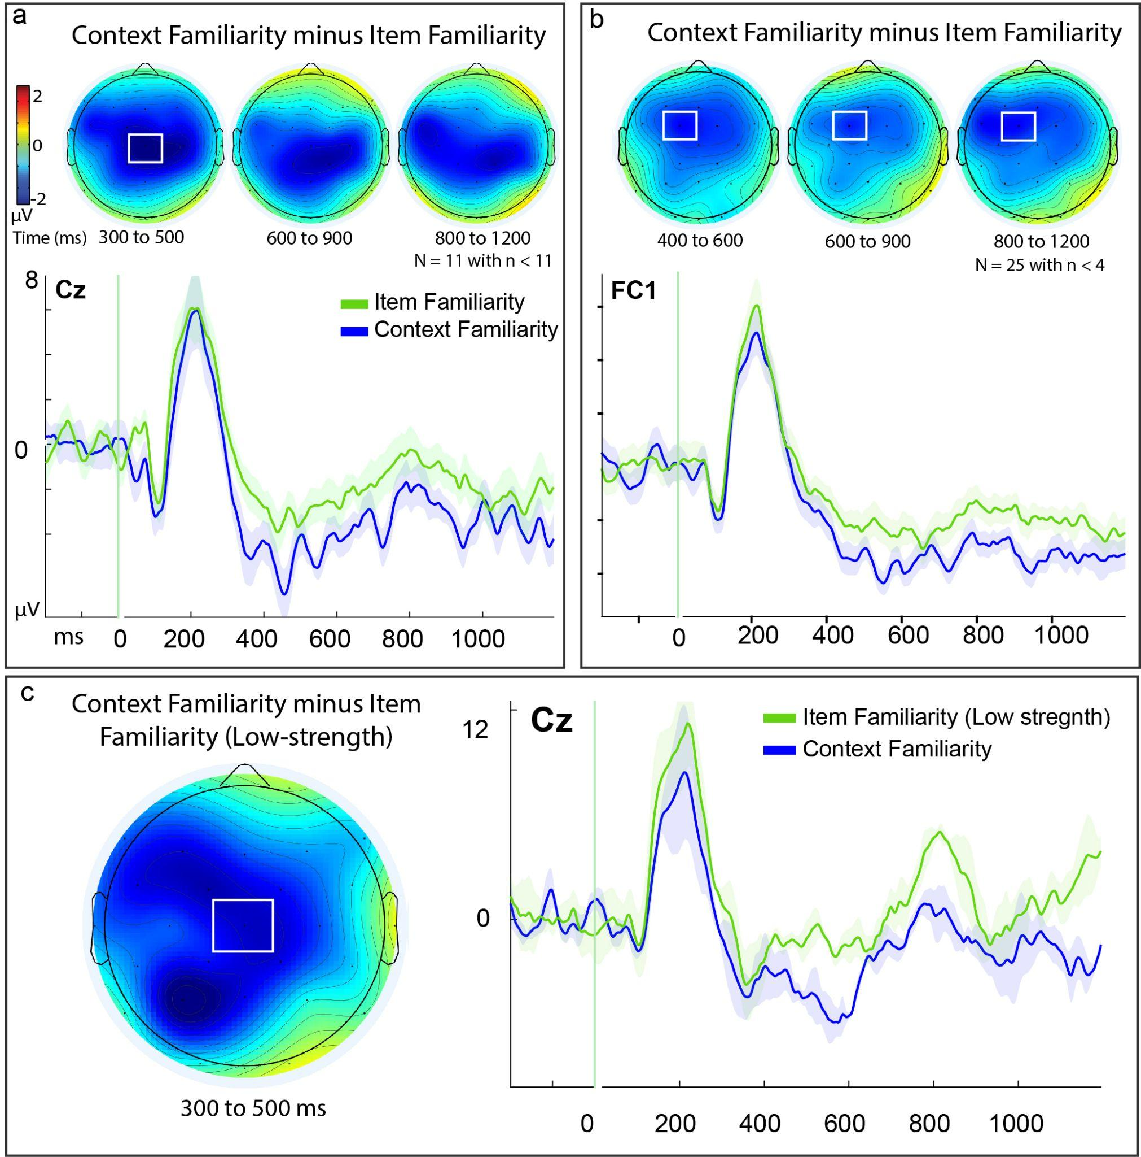
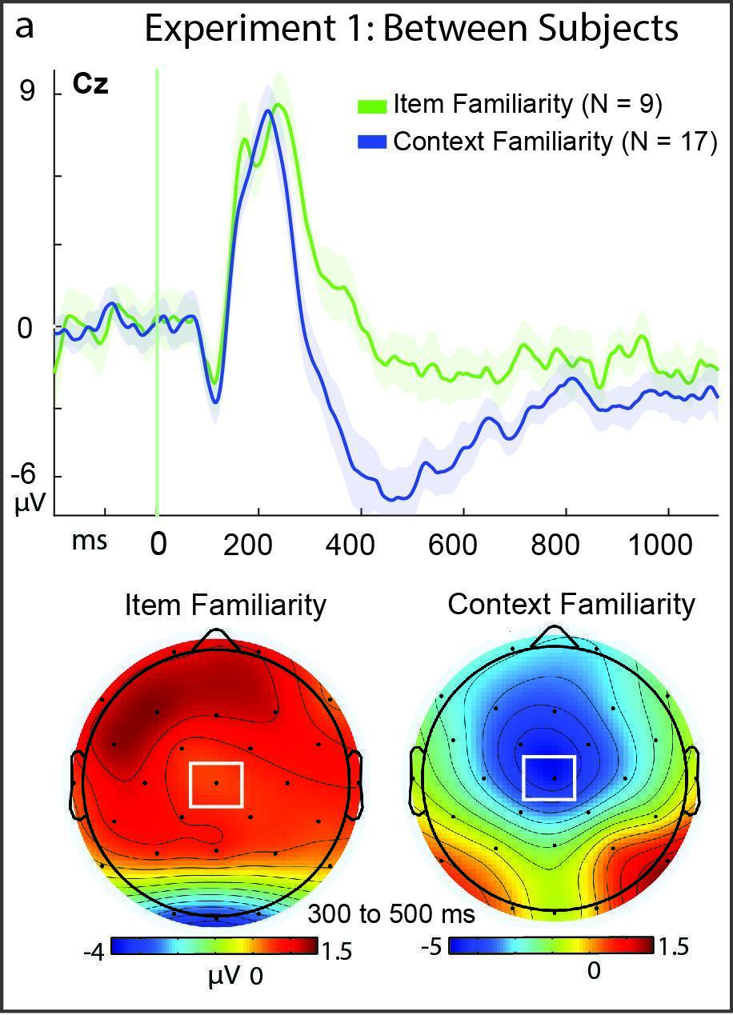
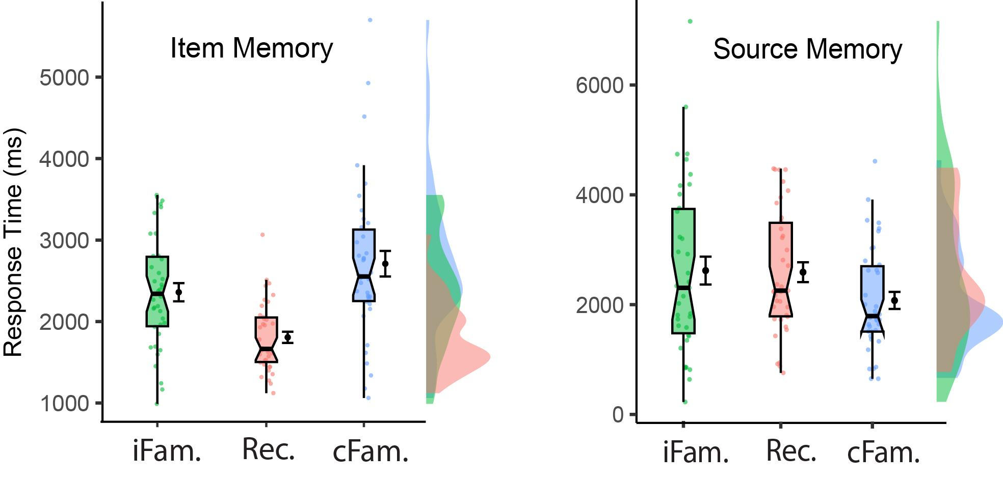
A new memory process: Context familiarity dissociates from item familiarity
Jahdiel Perez Caban, Evan Clise, Sarah Smith, Kiera Rivera, Jesse Bengson, Daniel Drane, Randal Waechter, Arel Marsh, & Richard J. Addante
Faculty Advisor: Dr. Richard J. Addante, Dept. of Psychology, Florida Institute of Technology
Introduction
Eletrophysiological Results
Physiologically-informed model
Recollection: often measured as “Source memory” for context of where prior memories came from.
Familiarity: low levels of item memory confidence
Paradoxical combination: Sometimes people have accurate source memory despite also having low-confidence item recognition for same info.
Prior research for this condition exhibited a significant negative-going brainwaves (Event-related potential, ERP) differentiated from both recollection signals (Addante, et al, 2012, Neuroimage), but lacked behavioral measures.
Goal: Secondary analysis of published data (Addante et al., 2023, Psychophysiology, N = 54), to: A) replicate combo of item + source memory, B) extend with novel measures of behavior, C) identify if cFam. was also distinct from ifam., D) test of BIC model predictions (Diana et al., 2008)
Basic Old-New Memory Effects:
A memory x site x time interaction (p <.001).
FN400: t(53) = 3.186, p <.001, d =.23
LPC: t(53) =3.10, p =.001, d =.32
BCN: t(53) = 2.84, p =007, d =.26
→ Three dissociable neural signals underlying basic episodic recognition: different times and places on scalp.
Direct tests of each memory type compared to correct rejections:
A new model: Rec., cFam, & iFam are distinct processes of memory.
MTL: Parahippocampal & perirhinal cortex process different familiarity
**
**
Encoding: 200 words in 2 tasks
Test: 200 old & 100 new words
*
Conclusions
cFam & iFam Behaviorally Distinct
cFam slower than iFam for items
cFam faster than iFam on source
Triple dissociation of ERP effects:
  FN400, 400-600 ms, central
  LPC, 600-900 ms, left parietal
  BCN, 800-1200 ms, negativity
cFam & iFam are Neurally Distinct
Early BCN effect (300-500 ms)
Results also between-subjects
Control Analyses: results not attributable to sample size, SNR.
Results replicated across studies
A 3rd process of episodic memory
Acknowledgments
Work supported by NIH Grant 2 L30 NS112849-02, IDC Grants from CoPLA, & the FIT Office of the Provost, Dr. Marco Carvalho.
Conditions of interest:
Item 5 w/ Source Correct (SC) = Recollection
Item 4 w/ Source Correct (SC) = Context Familiarity
Item 4+5 w/ Source Unknown (SU) = Item Familiarity
*
p < .05*, p < .01**
Recollection: LPC & FN400, No BCN (Bayes Factor = 4.9, N = 27)
Context familiarity: BCN, No LPC or FN400 (Bayes Factors > 4, N = 27)
Item familiarity: FN400, No LPC or BCN (Bayes Factors = 1, N = 19)
→ Context familiarity, item familiarity, & recollection ERPs are distinct
Hypotheses
cFam. iFam., & Rec. will dissociate in behavior RTs
Context familiarity will exhibit a negative ERP effect, dissociate from FN400 (iFam.) & LPC (Rec.)
Direct tests: Are context- & item-familiarity physiologically distinct?
Behavioral Results
Performance: cFam. memory was above chance (M = .57, p = .006), replicated prior findings (M = .58).
Item Response Times: cFam. responses were significantly slower than iFam & Rec. (p = .024, p < .001).
Source Memory: cFam was faster than Rec. & iFam (p < .003, p = .002).
→ All 3 memory types dissociated RTs
cFam distinct from iFam (p = .030).
Effects remained with less SNR (n > 4) (p=.047)
Effects remained when holding item confidence levels constant (p= .015).
→ Results not confounded with confidence
Between subjects: cFam distinct from iFam (p = 01).

