Slide 1
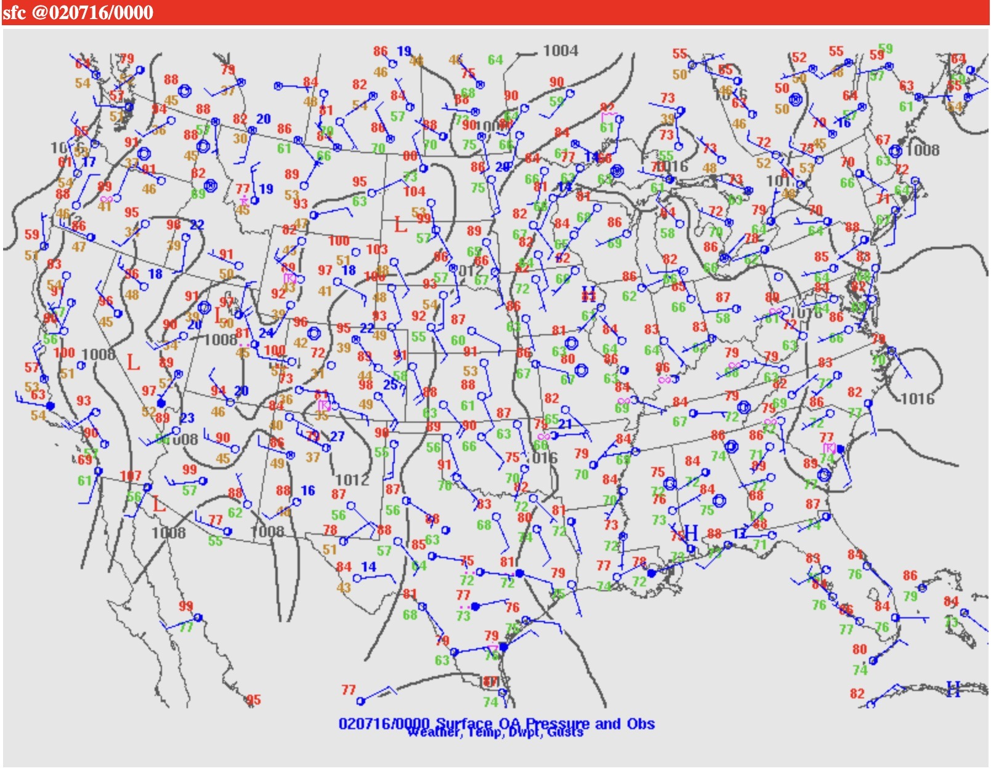
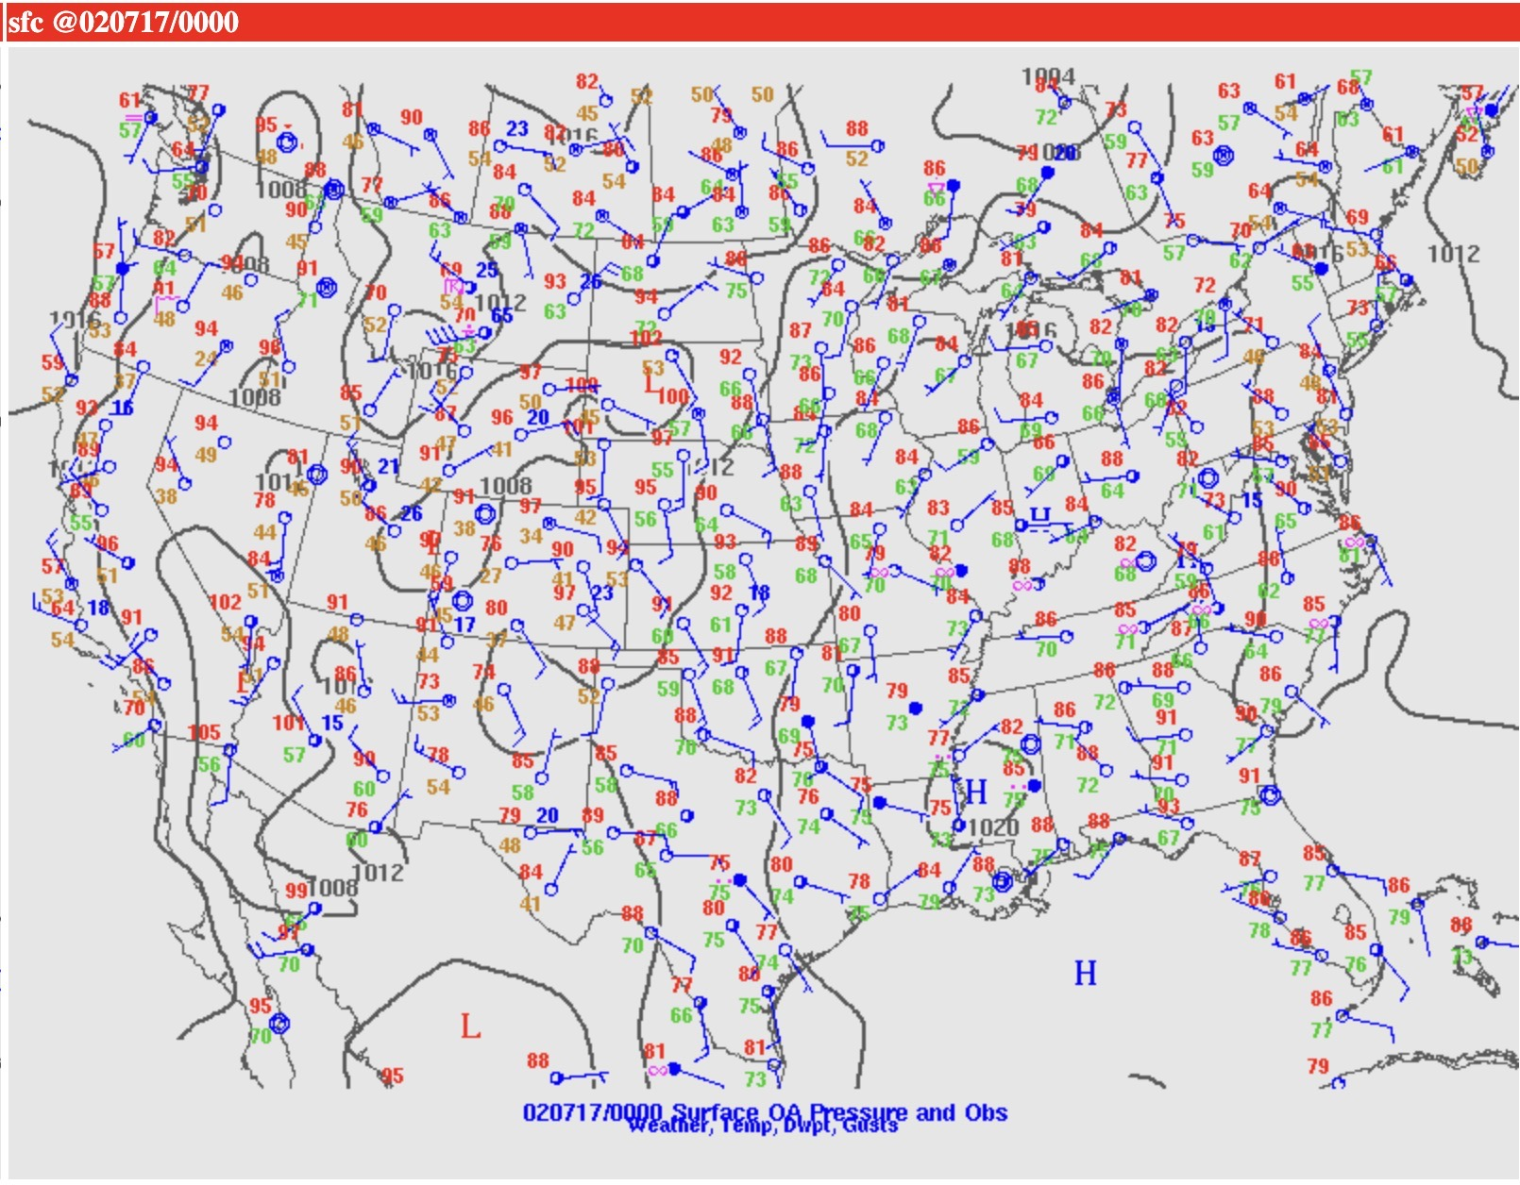
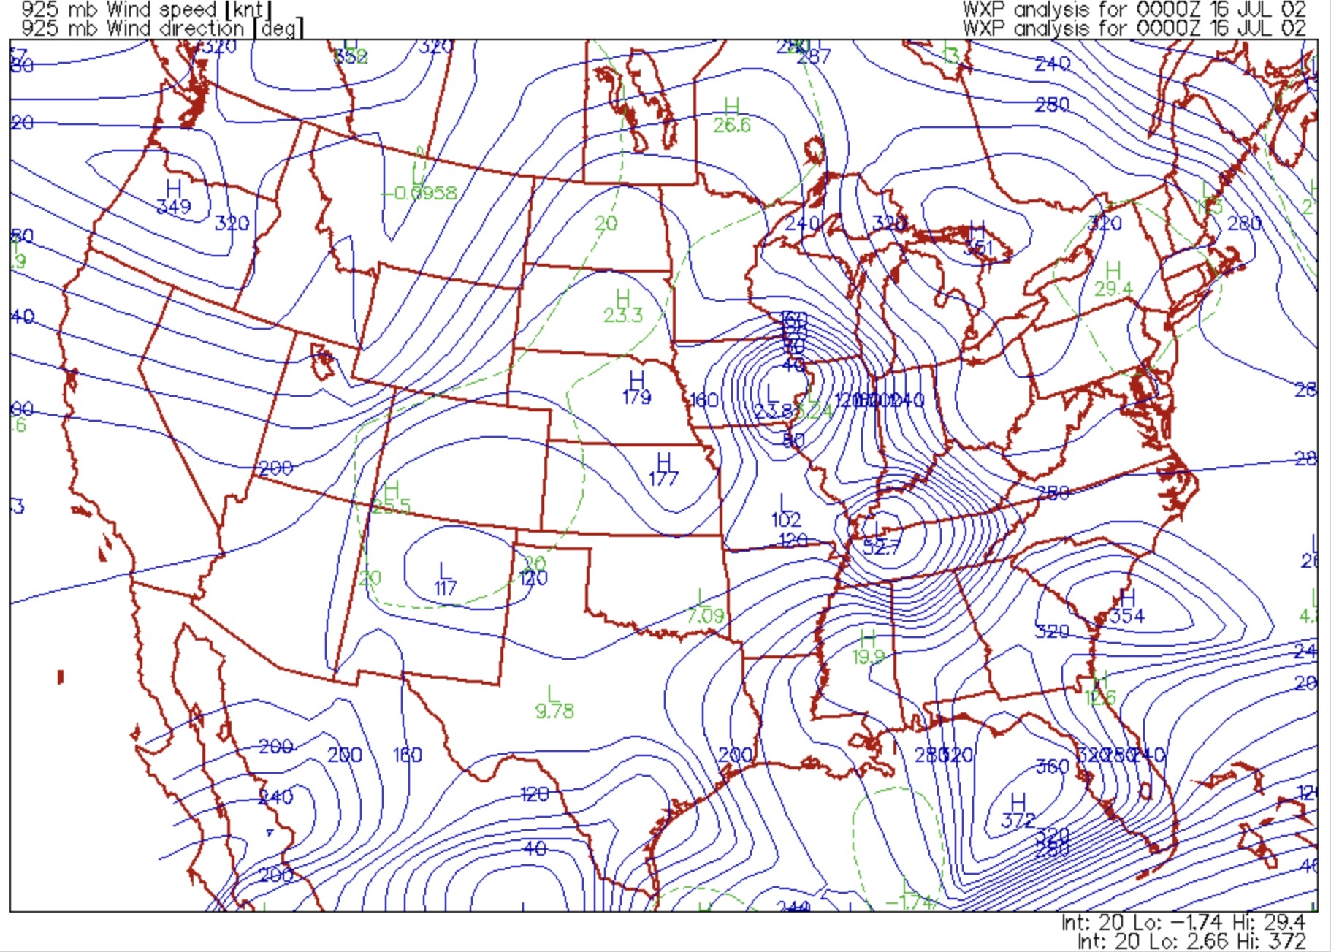
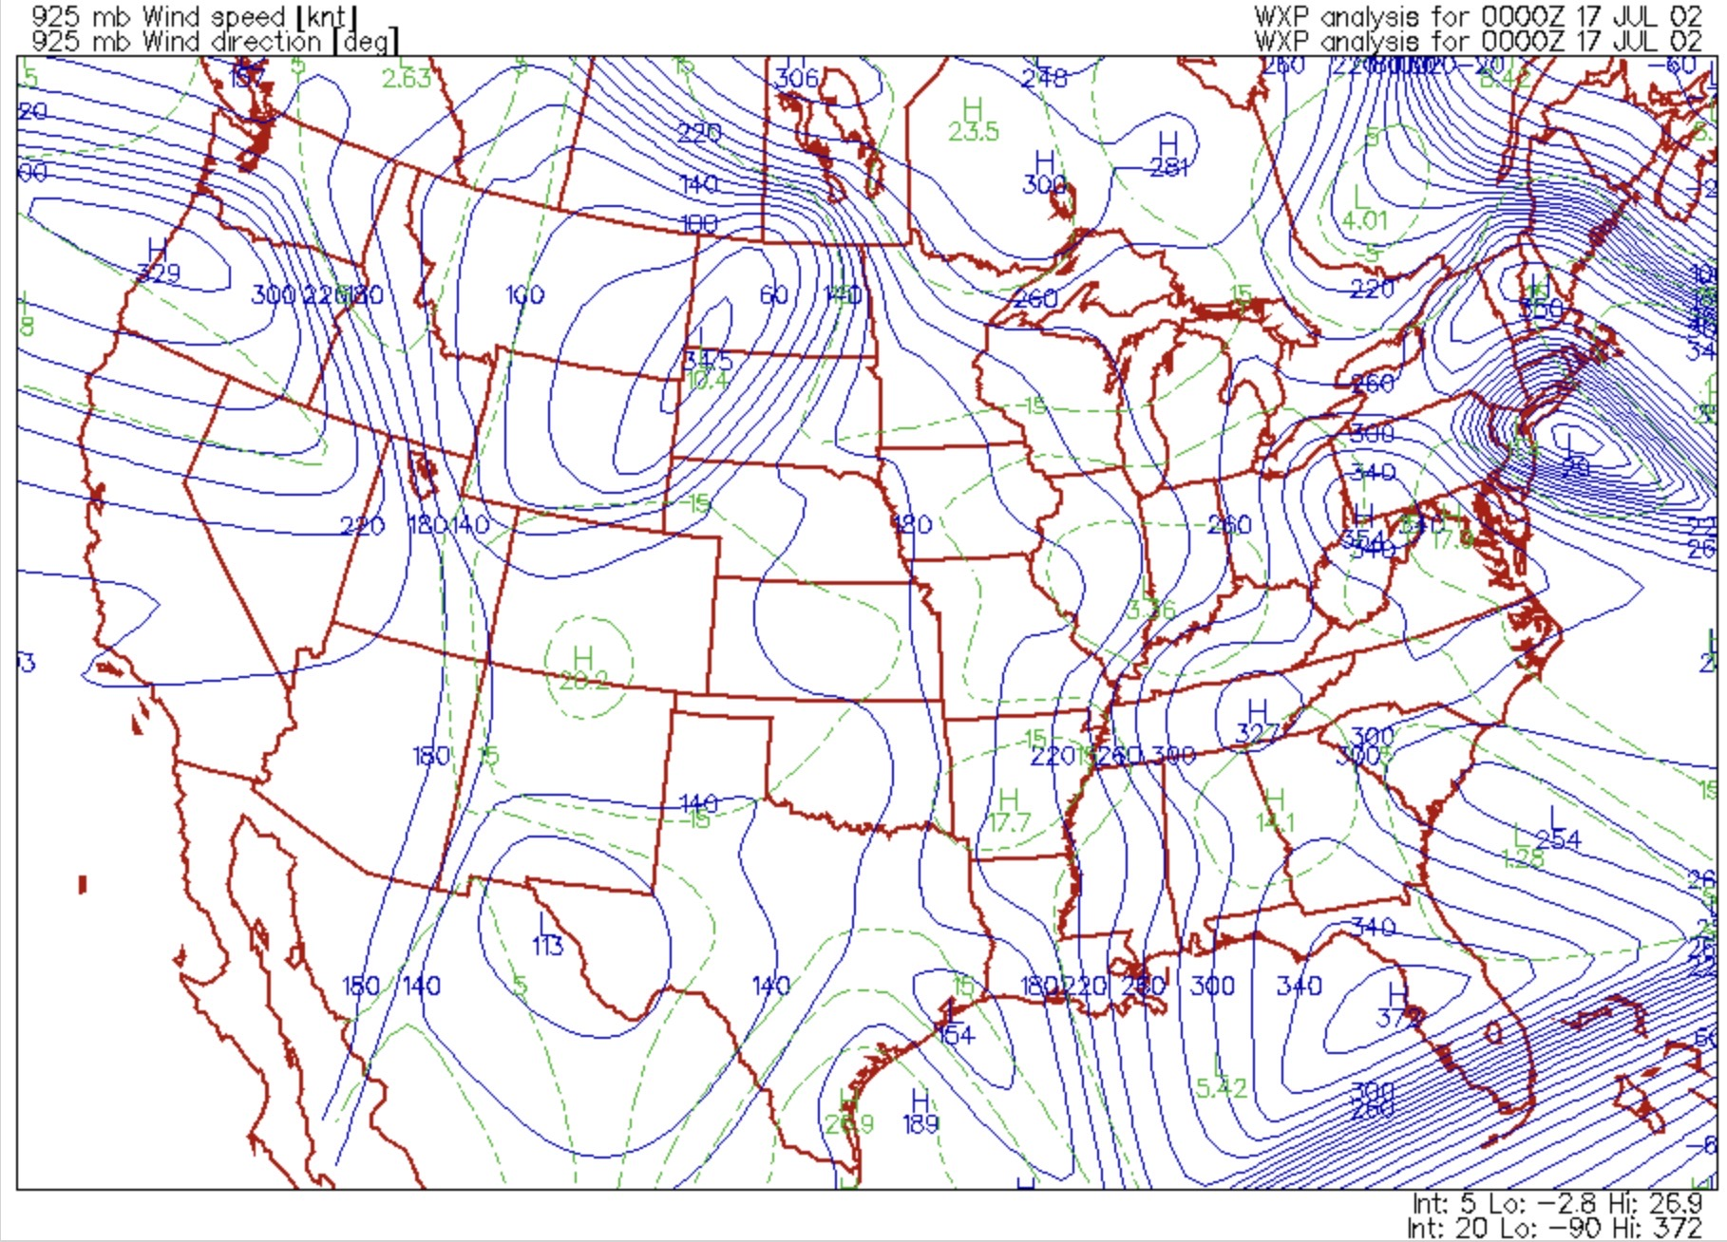
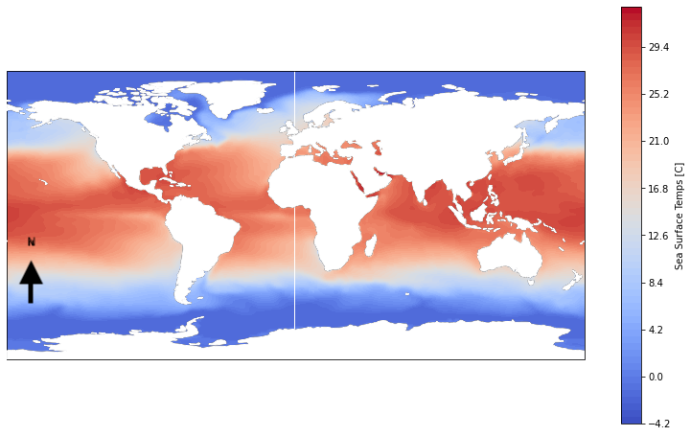
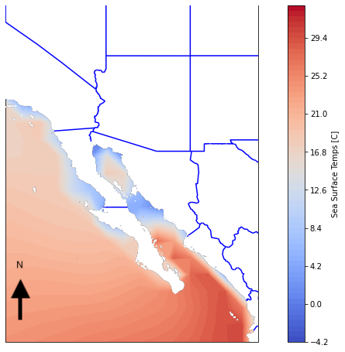
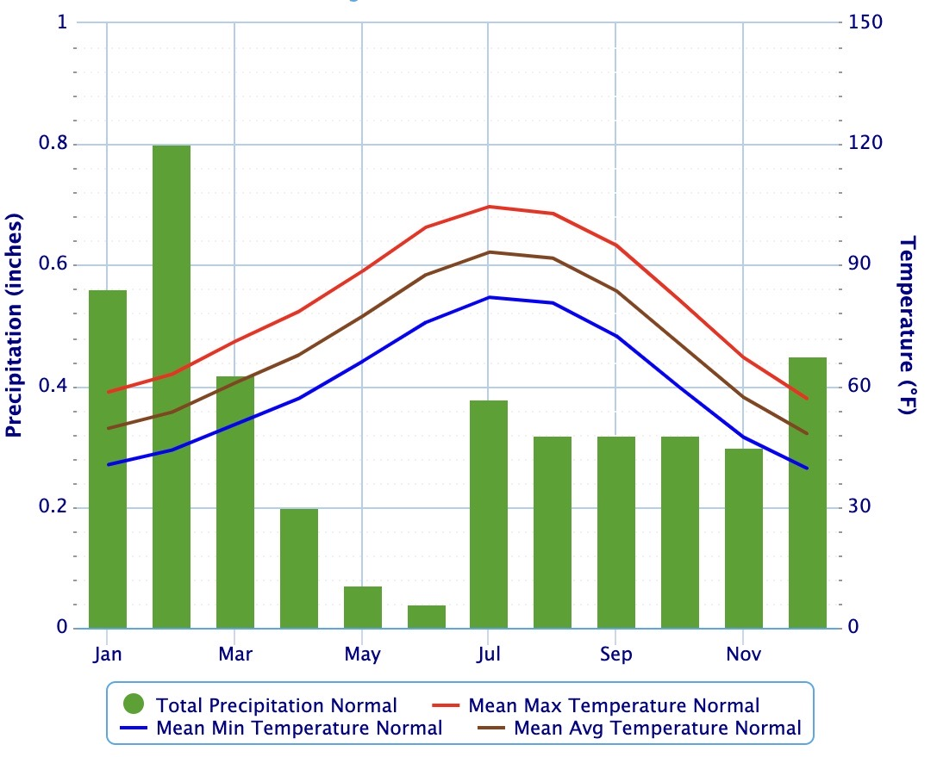
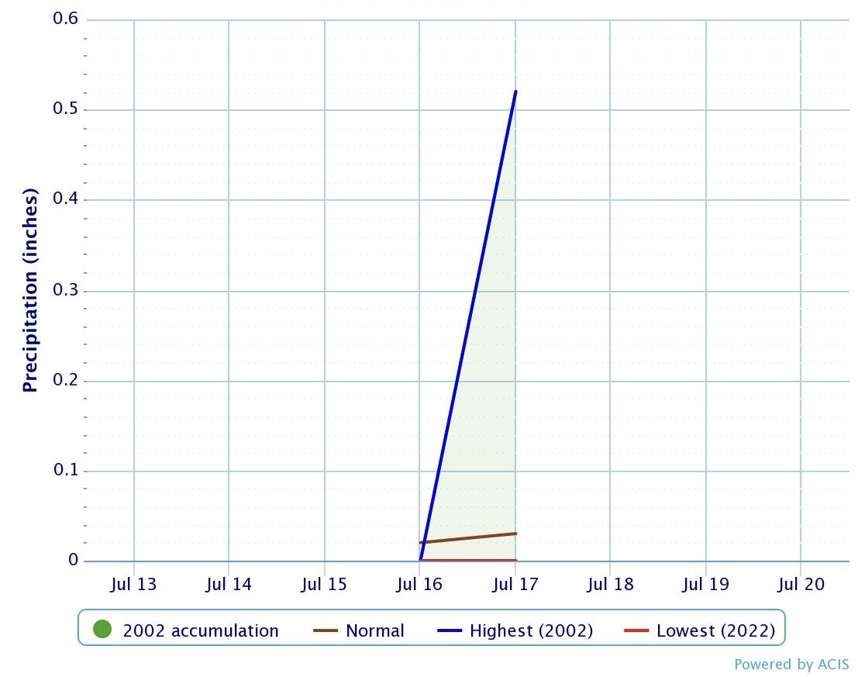
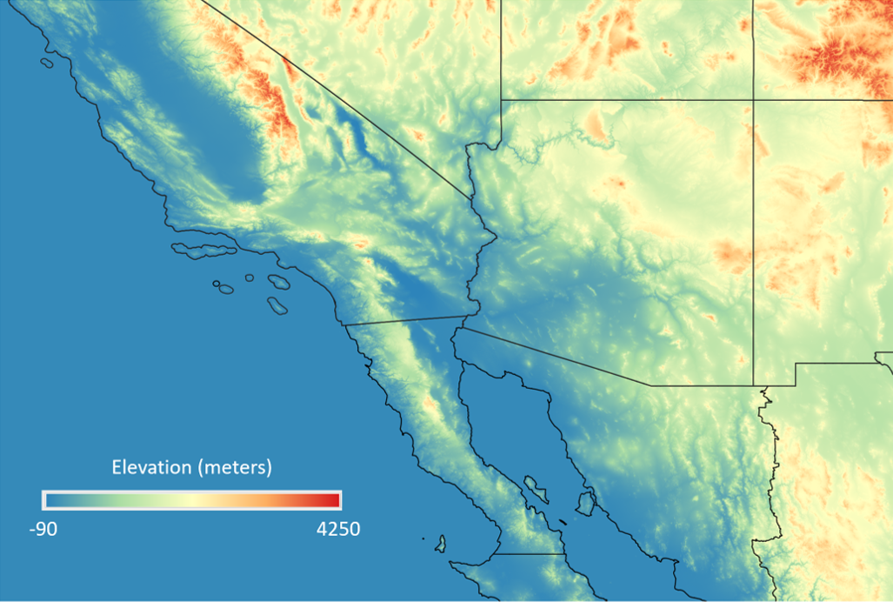
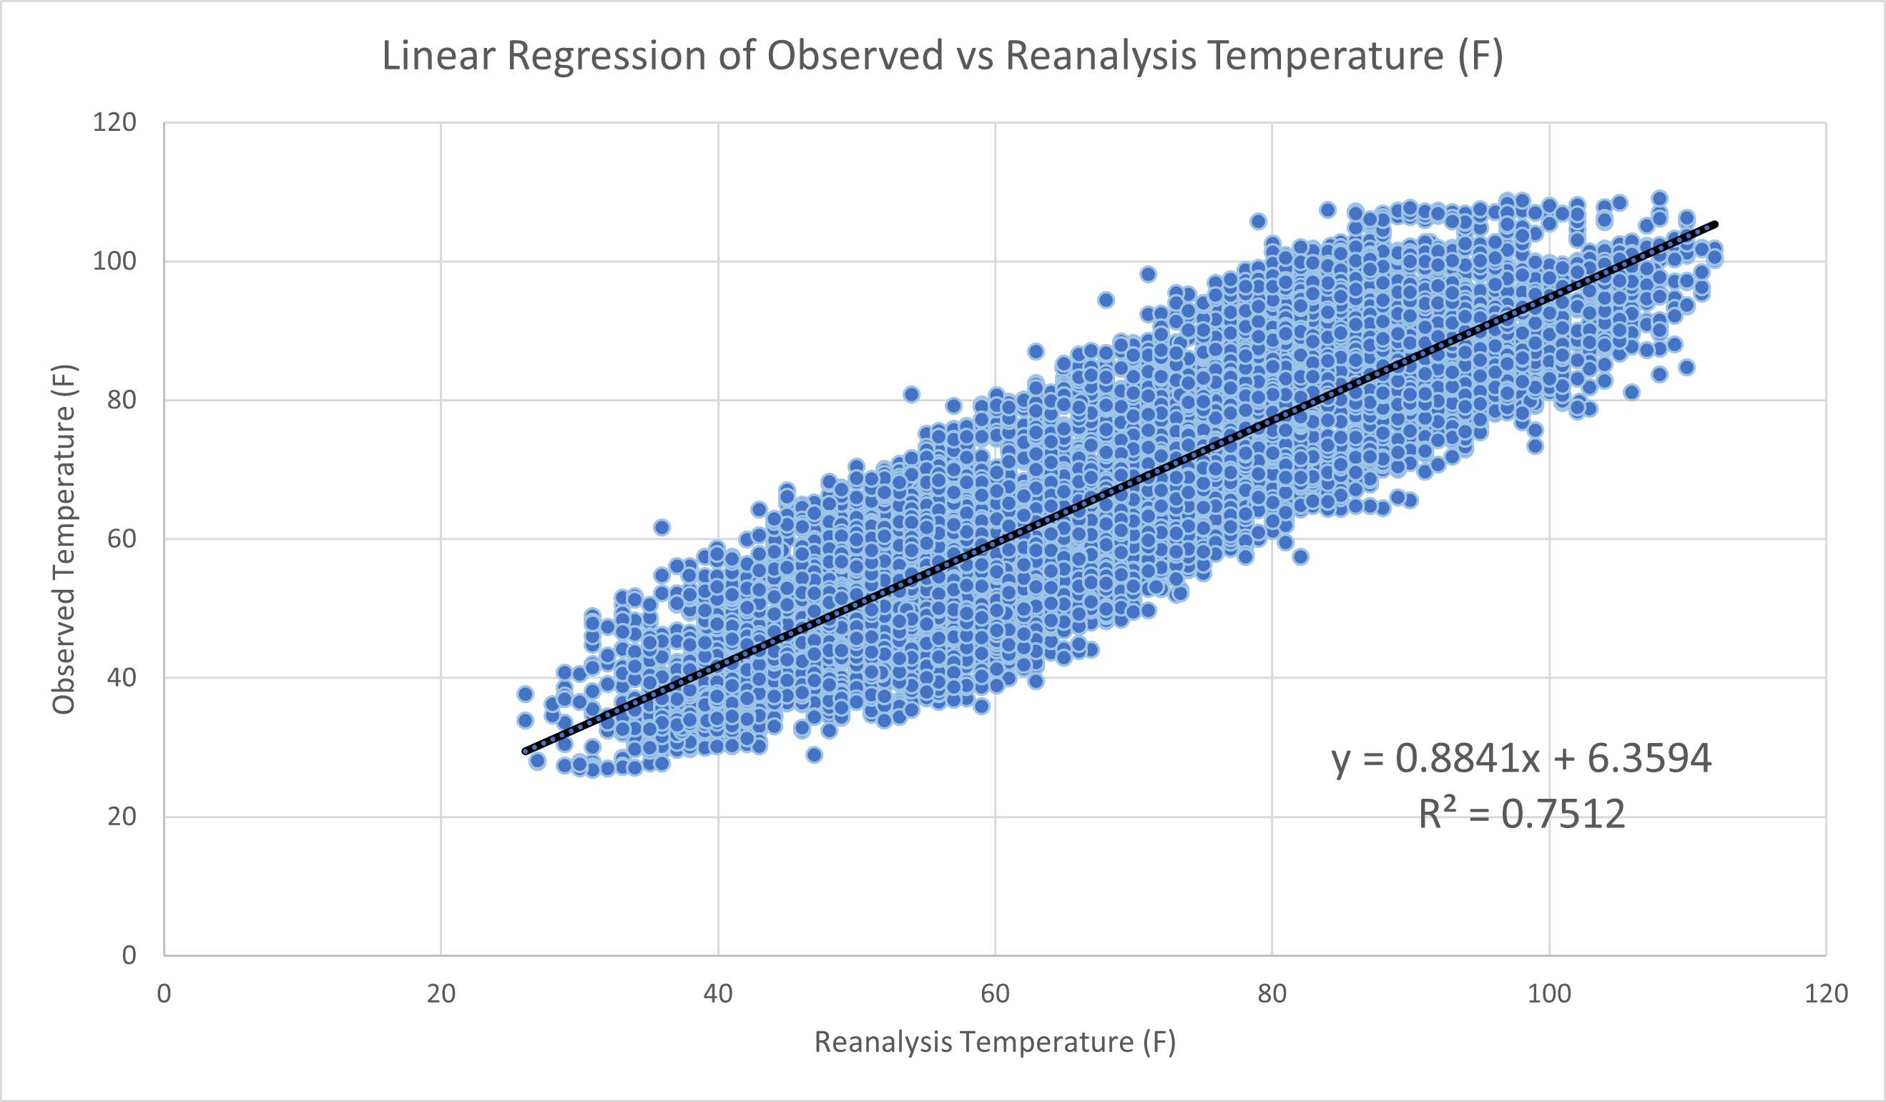
A Case Study: The Onset of the North American Monsoon in 2002
Michael Hodges, mhodges2020@my.fit.edu, Dr. Milla Costa, mcosta@fit.edu
Introduction
Surface Obs. July 16, 2002
Surface Obs. July 17, 2002
Results/Discussion
The North American Monsoon is a direct result of a seasonal change in atmospheric circulation worldwide as a result of the ENSO cycle (Mitchell, et. al 2002).
As summer progresses, a high-pressure system from the Mexican Plateau moves northward into desert southwest and heats the landmass (Barlow, et. al 1998).
The location of this high pressure, combined with the effects of the El Nino/La Nina (ENSO) cycle will be examined for the year of 2002.
A case study of the dates of July 16-17 will be examined to determine the onset of the monsoon in Las Vegas (ID station: KLAS), Nevada.
The winds in the El Nino circulation are driven by the pressure changes which are in turn are caused by the temperature changes.
Surface maps from 16-17 July 02 were used to determine the location of the thermal low in the SW United States.
The thermal low was located just south of Las Vegas, Nevada on 0000 UTC 17 Jul 02 surface observation.
Winds from the south indicated that moisture from the Gulf of California was entering Las Vegas as well as the southwest region.
No precipitation was recorded on 16 Jul 02, but record precipitation was recorded on 17 Jul 02 signaling the arrival of the North American Monsoon in Las Vegas.
ID
ID
Background/Literature Review
The change in water temperature caused by El Nino sets up a thermal low in the Gulf of California and the Eastern Pacific.
This thermal low leads to subsidence (sinking air), which is high pressure. Clockwise rotation from the thermal low brings moisture from the Gulf of California and Eastern Pacific and into the SW United States.
Southwest winds from the circulation associated with the thermal low results in the moist air being orographically lifted by the topography.
This orographic lift will produce significant precipitation on the windward side of the mountains.
There is a relationship between El Nino (ENSO) and above average precipitation in the SW United States.
During El Nino in 2002, a warm pool of water in the Western Pacific moved eastward towards the Central Pacific signifying a moderate El Nino event (Barlow, et. al 1998).
As this warm pool of water moves Eastward towards the west coast of Ecuador/Peru, the convection also moves east. Rising air from convection caused low pressure in the Eastern Pacific.
Circulation in the Pacific Ocean breaks into two circulations (one in the east and another in the west), separated by convection from temperature changes.
Figure 5. Surface Observations for 16 Jul 02 in Las Vegas (ID Station: KLAS), NV at 0000 UTC. Source: NWS Archive.
Figure 8. Surface Observations for 17 Jul 02 in Las Vegas (ID Station: KLAS), NV at 0000 UTC. Source: NWS Archive.
Winds July 16, 2002
Winds July 17, 2002
Conclusion
ENSO SST Data for July 2002
Regional SST-July 2002
The onset of the monsoon in Las Vegas, NV is heavily dependent on the location of the thermal low in the SW United States.
The position of the thermal low prevented the local topography from influencing the influx of moisture into the Las Vegas Valley.
The moderate El Nino event in 2002 was responsible for Las Vegas receiving the most precipitation for the entire year on 17 Jul 02.
Figure 6. Wind direction and speed in Las Vegas for 16 Jul 02 at 0000 UTC. Source: Plymouth State Weather Center.
Figure 9. Wind direction and speed in Las Vegas, NV for 17 Jul 02 at 0000 UTC. Source: Plymouth State Weather Center.
Climatology of Las Vegas, NV
Precipitation
July 16th to 17th 2002
References
Figure 1. ENSO Data indicating worldwide sea surface temperatures averages for the month of July in 2002. Temperatures are in degrees Celsius. Data obtained from ECMWF.
Figure 2. Sea Surface Temperatures average (in Celsius) for the Gulf of California and Eastern Pacific for July 2002. Data obtained from ECMWF.
Mitchell, D. L., Ivanova, D., Rabin, R., Brown, T. J., & Redmond, K. (2002, September 1). Gulf of California sea surface temperatures and the North American Monsoon: Mechanistic implications from observations. AMETSOC. Retrieved April 17, 2023, from https://journals.ametsoc.org/view/journals/clim/15/17/1520-0442_2002_015_2261_gocsst_2.0.co_2.xml
Barlow, M., Nigam, S., & Berbery, E. H. (1998, September 1). Evolution of the north american monsoon system. AMETSOC. Retrieved April 18, 2023, from https://journals.ametsoc.org/view/journals/clim/11/9/1520-0442_1998_011_2238_eotnam_2.0.co_2.xml?tab_body=pdf
Luong, T. M., Castro, C. L., Chang, H.-I., Lahmers, T., Adams, D. K., & Ochoa-Moya, C. A. (2017, September 1). The more extreme nature of North American monsoon precipitation in the Southwestern United States as revealed by a historical climatology of simulated severe weather events. AMETSOC. Retrieved April 18, 2023, from https://journals.ametsoc.org/view/journals/apme/56/9/jamc-d-16-0358.1.xml
Methods/Methodology
Regional Topography
Reanalysis Data
Figure 7. Monthly climate normals for Las Vegas, NV from 1991-2020. Source:
NWS Las Vegas website.
Figure 10. Precipitation values for Las Vegas, NV for 16-17 July 2002 showing record precipitation on July 17th. Source:
NWS Las Vegas website.
Acknowledgements
Figure 3. Regional topography of the Southwest United States detailing the distinct topography of the region. Source: Data obtained from USGS.
Figure 4. Temperature reanalysis data from Harry Reid International Airport in Las Vegas (ID Station: KLAS), NV for the year of 2002. Data obtained from ECMWF.
Thank you to Dr. Milla Costa and Conner Welch for their guidance on this project.

