Slide 1
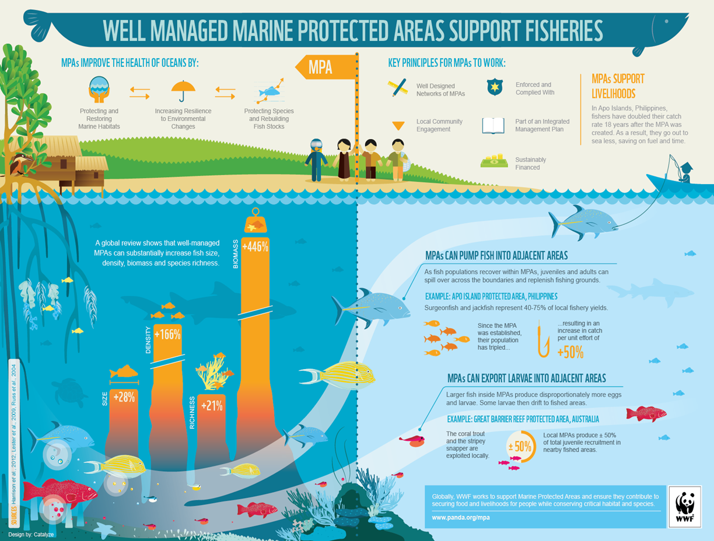
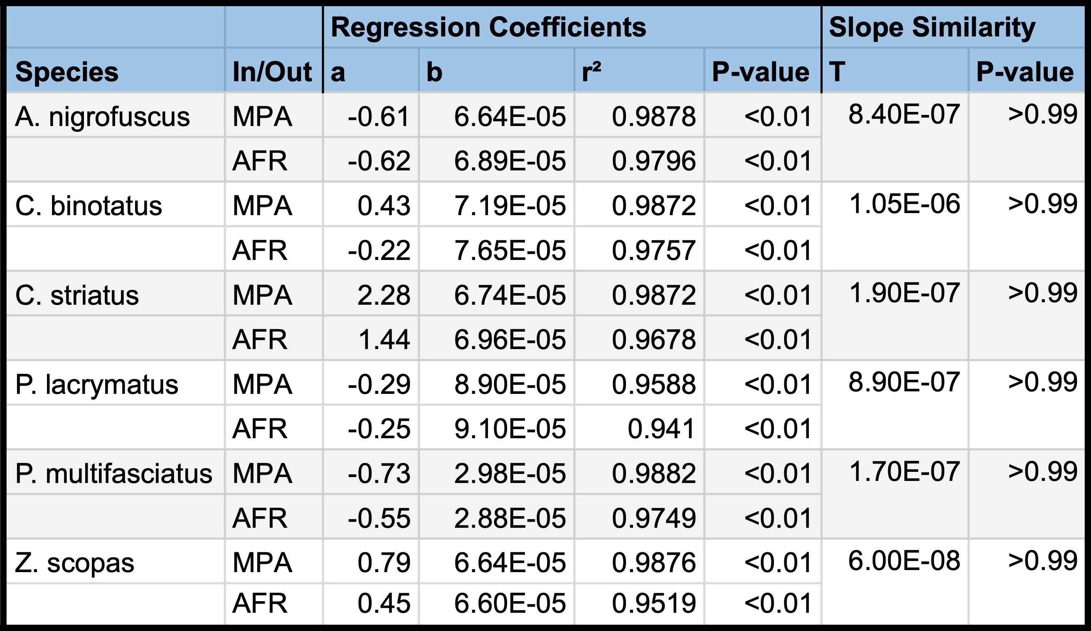
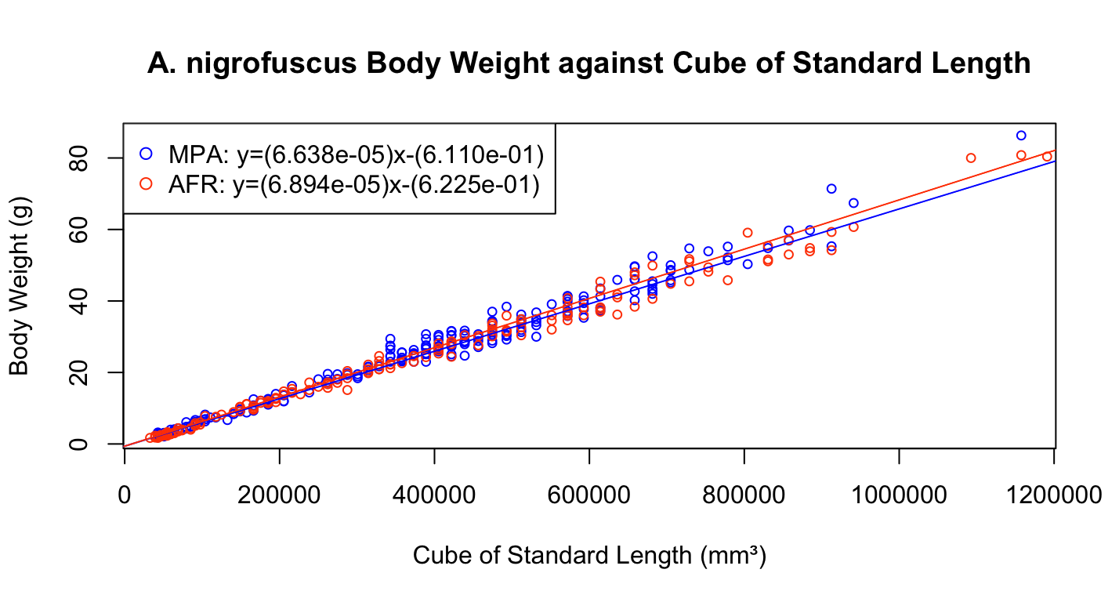
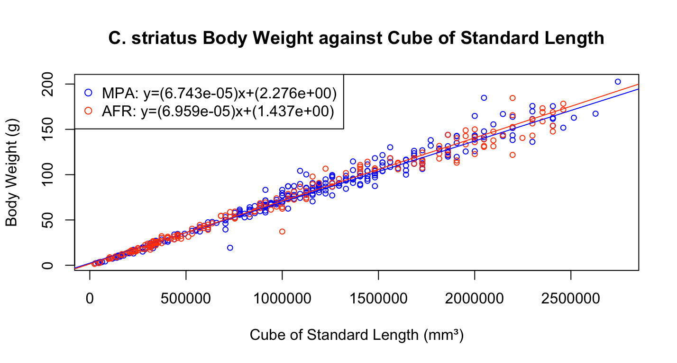
Fished Reefs Benefit from Marine Protected Areas
Nathaniel Isabella, Noel Casanova, Declan O’Leary, Allyah Vega
Faculty Advisor: Dr. Ralph Turingan, Deptartment of Ocean Engineering and Marine Sciences, Florida Institute of Technology
Background and Rationale
Table 1. Statistical comparison of growth coefficients for six fish species between MPAs and AFRs.
Marine protected areas (MPAs) are subsets of traditional fishing grounds that have been closed to fishing as a major component of fisheries management and sustainability programs worldwide. It is hypothesized that MPAs help sustain exploited stocks by either or both mechanisms: (1) larvae spawned in MPAs recruit into the Adjacent Fished Reefs (AFR); and (2) juveniles and adults emigrate from MPAs into AFRs. Evidence show that (1) although fish density is higher in MPAs than in AFRs at a given sampling period, in general, reef-wide fish density either increases or remains stable over time, and (2) large-bodied fish become increasingly abundant in AFRs over time. These results suggest that, over relatively few years of protection, MPAs promote beneficial shifts in fish population structure throughout the entire reef systems rather than simply maintaining stable populations within their borders. In this study we examine two metrics of fish performance (1. Age and Growth, and 2. Condition Factor) to further provide evidence that MPAs benefit AFRs through spill-over mechanisms.
Is there a difference in growth rate and condition factor of fish between MPAs and AFRs?
Research Hypothesis
Growth rate and condition factor of fish are statistically similar between MPAs and AFRs.
Fish Condition Factor
Age and Growth of Fish
Fish Species | Median K in MPA | Median K in AFR
A. nigrofuscus | 5.46 | 5.66
C. binotatus | 6.25 | 6.56
C. striatus | 6.02 | 6.18
P. lacrymatus | 7.42 | 7.71
P. multifasciatus | 2.70 | 2.58
Z. scopas | 5.51 | 5.56
Figure 1. Comparison of A. nigrofuscus’ body weight to the cube of their standard length between MPA and AFR.
Conclusions and Implications
1.Growth rate of fish is statistically similar between MPA and AFR.
2. Fish health (Condition Factor) is statistically similar between MPA and AFR.
Research Question
Acknowledgements
We would like to thank Dr. Robert Fidler and the Fulbright Program for assistance in data collection.
Figure 2. Comparison of C. striatus’ body weight to the cube of their standard length between MPA and AFR.

