Slide 1
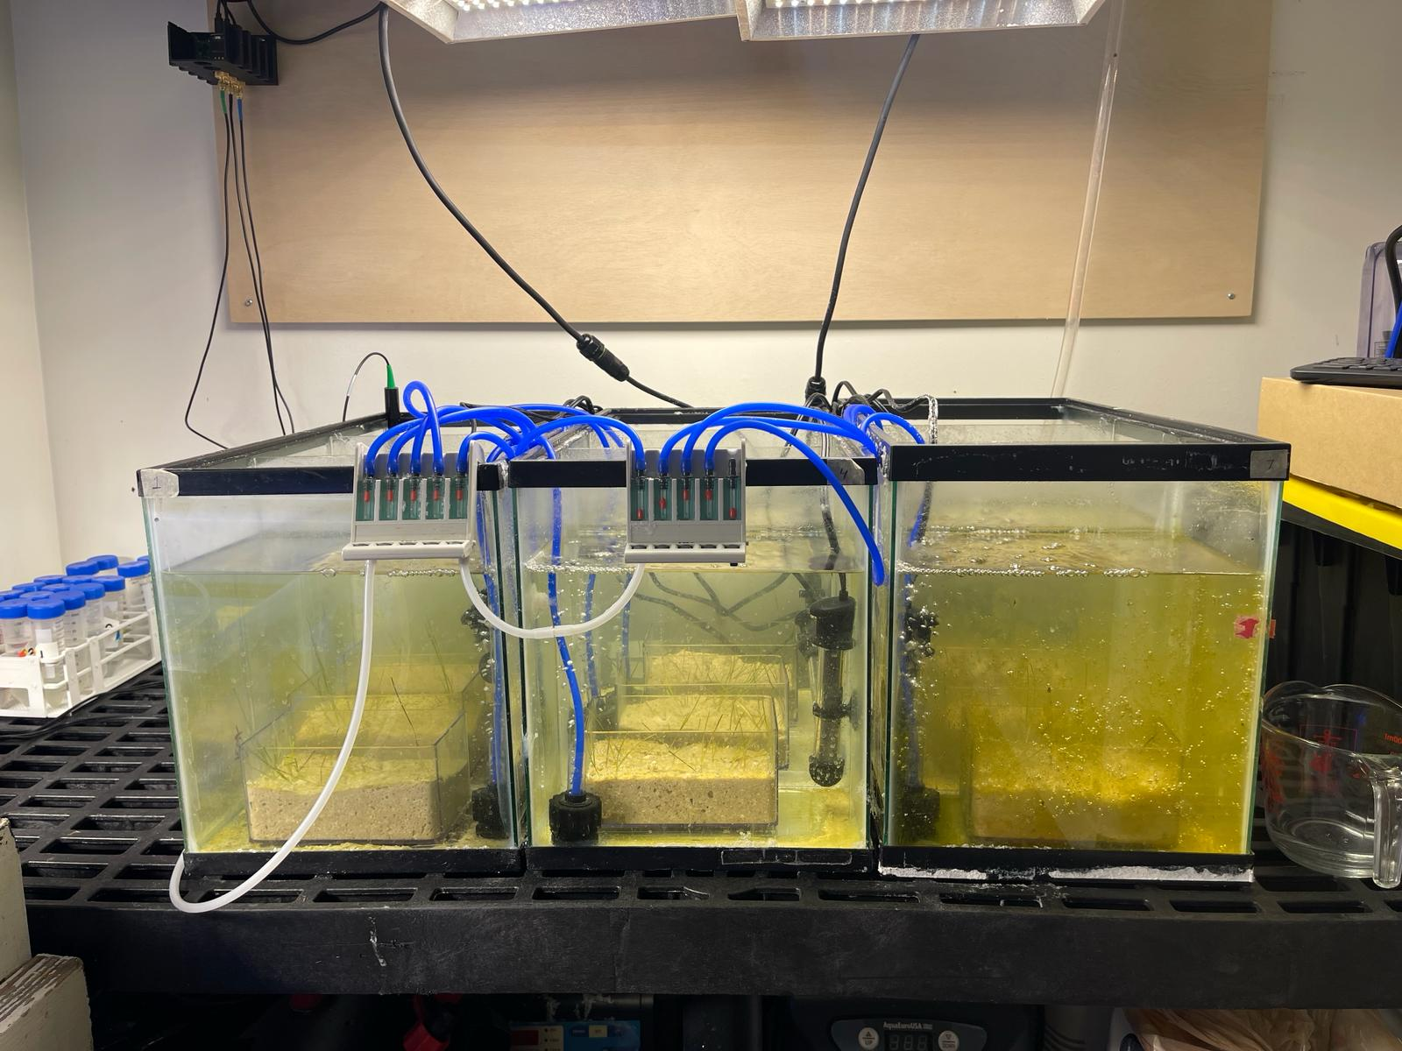
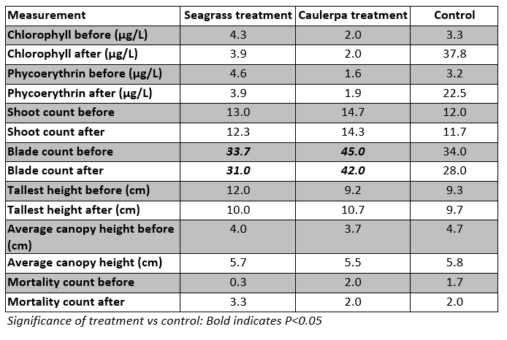
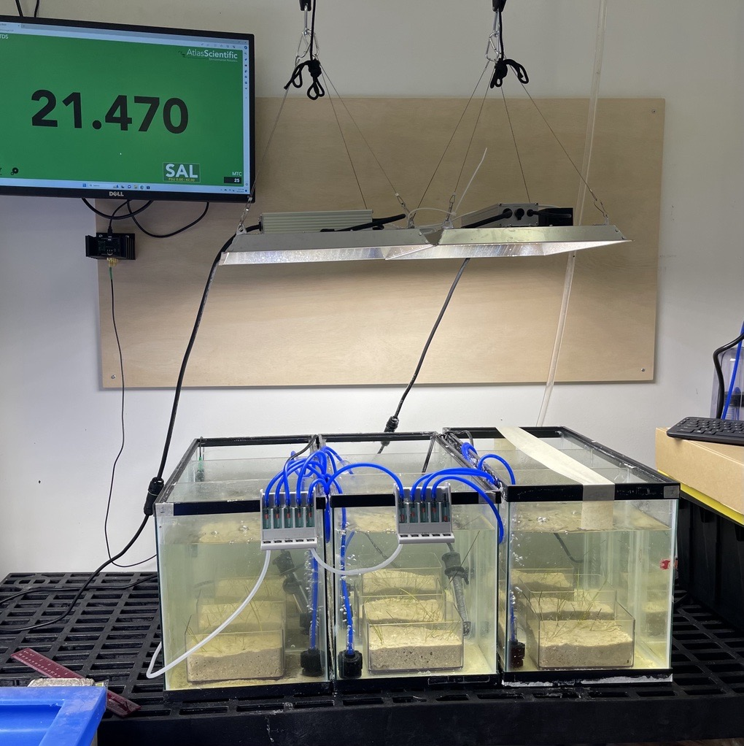
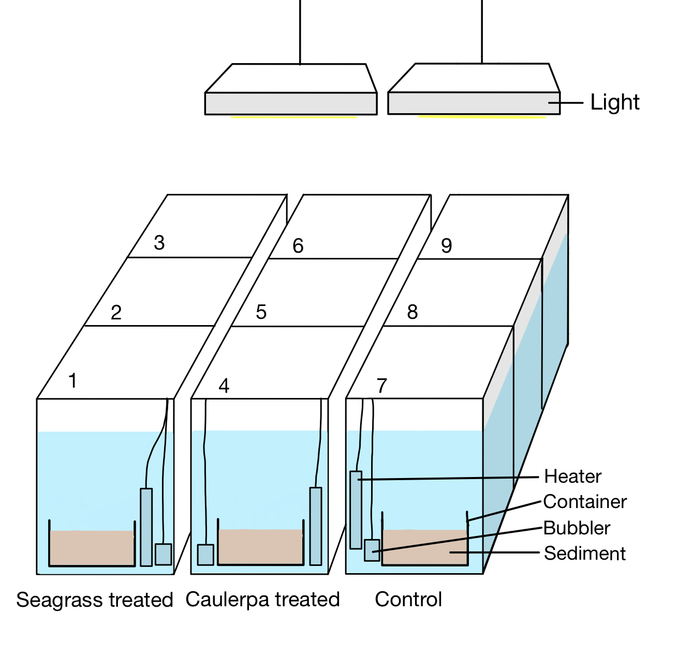
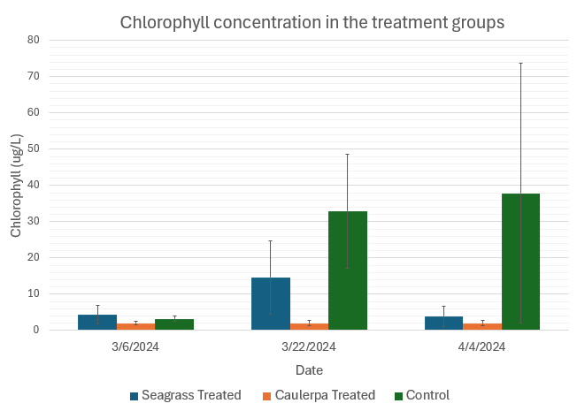
Stressors of Seagrass in the Indian River Lagoon: The effect of Caulerpa prolifera on Halodule wrightii
Alyssa Metivier
Faculty Advisor: Dr. Austin Fox, Dept. of Ocean Engineering and Marine Sciences, Florida Institute of Technology
Background
Halodule wrightii is one of the most abundant seagrass species in the Indian River Lagoon (IRL). Caulerpa species, macroalgae known for their rapid colonization abilities, could potentially outcompete seagrasses disrupting trophic interactions, and impacting marine life. Caulerpenyne, a chemical compound synthesized by Caulerpa species, acts as a potent deterrent against herbivores and is also a potential phytotoxin that can harm marine flora and fauna. The study aimed to determine if chemical signals from Caulerpa prolifera impacted Halodule wrightii growth in the IRL.
Methods
Figures 1 & 2: Tank set up and Treatment schematic.
Three tanks were arranged, each partitioned into 3 sections to create 9 mesocosms. Mesocosms 1-3 received treatment with 0.9 grams of liquified H.wrightii slurry and 4-6 were treated with 0.9 grams of liquified C.prolifera slurry. Mesocosms 7-9 served as control units. Light penetration was monitored using an Onset HOBO MX2202 Pendant MX Light Data Logger, when the slurries were added to equalize turbidity.
Chlorophyll concentration and Phycoerythrin concentration in the water were recorded before, during and after the study. Measurements including shoot and blade count, mortality count, tallest blade length, average canopy height and color were collected over several weeks. The procedure was replicated with adjusted concentrations to match initial turbidity observations, ensuring consistency in measurement.
Results & Discussion
Table 1: Measurements for each treatment group before and after 1 month
Statistically, there was no significant difference between Caulerpa-treated and Control groups for percent survival, shoot count, mortality count, tallest blade height or average canopy height (p >0.05). However, Chlorophyll concentrations (μg/L) were much higher in the Control groups as compared to the treated groups (figure 4).
Figure 3: Average Chlorophyll concentration
The study found varied algae levels: high in Control groups, consistency in Caulerpa-treated groups, fluctuating levels in Seagrass- treated groups.
Figure 4: Treatment tanks during week 3
Conclusions & Future Work
There was no significant difference in survival percent (%) between the Caulerpa-treated and Control groups, indicating that the chemical signals from C.profilera might not solely act as a stressor to H.wrightii. However, Chlorophyll concentrations (μg/L) were much higher in the Control groups as compared to the treated groups. Moreover, the Caulerpa-treated group showcased limited algae growth throughout the study, suggesting Caulerpa’s potential effectiveness in managing algae. Future investigations will delve into the potential of C.profilera in its capacity to mitigate algae overgrowth and disturbances in the Indian River Lagoon. Additionally, this study shows promise that Caulerpa may benefit seagrass thus warranting further research.
Acknowledgements
Thank you is extended to Dr. Austin Fox for his invaluable guidance and advising throughout the project. Gratitude is also extended to Sean Crowley for his dedicated assistance. Thank you to our partners at Restore our Shores and Laura Lee Thompson for their assistance with obtaining C.profilera and H.wrightii for this study.

