Slide 1
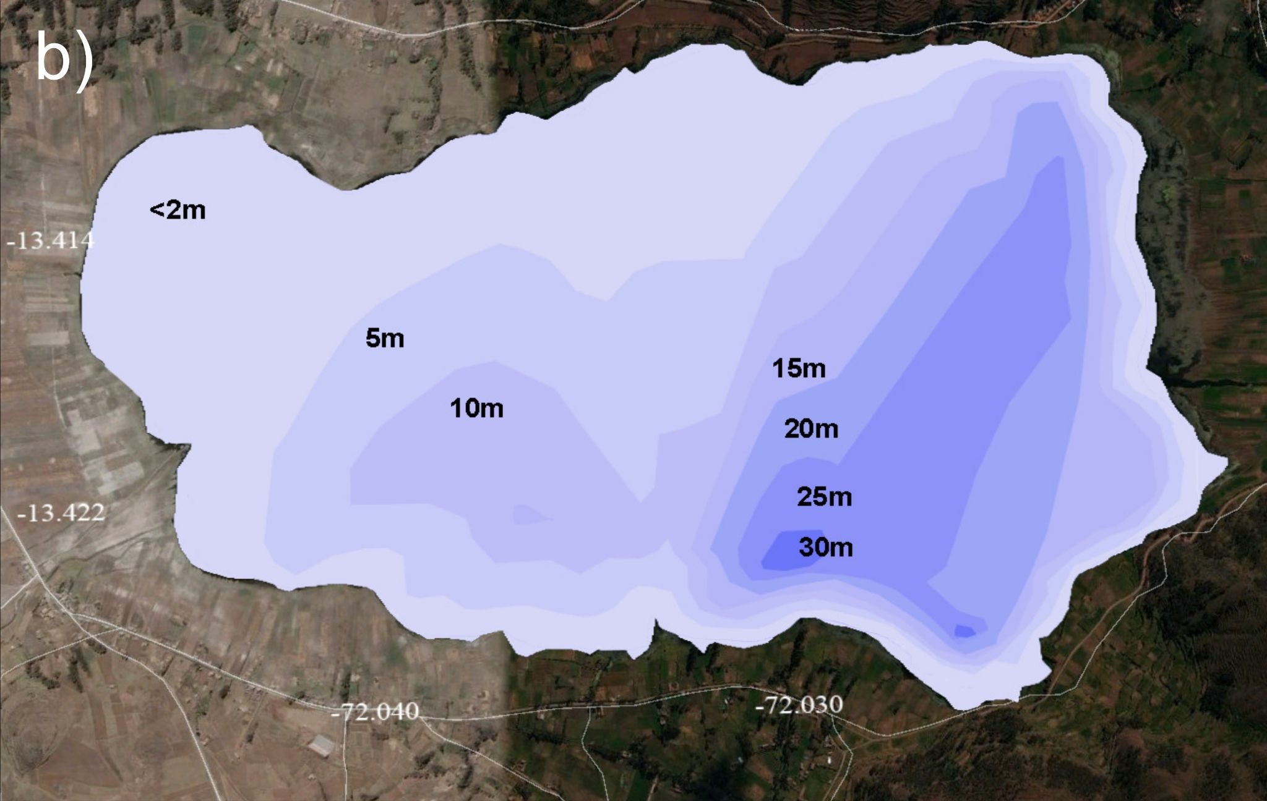
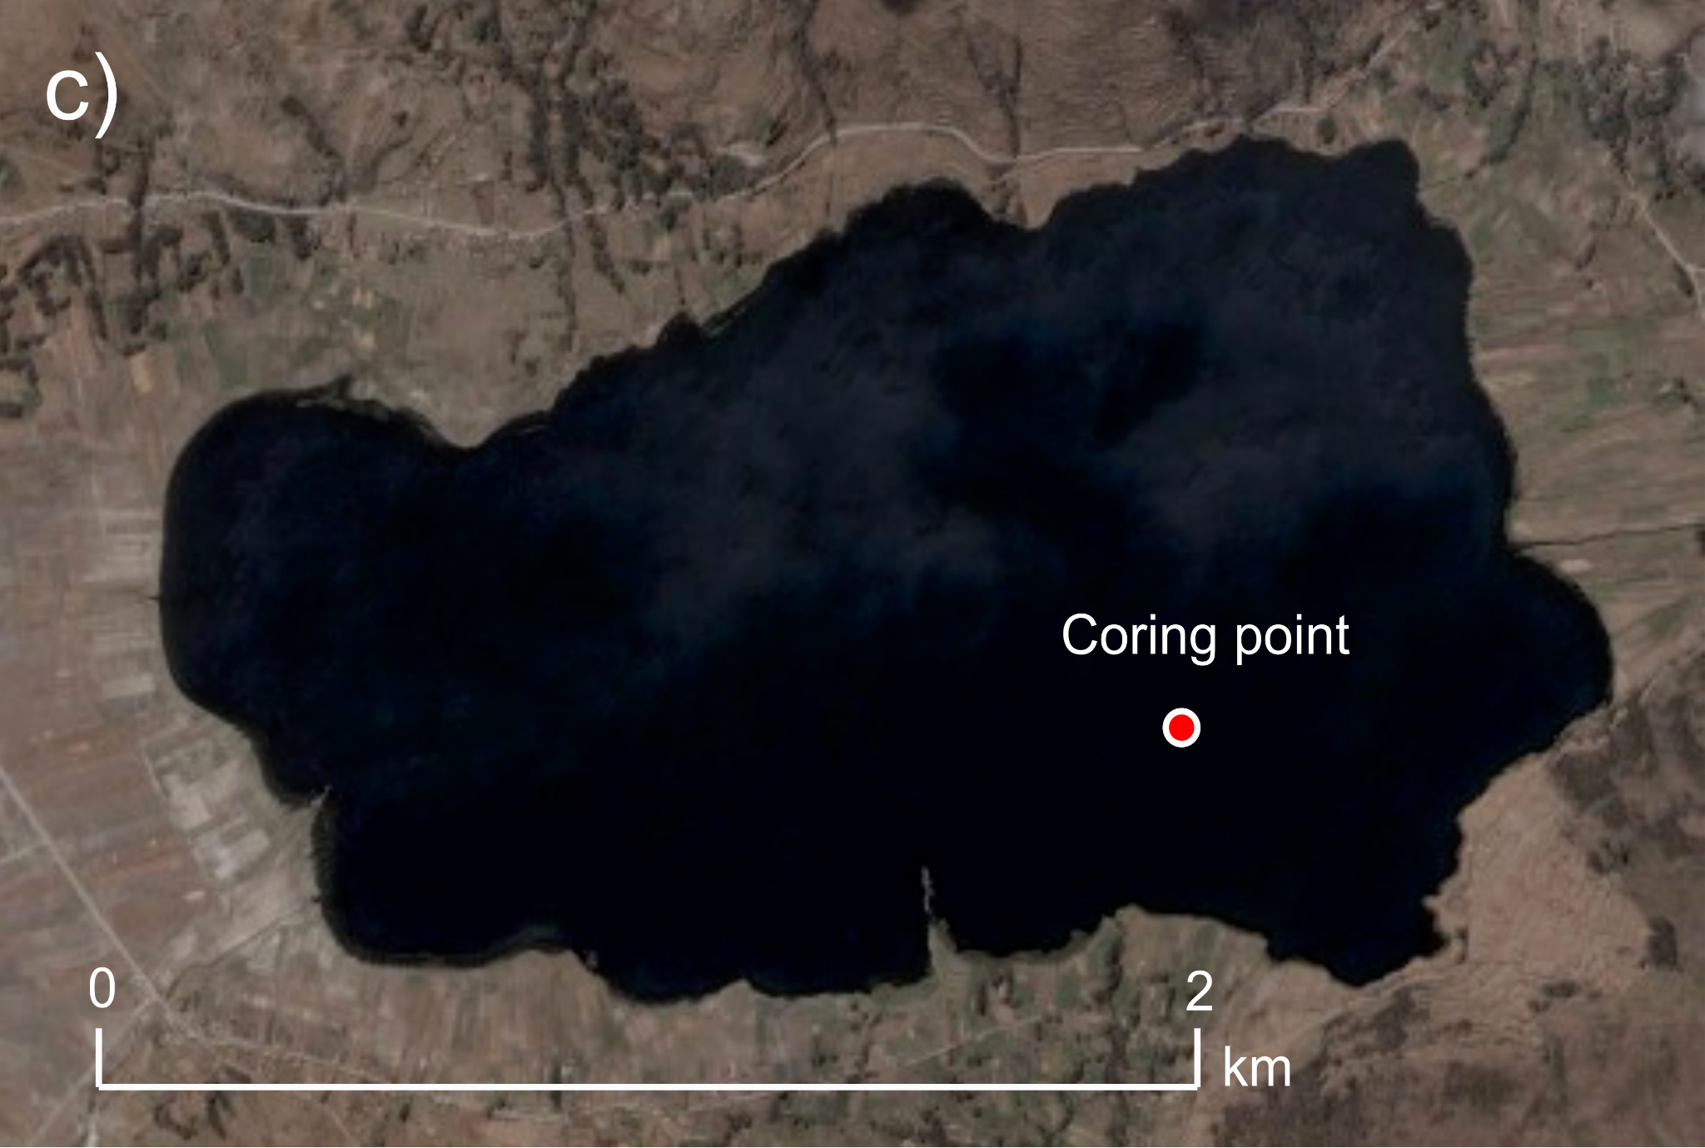
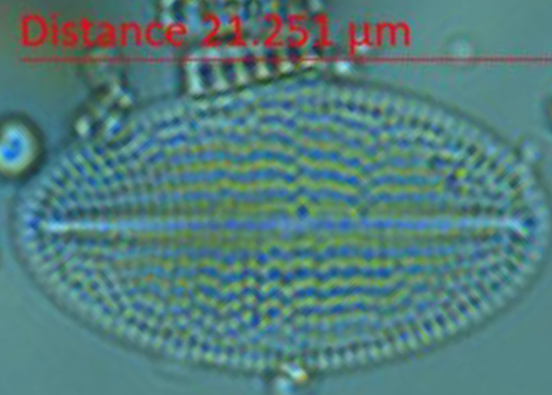
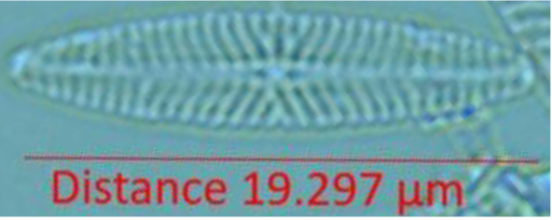
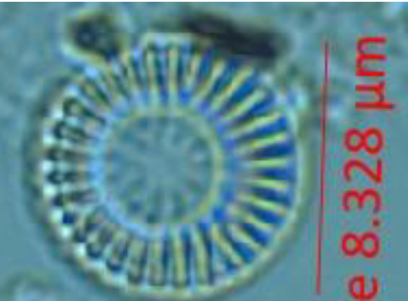
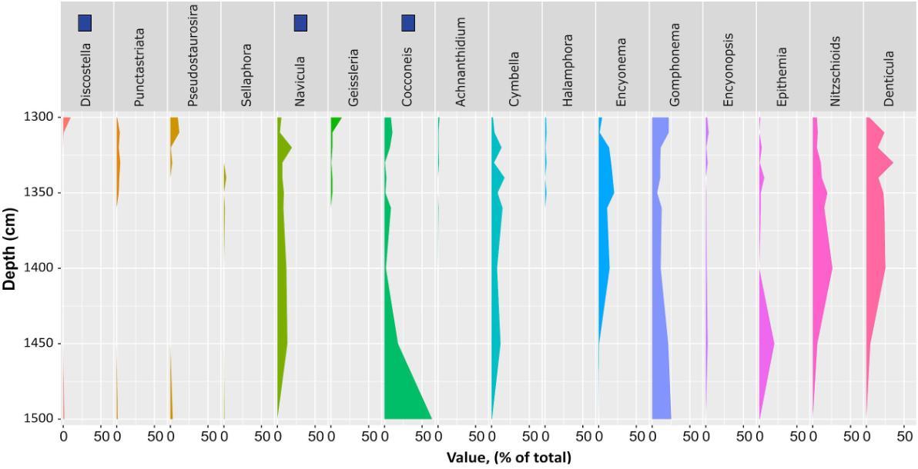
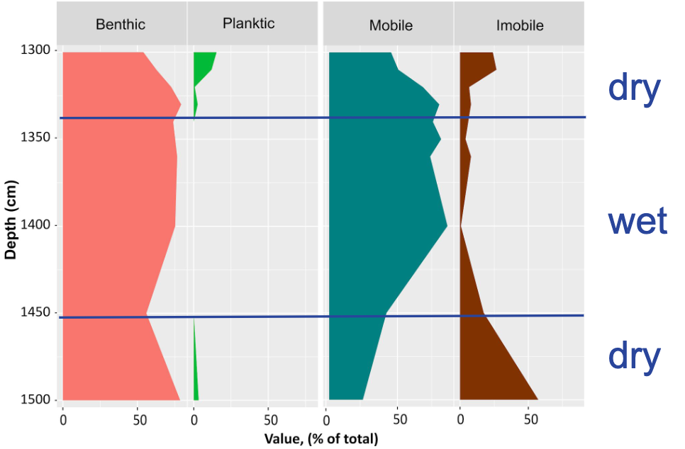
Characterizing the Last Interglacial:
A Survey of Diatom Populations in a Highland Andean Lake
Rodrigo Sandoval Sanchez
Faculty Advisor: Dr. Mark B. Bush, Dept. of Ocean Engineering and Marine Sciences, Florida Institute of Technology
Background
For the last ~2.5 Myr, Earth has undergone periods of glaciation.
Between glaciation periods there exist warmer periods called interglacials.
Last interglacial is calculated to have been ca. 115 - 130 kyr ago, corresponding to 1350 cm to 1500 cm in this lake.
Changes in climate and vegetation are analyzed via proxies such as pollen, charcoal, or diatoms archived in the sediments of lakes.
Diatoms are algae whose fossils are well-preserved in lake sediment.
Diatoms tell us about lake depth, salinity, and pH.
Diatoms are highly specific about their habitats depending on the species and genus.
Analyzing the population distribution found in a particular lake can tell us about the habitats that were available at different times in the lake’s history.
Lake Piuray - Core Location & Bathymetry
Fig. 1: Bathymetry of Lake Piuray. Darker regions show deeper points in the lake at time of coring.
Fig. 2: Location of the coring point. Referring back to Fig. 1, note that the coring location is at roughly 25 m.
Preliminary Results - Images
From a wide array of species, below are examples of the diatom frustules (shells) that were imaged:
Fig. 3: Cocconeis placentula
(Benthic, Im)
Fig. 4: Navicula staffordiae
(Benthic, M)
Fig. 5: Discostella stelligera
(Planktic, Im)
Preliminary Results - Data
Methodology
The sediment core (24 m) was extracted from Lake Piuray, Peru. The core was radiocarbon (¹⁴C) dated to infer the sediment age.
Once in lab, samples of ~1g were taken every 10 cm, beginning at 1300 cm, ending at 1500 cm.
Samples were prepared in accordance to the procedure laid out in Battarbee (1986), to eliminate silicates and carbonates from soil and purify diatom content.
Each sample was analyzed for taxonomic classifications of diatoms under a light microscope. The sample size is set at 150.
After the population of a particular sample was tallied, the taxons were categorized by ecological niche.
Fig. 4: Genera of Diatoms vs. Depth; blue squares are those pictured above
Fig. 5: Habitat preference of diatoms vs. Depth; blue lines indicate transition
The preliminary results exhibit compositional changes in the diatom population between the upper, central and lower sections of the analyzed portion of the core.
Top: increase in planktic and immobile, suggests shallow water body.
Middle: benthic and mobile, suggesting a deepening of the lake.
Bottom: return to top properties.
The above is preliminary data for the lake (Piuray) properties, climatic conditions, and diatom compositions that are found in this portion of the core.
Future Work
Increase sample size for existing samples
Fill in gaps in resolution between 1360 cm and 1500 cm
Continue work from current position to end of core
References
[1] Battarbee, R.W., 1986. Handbook of Holocene Palaeoecology and Palaeohydrology.
[2] Fritz, S. C., et al.(2012). Evolution of the Lake Titicaca basin and its diatom flora over the last~ 370,000 years. Palaeogeography, Palaeoclimatology, Palaeoecology.
[3] Spaulding et al. 2021. Diatoms.org

