Slide 1
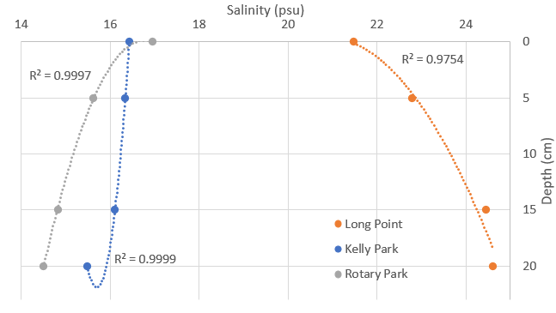
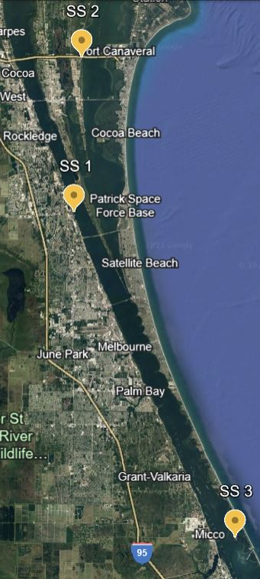
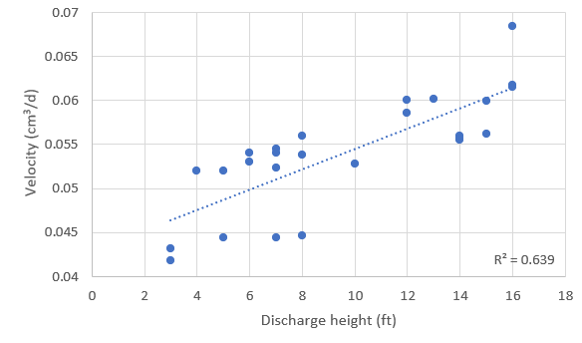
Submerged Groundwater Discharge Diffusion in the Indian River Lagoon, FL
Noor Daraiseh
Faculty Advisor: Dr. Austin L. Fox, Dept. of OEMS, Florida Institute of Technology
INTRODUCTION
RESULTS
Submerged groundwater within estuarine environments contributes nutrients and salinity to the water column by discharge. (Pain et al. 2021). Due to the large variation of salinity in estuaries, added salinity from groundwater discharge is significant. To determine the speed of diffusion through the water column, the conductivity and velocity of the discharge was identified. The measurement of groundwater
seepage in the Indian River
Lagoon aided in determining
lasting affects groundwater has
within the water column.
When observing SGD, it is expected that the porewater becomes fresher as depth increases due to the salinity diffusing into the water column (Martin et al. 2006). This trend was observed at Kelly and Rotary Park, while the opposite effect was experienced at Long Point (Fig. 2). Each site had a significant relationship between salinity and the change of depth, even with Long Point showing a reversed trend. Long Point also had the largest amount of variance between each depth point.
Figure 2. Depth profiles of salinity at each site. Each point represents average salinity at depth.
Objectives
To measure the conductivity of groundwater over time and obtaining the velocity of the to determine the effect of diffusion on the water column, and
determine how freshwater discharge affects salinity uptake.
The speed of the diffusion of SGD into the water column was calculated for each sample group at each site. The velocities have a slight correlation with the discharge height at each site but is not statistically significant. At Long Point, the average velocities were higher than the other two sites but were diffusing in the opposite direction. The discharge speeds fell between 0.04 and 0.07 cm³/d within the first 20cm of the sediment at each site. This is slower than the proposed speed by Martin et al. (2007), but further sampling in deeper depths can further conclude the velocity speeds being seen.
METHODS
Figure 1. Map of three sites: Rotary Park (1), Kelly Park (2), Long Point (3).
Figure 3. Scatter of average velocity (absolute value) in relation to the discharge
height at all three sites.
WORKS CITED
Three sites were included in measuring submerged groundwater discharge (SGD): Kelly Park, Long Point, and Rotary Park (Fig. 1). Water samples were collected at the water column and at three consecutive depths below the column. The samples were then measured for conductivity and salinity. using a conductivity meter.
Vertical profiles of salinity as a function of depth were created for each site. To determine the velocity of SGD, Equation 5 of Martin et al.’s paper (2007) was used.
The variance of velocities at each site were determined. In addition, stream flow and water discharge levels were compared to each site to determine changes in SGD as a function of these changing factors.
CONCLUSION
The SGD movement trends reflect previous studies at Kelly and Rotary parks, located on the inland side of the lagoon. The SGD trends at Long Point reflected opposite movement. Freshwater discharge at Long Point was double the amount at Kelly and Rotary parks, creating a change in diffusion at Long Point, as the water column was taking in high amounts of freshwater discharge.
Li, Y.-H. and Gregory, S. (1974) Diffusion of Ions in Sea Water and in Deep-Sea Sediments. Geochimicaet Cosmochimica Acta, 38, 703-714. http://dx.doi.org/10.1016/0016-7037(74)90145-8
Martin, Jonathan & Cable, Jaye & Smith, Christopher & Roy, Moutusi & Cherrier, Jennifer. (2007). Magnitudes of submarine groundwater discharge from marine and terrestrial sources: Indian River Lagoon, Florida. Water Resour. Res. 43. 10.1029/2006WR005266.
Pain, A. J., Martin, J. B., & Young, C. R. (2021). Biogeochemical and Hydrological Drivers of Heterogeneous Nutrient Exports From Subterranean Estuaries. Frontiers in Marine Science, 8, 699916. https://doi.org/10.3389/fmars.2021.699916
Martin, J. B., J. E. Cable, J. Jaeger, K. Hartl, and C. G. Smith (2006), Thermal and chemical evidence for rapid water exchange across the sediment-water interface by bioirrigation in the Indian River Lagoon, Florida, Limnol. Oceanogr., 51, 1332–1341.
AKNOWLEDGEMENTS
I would like to thank Dr. Austin Fox for his guidance and support with this project. I’d also like to thank Bri Forte and the Lagoon Quest Team at Brevard Zoo for introducing the sites to the project and sampling. Finally, I would like to thank Chris Rowell in the Physics Department for assistance in calculating and solving the velocity equations.
Figure 4. Discharge height in feet at Long Point (top line) and Kelly/Rotary Park (bottom line) over a six month
period From November 1st to April 1st, 2024.

