Slide 1
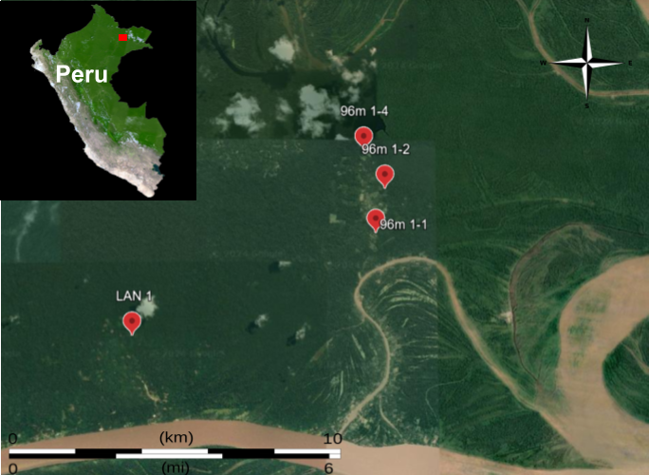
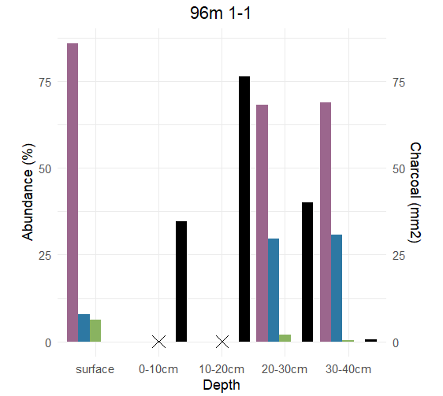
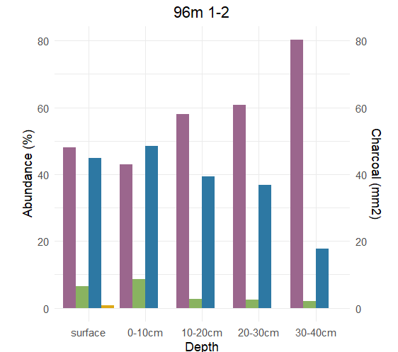
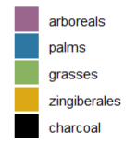
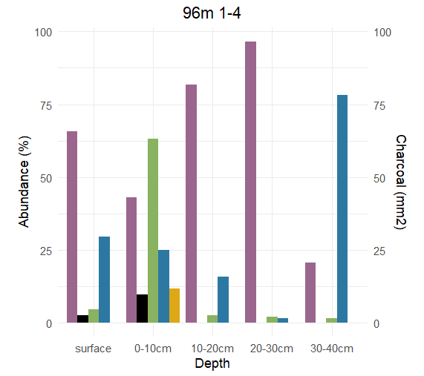
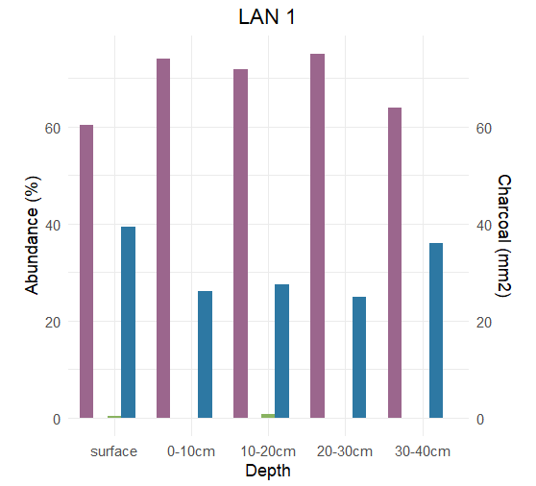
Modern Human Influence on Forest Dynamics in Northwestern Amazonia
Isabel Bennett
Faculty Advisors: Dr. Mark Bush and Dr. Austin Fox, Dept. of Ocean Engineering and Marine Science, Florida Institute of Technology
Introduction
Discussion
The Amazon rainforest plays a crucial role as a global carbon sink, processing carbon at up to twice the rate of anthropogenic fossil fuel emissions in 2009¹.
Changes in Amazonian forest dynamics could therefore substantially affect the concentration of atmospheric CO2 and thus the rate of climate change itself¹.
Recent studies suggest a decline in its carbon sequestration capacity, with human disturbance possibly being a factor².
This study aims to assess the extent of human disturbance in Northwestern Amazonia using phytolith and charcoal analysis.
Phytolith and charcoal analysis can offer insights into vegetation diversity and disturbance history as well as human influence in tropical forests³.
Charcoal presence in sites 96m 1-1 and 96m 1-4 suggests human activity, as humans are the predominant cause of fire in modern Amazonia⁵.
The prevalence of palm and grass phytoliths, coupled with a decline in arboreal phytoliths, further supports the inference of human disturbance, as they are predominantly early successional taxa³.
The pattern of disturbance found in this data signifies a predominant composition of new growth forest, which sequester less carbon compared to old growth forests.
This suggests that human disturbance likely contributes to the diminished carbon uptake in Amazonia. However, a comprehensive evaluation of human influence on carbon sequestration across various regions of Amazonia is warranted for a more nuanced understanding.
Figure 1: Sampling locations in Yana Mono Island, Peru
Phytolith and Charcoal Abundance vs Depth
Methods
Four 40cm long soil cores were taken from Yana Mono island, Peru (figure 1).
Phytolith and charcoal samples were taken in 10cm intervals throughout the core.
Samples were analyzed for phytolith and charcoal presence using standard protocols⁴.
References:
Figure 2: phytolith and charcoal abundance vs depth bar plots for all sites
1. Phillips, O. L., Aragão Luiz E., Lewis, S. L., Fisher, J. B., Lloyd, J., López-González Gabriela, Malhi, Y., Monteagudo, A., Peacock, J., Quesada, C. A., van der Heijden, G., Almeida, S., Amaral Iêda, Arroyo, L., Aymard, G., Baker, T. R., Bánki Olaf, Blanc, L., Bonal, D., … Torres-Lezama, A. (2009). Drought sensitivity of the amazon rainforest. Science, 323(5919), 1344–1347.
2. Brienen, R. J., Phillips, O. L., Feldpausch, T. R., Gloor, E., Baker, T. R., Lloyd, J., Lopez-Gonzalez, G., Monteagudo-Mendoza, A., Malhi, Y., Lewis, S. L., Vásquez Martinez, R., Alexiades, M., Álvarez Dávila, E., Alvarez-Loayza, P., Andrade, A., Aragão, L. E., Araujo-Murakami, A., Arets, E. J., Arroyo, L., … Zagt, R. J. (2015). Long-term decline of the Amazon Carbon Sink. Nature, 519(7543), 344–348. https://doi.org/10.1038/nature14283
3. McMichael, C. H., Piperno, D. R., Bush, M. B., Silman, M. R., Zimmerman, A. R., Raczka, M. F., & Lobato, L. C. (2012). Sparse Pre-Columbian human habitation in Western Amazonia. Science, 336(6087), 1429–1431. https://doi.org/10.1126/science.1219982
4. D. R. Piperno, Phytoliths: A Comprehensive Guide for Archaeologists and Paleoecologists (Altamira, Lanham, MD, 2006).
5. Bush, M. B., McMichael, C. H., Piperno, D. R., Silman, M. R., Barlow, J., Peres, C. A., Power, M., & Palace, M. W. (2015). Anthropogenic influence on Amazonian forests in pre‐history: An ecological perspective. Journal of Biogeography, 42(12), 2277–2288. https://doi.org/10.1111/jbi.12638

