Slide 1
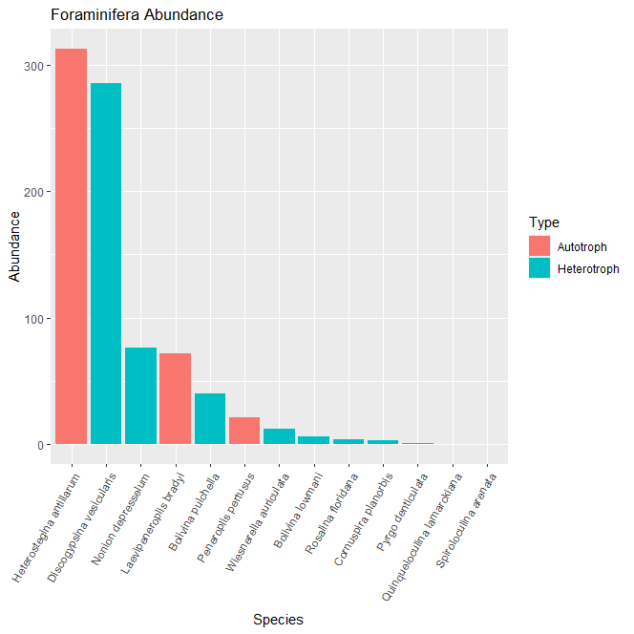
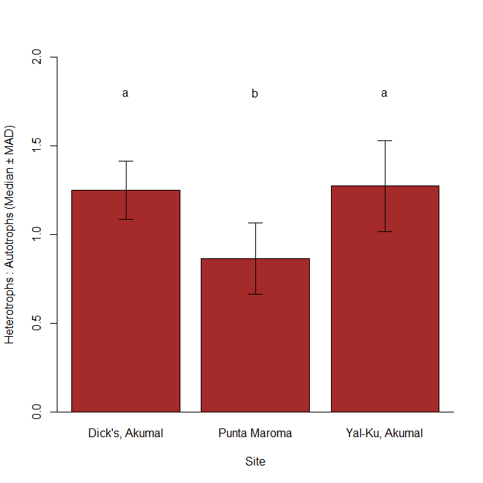
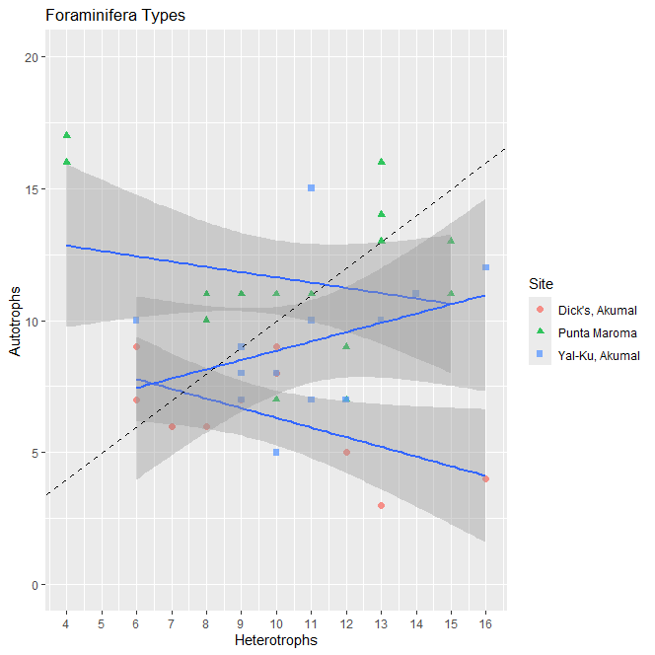
The Balance of Heterotrophic and Autotrophic Foraminifera
Abby Swierz
Faculty Advisor: Dr. Richard B. Aronson, Dept. of Ocean Engineering and Marine Sciences, Florida Institute of Technology
Abstract
Results
Foraminifera, or forams, are single-celled protists with multi-chambered shells. Heterotrophic forams, which consume bacteria, dominate in more nutrient-rich habitats, whereas autotrophic forams with symbiotic algae dominate in more nutrient-deficient habitats. This study tests predictions of the balance of functional types under different presumed nutrient conditions. It was hypothesized there would be more heterotrophs than autotrophs in the Yucanán Peninsula. Two locations, Akumal and Punta Maroma, were studied, with sites established within locations. Forams were sampled at each site. Location was expected to play a larger role than site, since Akumal is in an area that is more nutrient-rich. The most common foram species was actually an autotroph, Heterostegina antillarum, rather than a heterotroph, and the ratio of functional groups varied more by site than by location.
Foraminifera are good indicators by showing sediment quality, pollution, and water quality (A’ziz 2021). This study explores the variability across spatial scales of the balance between heterotrophs and autotrophs. Heterotrophic forams predominate more nutrient-rich environments due to the increased bacteria abundance (Hallock 1999).
Forty-three samples were collected from coral reefs along the Yucatán Peninsula in a hierarchical design (Fig. 1). For each sample, 300 random grains were counted and identified using a dissecting microscope.
Figure 1: Experimental Design. This shows which location, site, and transect go with each sample.
The species-abundance curve is shown in Fig. 2. Functional groups varied by site rather than location (Fig. 3). Ratios of the two functional groups, heterotrophs and autotrophs, again varied by site (Fig. 4).
Figure 2: Foraminiferal Abundance. Species-abundance curve is colored by functional group.
Introduction
Figure 4: One Way ANOVA on Functional Group Ratios. Letters above the bars indicate significant differences.
Conclusion
Heterotrophic Foraminifera were more abundant than autotrophs at the three sites, but the most common species was Heterostegina antillarum, an autotroph (Fig. 2). The ratio of heterotrophs to autotrophs varied more among sites than among locations (Figs. 3 and 4). This indicates that foraminiferal assemblages respond to environmental variability at a small scale.
Thanks to Anna Barcala, Victor Rodriguez Ruano, and Angelica Zamora-Duran for advice and assistance.
A’ziz, A. N. A. et al. “Reef Foraminifera as Bioindicators of Coral Reef Health In Southern South China Sea.” Nature News, Nature Publishing Group, 26 Apr. 2021.
Hallock, P. “Symbiont-Bearing Foraminifera.” SpringerLink, Springer Netherlands, 1 Jan. 1999.
Methods
Acknowledgments
References
Figure 3: Foraminiferal Functional Groups by Site. This shows the abundance of the two functional groups in relation to each of the three sites.

