Slide 1
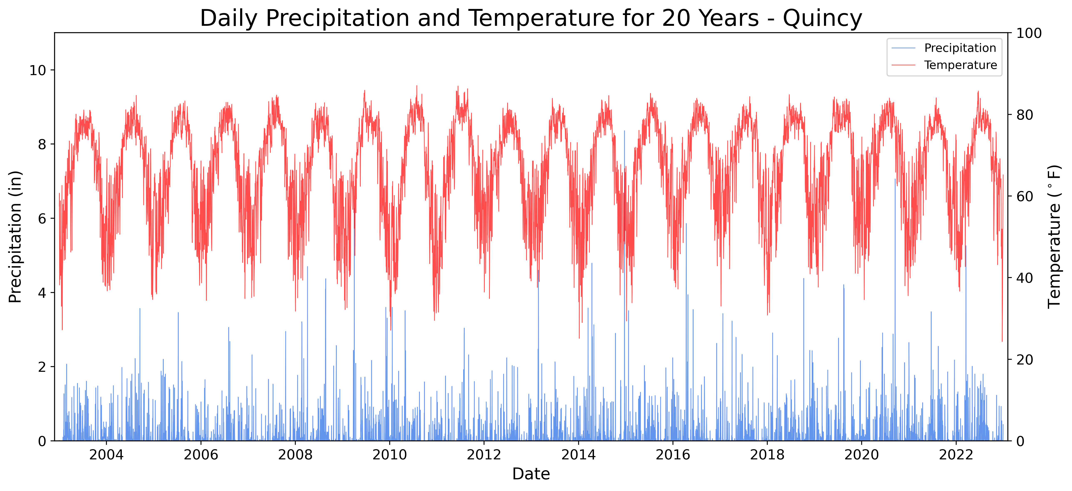
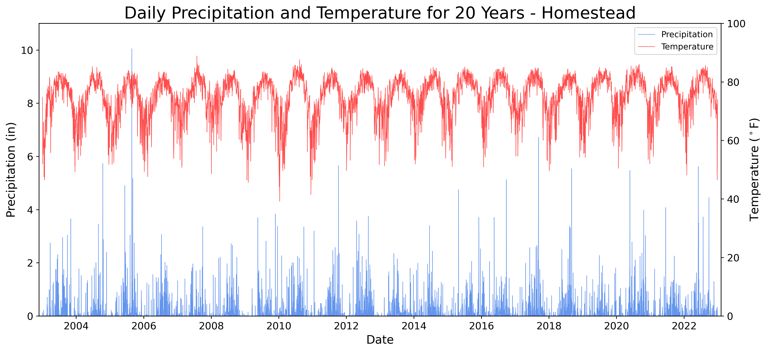
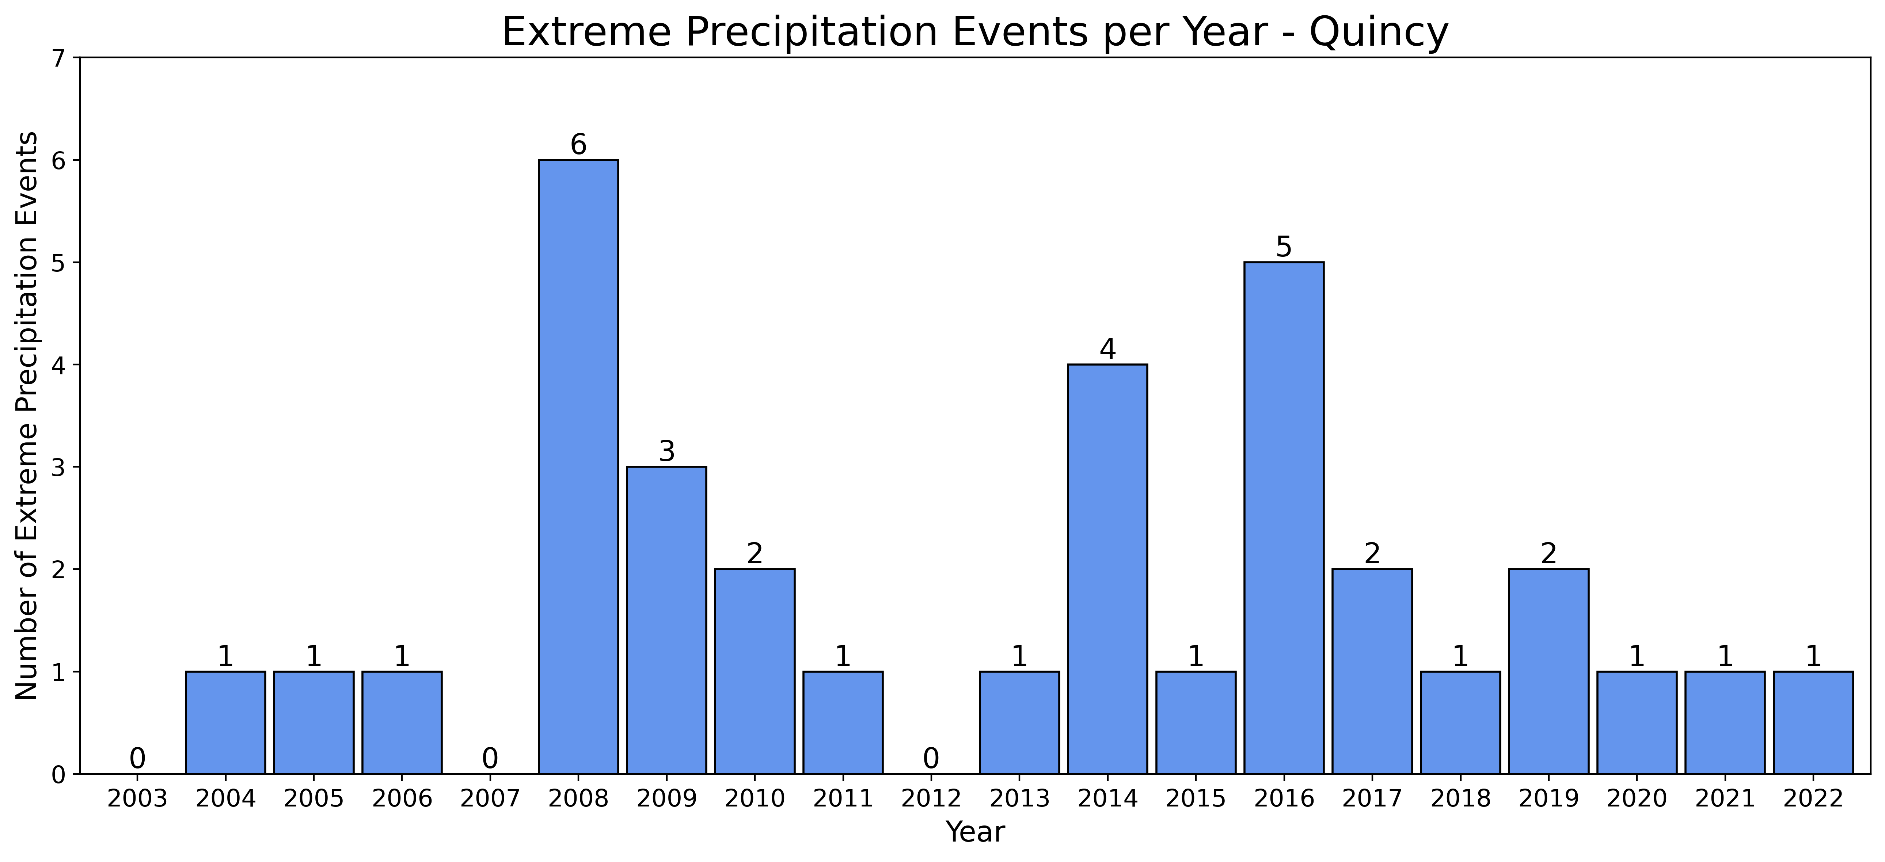
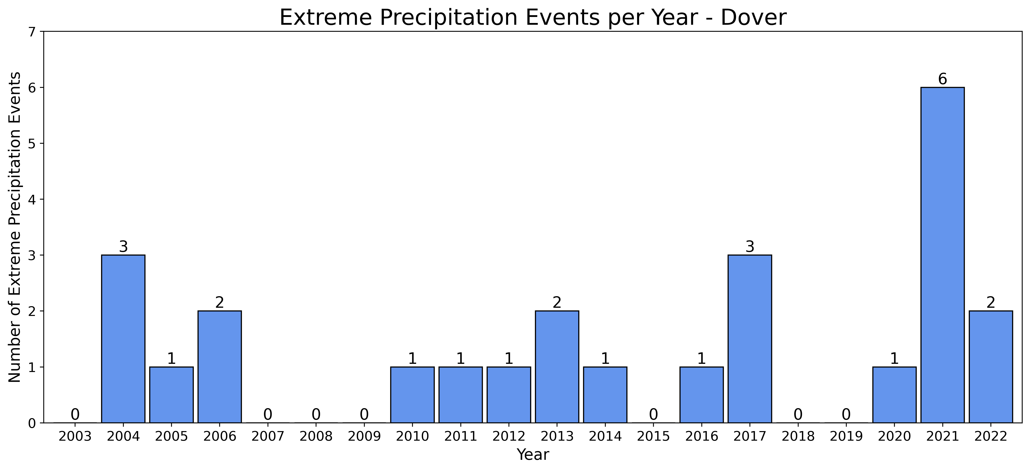
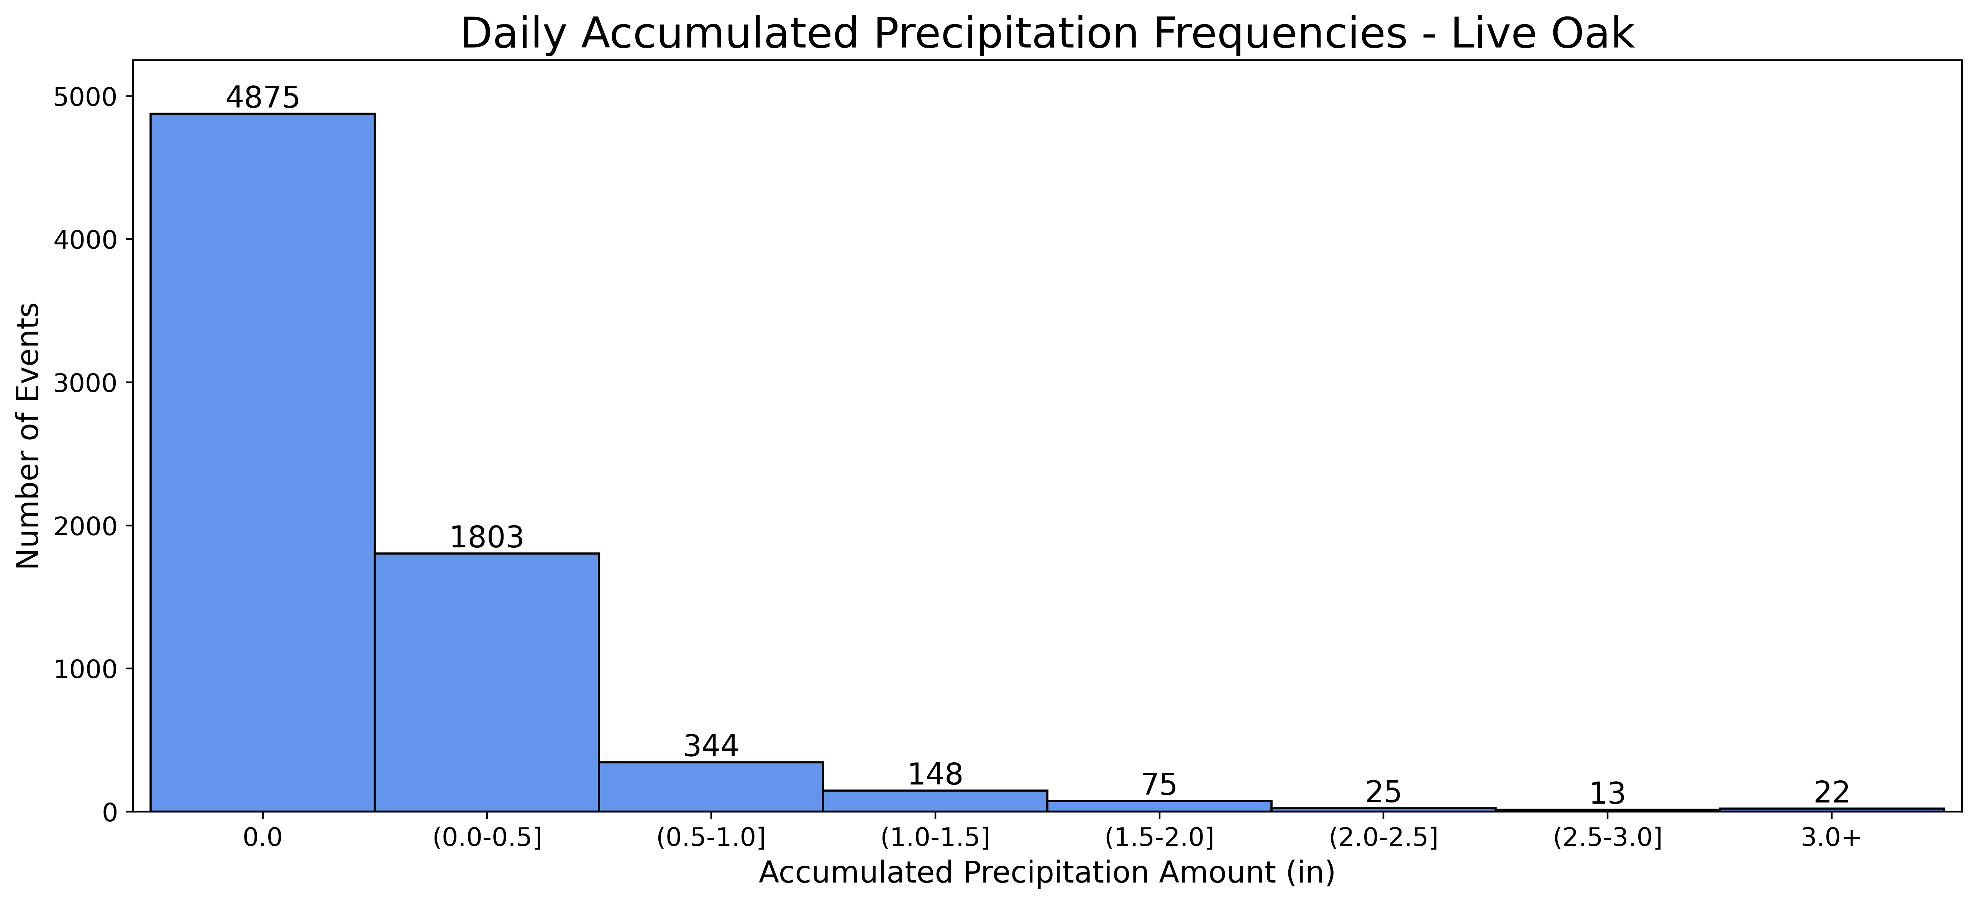
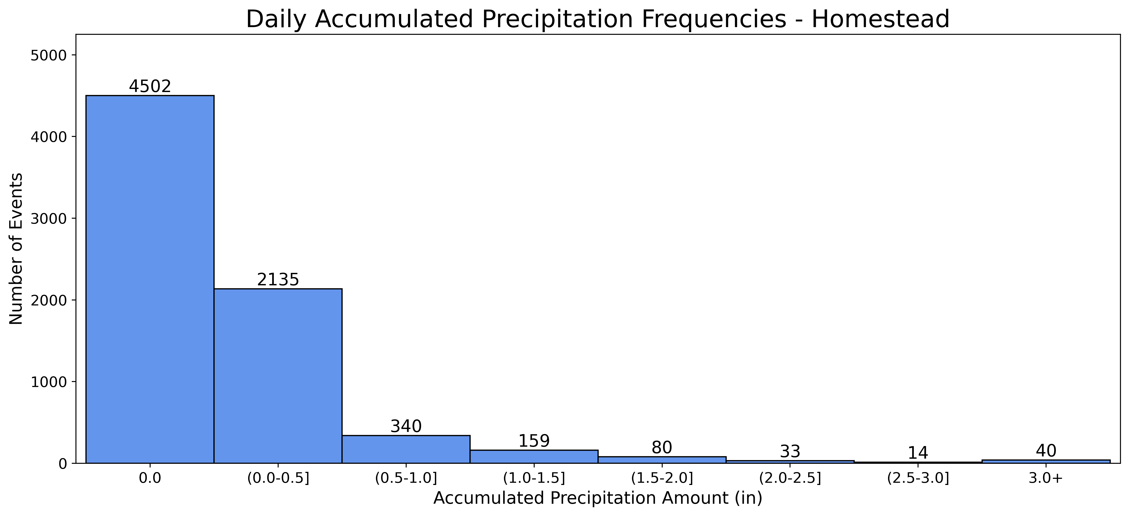
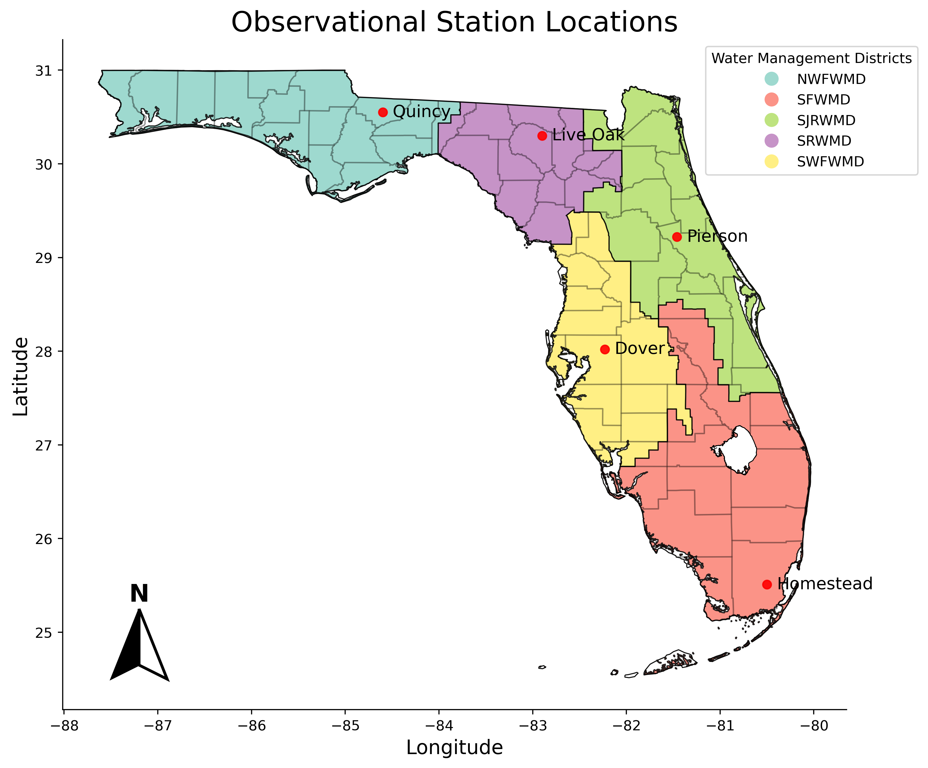
Climatological Evaluation on Extreme Precipitation in Florida
Jozette Conti
Faculty Advisors: Dr. Milla Costa, Dr. Pallav Ray
Dept. of Ocean Engineering and Marine Sciences, Florida Institute of Technology
Background
Results
Discussion
Florida receives ~50in of precipitation annually.
Extreme precipitation events are defined as 3in or more within a 24-hr period.
Extreme precipitation contributes to flooding, posing risks to communities, agriculture, and water quality.
The El Niño Southern Oscillation (ENSO) can influence precipitation amounts.
Temperature increases can increase extreme precipitation events.
Current climate projections cannot provide accurate predictions for hydrometeorological variables.
There is currently no comprehensive statewide assessment of hydrologic impacts due to climate change.
This study aims to evaluate the long-term trend of extreme precipitation events in Florida.
The reanalysis data was deemed unusable due to the weak positive correlations with daily precipitation observations.
Quincy and Dover had the highest number of extreme events per year, with 6 events in 2008 and 2021, respectively.
Homestead had the highest number of extreme precipitation events (40), while Live Oak had the fewest (22).
Extreme precipitation events were observed across El Niño, La Niña, and neutral ENSO phases, indicating an uncertain influence of ENSO on precipitation.
Significant increasing trends in both daily mean temperature and accumulated precipitation across all stations.
No statistically significant trends for extreme precipitation events were observed.
Figure 2. Time series plots of the daily accumulated precipitation and air temperature for the Quincy (left) and Homestead (right) observational stations.
Figure 3. Annual frequency of extreme precipitation events for the Quincy (left) and Dover (right) observational stations from 2003 to 2022.
Data and Methods
Conclusion
20-year period: January 1st, 2003, to December 31st, 2022.
Collected daily mean 2m air temperature and accumulated surface precipitation.
Correlated NCEP-NCAR Reanalysis 1 data to FAWN observational data for verification.
Analyzed the time series and frequency of daily and extreme precipitation events per year.
Mann-Kendall tests statistically assessed trends in temperature, precipitation, and extreme precipitation events.
This study attempted to establish a stronger understanding of long-term trends of extreme precipitation in Florida.
Limitation in the use of reanalysis data for precipitation.
Uncertainty in the influence of ENSO as there was no apparent connection to extreme precipitation events.
Daily accumulated precipitation and air temperatures are rising throughout Florida.
Extreme precipitation events in Florida could not be projected as no trend was seen.
The rising trend for daily precipitation and temperatures can have harmful implications for Florida, as it can negatively affect the environment, agriculture, and other socio-economic sectors.
Figure 4. Histogram of daily accumulated precipitation in 0.5in bins for the Live Oak (left) and Homestead (right) observational stations.
Table 1. Mann-Kendall test results for daily mean air temperature.
 | Dover | Homestead | Live Oak | Pierson | Quincy
Trend | Increasing | Increasing | Increasing | Increasing | Increasing
p-value | 0.00 | 0.00 | 0.00 | 0.00 | 0.00
Figure 1. Geographical locations of the 5 Florida Automated Weather Network (FAWN) observational stations, each located within a distinct Florida Water Management District for comprehensive regional coverage.
Table 2. Mann-Kendall test results for daily accumulated precipitation.
 | Dover | Homestead | Live Oak | Pierson | Quincy
Trend | Increasing | Increasing | Increasing | Increasing | Increasing
p-value | 0.00 | 0.00 | 0.02 | 0.00 | 0.02
Table 3. Mann-Kendall test results for extreme precipitation events.
References
 | Dover | Homestead | Live Oak | Pierson | Quincy
Trend | No trend | No trend | No trend | No trend | No trend
p-value | 0.09 | 0.55 | 0.91 | 0.56 | 0.75
Irizarry-Ortiz, M. M., Obeysekera, J., Park, J., Trimble, P., Barnes, J., Park-Said, W., & Gadzinski, E. (2013). Historical trends in Florida temperature and precipitation. Hydrological Processes, 27(16), 2225-2246–2246. https://doi.org/10.1002/hyp.8259
Myhre, G., Alterskjær, K., Stjern, C. W., Hodnebrog, Ø., Marelle, L., Samset, B. H., Sillmann, J., Schaller, N., Fischer, E., Schulz, M., & Stohl, A. (2019). Frequency of extreme precipitation increases extensively with event rareness under global warming. Scientific Reports, 9(1). https://doi.org/10.1038/s41598-019- 52277-4
Shi, S., & Misra, V. (2020). The role of extreme rain events in Peninsular Florida’s seasonal hydroclimate variations. Journal of Hydrology, 589. https://doi-org.portal.lib.fit.edu/10.1016/j.jhydrol.2020.125182
Obeysekera, J., Graham, W., Sukop, M., Asefa, T., Wang, D., Ghebremichael, K., & Mwashote, B.M. (2017). Implications of Climate Change on Florida’s Water Resources. Florida Climate Institute. 10.17125/fci2017.ch03.
Winsberg, M.D., Climate of Florida. (2012). Florida Climate Center. https://climatecenter.fsu.edu/images/fcc/climateofflorida.pdf
Future Work
Further analysis of datasets such as the North American Regional Reanalysis (NARR) and Integrated Multi-satellitE Retrievals for GPM (IMERG).
More evaluation on the seasonality of extreme precipitation events and the influence of climate drivers (e.g., ENSO, MJO, PDO, etc.).
Better assessment of the hydrometeorological trends in Florida through more extensive data.
Acknowledgements
Thank you to Dr. Milla Costa and Conner Welch for guidance in the research and data analysis process.

