Slide 1
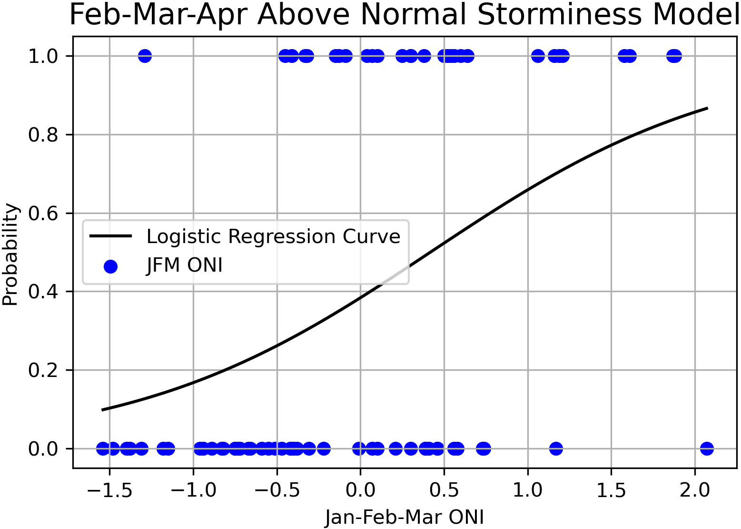
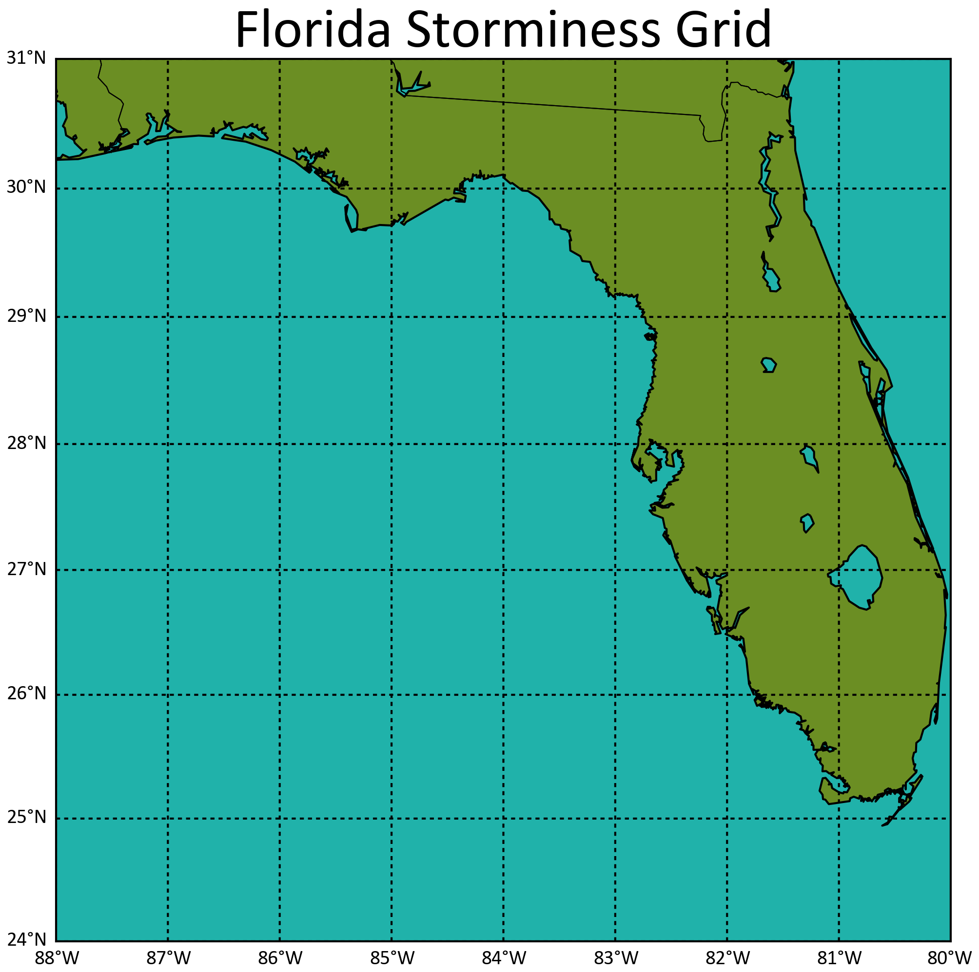
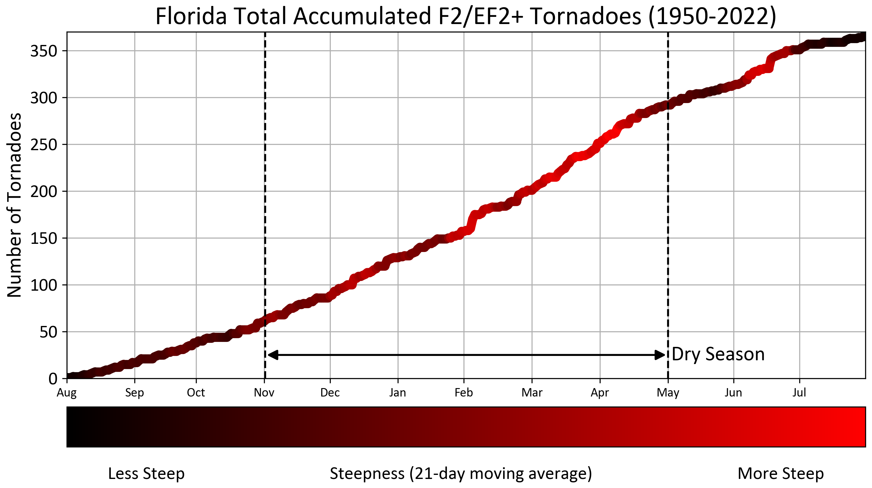
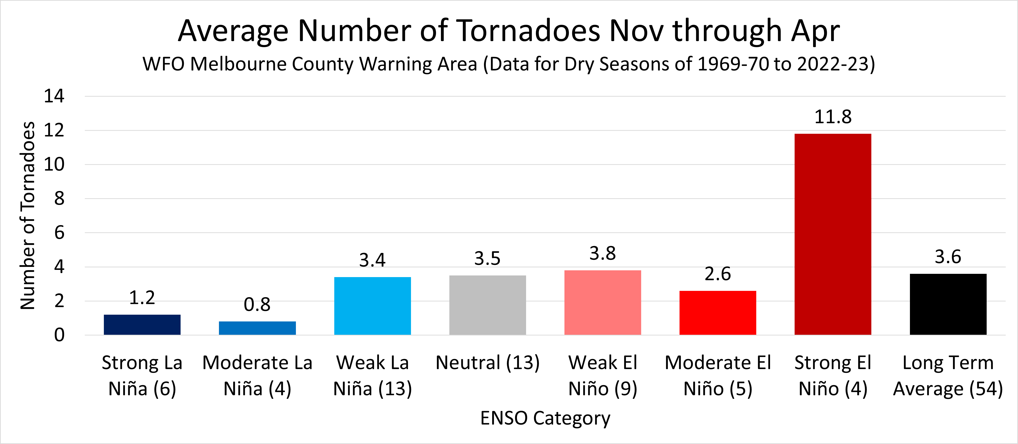
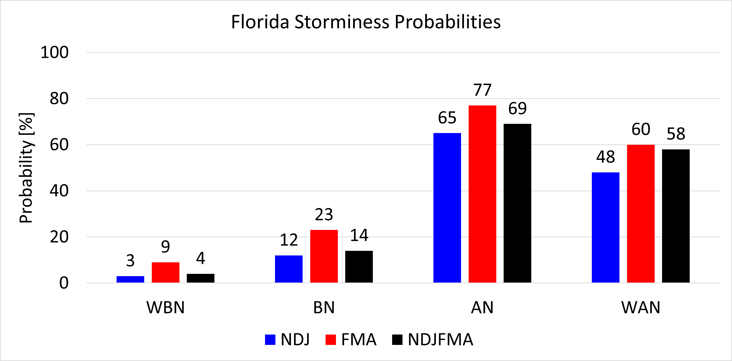
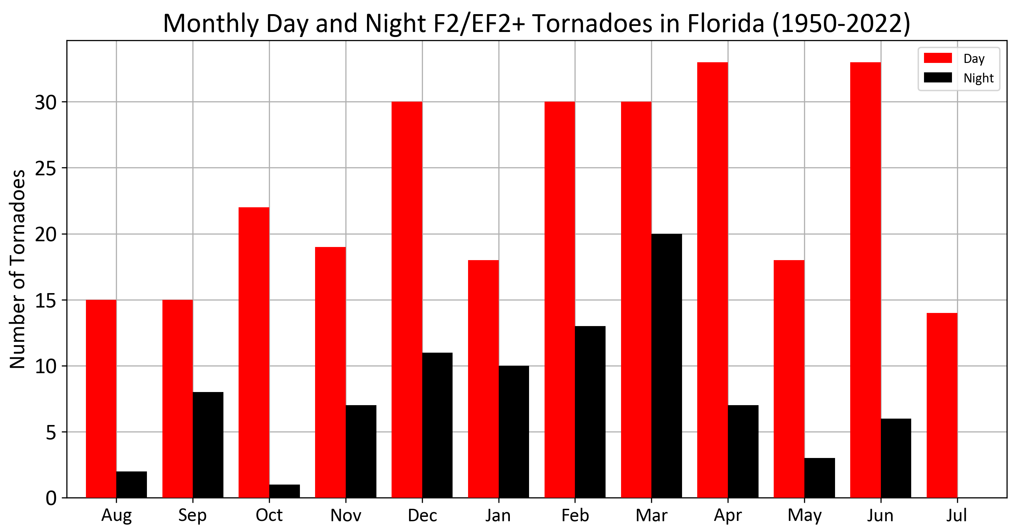
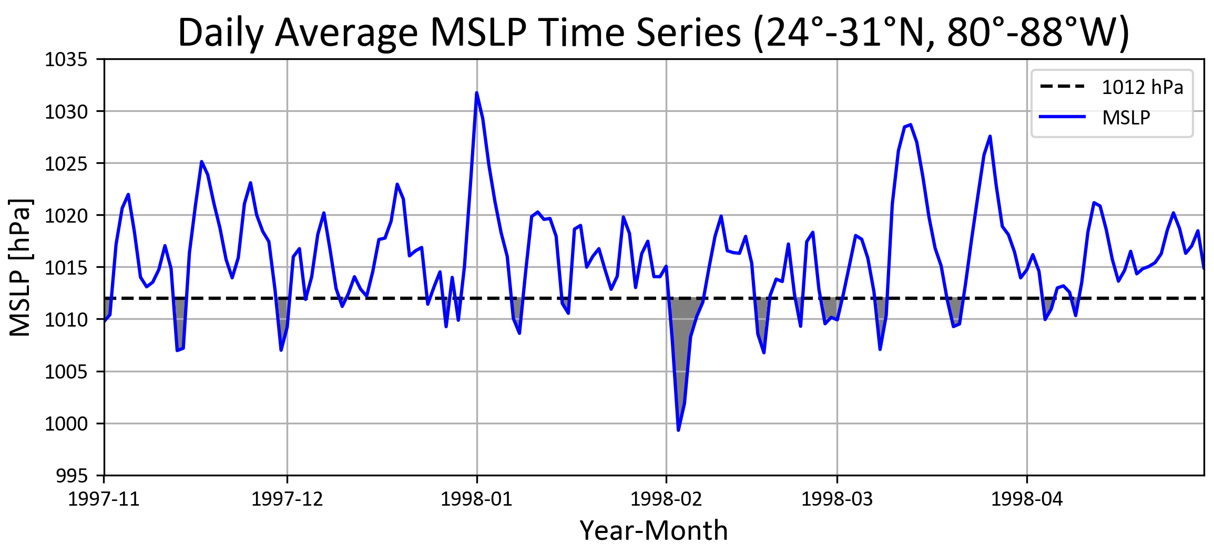
Using ENSO to Predict Florida Storminess Associated with Dry Season Tornadoes
Gabriel Taylor
Advisors: WCM Will Ulrich and SOO Matt Volkmer, National Weather Service, Melbourne
(1) Introduction
The majority of Florida’s strongest and most impactful tornadoes tend to occur during the dry season months of November through April (Figure 1) when the Oceanic Niño Index (ONI) is anomalously positive (referred to as El Niño).
This was largely a result of El Niño’s ability to shift the location and enhance the strength of the subtropical jet stream to favor the development of these low pressure systems that produce heavy rain and severe weather in FL (Figure 3), whereas strong La Niña’s promote drought and wildfires. ONI can be predicted several months in advance allowing for a seasonal forecasting opportunity for the National Weather Service offices in FL.
Figure 5: LR curve for above normal FL storminess, the blue dots represent the Jan-Feb-Mar ONI value for each dry season since 1950, where the top dots are the top 40% in terms of storminess.
Figure 6: FL storminess grid where MSLP is averaged from 24°-31°N to 80°-88°W.
(3) Results and Discussion
Twelve LREs were created for the NDJ, FMA, and full dry season (NDJFMA) period allowing for the probabilistic prediction of well below, below, above, and well above normal storminess (Figure 7) where each period uses the ONI value one month beforehand, i.e., the NDJ LREs use the OND ONI value to output a probability.
Figure 1: Accumulation of strong to violent tornadoes in Florida from 1950 to 2022 colored-coded by steepness.
Figure 3: Average number tornadoes within the NWS Melbourne CWA during each ENSO category for each dry season since 1969, the number next to the ENSO categories are the number of dry seasons that had those conditions.
Approx. 24% of the 365 F2/EF2+ tornadoes that have occurred in FL since 1950 happened at night (from 03 UTC to 11 UTC) when most people are asleep. 77% the 88 nighttime tornadoes occurred during the dry season (Figure 2).
(2) Data and Methods
Storminess is a function of both the frequency and strength of low pressure systems that pass near or through FL during the dry season. Using ERA5 reanalysis data, the storminess of each dry season can be given a score by measuring the daily-averaged mean sea level pressure (MSLP) over the grid (Figure 6) then determining by how much it dropped below a threshold of 1012 hPa (Figure 4). The dry seasons can then be ranked in order from least to most stormy allowing for the creation of numerous logistic regression equations (LREs) that predict the probability of above or below normal storminess during different periods (Figure 5) using forecasted ONI values.
Figure 7: Florida storminess probabilities for the 2023-24 dry season.
The observed/expected OND, JFM, and ONDJFM ONI values of 1.9, 1.5, and 1.7 respectively, imply that above normal storminess (about 8 or more threshold storms) would be expected during the 2023-24 dry season. Higher probabilities during FMA suggest that ENSO has a greater affect on FL’s weather during the latter half of the dry season.
Figure 2: Monthly count of strong to violent day (red) and nighttime (black) tornadoes in FL from 1950 to 2022.
For example, during the overnight hours of February 22-23, 1998, an unusually severe outbreak of seven damaging tornadoes killed 42 people and injured 260 in east central FL when a potent low pressure system passed near the state. This 1997-98 dry season was record breaking in terms of tornado damage and the number of storms that impacted the state, during which Strong El Niño conditions were ongoing.
(4) Future Work
Training these statistical models and/or the use of ML using other oceanic and atmospheric oscillations could provide greater skill in forecasting storminess on shorter time scales.
Figure 4: Time series of daily average MSLP over a grid encompassing 24°-31°N to 80°-88°W, areas where MSLP dips below the 1012 hPa threshold are shaded gray.

