Slide 1
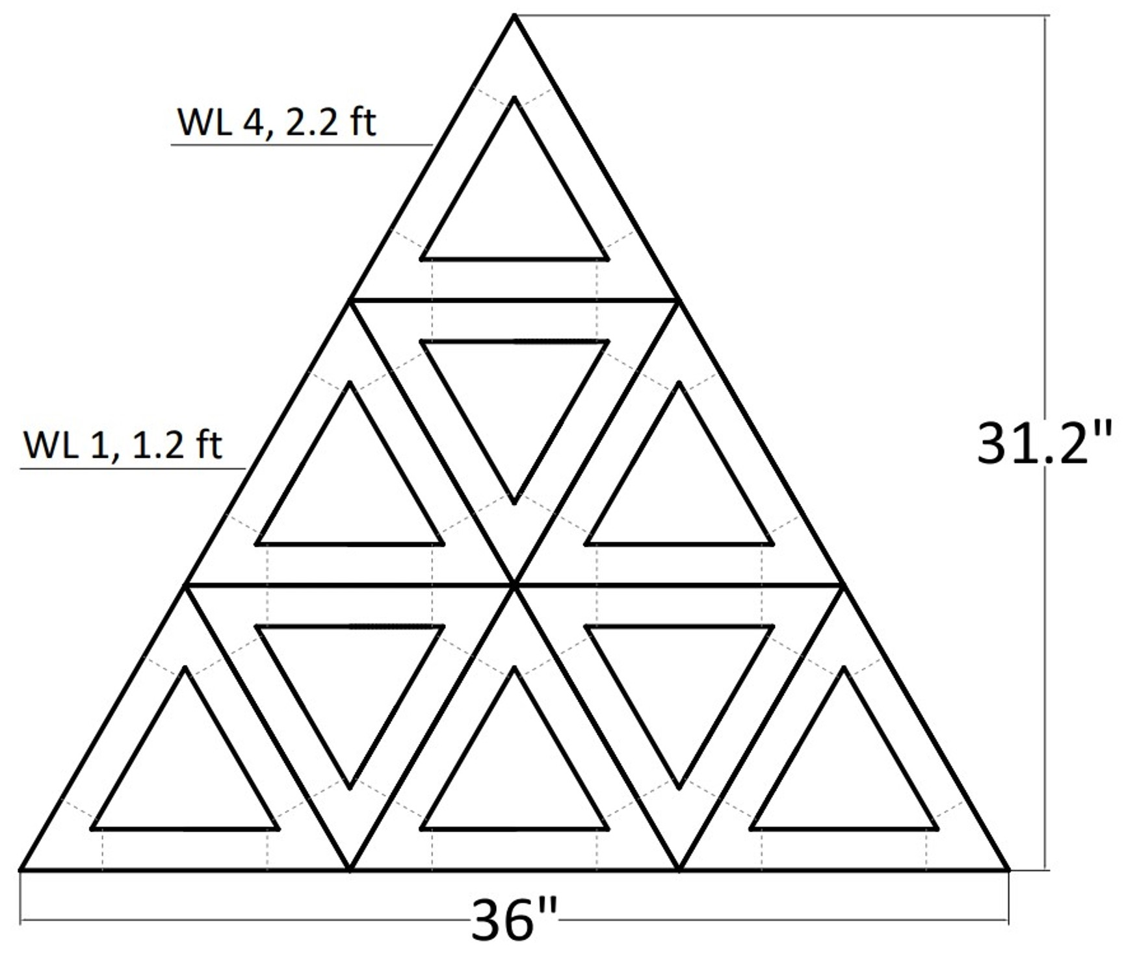
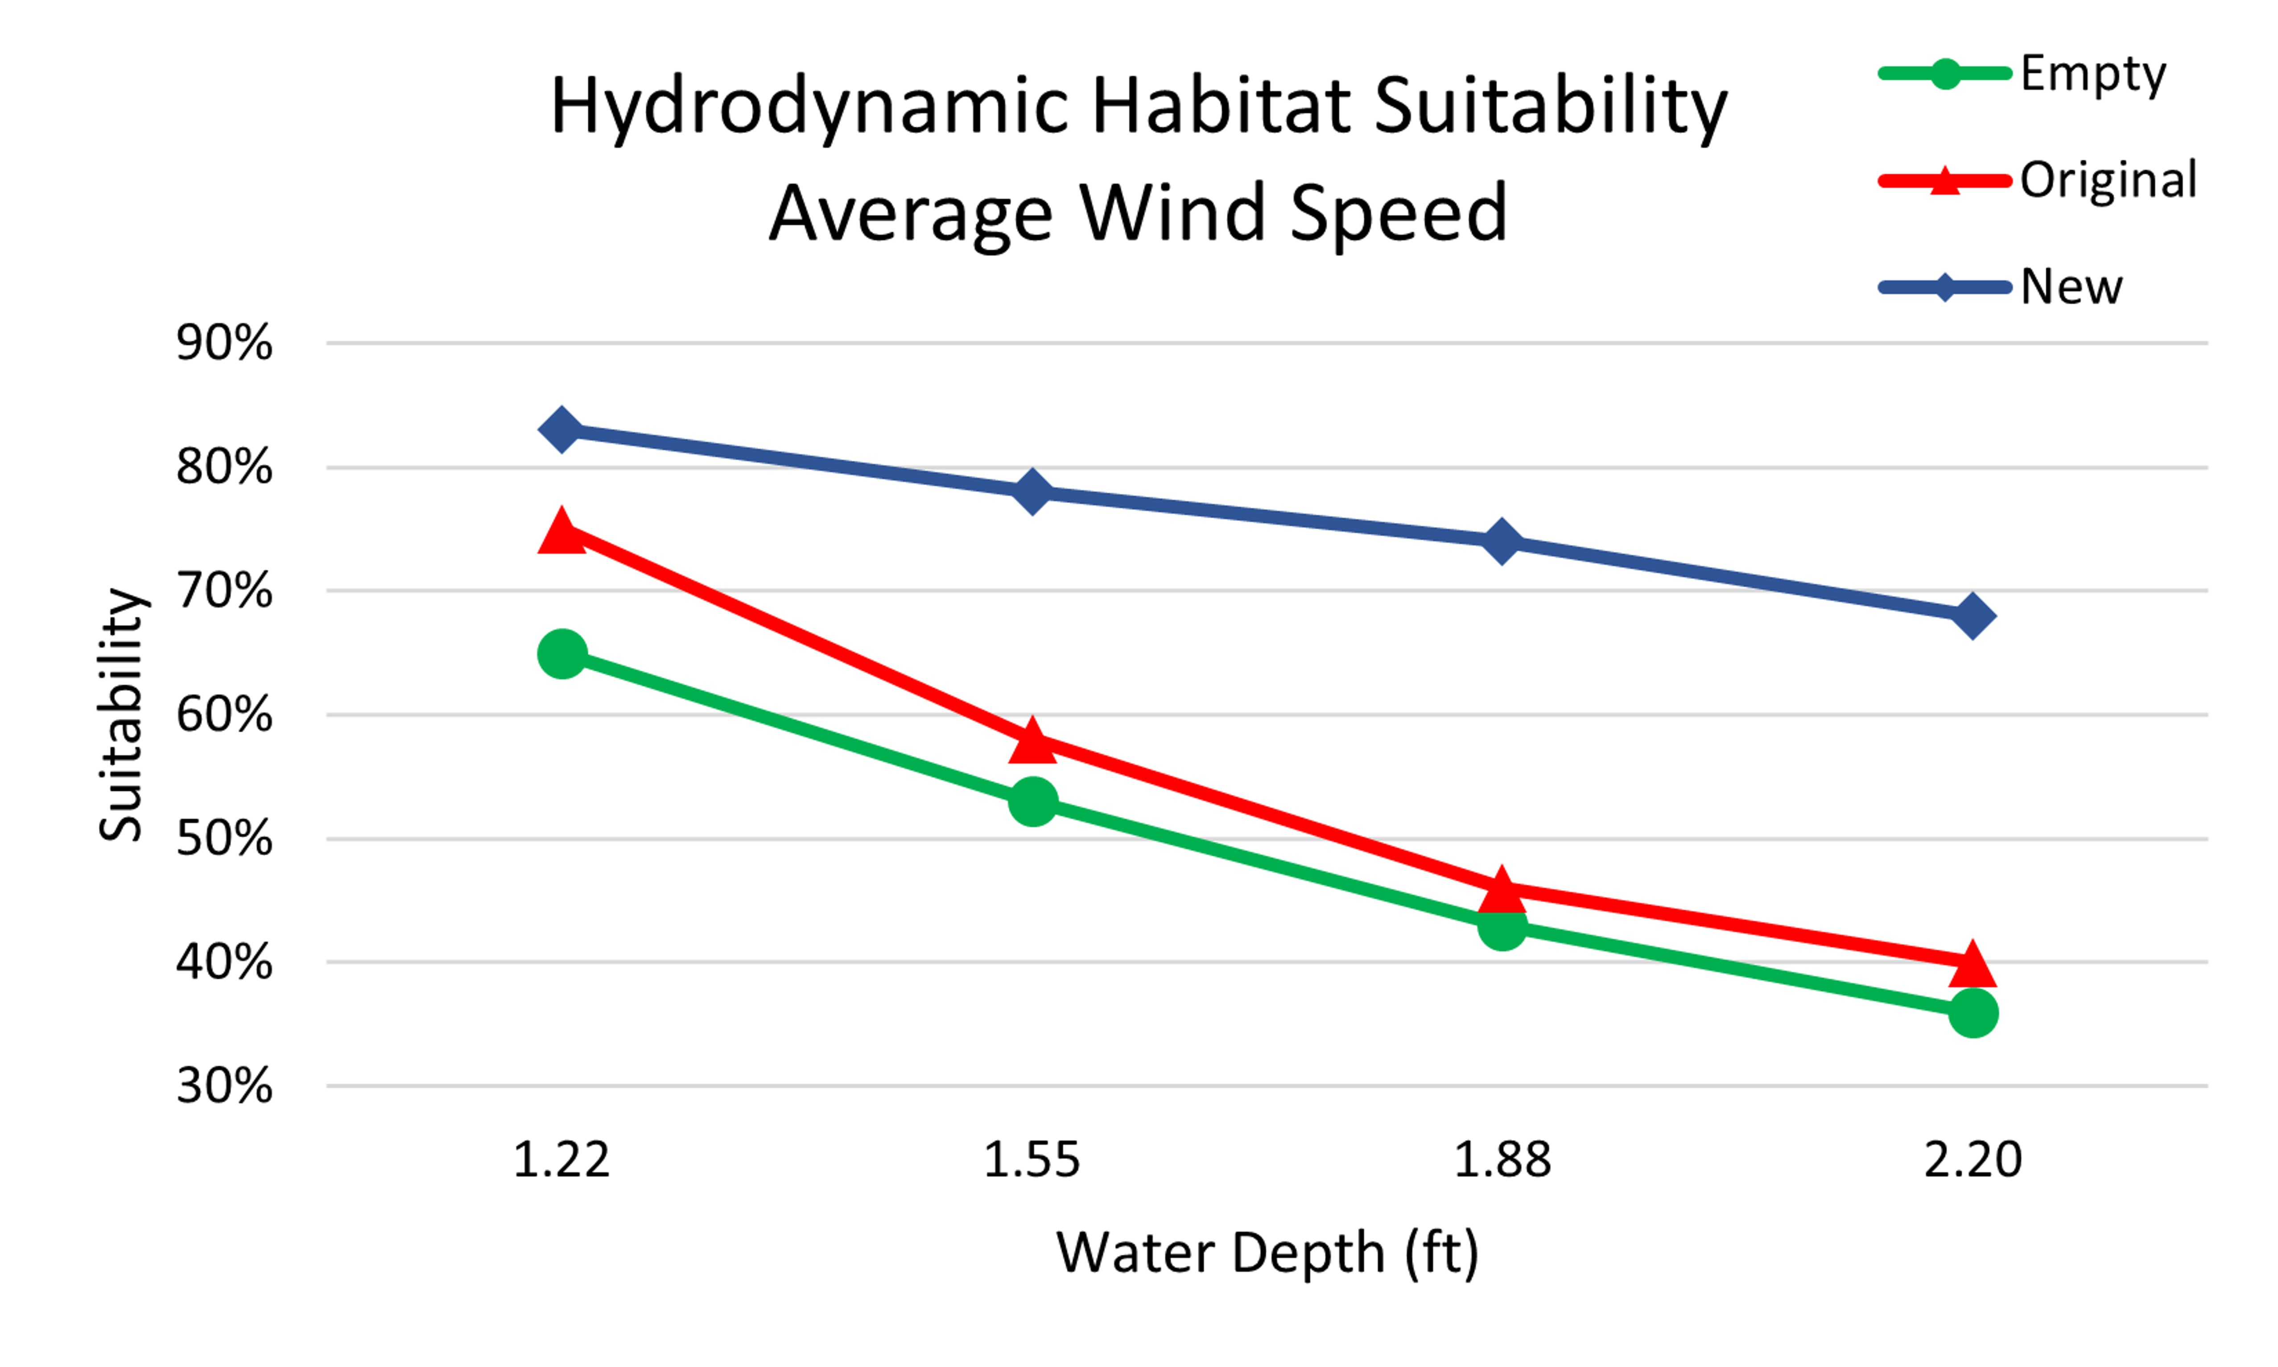
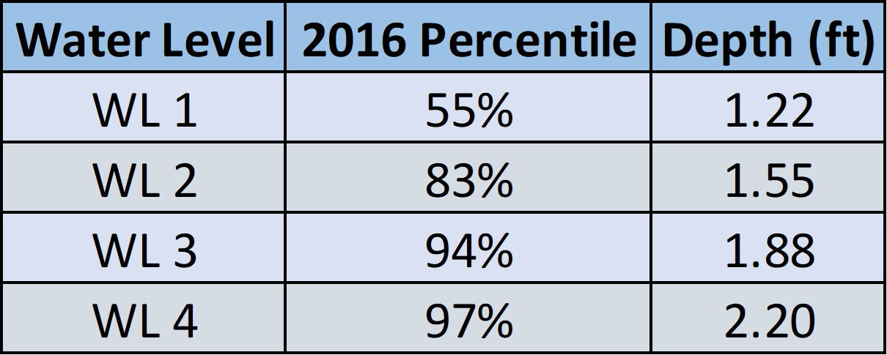
Modular Breakwater for Living Shorelines
Allison Poling, Elias Martin, and Matthew Ninesling
Faculty Advisors: Dr. Stephen Wood and Dr. Deniz Velioglu Sogut,
Dept. of Ocean Engineering and Marine Sciences, Florida Institute of Technology
Breakwater Design
CFD Modeling
Introduction
The Marine Resources Council (MRC) is a non-profit that installs red mangrove-focused living shorelines in the Indian River Lagoon (IRL). Mangrove trees are excellent for naturally stabilizing shorelines and improving marine ecosystems, but they are difficult to plant on high-wave energy shorelines. The MRC’s current living shoreline projects are failing due to a dysfunctional breakwater that fails to protect the juvenile mangroves during high water season. Therefore, the Modular Breakwater for Living shorelines was specifically designed to be effective during high water season and create favorable hydrodynamic conditions for mangroves.
Objectives
To design a new breakwater that addresses the MRC’s requirements and constraints
To quantify the new breakwater’s ability to create favorable hydrodynamic conditions for mangroves using computational fluid dynamics models
Design Features
The final breakwater design (Fig. 1) is composed of concrete prisms bounded together by galvanized steel fasteners. The key design features include:
Modular Pieces: The breakwater is constructed of modular triangular prisms (Fig. 2) for easy fabrication and installation.
Porous: High porosity allows water to flow through the breakwater. This enhances circulation, encourages sedimentation, and reduces forces on the structure.
Emergent: It will remain effective throughout the high-water season and dissipate more wave energy than the original.
Lightweight: Weighing 80 pounds, one or two individuals can comfortably handle a prism.
Materials: Eco-friendly materials were selected to encourage biological settlement and eliminate the use of any plastics.
Overview
Computational fluid dynamics models were conducted on FLOW-3D HYDRO to simulate the wave-structure interaction and analyze the breakwater hydrodynamics with respect to mangrove habitat suitability. Three scenarios were modeled: an empty site, the original breakwater, and the new breakwater. The empty site was used as a baseline to measure breakwater performance across various conditions.
Considerations
Water Level: Referenced historical data. Table 1 outlines the four high-water levels that were tested.
Waves: Estimated using the SMB Formulation¹. Considers fetch distance, water depth, and wind speed. Outputs significant wave height and period. Tested 50th, 75th, and 90th percentile wind speeds.
Nearshore Slope: Measured during a site survey.
Analysis
Wave heights were recorded at the mangrove location in the model and correlated to mangrove hydrodynamic habitat suitability (HHS). The HHS scale was developed by analyzing mangrove prevalence in the IRL with respect to wave conditions².
Conclusion
The new breakwater design was proven to create a more suitable environment for mangrove vegetation. For the conditions tested, there was a 20-30% improvement in HHS over the original, and it consistently exceeded 50%. Figure 3 illustrates the HHS results for the average wind speed condition. Using the MBLS design, living shorelines at high-energy locations can significantly increase their likelihood of success, as the breakwater creates a favorable environment for mangrove vegetation.
References
[1] CERC Shore Protection Manual, 1984
[2] Cannon et al. Ecological Engineering, 2020
Acknowledgments
Mara Skadden, Marine Resources Council
Dr. Robert Weaver, Florida Institute of Technology
Figure 1: MBLS Breakwater Cross-section
Figure 2: MBLS Prism Dimensions
Figure 3: HHS Results for Average Wind Speed
Table 1: Tested Water Levels

