Slide 1
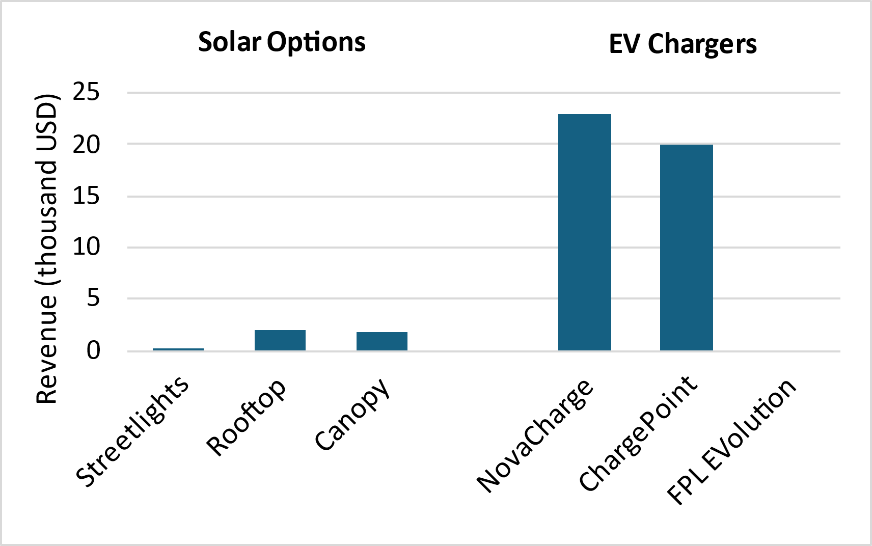
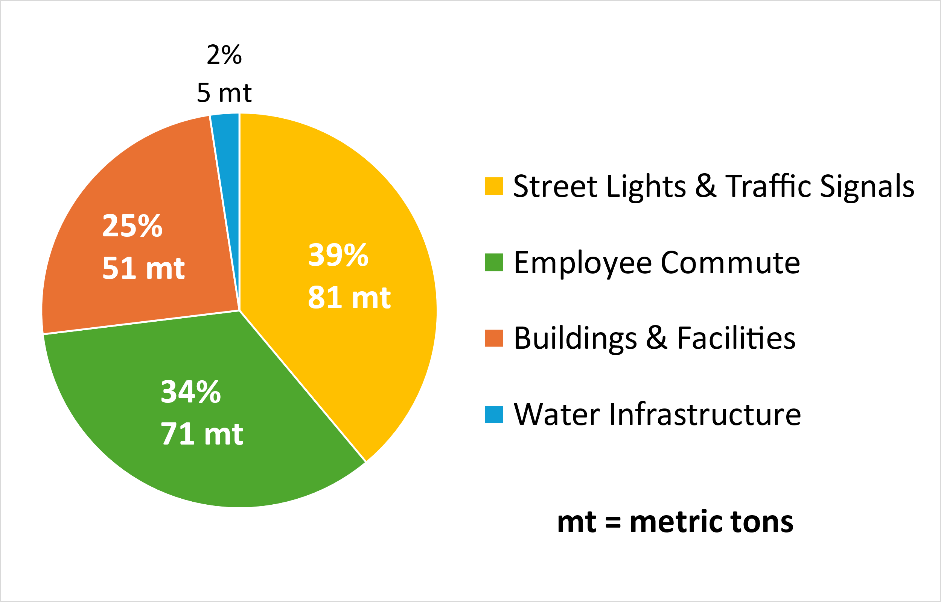
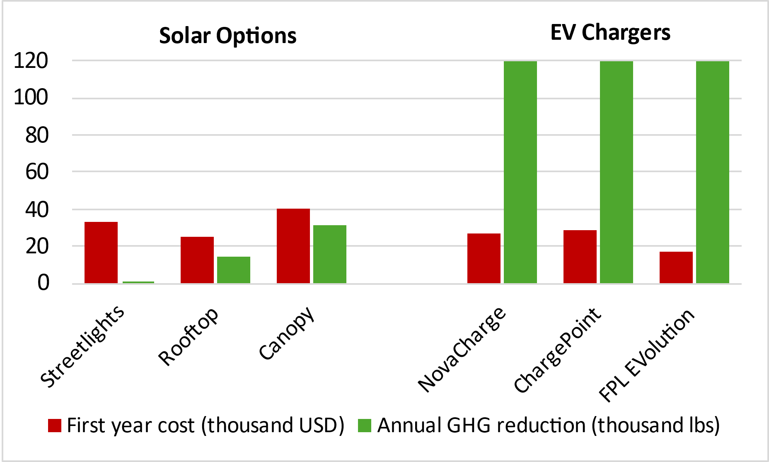
Indialantic GHG Emissions Inventory & Reduction Strategies
Sara Gabby Lail
Faculty Advisors: Dr. Emily Ralston, Dr. Ken Lindeman, Dept. of Ocean Engineering and Marine Sciences, Florida Institute of Technology
Introduction
Climate change is a growing issue affecting humanity and the global environment. Its primary cause is the anthropogenic emission of greenhouse gases (GHGs) such as CO2⁽¹⁾. Reducing emissions on every possible scale is thus a crucial step in combatting climate change⁽²⁾. This project aims to identify feasible and effective means of reducing GHG emissions on a local government scale in the Town of Indialantic, FL.
Objectives
To assemble a GHG emissions inventory and report for the Town of Indialantic.
To identify feasible emissions reduction strategies in town hotspots.
Methods
Emissions Inventory
Electricity consumption and approximate employee fuel use data were provided by Florida Power & Light (FPL) and Indialantic.
Inventory construction was performed using ICLEI’S ClearPath software with built-in emissions equivalent calculators.
A summarizing report was written using a template provided by ICLEI.
Reduction Strategies
Data was gathered from relevant businesses and local government, including FPL, NovaCharge, First Light Technologies, and the City of Cape Canaveral.
Options were then compared based on cost, potential savings or revenue, and calculated CO2 reduction capability.
Results
Emissions Inventory
Figure 1 shows emissions by sector for Indialantic local government operations (LGO) in 2021. The greatest contributors were streetlights, employee commute, and buildings & facilities.
Figure 1: 2021 CO2 emissions by sector for Indialantic LGO.
Reduction Strategies
Based on Figure 1 and the interests of Indialantic, the investigation of solutions focused on electric vehicle (EV) and solar-related town upgrades. Figure 2 compares the approximate initial costs and annual GHG reductions from implementing 15 solar streetlights, one 10 kW rooftop array, one 25 kW solar canopy, and two dual-port EV chargers from three different brands.
Figure 2: Costs and GHG reduction of solar & EV strategies.
Results (cont.)
Installation of EV chargers was shown to have the greatest potential impact on GHG emissions. This was also the most profitable option, as shown in Figure 3.
Figure 3: Potential revenue from solutions reviewed.
Conclusion
References Figure 4: NovaCharge NC8000 station.
1. IPCC, 2023. Climate Change Synthesis Report.
2. Ou et al., 2021. Deep mitigation of CO2 and non-CO2 greenhouse gases toward 1.5°C & 2°C futures.
Acknowledgements
M. Casey, V. Taranto, Indialantic SC&RC, ICLEI, Audubon FL, S. Brooks, & Z. Eichholz.
Local governments must move toward renewable and efficient technology whenever possible. For Indialantic, installing NovaCharge EV charging stations (Figure 4) is a feasible and effective next step. Moving forward, funding prospects will be reviewed. Once approved by the Mayor and Town Council, a NovaCharge representative will be brought out for site assessment.

