Slide 1
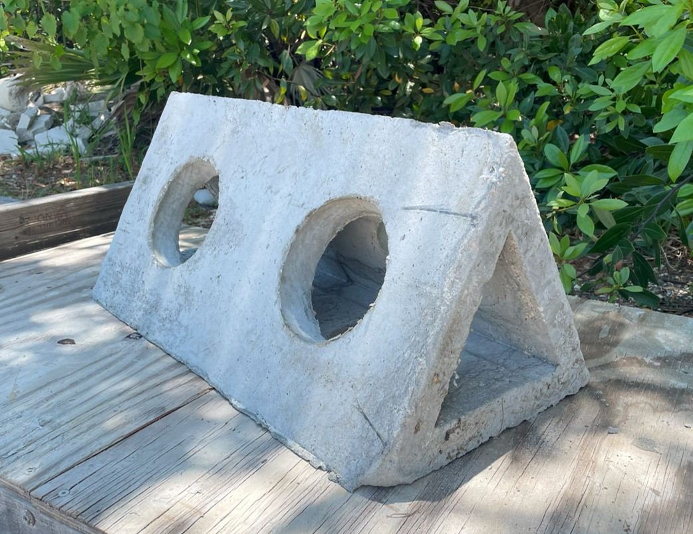
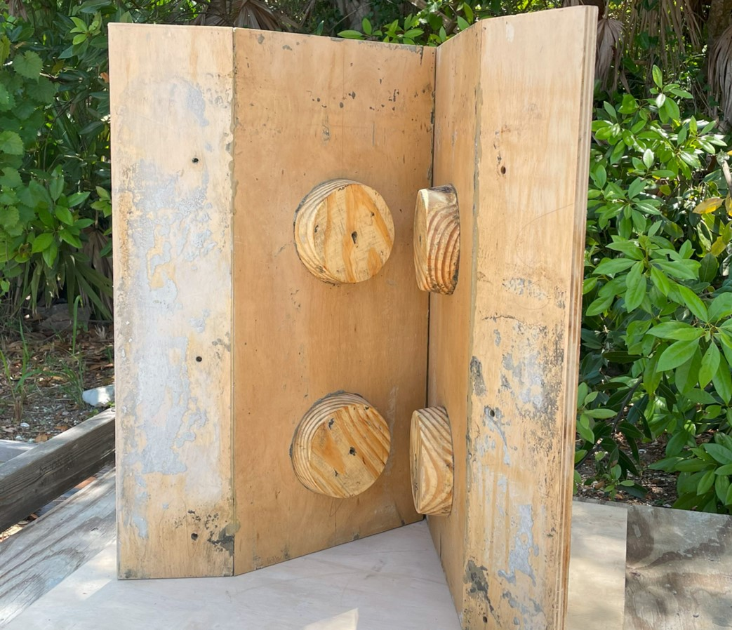
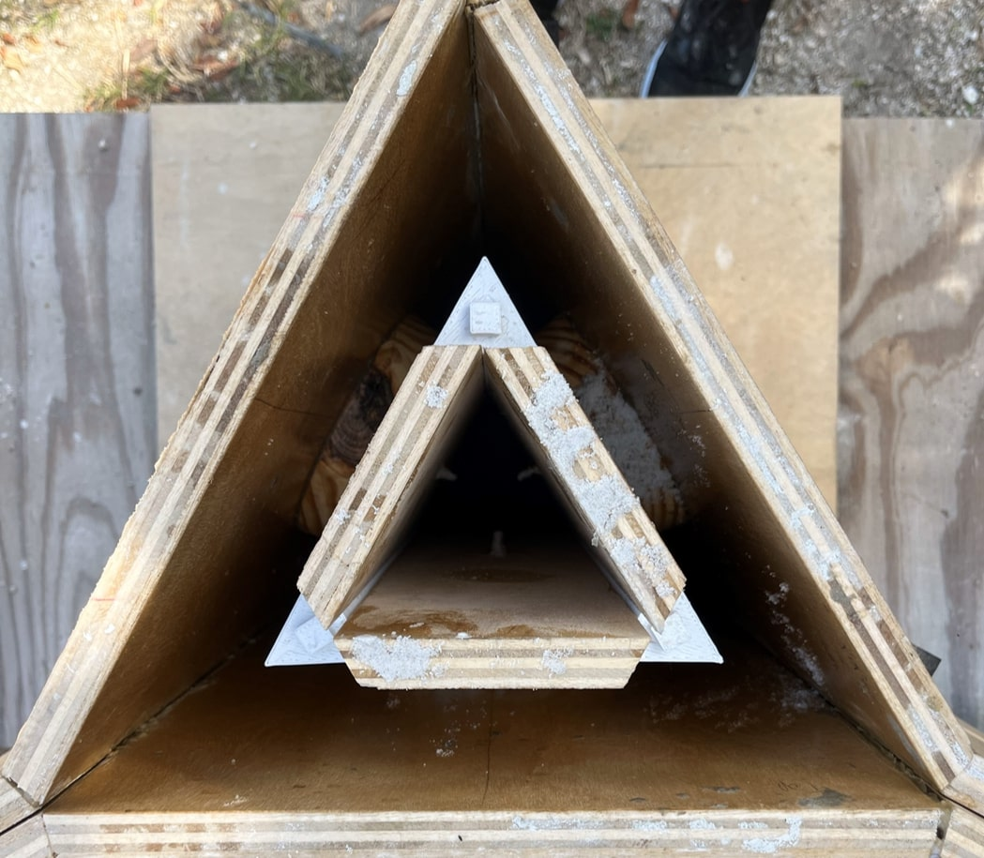
Implementation of the Modular Breakwater for Living Shorelines
Matthew Ninesling and Darin Hiraldo
Faculty Advisors: Dr. Emily Ralston and Dr. Ken Lindeman,
Dept. of Ocean Engineering and Marine Sciences, Florida Institute of Technology
Introduction
The Marine Resources Council¹ (MRC) is a non-profit that installs living shorelines in the Indian River Lagoon (IRL) to mitigate erosion and enhance marine ecosystems. They want to utilize the Modular Breakwater for Living Shorelines (MBLS) design for its modularity and favorable hydrodynamic properties. However, an efficient and scalable construction method for the breakwater does not exist. Therefore, in collaboration with the MRC, a method for molding the individual concrete prisms that comprise the breakwater was developed with an emphasis on accessibility and scalability.
Objectives
To design a concrete mold for constructing the MBLS prisms
To create a construction manual and video detailing the prism fabrication process
Methods
Design and Production of MBLS Prisms
The goal was to design a concrete mold that could efficiently produce entire prisms. It was essential that the mold be simple to construct, easy to replicate, and composed of readily available materials. These principles guided the iterative design process and acted as a problem-solving lens.
Construction Manual and Video Creation
Each step was documented throughout the design and construction process to create a detailed construction manual. A video demonstrating the construction process was also produced. With thorough documentation, the MRC can smoothly take over the project and ensure its development and implementation.
Results
The final mold consists of three exterior plates that are bolted together. The plates have cylindrical protrusions that define holes in the side of the prism (Fig. 1). Three plates are fastened to the cylinders on the interior to define the central void space (Fig. 2).
Figure 1: Interior of mold
Figure 2: Top-view of assembled mold
Results cont.
Figure 3: MBLS concrete prism
Conclusion
The finalized mold could produce entire concrete prisms (Fig. 3) in a simple manner with readily available materials. In the future, the prism construction method needs to be streamlined to build the breakwater efficiently. Smooth knowledge transfer via the construction manual and video will ensure the project’s future development. Although the mold was successfully produced during this project, significant investment must be made to optimize the mold design and prepare for mass production. Additionally, an adequate concrete mixture must be determined so that the prisms can withstand the IRL’s aquatic environment and organisms can settle on the surface.
References
[1] https://lovetheirl.org
Acknowledgments
Mara Skadden, Marine Resources Council
Keith Richardson, Hendrick Brothers Environmental
Sarah Brooks, Florida Institute of Technology

