Slide 1
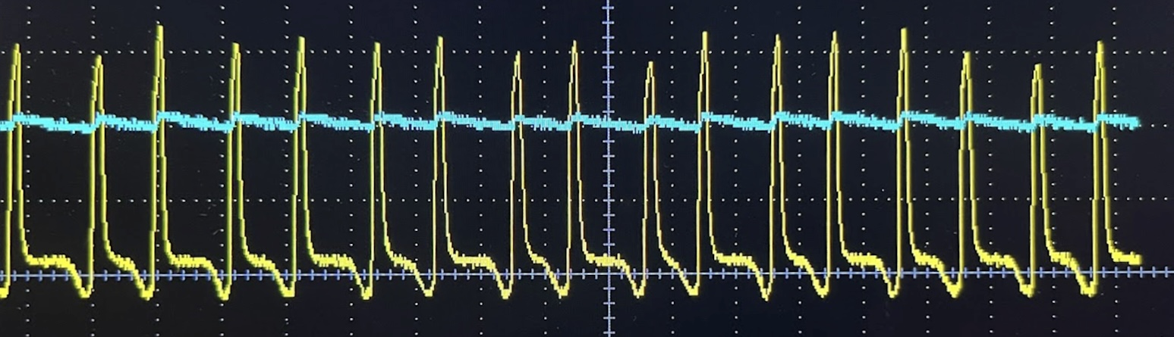
Shoreline Wave Energy Conversion
Darin Hiraldo, Ceana Palacio, Daniel Louw, and Gabriela Rodezno Wilson
Faculty Advisor(s): Dr. Stephen Wood and Dr. Chungkuk Jin Dept. of Ocean Engineering and Marine Science, Florida Institute of Technology
Introduction
A study has shown that by 2050, many nations stretching across the equator will reach temperatures that are too high to sustain life^{1.} However, this crisis can be solved by turning to the source that covers more than 70% of our planet: water². The United Nations Ocean Conference found that about 40% of the world population lives within 100 km (60 miles) of the coast in 2017³. Therefore, utilizing the ocean as a source for renewable energy holds the potential for more than 40% of the world’s population to receive clean energy. With that potential in mind, a study was conducted into proving the viability of a Shoreline Wave Energy Converter (SWEC) that operates on a magnetic induction coil.
Objectives
To prototype a wave energy converter that utilizes a magnetic induction coil to convert wave energy into a usable electrical output.
To utilize a method of converting the electrical output into a usable form
Methods
Prototyping of a Wave Energy Converter (WEC)
Utilizing characteristics of an existing UNF study⁴, a 6-magnet system was utilized with 26 AWG copper wire to create the magnetic induction coil that complemented a WEC system made up of 3D printed material and linear bearings. Multiple designs and iterations were tested to prioritize velocity of the magnets passing through the coil.
Creation of a Usable Electrical Output
Through the use of a full-wave rectifier, the raw output of the WEC was converter from an alternating current (AC) to a direct current (DC) to power a red light emitting diode (LED).
Results
Prototyping a Wave Energy Converter
The two designs created were the “Perpendicular Slider” (PS) and the “Truncated Cone” (TC). The values collected (Tables 1 & 2) for the tests conducted at different wave frequencies for both designs and different slope angles for the PS.
Table 1: PS Velocity output under varying slopes and wave-generator motor frequencies
Table 2: TC Velocity output under varying wave-generator motor frequencies
The parameters decided upon for the magnetic induction coil (Table 3) are as follows:
Table 3: Magnetic induction coil parameters
Results (cont.)
Creation of a Usable Electrical Output
The output of the coil at a 2 Hz frequency (Fig. 1) peaks at about 3.25V recorded under AC. With the use of the full-wave rectifier, the voltage remains relatively constant at ~2V.
Figure 1: Oscilloscope reading of the WEC AC (yellow) and DC (blue) outputs with 1V vertical increments
Conclusion
The PS system proved more efficient than the TC in harnessing larger velocities under the same frequencies. Additionally, the magnetic induction coil was able to generate and convert energy into a usable source that was sufficient enough to provide the 1.8V required to power the red LED.
Although proving viability in utilizing a SWEC, it is still necessary that there be extensive testing into the optimization of the system for a specific site. As well, proper measures must be taken to ensure safety from the intended environment.
References
Xu, Chi, et al. “Future of the Human Climate Niche.” Proceedings of the National Academy of Sciences, vol. 117, no. 21
How Much Water Is There on Earth? | U.S. Geological Survey.
Factsheet: People and Oceans. The Ocean Conference, United Nations, 5 June 2017
Fernandez de Valderrama, Luis. Linear Generators in Wave Energy Conversion: Performance, Feasibility, and Location Study.
Acknowledgements
Humberto Lebrón Rivera, Florida Institute of Technology
Degree | Frequency (Hz) | Maximum Speed (m/s) | Minimum Speed (m/s) | Average Speed (m/s)
10 | 12 | 0.102 | 0.0009 | 0.047
 | 14 | 0.333 | 0.0002 | 0.174
 | 16 | 0.431 | 0.0033 | 0.238
15.7 | 12 | 0.258 | 0.0013 | 0.213
 | 14 | 0.357 | 0.0059 | 0.188
 | 16 | 0.367 | 0.0046 | 0.217
21.5 | 12 | 0.199 | 0.0067 | 0.093
 | 14 | 0.194 | 0.0007 | 0.098
Frequency (Hz) | Maximum Speed (m/s) | Minimum Speed (m/s) | Average Speed (m/s)
12 | 0.019 | 0 | 0.0059
14 | 0.077 | 0 | 0.0084
16 | 0.179 | 0 | 0.0931
Parameter | Value | Units
Windings | ~800 | n/a
Coil Diameter (inside) | 4.45 | cm
Wire Diameter | 0.43 | mm (26 AWG)
Magnet Diameter | 1.905 | cm
Magnet Thickness | 0.635 | cm

