Slide 1

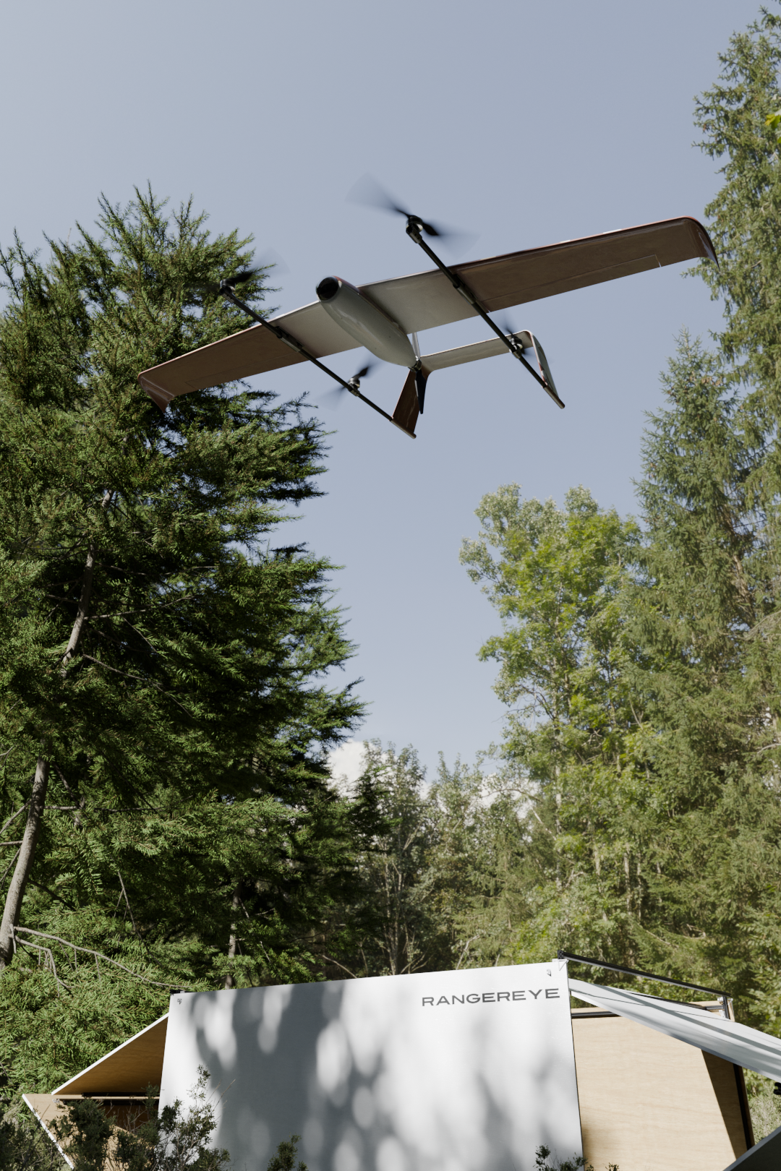
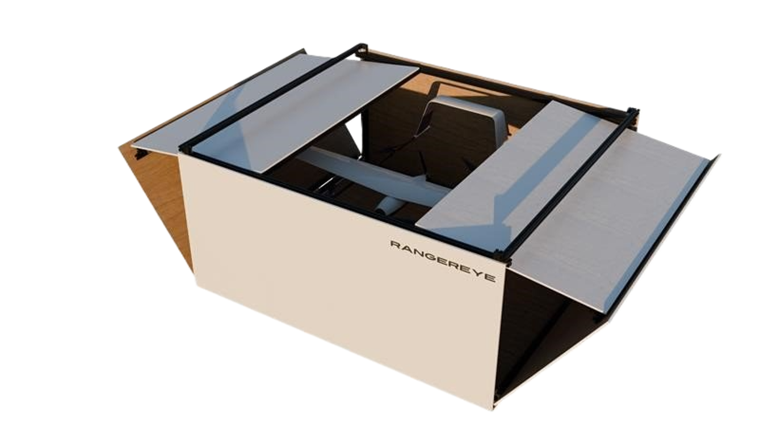
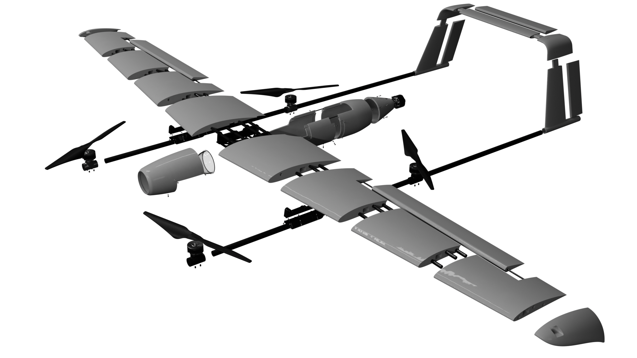
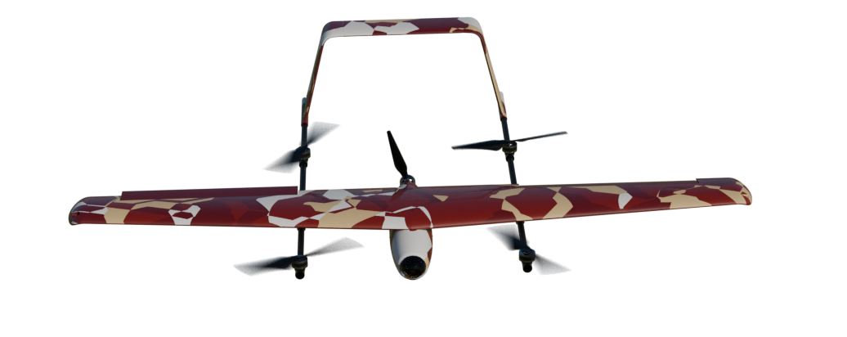
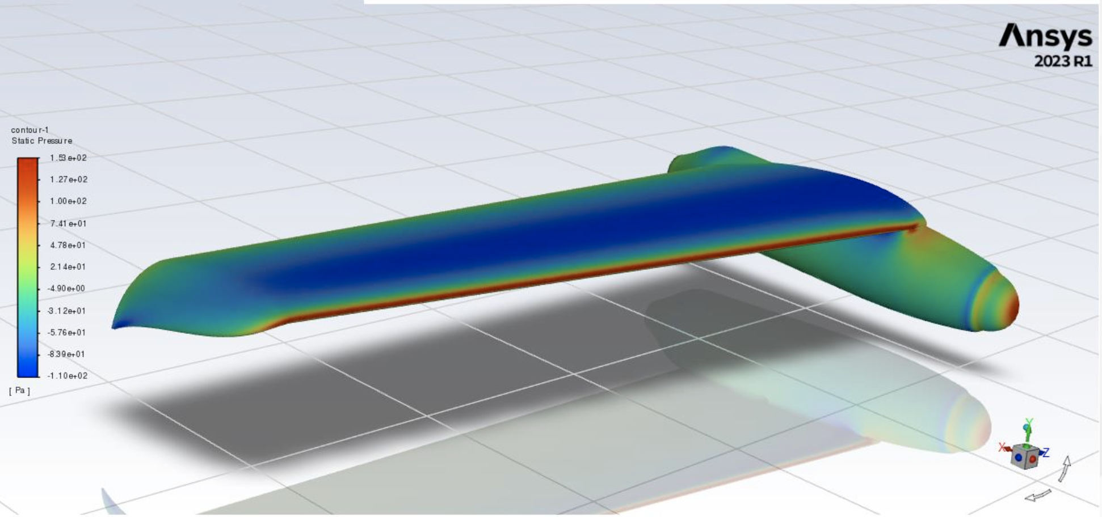
RangerEye: Autonomous Wildfire Detection and Patrol Drone
Onat Cakici, John Munday, Mitchell Lacle, Manuel Villamor, Otto Dorschner, Yuto Imai, Ishaben Trada, Abdulrahman Almutairi, Abdullah Alaskar
Faculty Advisor: Dr. Firat Irmak, Dept. of Aerospace, Physics and Space Sciences,
Florida Institute of Technology
Introduction
Operational View
Objectives
Wildfires present a growing threat to ecosystems and infrastructure. RangerEye is an autonomous wildfire monitoring system to patrol fire-prone areas, detect heat anomalies using onboard thermal imaging, and transmit alerts in real time. The system operates independently, utilizing a drone capable of both vertical takeoff and landing (VTOL) and conventional flight, with a self-charging ground station.
Develop an autonomous aerial system for wildfire detection using a VTOL drone.
Integrate thermal sensors and autonomous navigation for early fire recognition.
Construct a ground station capable of automated charging and mission control.
Ensure operation on off-grid, remote environments without manual intervention.
Drone
Ground Station
Quad‑rotor VTOL lift system with rear pusher propeller enables efficient hover and high‑speed cruise.
High‑wing, twin‑boom tail and NACA 4412 airfoil deliver inherent stability, endurance, and smooth stall behavior.
3D‑printed airframe allows easy part replacement; CFD‑driven aerodynamic refinements across wings, fuselage, and tail to minimize drag and maximize performance.
Worldwide remote and control via secure global link. Solar-powered autonomy enables off-grid operation.
Weatherproof enclosure with automated elevator docking and conductive contact-plate charging for protected, hands-free UAV recovery.
Figure 3: Visualization of RangerEye in Operation
Figure 1: Exploded View of RangerEye
Automation & Controls
Figure 4: Ground Station
ArduPilot flight control powered by DroneKit (Python) scripts, featuring automated patrol routines and adjustable fire‑detection thresholds.
The system autonomously generates GPS waypoints from detected heat‑spot positions using terrain‑optimized search patterns to survey predefined areas on the user interface.
Figure 2: View of RangerEye
Figure 5: CFD Analysis for Wing and Fuselage
Notes:
Automation – DroneKit in Python, waypoints generated based on heat spot position and appropriate search pattern for terrain

