Slide 1
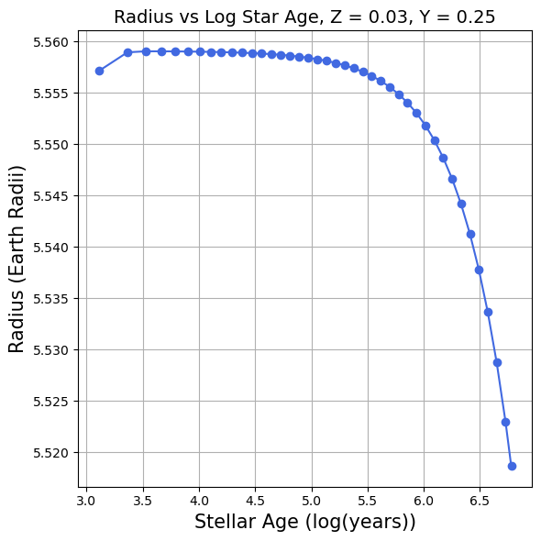
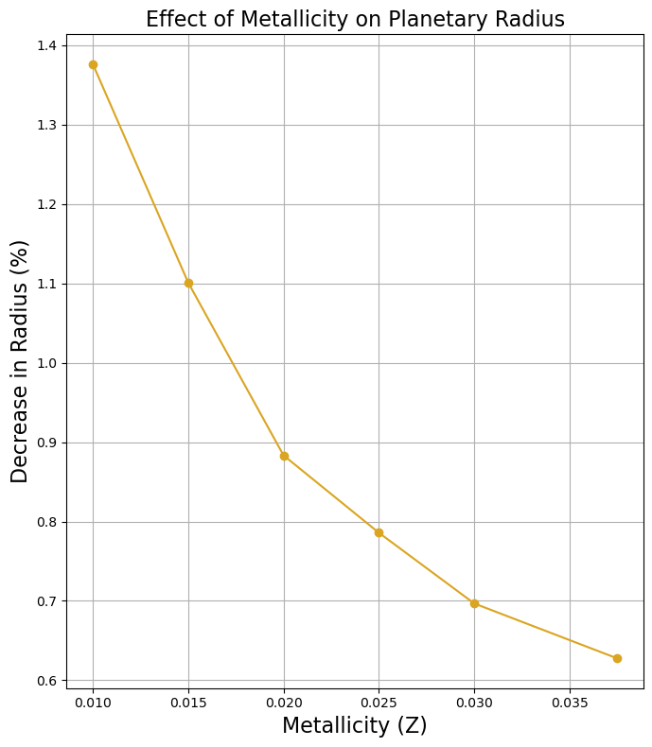
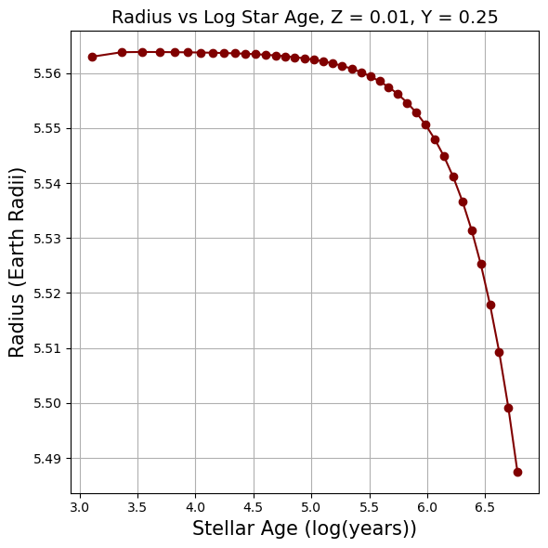
Planetary Evolution with Variable Stellar Metallicity
Justin Alderdice
Faculty Advisor: Dr. Howard Chen, Dept. of Aerospace, Physics and Space
Sciences, Florida Institute of Technology
INTRODUCTION
RESULTS
CONCLUSIONS
To conduct my research, the software suite ‘MESA’ (Modules for Experiments in Stellar Astrophysics) was used to run simulations of planetary evolution. I focused on altering the host star’s metallicity fraction “Z”. By definition, metallicity is the fraction of a star that is made up of elements heavier than hydrogen and helium. For context, our Sun has a metallicity of Z = 0.0122 (1.22%)
OBJECTIVE
The goal was to run simulations to see how altering stellar metallicity would affect planetary evolution. To do this, I’d run a simulation using MESA code and collect the radius data throughout a given timescale. The main objective was to focus on how the radius of the simulated planet changed over time while changing the metallicity
Across 50+ simulations, one thing stood out – As the metallicity increased, the radius loss decreased
Planets orbiting more metal-rich stars retained more of their size (radius) over the timescales of the simulations. This could indicate that these planets are more stable long term, although more research needs to be done
In the future I’d be interested in exploring the effects of further increasing the metallicity and observing how this impacts the planet's radius, as well as increase the length of the simulations
METHODOLOGY
Alter the Z value in the code given by MESA, the upper limit was ~Z = 0.038, any higher than that and the simulation would fail. The helium fraction ‘Y’, was kept at a constant 0.25 throughout all simulations
Run the code, and gather the age and radius data for each value of Z
Extract radius vs. time data from MESA and run through a script to create figures
Repeat to test the limits of the code
REFRENCES
Chen et al., 2016, ApJ vol 831(2) p.180
Chen et al., 2018, ApJL vol. 868, p.L6
Notes:
It would also be valuable to extend the simulations beyond the current stellar age of 10^{6.77} years to see how the planet evolves over a longer time scale.

