Slide 1
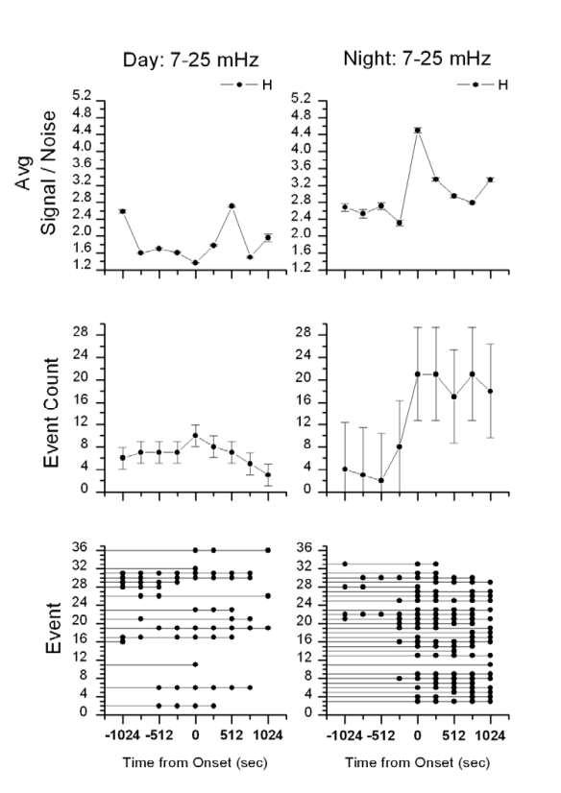
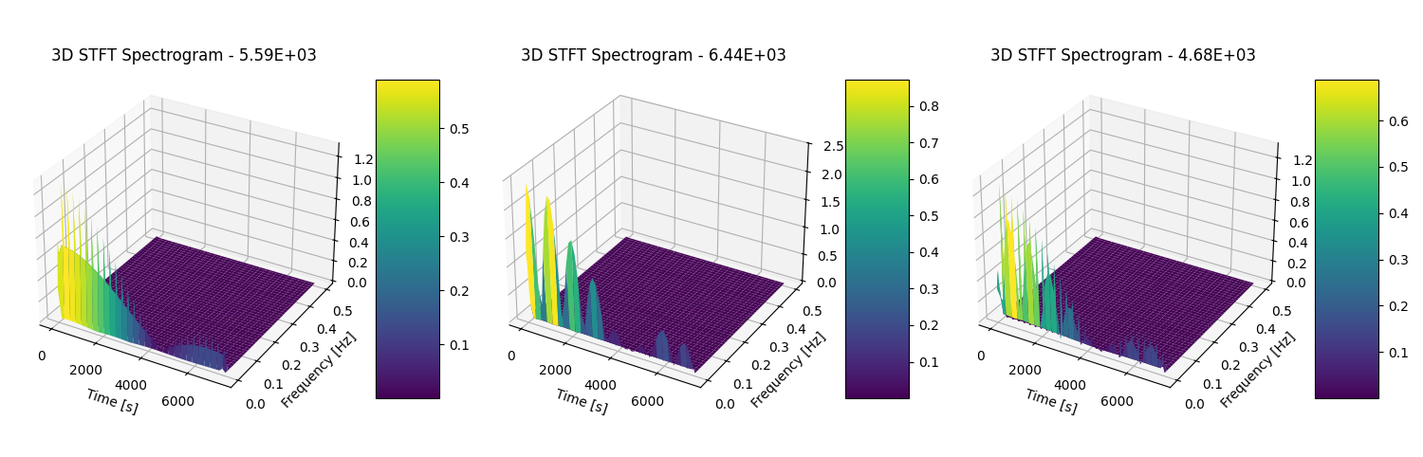
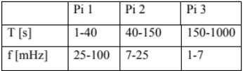
Magnetic Hydro- Dynamic Waves(MHD)
Koustav Saha
Faculty Advisor: Dr. Paul Martin, Dept. of Space Science, Aerospace and Physics, Florida Institute of Technology
Introduction:
Magnetic hydrodynamic waves or MHD waves are low frequency waves that are the result of solar winds hitting the Plasmasphere of Earth.
These waves primarily being of low frequencies range from between 7 to 500 mHz.
Therefore, these waves can be divided into five sections, Pi 1, 2, 3, 4 and 5. For this research, the primary focus is on Pi 2 and 3 bands.
Methodology:
Use of Magnetometers:
Ground-based magnetometers are used to detect the Earth’s magnetic field and its fluctuations.
Arrays of magnetometers across latitudes provide profiles of field line displacements (Alfvén waves) characterized by Duration and Frequency.
Data Collection and Processing:
The data collected from the magnetometers have low frequencies and need to be cleaned up. Therefore, a Short Time Fourier Transform is performed using python.
Results and Conclusion:
The dayside data reflects much lesser events with greater noise at higher frequencies. Also, the number of events seem to drastically decrease with greater time dilation indicating a weak signal.
On the contrary, nightside signals exhibit large event counts for the entire 1024 seconds. Furthermore, the frequency of each signal is higher than their counterpart’s at the same level of noise.
Therefore , it can be understood that the dayside waves are a result of diferent interference patterns and does not have a single source. While the night side waves are direct results of the disturbances caused by solar winds.
Figure 1: Elaboration of different bandwidths
Abstract:
This experiment intends to elaborate upon the idea that day-side MHD waves and night-side MHD waves both originate from solar winds.
After extensive data collection and processing , it can be understood that day-side waves are a result of night-side waves travelling to the day-side post their inception in the night-side.
.
Figure 2: Short Time Fourier Transform plots
After cleaning up the data, a heatmap spectrogram is created to provide a better understanding of the distribution of frequencies of the waves relative to the time in seconds since the inception of each event.
Then a wavelet transform is performed after having normalized the waves between 26.9 mHz to 27.5 mHz for further statistical analysis.

