Slide 1
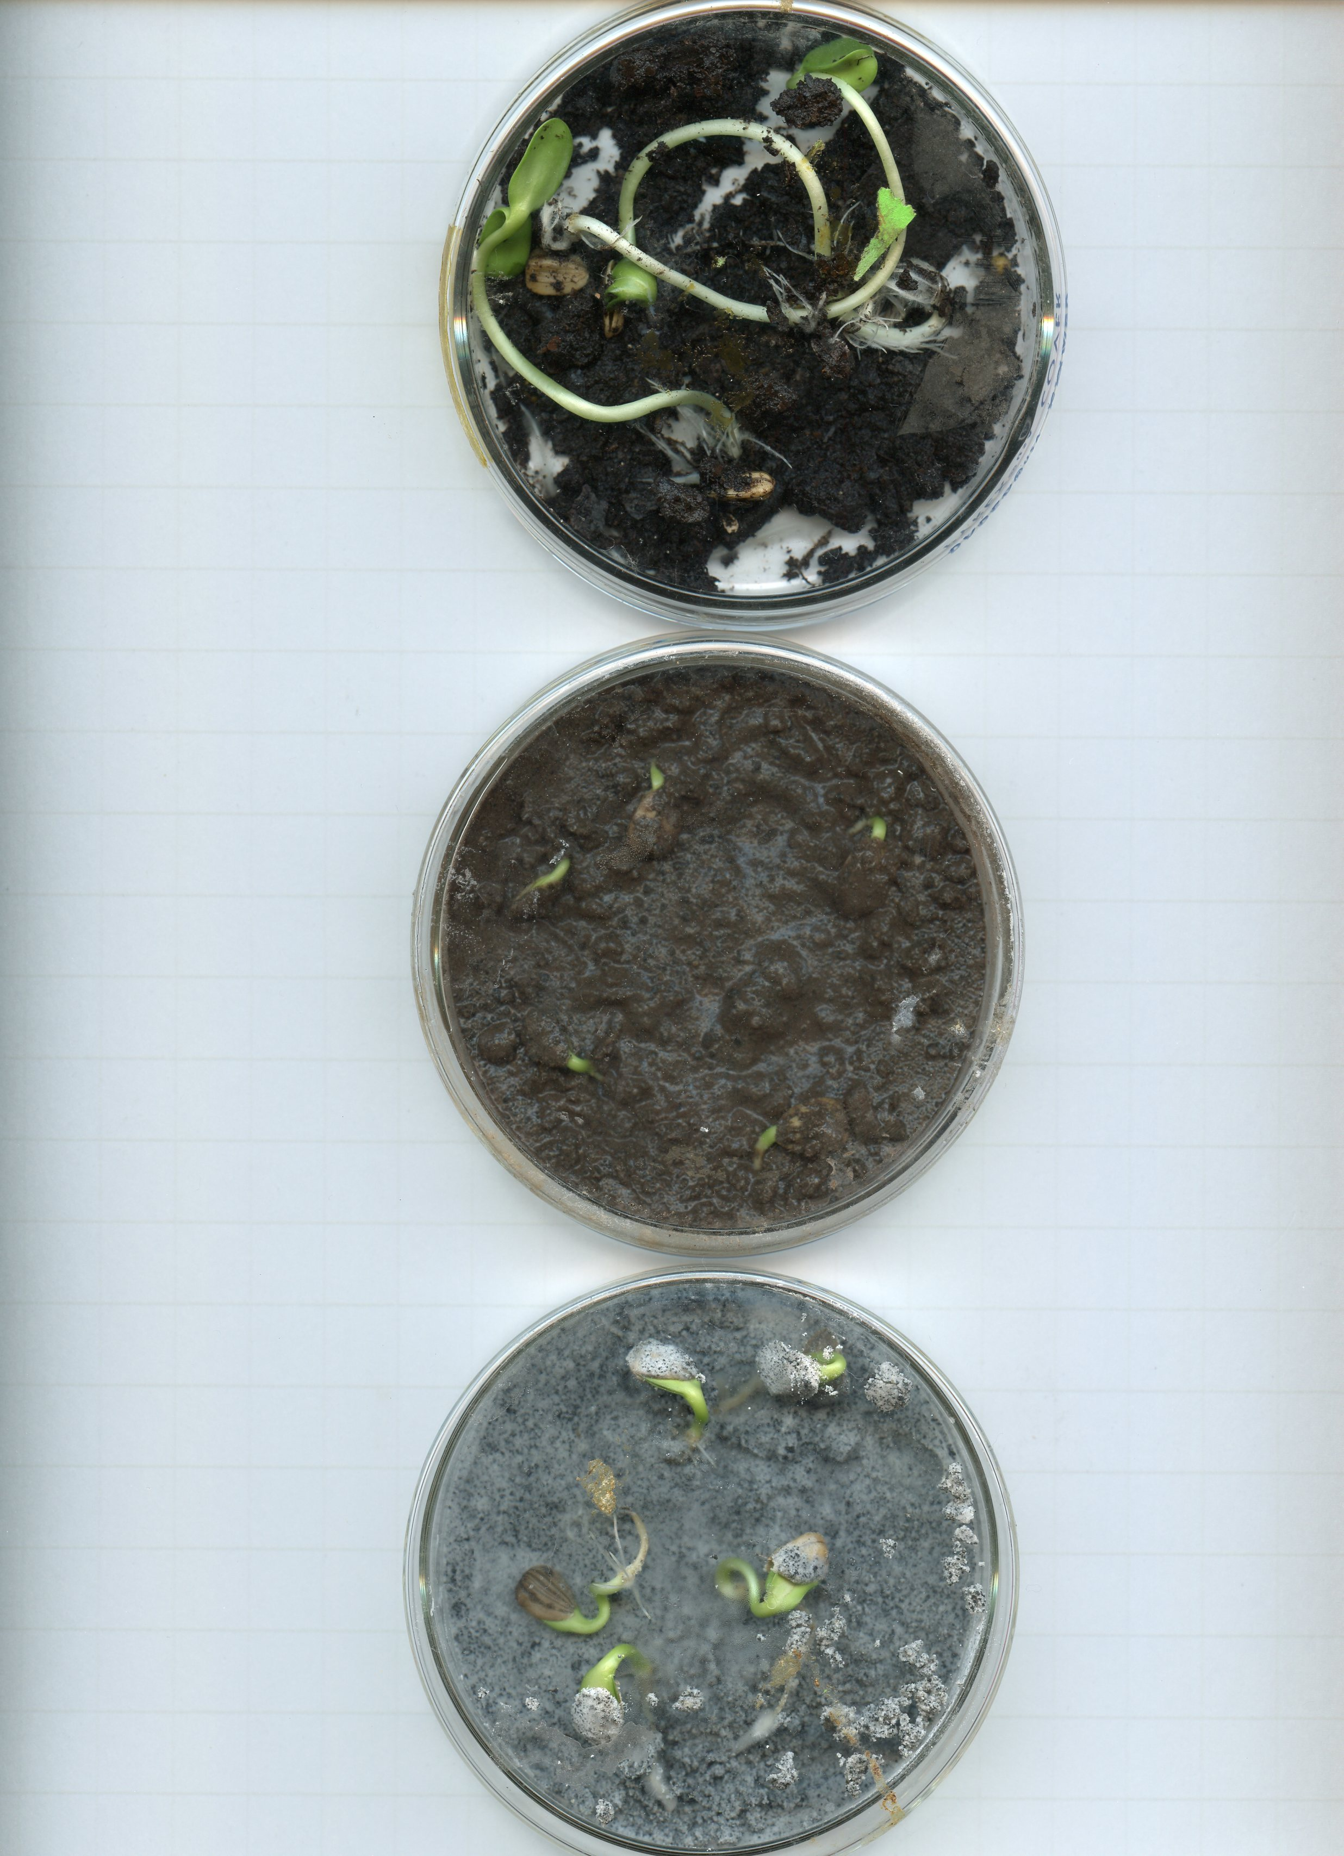
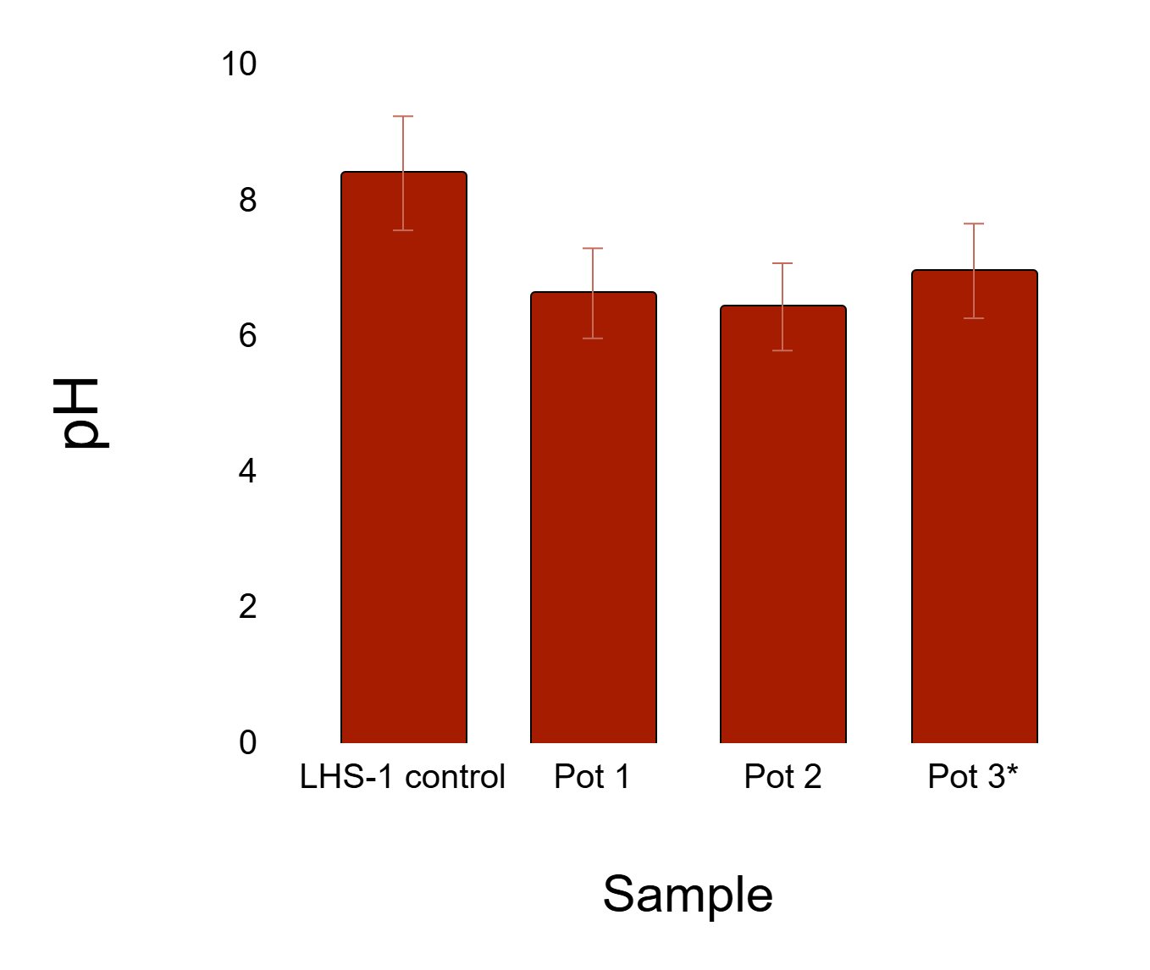
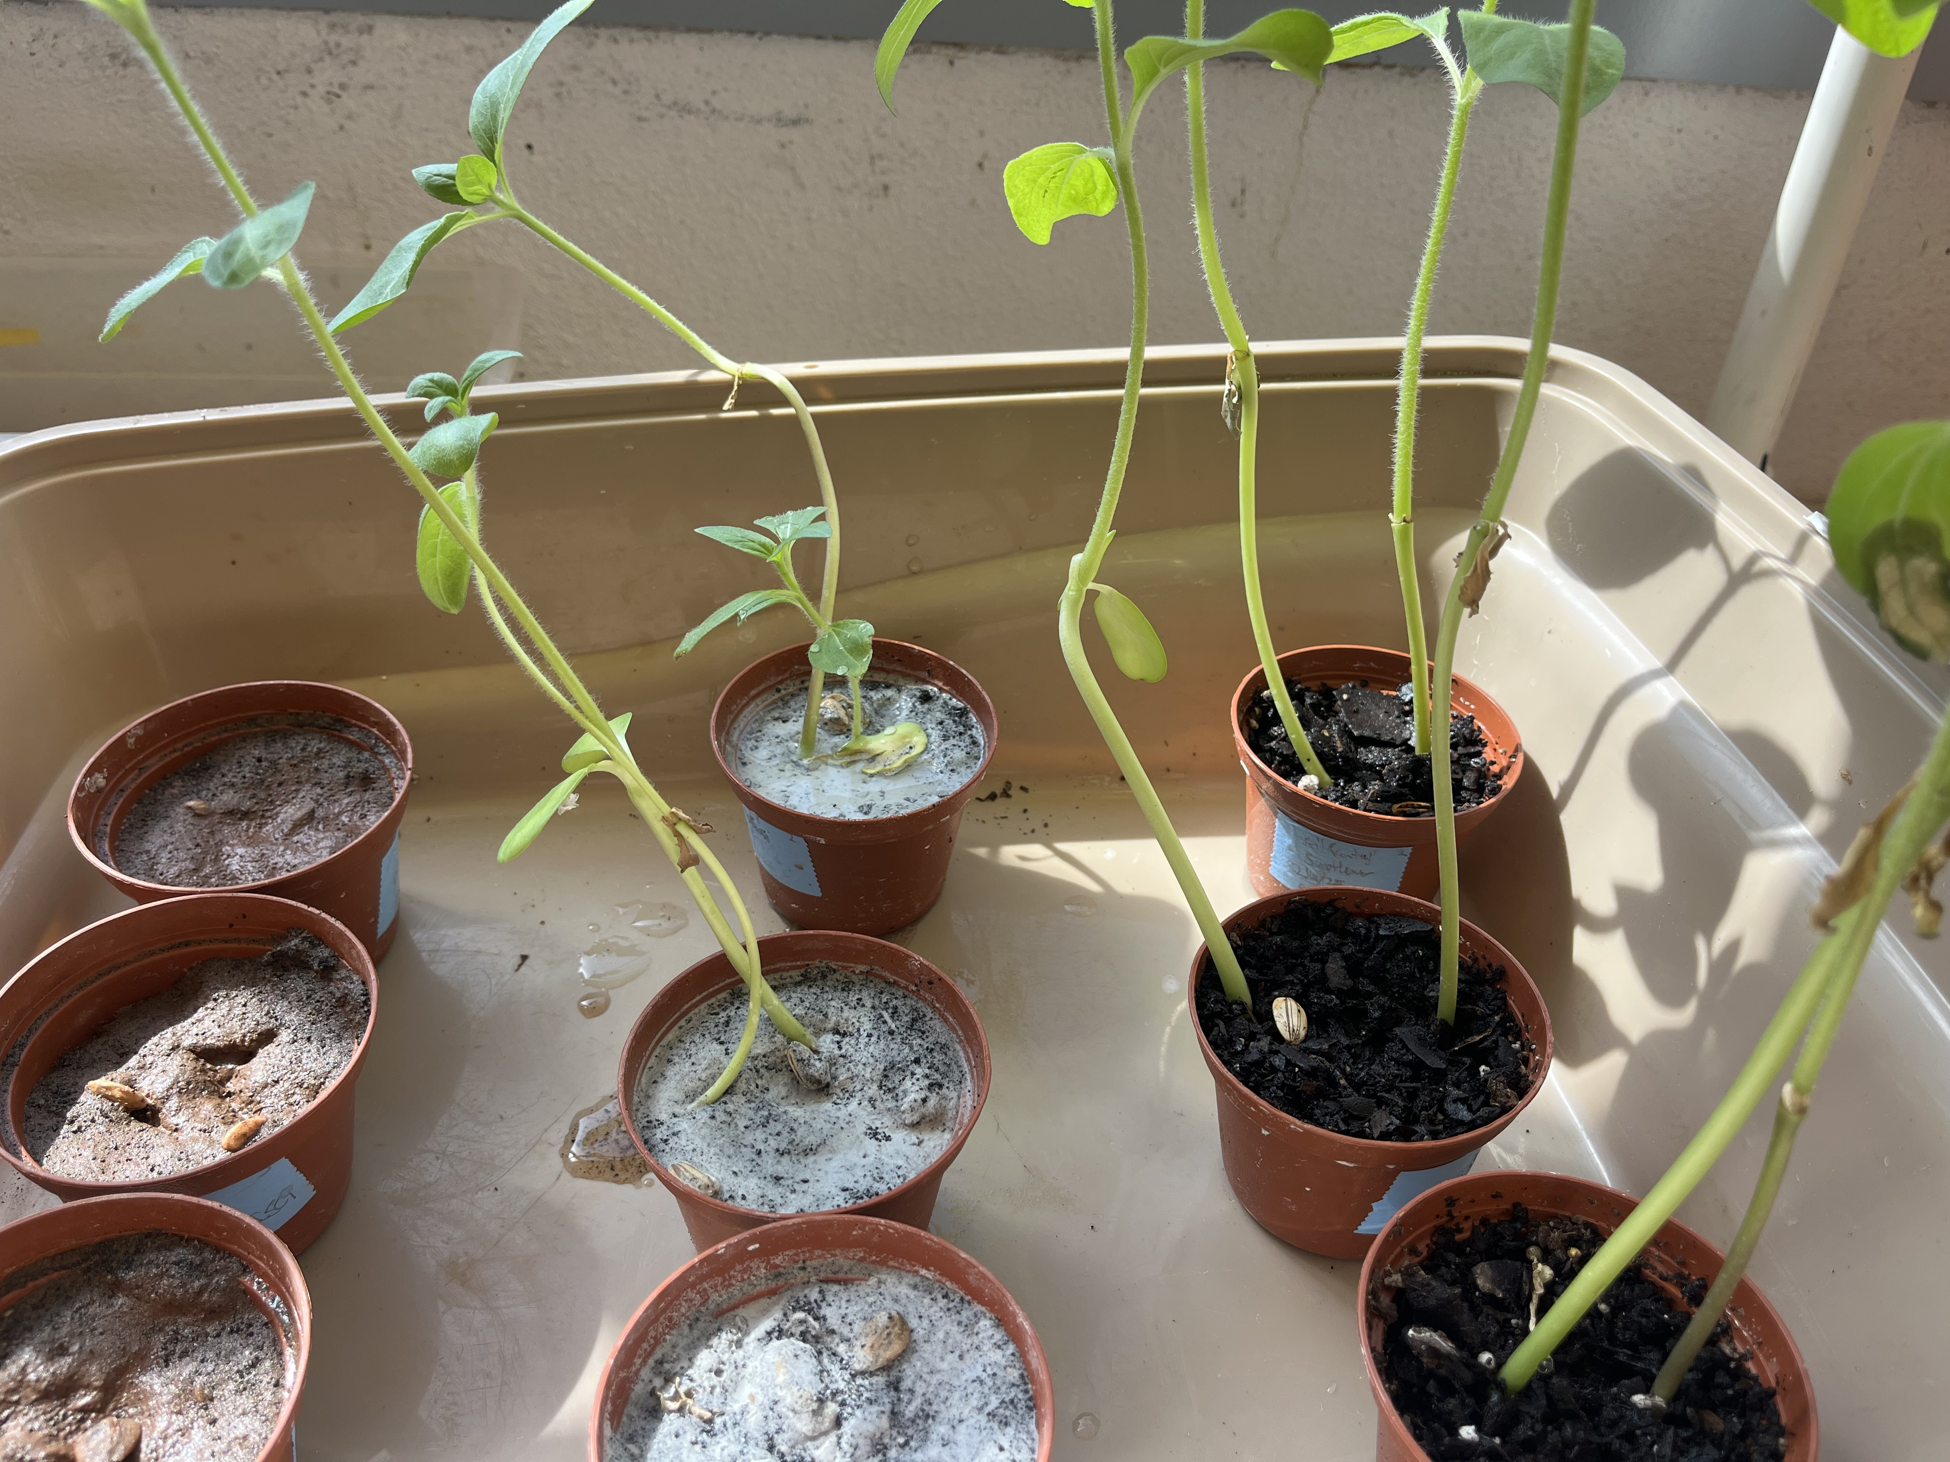
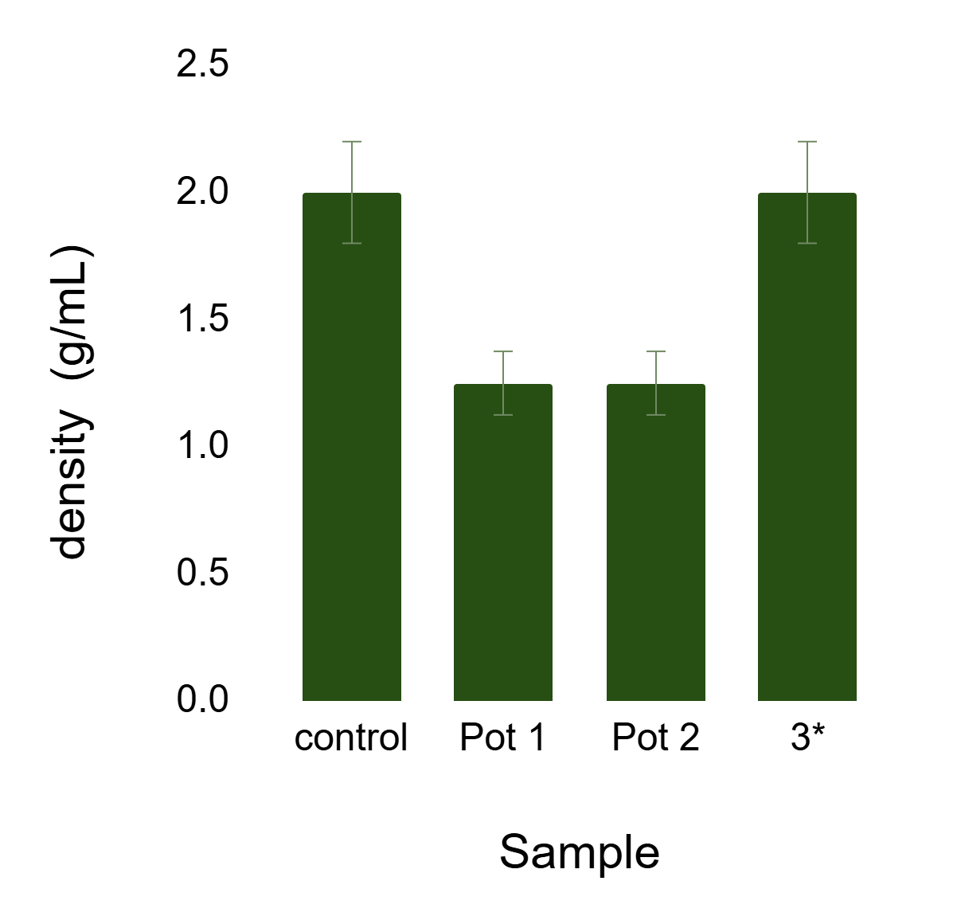
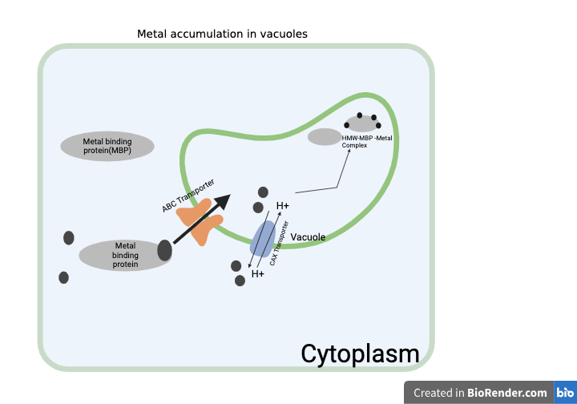
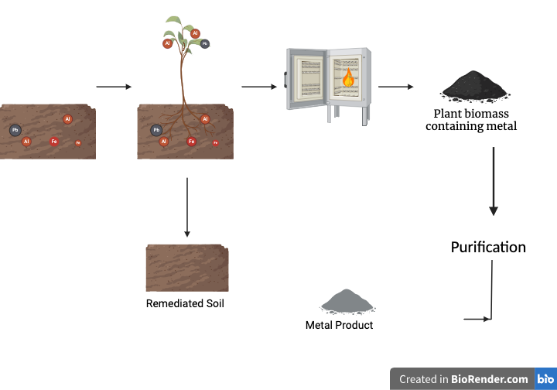
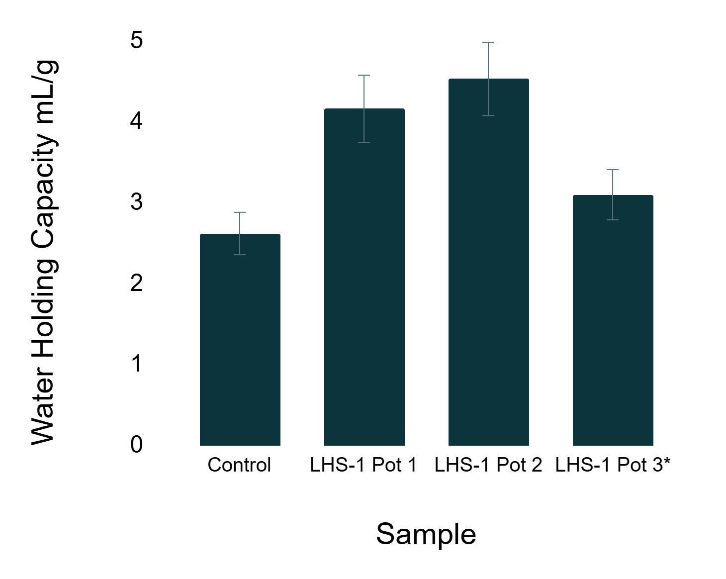
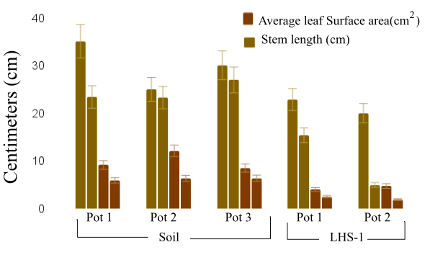
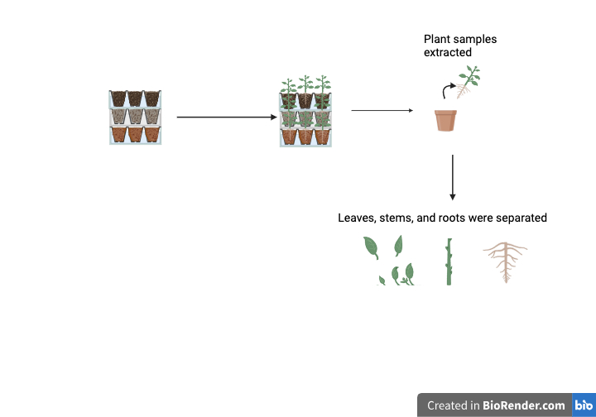
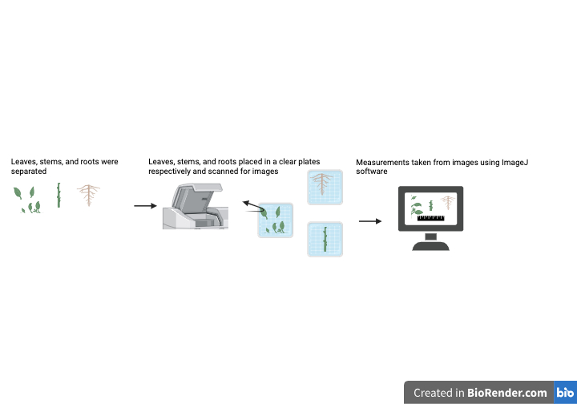
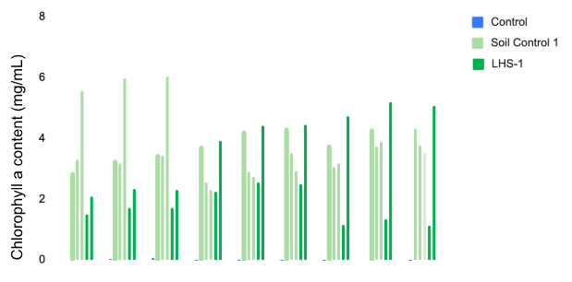
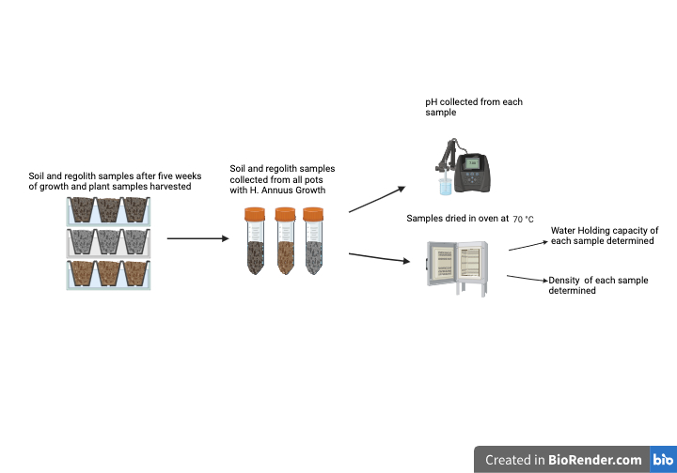
Metal extraction of regolith by Phytomining
Davonya Cheek
Faculty Advisor: Andrew G. Palmer Departments of: Ocean Engineering and Marine Sciences; Biomedical and Chemical Engineering and Sciences, Florida Institute of Technology
Background
Long-term Lunar and Martian settlements will require sustainable food production to ensure stability and security. Regolith at these sites may serve as a viable substrate for space crop production. However, both regoliths contain heavy metals detrimental to plant growth and may bioaccumulate to be toxic to settlers as well.
Hyperaccumulating plants accumulate metals in their roots and shoots by forming metal complexes that store and/or detoxify metal ions absorbed by the plant. Such hyperaccumulators can assist in both phytoremediation and phytomining.
Here I evaluate the potential of Helithanus annuus (sunflower) a known hyperaccumulator of heavy metals including lead, nickel and cadmium to grow in and remediate Martian and Lunar regolith simulants.
Results
Regolith characterization after H. annuus Growth:
Germination Experiment:
Figure 8: pH of samples with H. Annuus growth compared to LHS-1 control. Asterisk indicates no growth in the sample.
Soil (control)
MGS-1
LHS-1
Figure 4: Germination of H. annuus after 10 days. 100% germination in both LHS-1 and MGS-1.
Five- week accumulation Experiment:
Figure 9: Density of samples with H. annuus growth compared to LHS-1 control. Asterisk indicates no growth in the sample.
Figure 5: Results after five weeks of growth. The leftmost row of pots contained MGS-1. No H. annuus growth occurred in the MGS-1 pots. The middle row of pots contained LHS-1. H. annuus growth occurred in two of the three pots. The third row contained the soil control.
Figure 10: Water holding capacity of samples with H. Annuus growth compared to LHS-1 control. Asterisk indicates no growth in the sample.
Figure 1: Accumulation mechanism in vacuole of plant cell.
Figure 2: Objective. Graphic of Bioremediation and metal extraction via phytomining
Procedure
Conclusion
H. annuus has the potential to grow in lunar regolith simulant with limited impedance to growth.
Chlorophyll content in H. annuus is minimally affected by LHS-1, Lunar regolith simulant.
Growth in LHS-1 alters the physical properties of the lunar regolith simulant.
Figure 6: Stem length and average surface area of leaves from samples of H. annuus growth in LHS-1 compared to soil control.
Next Steps
Quantify metal accumulation in plant samples
Examine changes in composition of substrate samples.
Evaluate germination in substrate post H. annuus growth.
Future Directions
Evaluate H. annuus accumulation after full maturity has been reached.
Examine the accumulation of Nutrionally essential metals.
References
Dhiman SS Et Al. Metal accumulation by sunflower (Helianthus annuus L.) and the efficacy of its biomass in enzymatic saccharification. PLoS One. 2017 Apr 24;12(4):e0175845. doi: 10.1371/journal.pone.0175845. Erratum in: PLoS One. 2017 Jun 9;12(6):e0179746. doi: 10.1371/journal.pone.0179746. PMID: 28437478; PMCID: PMC5402931.
Figure 3: Experimental Design.
Figure 7: Chlorophyll a content from samples of H. annuus growth in LHS-1 compared to soil control.

