Slide 1
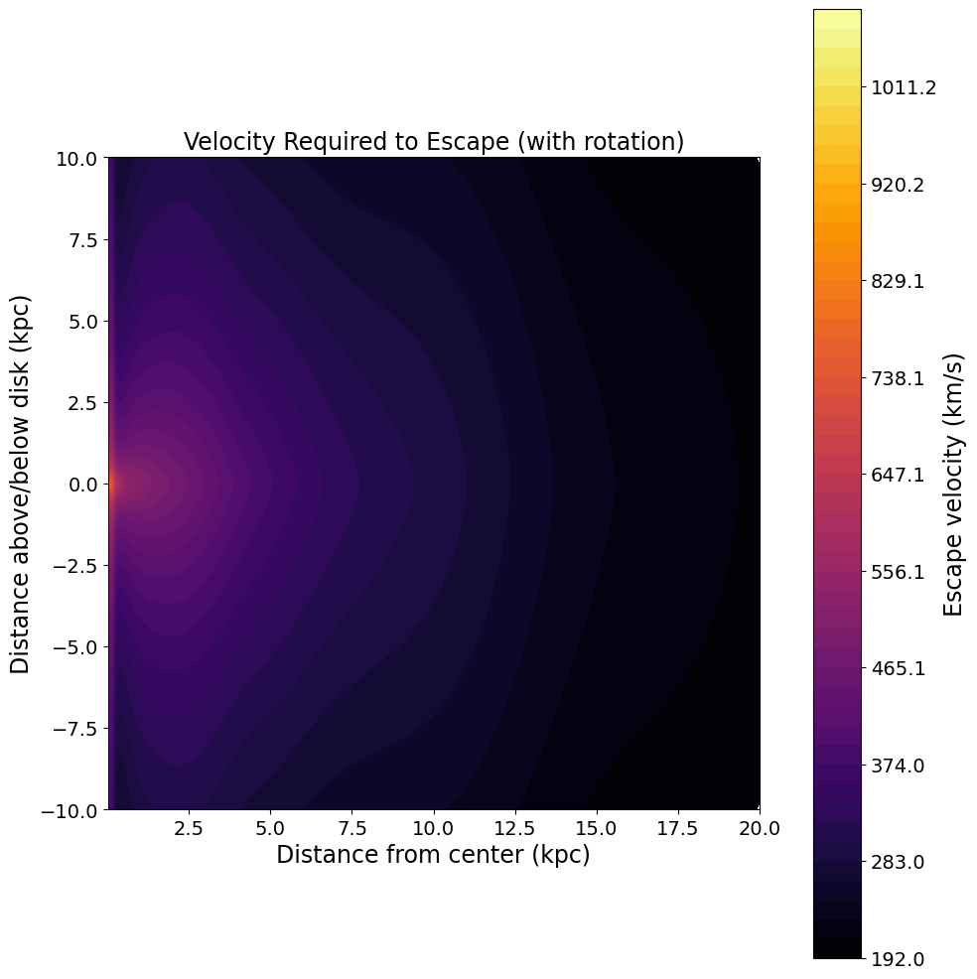
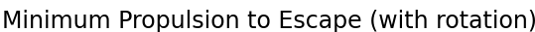
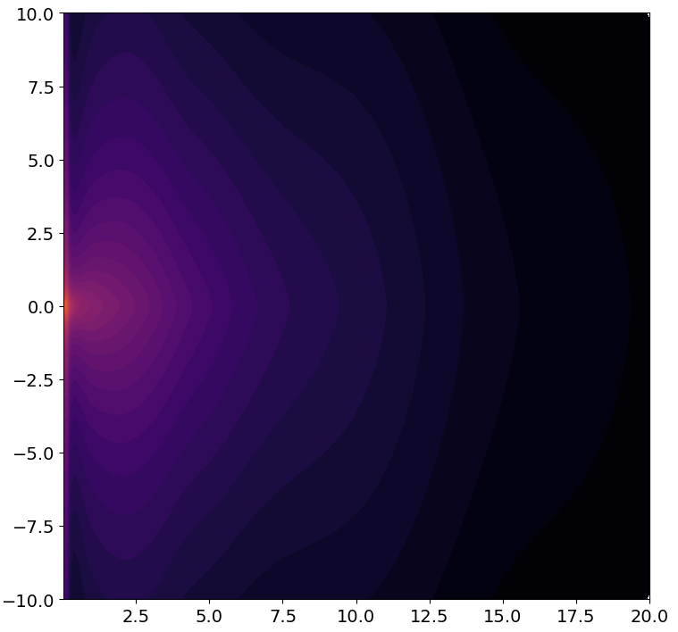

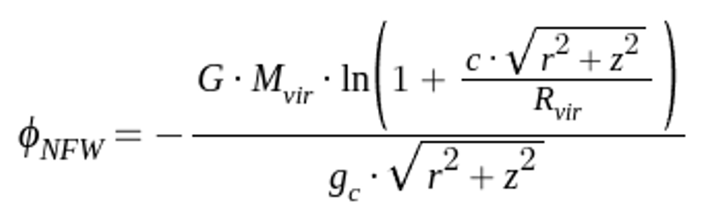
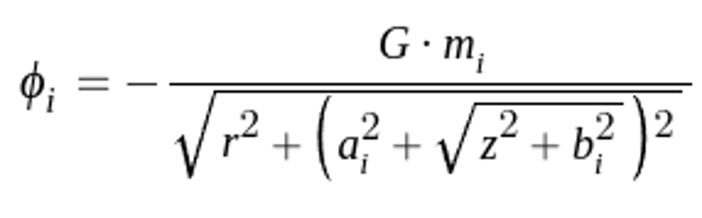
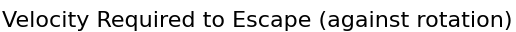
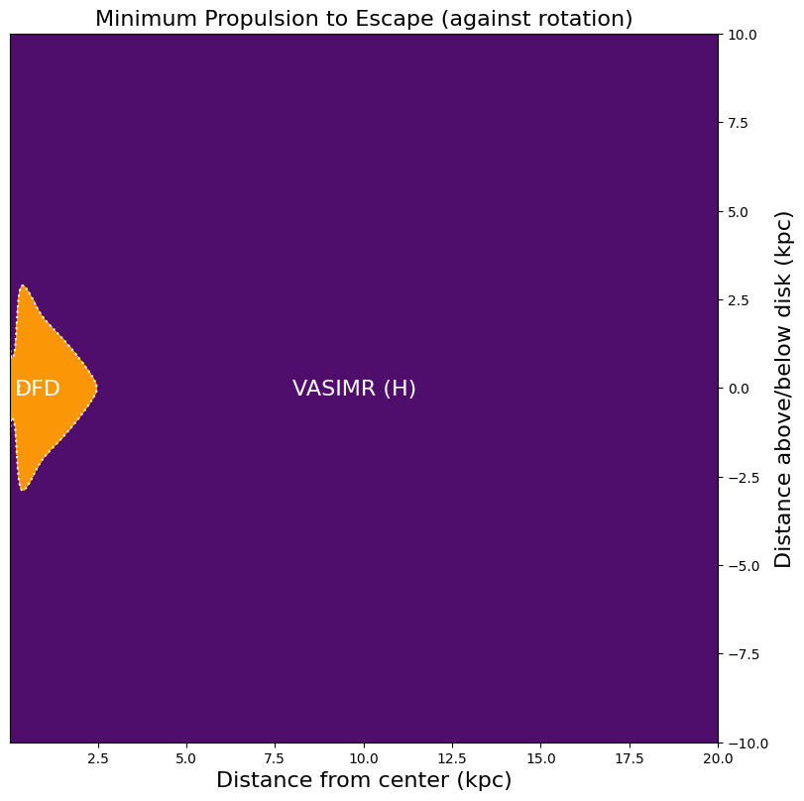
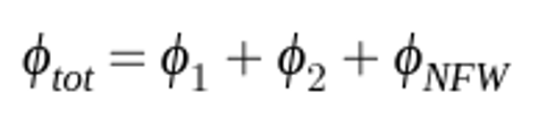
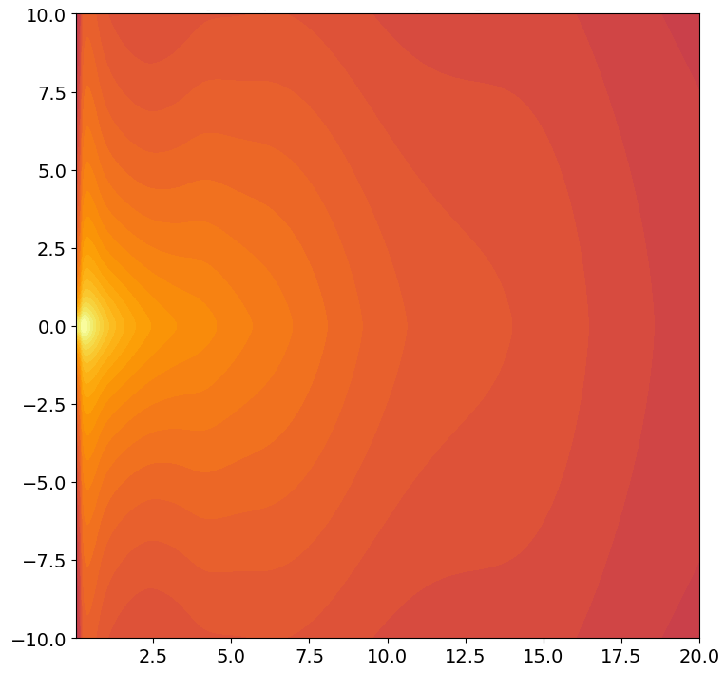
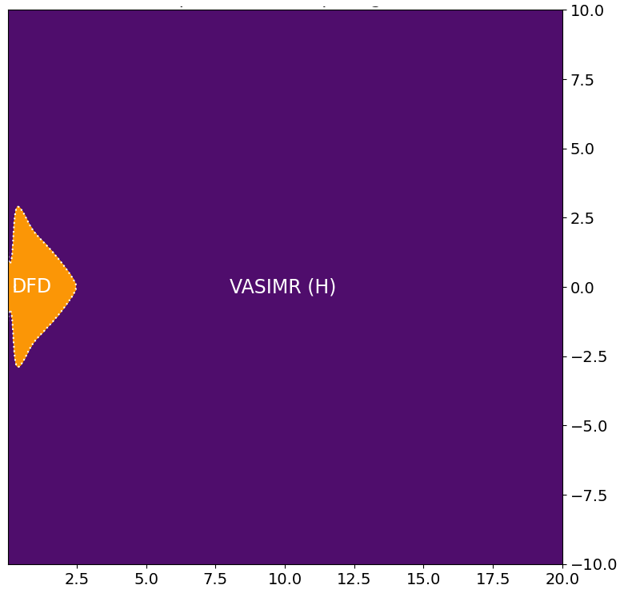
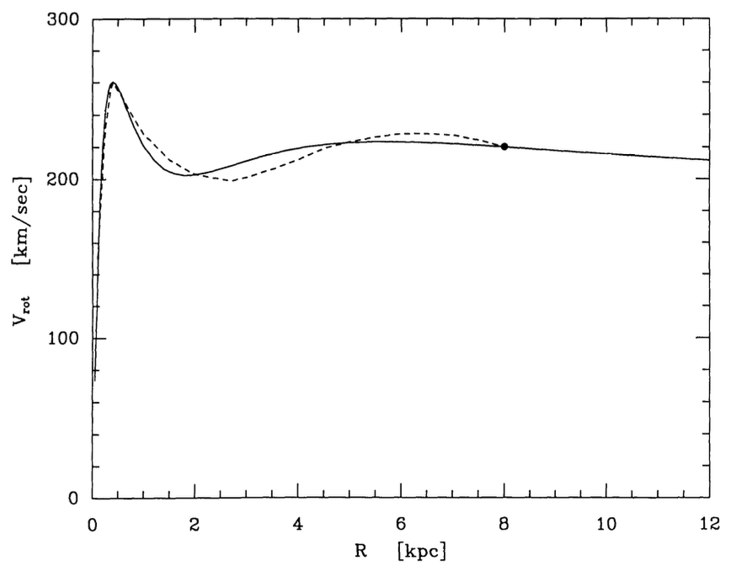
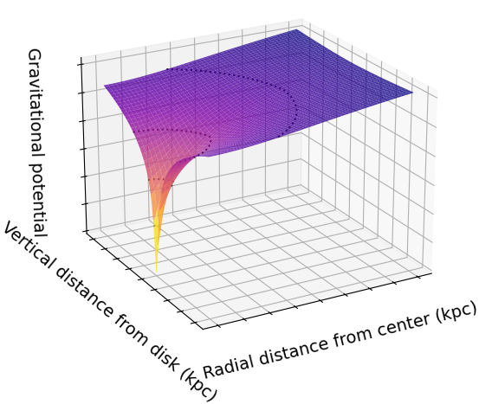
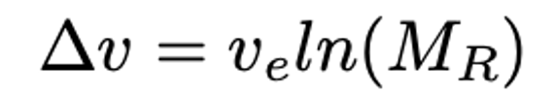

Galaxy Quest: Using Gravitational Potential to Determine
the Propulsion Methods Necessary for Extragalactic Travel
Colin Harrison, Kate Helminiak, Bryce Johnson
Faculty Advisor: Dr. David Harris, Dept. of Aerospace Physics and Space Sciences, Florida Institute of Technology
Introduction
The escape velocity from the Milky Way depends on the gravitational potential of the galaxy. We identified the propulsion methods that could be used to send a probe outside of the galaxy. The depth of the gravitational well determines which methods are required to escape.
Methods
To model the gravitational potential of the Milky Way, the contributions from the disk, bulge, and halo must be considered. The galaxy’s total potential is represented by the following equations^{1,2}:
Figure 1: Galactic Rotation Curve ³ Figure 2: Gravitational Well
Results
A probe sent against the rotation of the galaxy requires a greater change in velocity to escape. Traveling in the same direction as the rotation requires less change in velocity.
Propulsion Methods
We assume a Δv equal to three times the exhaust velocity, using a mass ratio of 20.
Tsiolkovsky Rocket Equation:
Figure 3: Escape Velocity with Rotation
Figure 4: Escape Velocity Against Rotation
Conclusion
The propulsion methods required to escape the Milky Way include DHD, VASIMR, and Hall Thrusters. When launching away from the galaxy against the rotation curve, only DFD and VASIMR are plausible. While launching with the rotation, the plausible methods are DFD, VASIMR, and Hall Thrusters.
References
Kafle 2014 ApJ 794 p. 17
Paczynski 1990 APJ 348 p. 485
Sofue 2020 Galaxies p. 37
10
0
20
-10
0

