Slide 1
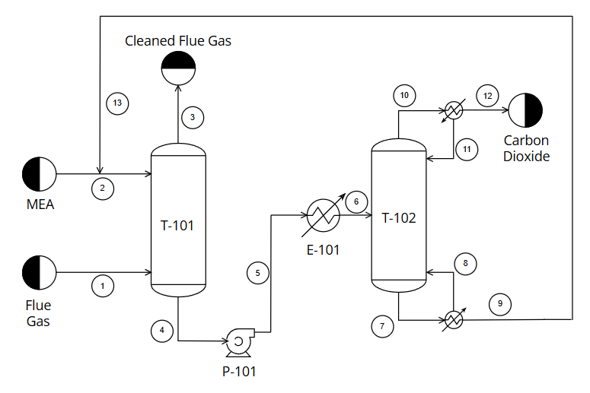
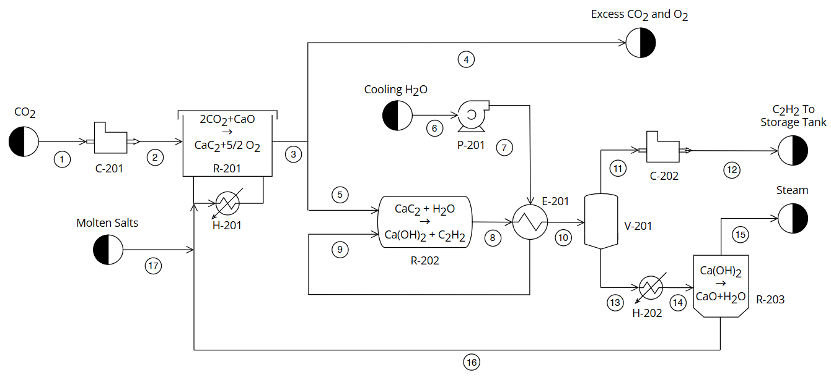
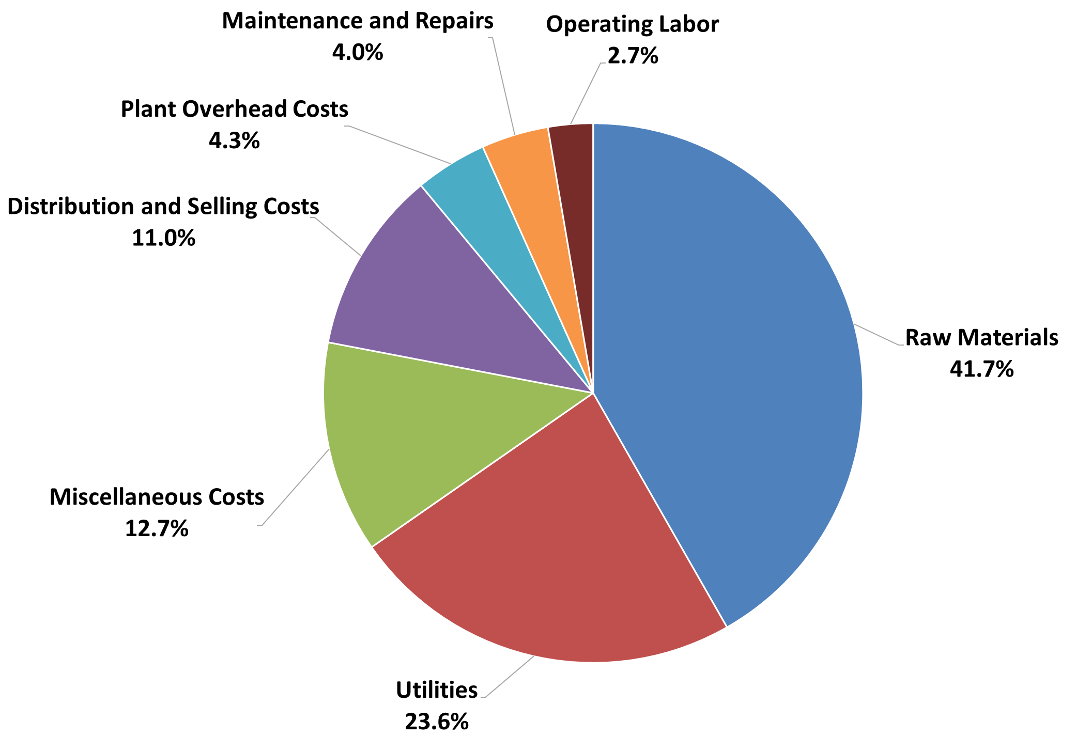
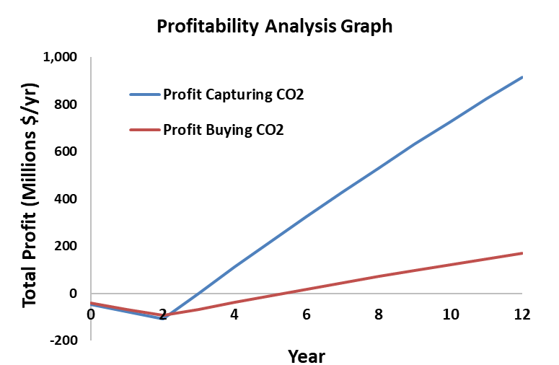
Sustainable Acetylene Synthesis (SAS)
Taylor Disharoon, Gene Koifman, Erik Laari, Isabella Luznar
Faculty Advisor: Dr. Jonathan E. Whitlow, Dept. of Chemistry and Chemical Engineering, Florida Institute of Technology
Abstract
Process Flow Diagram
PFD Table Index
Sustainable acetylene production process using CO₂ from flue gas, CaO, and water, with an innovative approach to carbon capture and high-purity acetylene generation, supporting industrial demand and reducing greenhouse gas emissions.
Novelty
The process captures CO₂ from flue gas using MEA absorption, converting waste emissions from coal plants into acetylene feedstocks.
Electrochemical reduction of CO₂ in a molten salt reactor produces calcium carbide, which is hydrolyzed to generate high-purity acetylene.
Reactions
Carbon Capture:
MEA + CO₂ → (R-NH-COO)⁻ + H⁺
(R-NH-COO)⁻ + H⁺ → MEA + CO₂
Acetylene Synthesis:
2CO₂ (g) + CaO (l) → CaC₂ (s) + 2.5O₂ (g)
CaC₂ (s) + H₂O (l) → C₂H₂ (g) + Ca(OH)₂ (aq)
Process Specifications
Economics and Profitability
Plant located in Tatum, Texas
Capital cost of $75 million
Annual manufacturing cost of $158 million
Net profit of $923 million after 2 years of construction and 10 years of production
Internal Rate of Return on Investment of 52%
Breakeven point after 3 years
4,300 kmol/hr CO₂ captured from flue gas
1,400 kmol/hr pure acetylene produced
Raw material cost is $66 million

