Slide 1
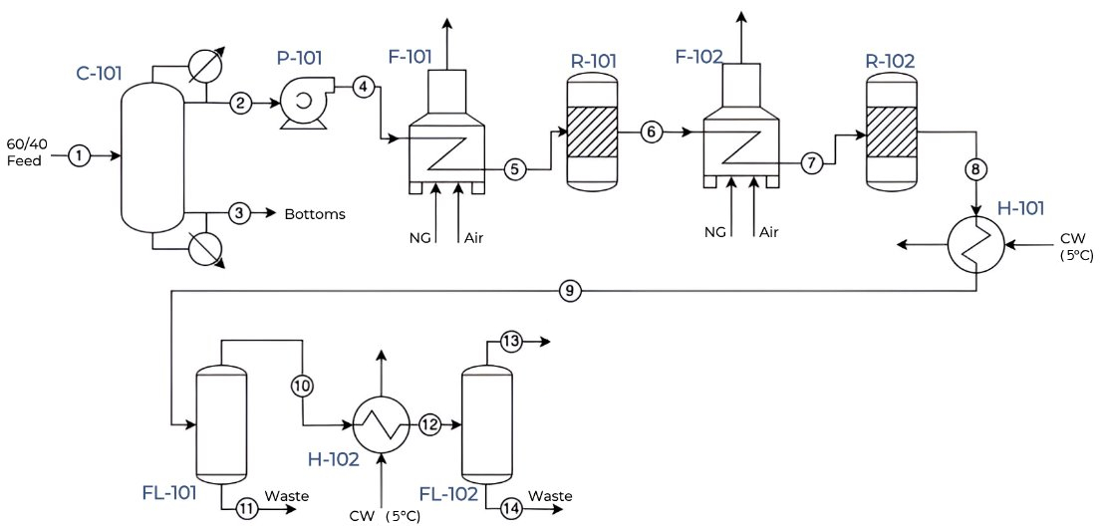

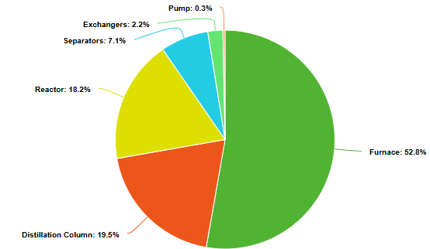
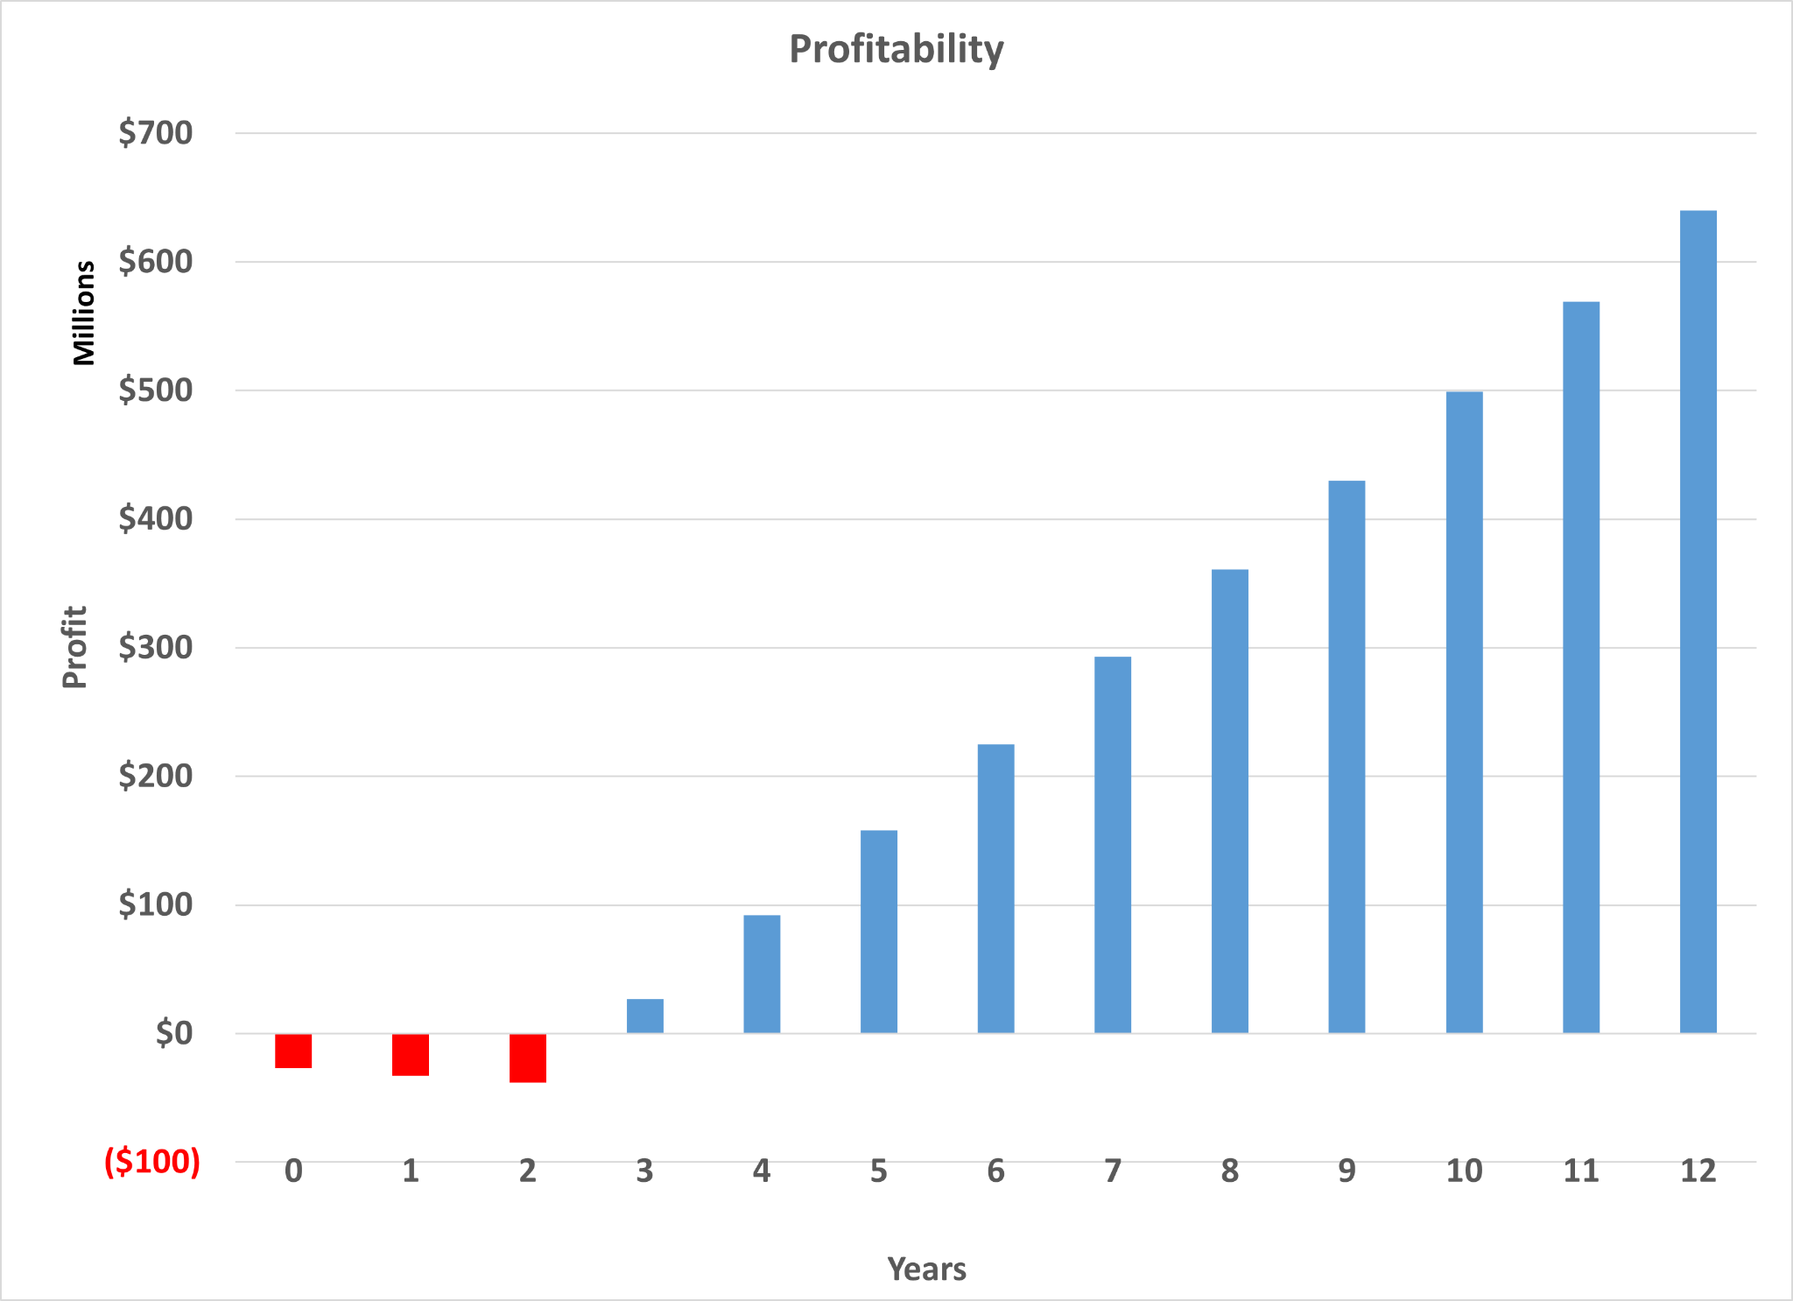
Ethanol to Ethylene via CircleStar Catalyst
Lucca DeMarco, Max Puig Powell, Caden Royster
Faculty Advisor: Dr. Jonathan E. Whitlow, Dept. of Chemistry and Chemical Engineering, Florida Institute of Technology
Abstract
Process Flow Diagram
Ethanol-to-ethylene conversion via catalytic dehydration is optimized using the CircleStar catalyst, whose unique geometry improves heat distribution and site exposure. This enables lower operating temperatures, 99.5% selectivity, and reduced emissions. The process supports renewable feedstocks and yields $70 million in annual profit at scale.
50,000 gal/hr
60% water
40% ethanol
Novelty
Product
37,000 kg/hr
99% ethylene
PFD Table Index
Unique catalyst shape maximizes surface area and catalyst lifetime
Operates 25 ℃ cooler than alternative shapes
Reduces carbon emissions by 10%
Selectivity improved to 99.5%
Index | Description
C-101 | Distillation Tower
P-101 | Centrifugal Pump
F-101 | Natural Gas Furnace
R-101 | Packed Bed Reactor
F-102 | Natural Gas Furnace
R-102 | Packed Bed Reactor
H-101 | Floating Head Cooler
FL-101 | Two-Phase Separator
H-102 | Fixed Pipe Cooler
FL-102 | Two-Phase Separator
Design Method
Designed and Modeled in Aspen V14
PFD modeled in process flow diagram editor on Draw
CircleStar design from BASF
Reactions
Ethanol ⇄ Ethylene + Water
Ethanol → Acetaldehyde + Hydrogen
2 Ethanol → Diethyl Ether + Water
Economics and Profitability
Process Specifications
Plant located in Sioux Falls, South Dakota
Capital cost of $35 million
Annual manufacturing cost of $490 million
Net profit of $640 million after 2 years of construction and 10 years of production
Break even point after 6 months
37,000 kg/hr of ethylene produced annually

