Slide 1
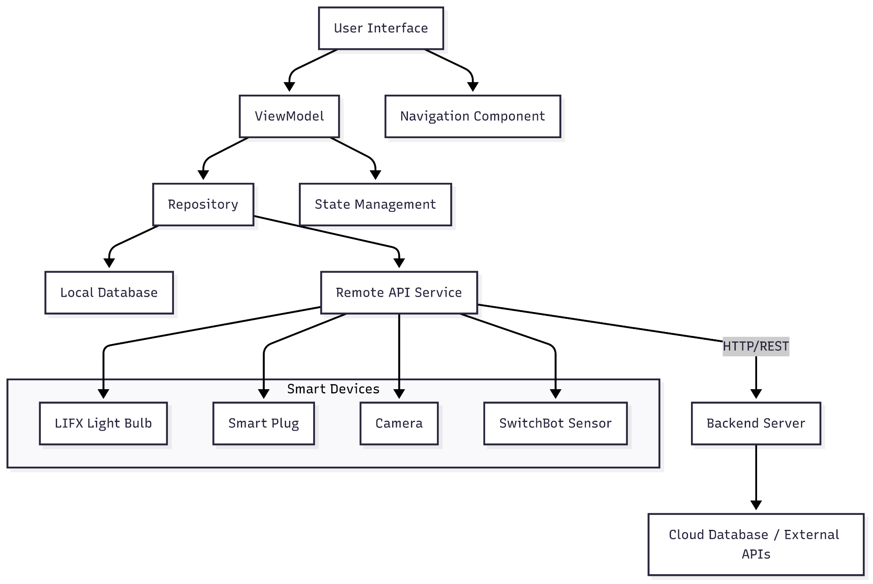
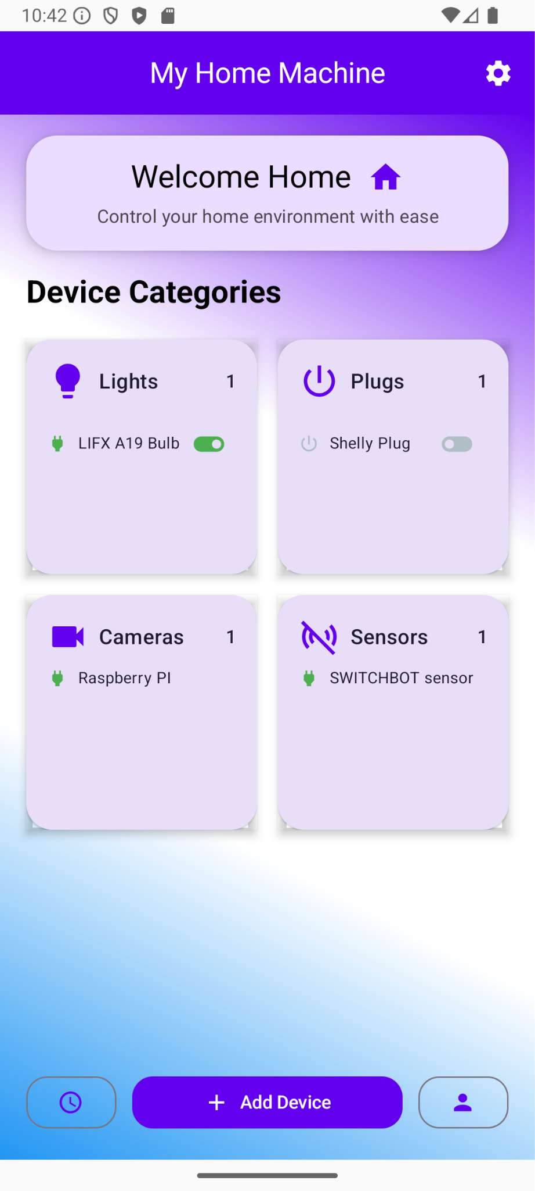
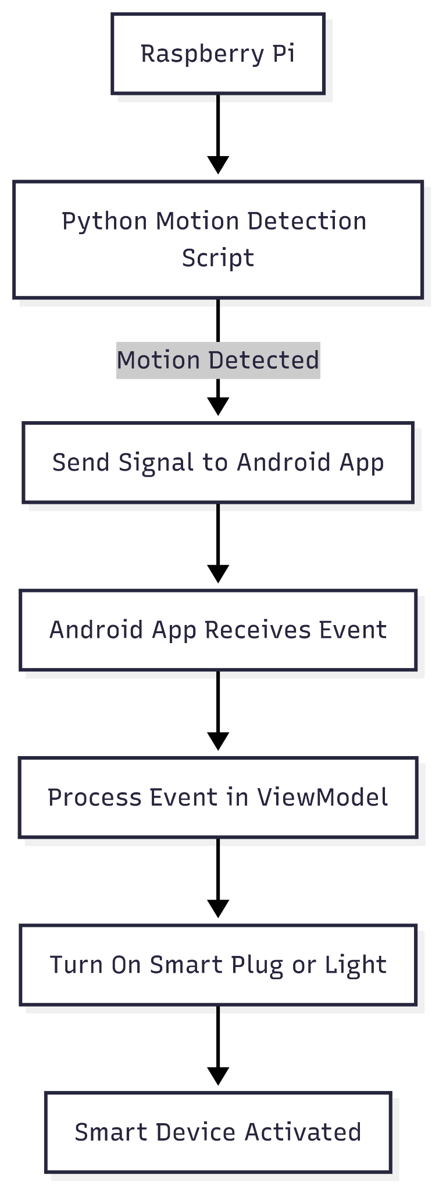
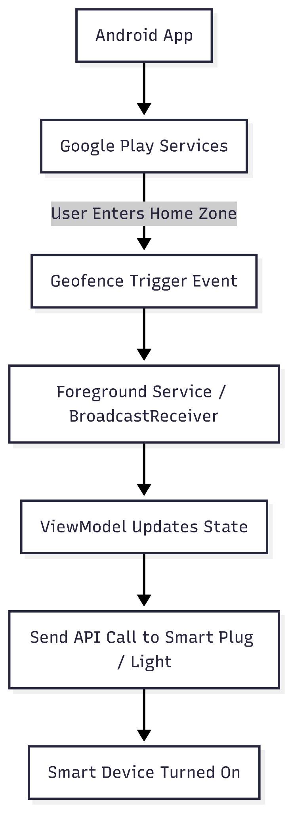
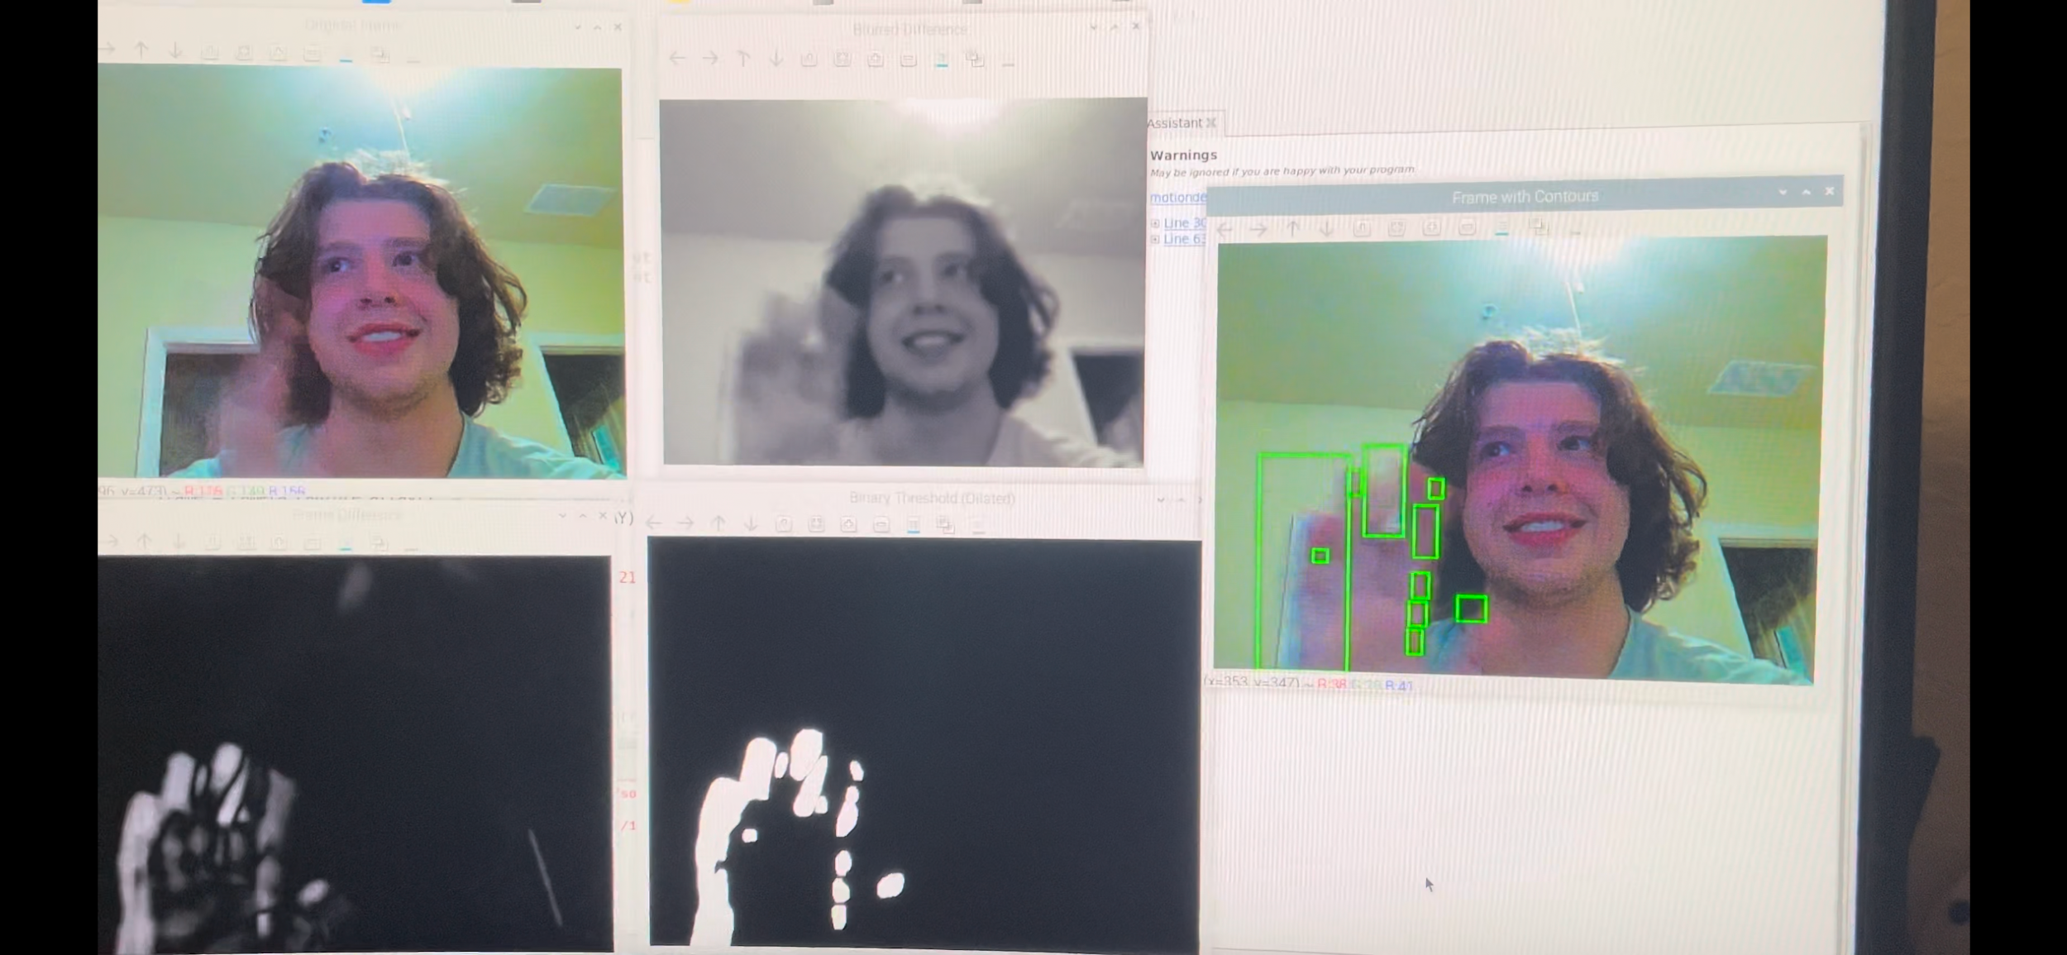
My Home Machine
John Wimmer, Steven Chase, Al Waleed Al Saleemi, Wala Aljohani
Faculty Advisor(s): Dr. Marius Silaghi, Dept. of Department of Electrical Engineering and Computer Science, Florida Institute of Technology
MISSION
Design an Android App that is capable of connecting to smart devices through Wi-Fi and APIs.
Make everyday life less tedious for our users through the ability to control smart devices, schedule tasks, utilize cameras, and monitor smart sensors.
Our app is engineered for user satisfaction, with a UI designed for easy to understand navigation and minimal button presses.
GEOFENCE
SYSTEM ARCHITECTURE
DEVICE CONTROL
Connects to the app via Google Play Services
Requires permission from the user to have access to background location
User sets a location and a radius
Transition functions to activate Smart Devices
Connection and control over several smart devices including smart plugs, lights, cameras, and sensors
LIFX Smart Light: Power, brightness, color Control via API connection and custom commands
Shelly Smart plug: Power control via HTTP commands over LAN connection
Switchbot thermo-hygrometer: Connects via Switchbot API and provides temperature and humidity data over the internet via request
RaspberryPi camera with flask server for virtual motion detection monitoring
SCHEDULING
Set timers for all connected smart devices
Choose specific days and times for automated actions
Device-specific options (color/brightness for lights)
Receive notifications when scheduled actions occur
UI
Figure 1: Full System FlowChart
MOTION DETECTION
Grid layout allowing selection between device types
On/Off toggle buttons for each device on home screen
More functionalities when selecting specific device
Dynamic icons reflecting device connectivity on home screen
Ability to add device, access settings, and schedule tasks on the same page
RaspberryPi Camera Connects to the app via Flask server
Motion detection script written in Python
Frame Differencing
Motion detection can be used to trigger Smart Devices
SECURE BACKEND
Flask app hosted on AWS EC2 Using HTTPS
User authentication with PBKDF2-SHA256 hashing and salting
Time-limited verification codes for email and password resets
SQL injection protection via parameterized queries
FUTURE WORK
Integration with Amazon Alexa/Google Home
Feedback System for water/electricity usage
Integration with machine learning to automatically detect users’ schedules
Integration with Matter/MQTT Protocols
Figure 2: Motion Detection FlowChart
Figure 3: GeoFence FlowChart

