Slide 1

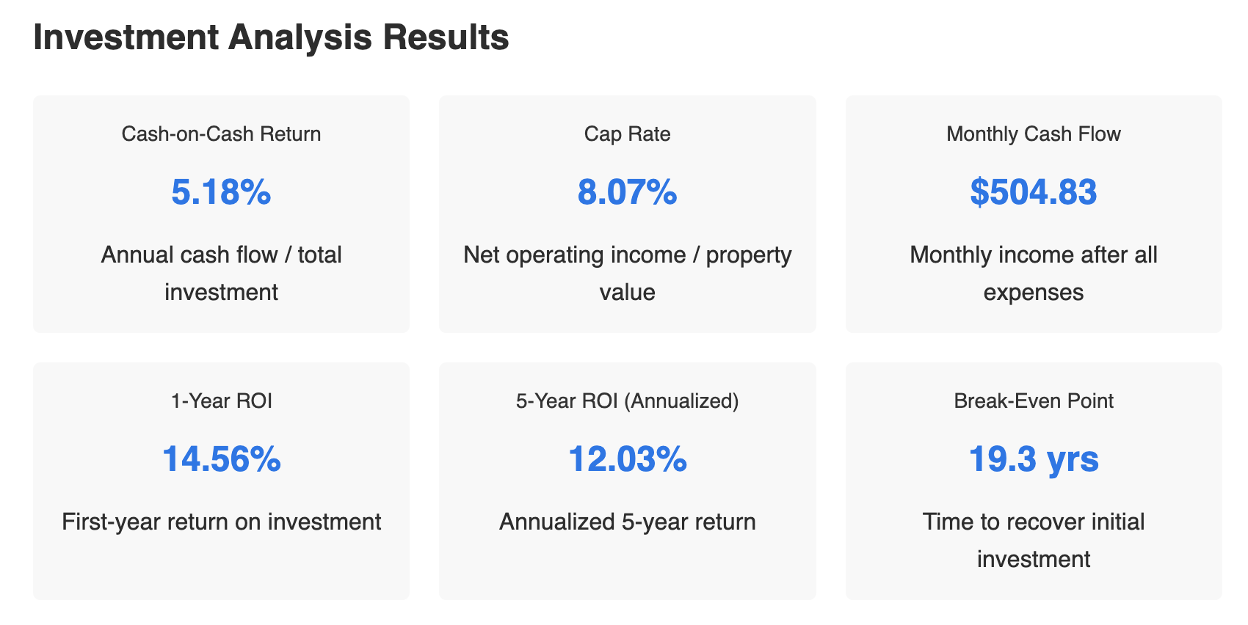
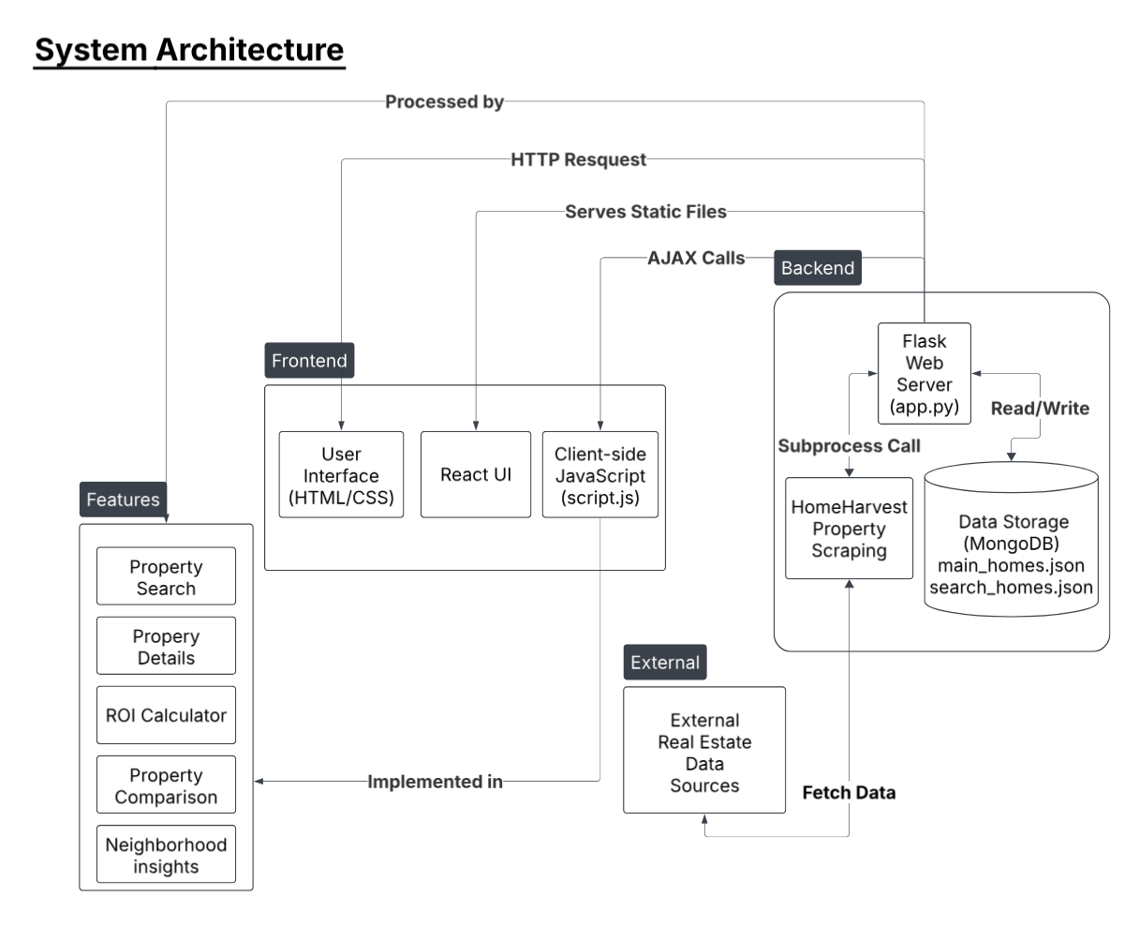

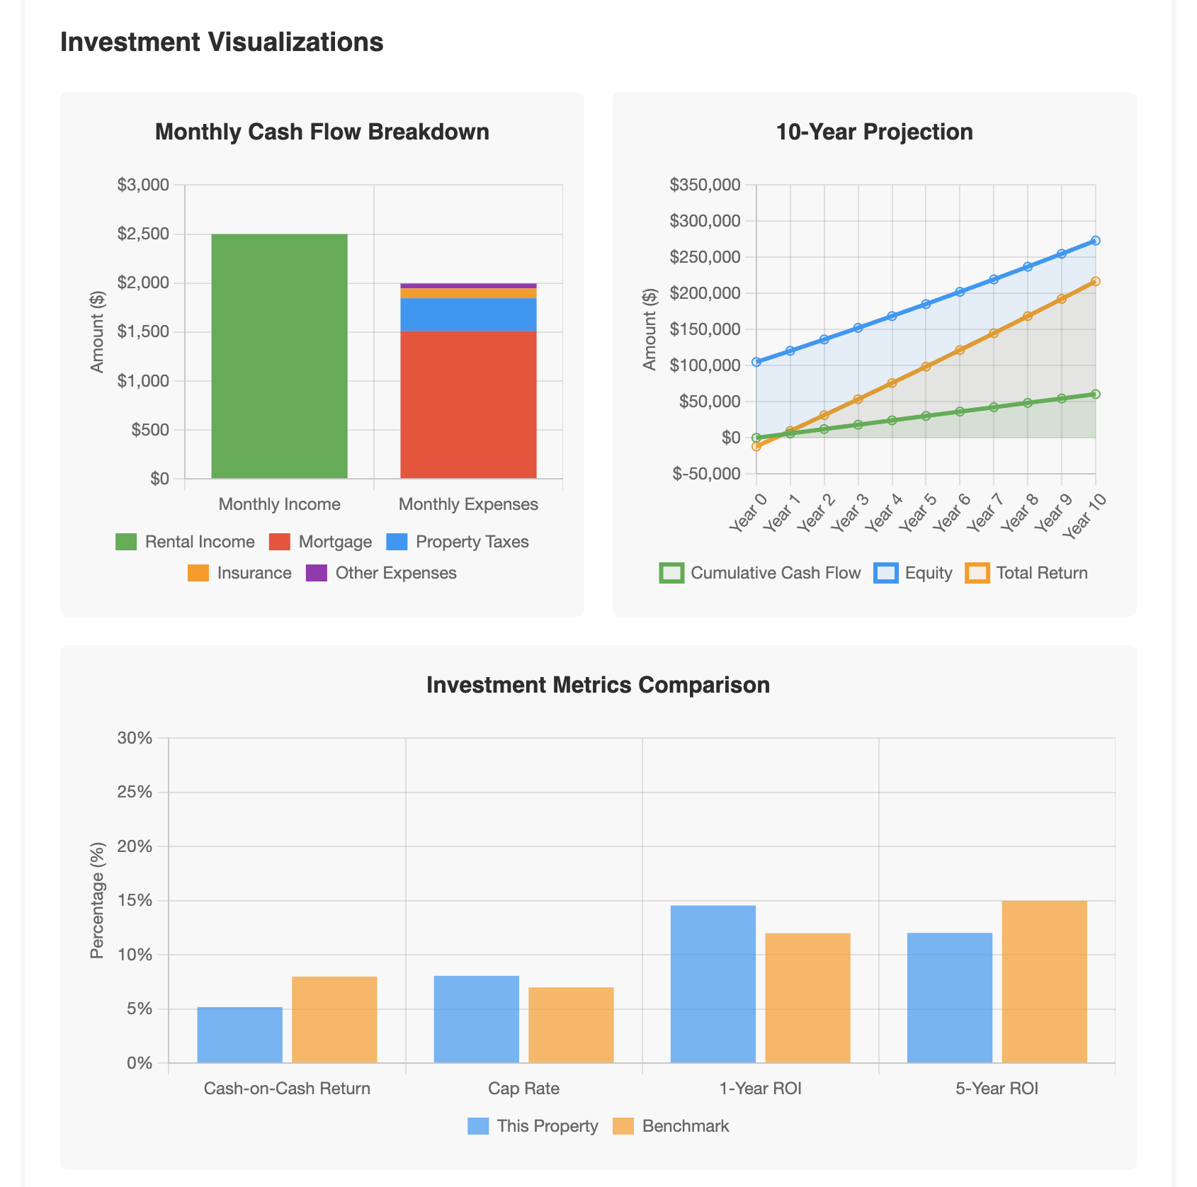
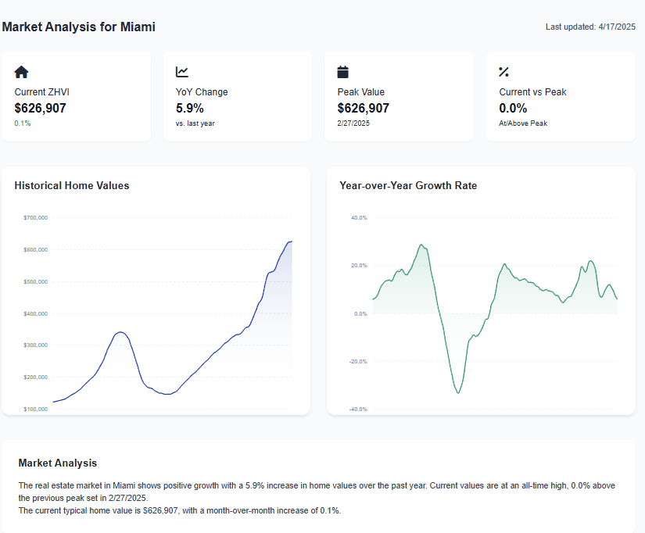
RealEase
Donovan Murphy, Jonathan Bailey, and Enrique Obregon
Faculty Advisor: Dr. Fitzroy Nembhard, Dept. of Computer Science,
Florida Institute of Technology
Novelty
Abstract
Methods
RealEase’s unique tools include:
Market Insights: Visualizes historical data, trends, and value indices with interactive charts.
Home Comparison Tool: Color-coded metrics for intuitive property evaluation.
ROI Calculator: Simplifies financial analysis with instant cash flow and appreciation metrics.
RealEase transforms home buying through a web platform that integrates advanced property analysis with intuitive tools. Aggregating listings via various APIs, it offers a Market Insights Dashboard for visualizing trends and value indices, a Home Comparison Tool with color-coded evaluations, an ROI Calculator for financial projections, and robust Home Search functionality. Leveraging machine learning, RealEase empowers users with data-driven decisions, making sophisticated real estate analysis accessible to everyone.
Data Aggregation: HomeHarvest and API data stored in MongoDB for real-time listings.
Backend: Flask for data processing.
Frontend: React, JavaScript and Plotly.
Features: Comparison tool, ROI calculator, market insights, and location-based search.
Machine Learning: XGBoost for price predictions using aggregated data.
Testing: Iterative usability tests and design updates for reliability and user experience. This ensures a robust, user-friendly platform.
Motivation
The real estate market’s fragmented data and limited analytical tools challenge buyers making significant financial decisions. RealEase addresses this by centralizing comprehensive listings and delivering advanced analysis tools. It enhances transparency with actionable insights into investment potential and lifestyle factors, empowering users to navigate the home-buying process with confidence and clarity.

