Slide 1

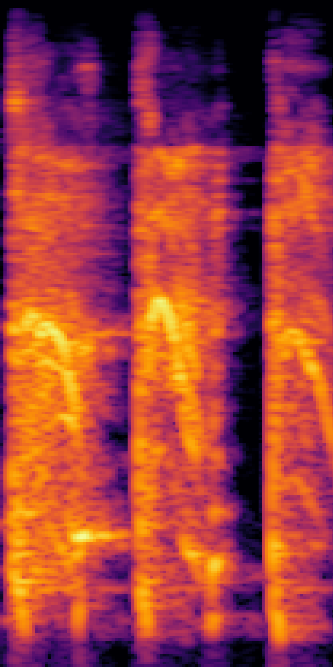
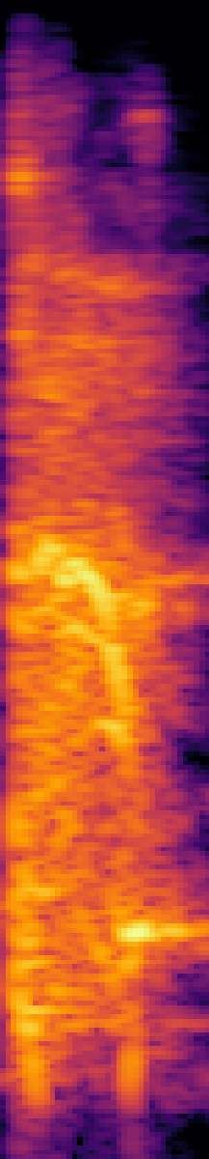
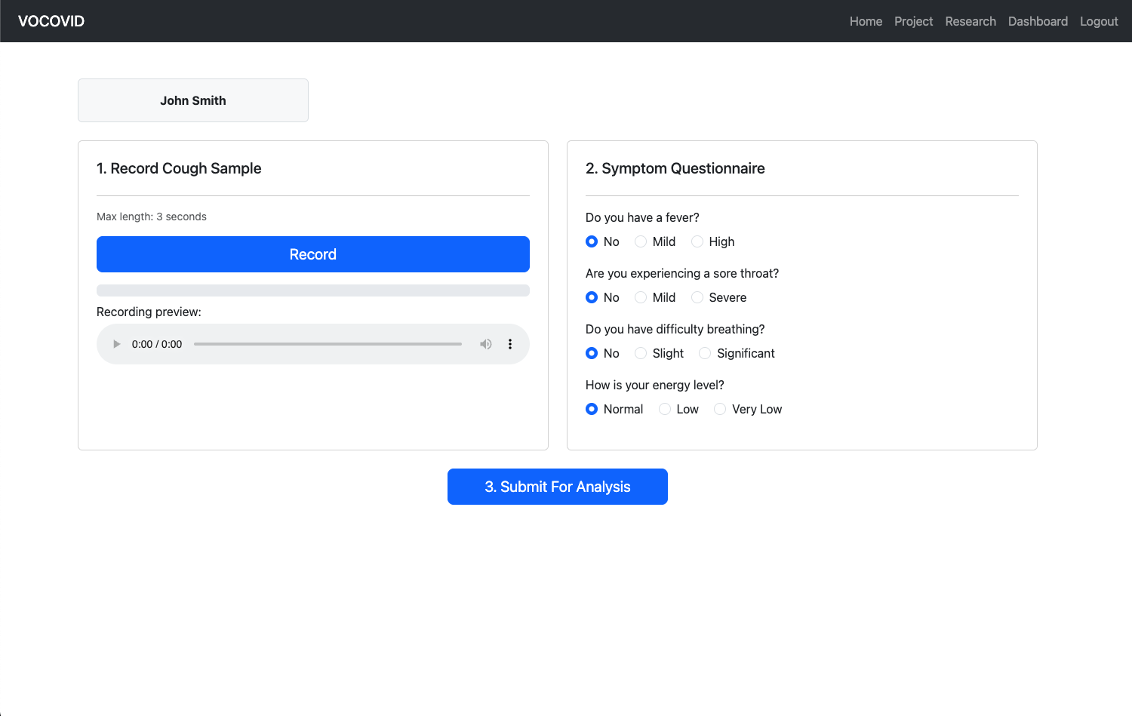
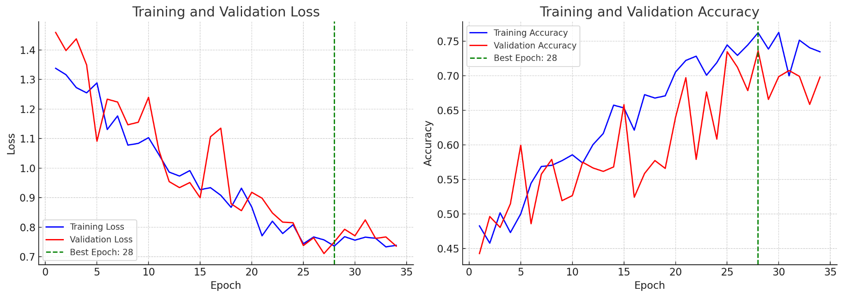
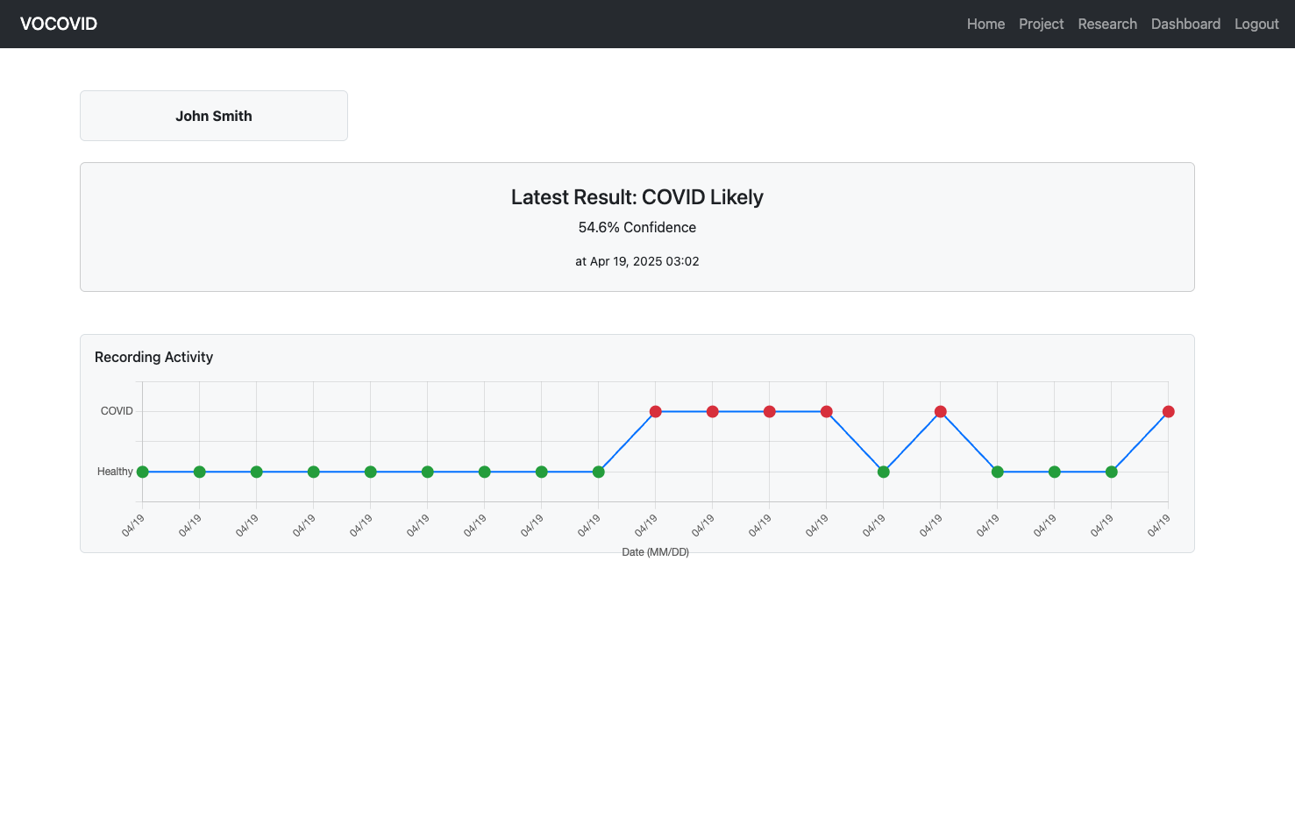
Automated COVID-19 Detection
Rodrigo Alarcon, Emma Conti, Lamine Deen, Audrey Eley
Faculty Advisor: Dr. Nematzadeh, Dept. of Computer Science, Florida Institute of Technology
PHASE 1: Data Cleaning & Preprocessing
PHASE 4: Web Application
Interface for classification via CNN model
Displays all research done for the project on the various types of ML models
Integrates the CNN and allows users to upload recordings of coughs
Symptom questionnaire
Login and recording saved securely
Can save multiple recordings per user
Segments recording to one cough, converts to Mel spectrogram, and classifies recording
Recommends testing for COVID-19 if classification of recording is COVID-19 positive
Initial Data Audit
Metadata Sync & Class Selection
Dataset Splitting
Used Kaggle dataset: “Covid-19 Cough Audio Classification”
All recordings converted into Mel Spectrograms
Binarized target variable to “Healthy” and “COVID”
CNN Model Achritechture
Block 1: Conv 3×3 (1→32) → BN → ReLU → MaxPool 2×2 → Channel‑Attention 32 → Spatial‑Attention
Block 2: Conv 3×3 (32→64) → BN → ReLU → MaxPool 2×2 → Channel‑Attention 64 → Spatial‑Attention
Block 3: Conv 3×3 (64→128) → BN → ReLU → MaxPool 2×2 → Channel‑Attention 128 → Spatial‑Attention
Head: AdaptiveAvgPool 1×1 → Flatten → FC 128→64 → ReLU → Dropout 0.5 → FC 64→2 (logits)
Filtering & Cleaning
Oversampling Minority Class
PyTorch DataLoader Prep
Waveform to Mel-Spectrogram
Augmentation Integration
Cough Segment Extraction
Final Balancing & Shuffling
Preprocessing for Attention Enhanced CNN
Audio 242 & Shortened Mel-Spectrogram
PHASE 2: Classification & Prediction
ResNet50 model uses pretrained ResNet50 model and replaces with our data at the last layer to maximize accuracy
Attention Enhanced CNN uses 3 convolutional blocks
1,118 datapoints are used under each classification using oversampling to ensure there is an equal amount of each evaluation type
Attention Enhanced CNN was selected for integration within the web application
ResNet50
Attention Enhanced CNN
Developed Models for Testing
VoCOVID Dashboard
Attention Enhanced CNN Training Validation Loss and Accuracy
PHASE 3: Evaluation
Highest achieved accuracy with Attention Enhanced CNN was 69%
Precision was 73%, minimizing false positive and negatives
uses a binary model to determine if user has COVID or is considered healthy
results may indicate the user is ‘symptomatic’ under a healthy evaluation based on confidence level
Healthy
COVID-19
Binary Evaluation of User Status
VoCOVID Recording Activity
Notes:
https://forms.gle/3HyCHsE83QAYqUzc9
What are your opinions on the games we’ve ranked so far: https://forms.gle/42UbuCQtUsc6x8Az8

