Slide 1

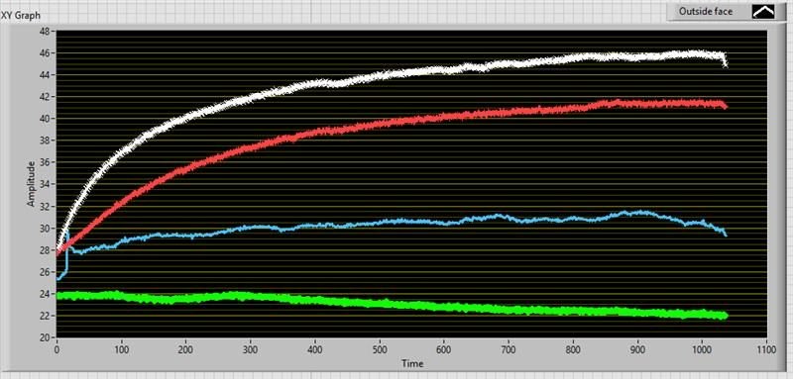
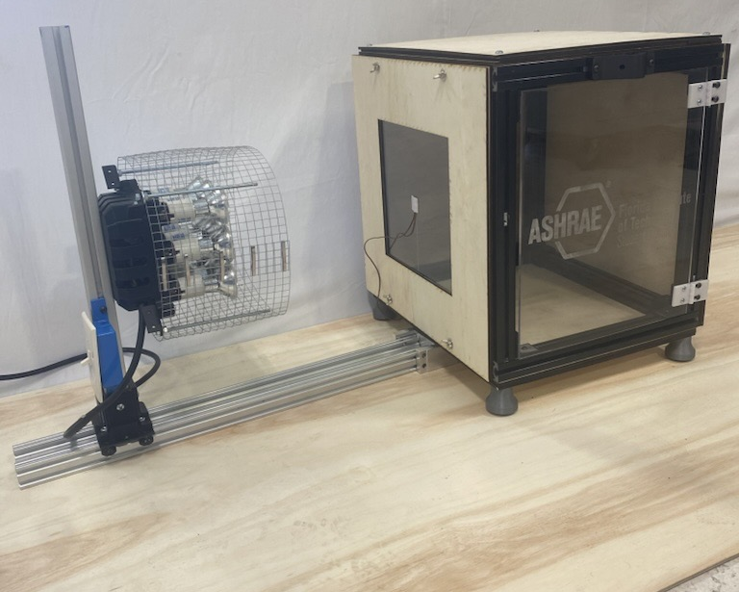
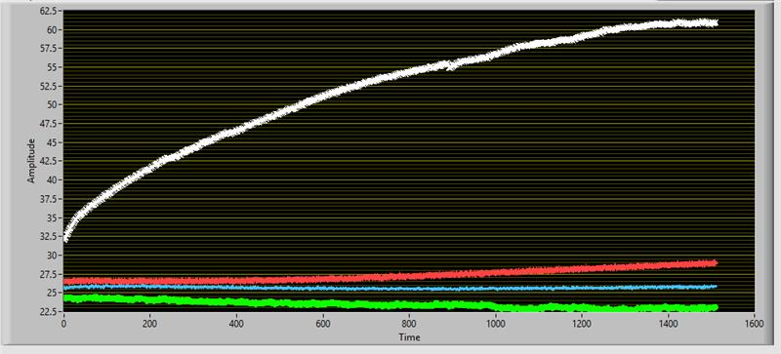
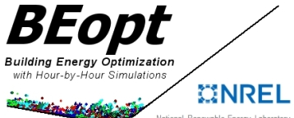
Experimental Platform for Evaluating Building Envelope Technologies for Decarbonization
Aidan Pryzgoda, Benedict Tarby, Alex French, Thomas Owenburg, Mazin Al-Siyabi
Faculty Advisors: Dr. Hamidreza Najafi and Dr. Chiradeep Sen
Dept. of Mechanical and Civil Engineering, Florida Institute of Technology
Introduction
Objectives
Data Collection
Buildings account for approximately 40% of energy consumption and 36% of annual greenhouse gas emissions in the United States. Advancing energy-efficient innovations in building envelopes can substantially lower energy demand and significantly reduce the operational carbon footprint of buildings.
Sponsored by the American Society of Heating, Refrigerating and Air Conditioning Engineers (ASHRAE), this project focuses on the design and development of a lab-scale apparatus to demonstrate the role of energy-efficient building envelopes in reducing energy consumption and supporting building decarbonization. The system simulates heat transfer through various wall and roof assemblies under controlled conditions, providing a hands-on tool for evaluating thermal performance and engaging students in sustainable building practices.
Develop a modular apparatus to demonstrate heat transfer through building envelope components.
Enable hands-on learning of heat transfer measurement and analysis techniques.
Highlight the role of energy-efficient envelopes in reducing energy use and carbon emissions.
T_s, outer
T_s ,inside
Test Apparatus
Figure 2: Single Pane glass
Heat Source
(nine 50W bulbs)
Thermocouple
T_s, outer
T_s ,inside
Figure 3: Double Pane Low e Glass
The LabVIEW graphical user interface allows students and GSAs to collect and display data on test panels using various measurement sensors.
Overview
ON/OFF Switch
Conclusion
The apparatus will be used by ME students to explore various modes of heat transfer through building envelopes, gain hands-on experience with temperature measurement techniques, and study energy-efficient innovations in envelope design. Students will also learn about the critical role of building envelopes in reducing energy demand and minimizing the carbon footprint of buildings.
The apparatus features modular building envelope components—including windows, wall panels, and roof panels—as outlined below:
Window: single pane, double pane argon clear, double pane low-emissivity clear. double pane low-emissivity tinted
Wall: Structural Insulating Panels (SIPs), and phase change materials (PCM)
Roof: “Coolguard” high emissivity coating, PCM ceiling tiles
Sliding Heat Source Gantry
Front Active Test Panel
Viewing/Access Panel
This project successfully delivered a modular test apparatus, a LabVIEW interface, and supporting materials that enhance student learning in heat transfer and building material science. The apparatus allows for hands-on investigation of energy-efficient building envelope elements and their impact on thermal performance. The integration of simulation using BEopt extends the educational experience to real-world energy modeling. Overall, the project supports experiential learning and promotes awareness of sustainable building practices.
Figure 1: Experimental Setup
Project Deliverables
Custom-built modular test apparatus for demonstrating heat transfer through building envelope components
Comprehensive lab manual detailing three distinct experiments
LabVIEW-based graphical user interface integrated with experimental procedures
BEopt model evaluating the energy performance of residential applications using the tested glass samples
Acknowledgements
A special thanks to our Advisor, Dr. Hamidreza Najafi and our dedicated GSA, Mr. Junot Damen. Thank you to Dr. Chiradeep Sen, Mr. Alex Larrivee (GSA) and all the staff at the L3HSDC and Machine shop for their continuous support and advice.
Notes:
Instructions say do not put anything above the gold line, but I think it would be nice to position the ashrae student logo in the top right.

Slide 2
INSTRUCTIONS
Do not use a color background
Keep all content within the gold lines and blue and crimson bars (other than title block and icons)
Do not change the size of the poster
Please keep the text readable. The only font allowed is “Calibri”. It is available on all Microsoft products . Minimum font size is 48 pts.
The size is already set to exactly the print size. Please arrange and size all the images and text properly.
Ensure that all images are at least 300 dpi
The name of any faculty should be put in as “Dr. [First Name] [Middle Initial]. [Last Name], Dept. Of [name of department], [name of institution]
Names of any sponsors, mentors, volunteers, helpers, etc. can be put in the acknowledgements section. Put in text only. Do not put in any additional logos in the poster other than the ones already in the template.
We should add an image of the apparatus and an image from the thermal camera of the front panel, preferably one with multiple materials
We should have a section discussing energy savings from worst to best materials
Discuss usefulness of the apparatus for teaching students

