Slide 1
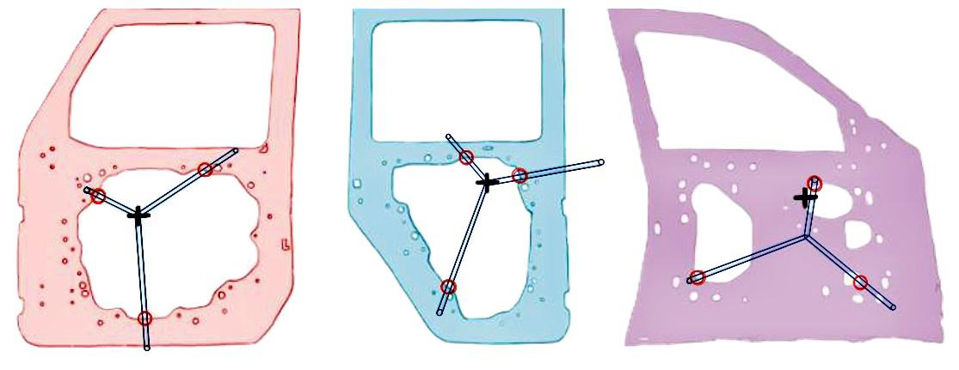
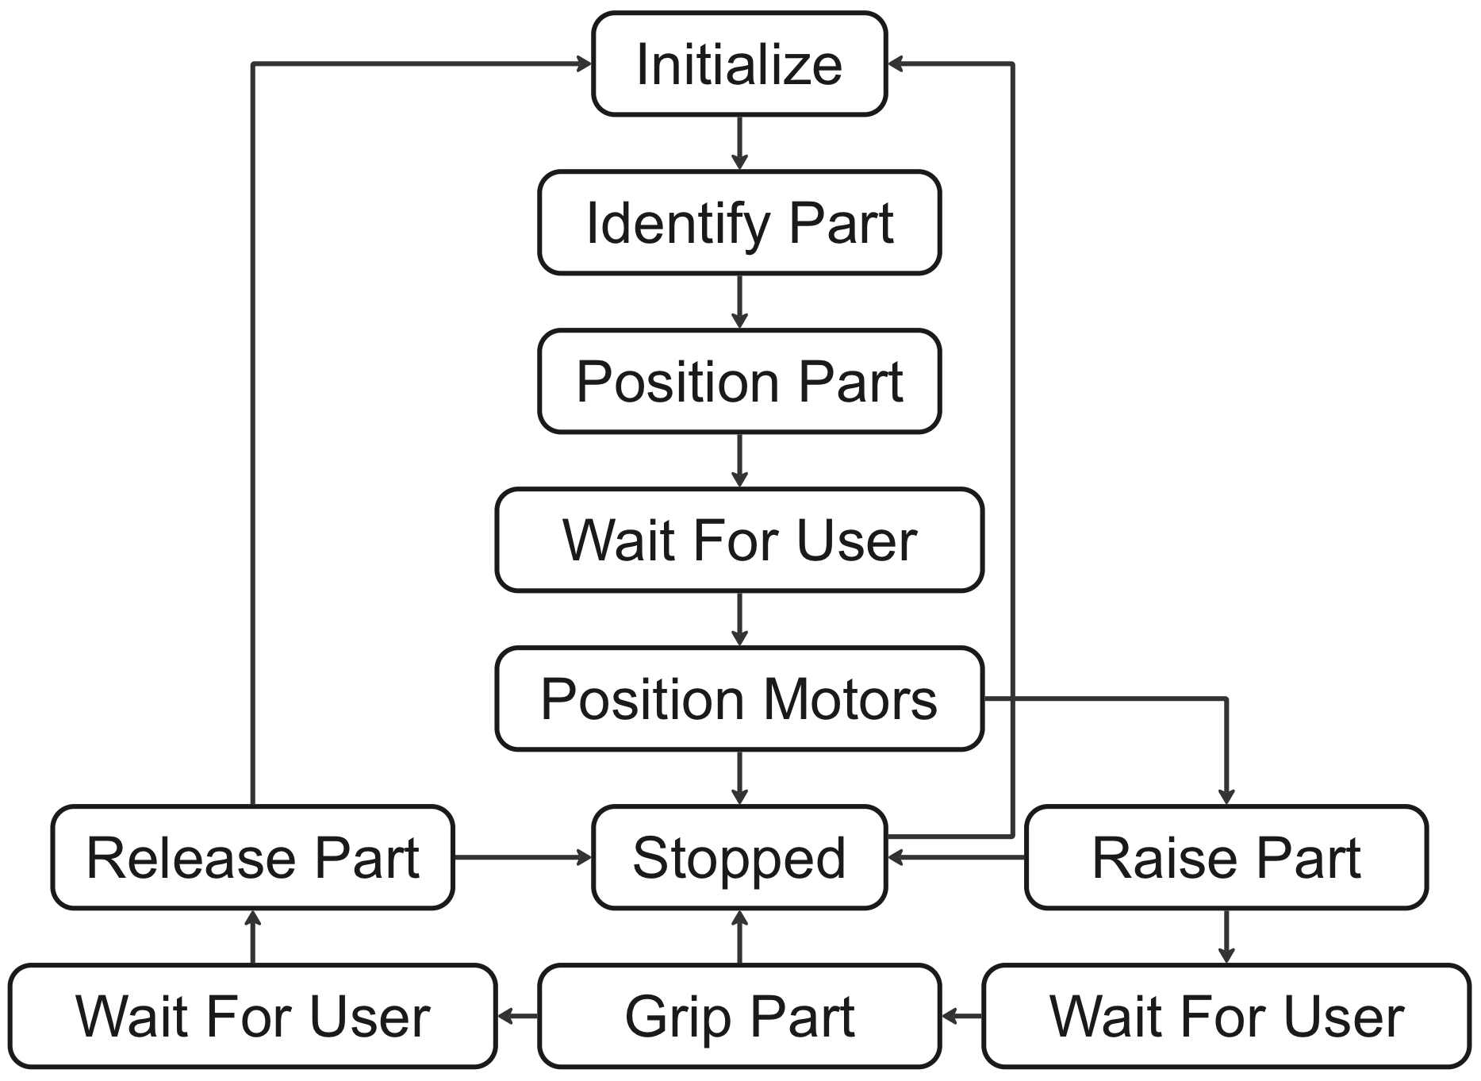
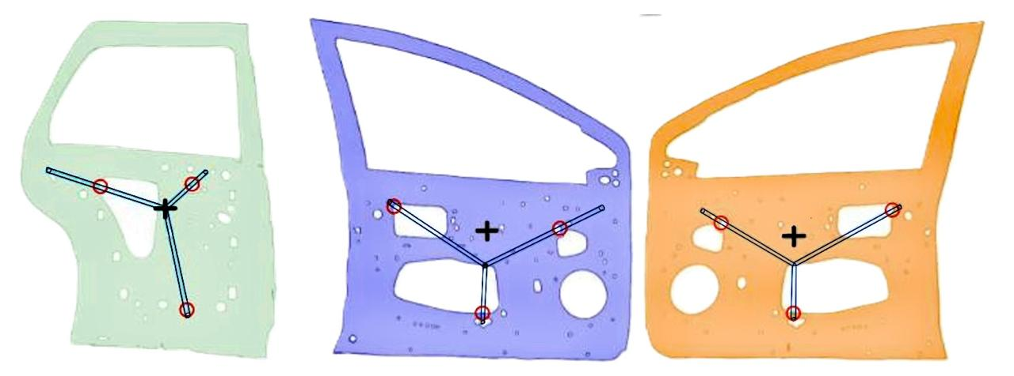
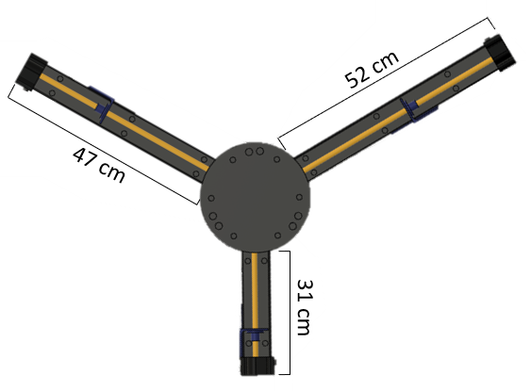
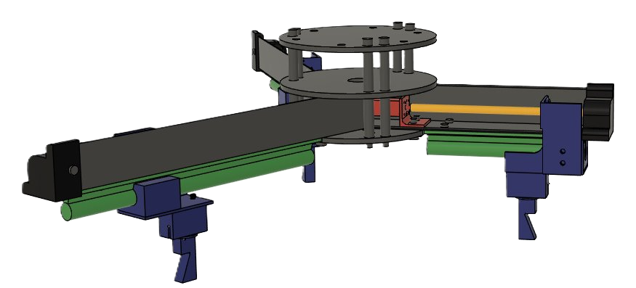
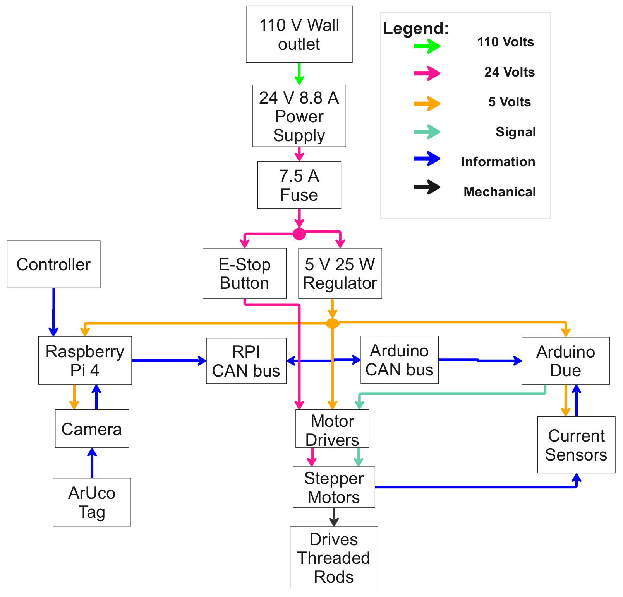
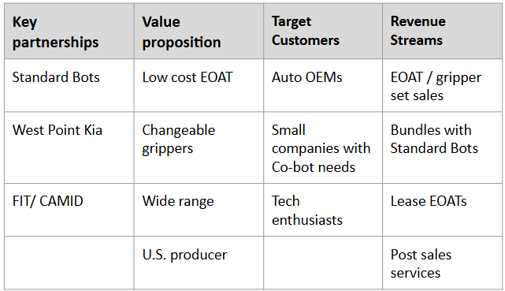
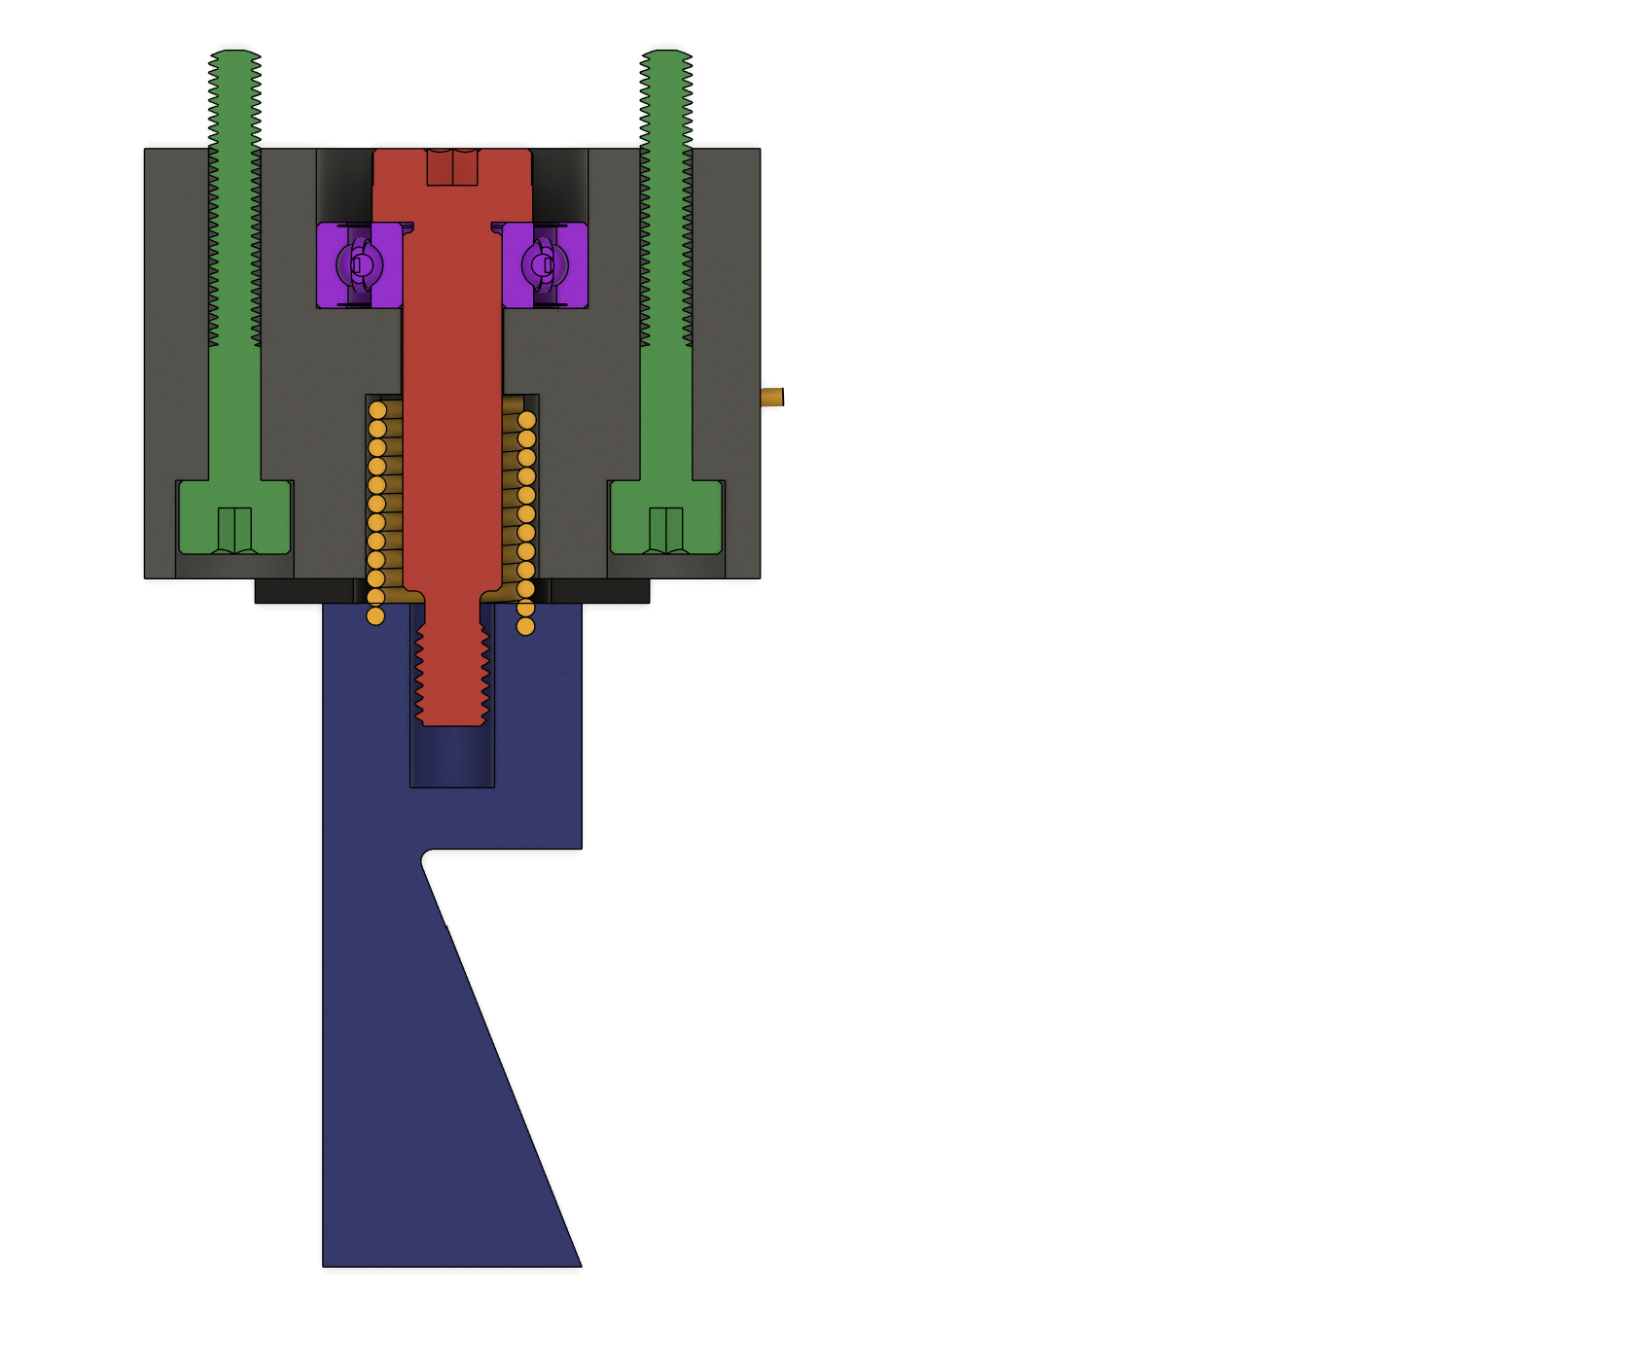
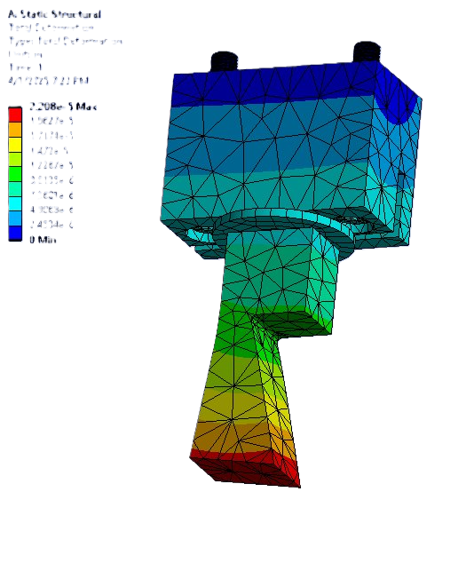
Flexible End Effectors
Sastia Birju, Parker Christensen, John Fonseca, Connor Neidhart,
Jennavive Nelson, Noah Reneau, Kendra Tiger, John Van Hooser,
Belisa Villa Torres, Gabrielle Yeager
Faculty Advisors: Dr. Chiradeep Sen and Dr. Kim-Doang Nguyen,
Dept. of Mechanical and Civil Engineering, Florida Institute of Technology
Introduction
Range Analysis
Automation & Electronics
This project focuses on innovating current automotive manufacturing practices by designing a flexible end effector tailored for grasping a variety of inner door panels. The objective is to streamline operations by reducing costs and complexity associated with single-part tools.
Can handle 6 different car door panels
Uses three points of contact for stability
Secures across all 6 degrees of freedom
Supports loads up to 30 kg
Reconfigures autonomously
Raspberry Pi 4 with ROS2 manages the user and camera interface.
Arduino Due handles current monitoring and stepper motor control.
CAN Bus enables communication between the computer and microcontroller.
Camera-based part identification uses ArUco Tags to detect pose and position.
Arms Design
+ indicates the door’s center of gravity
Mechanical Grippers
Ensures secure grip on parts of various thicknesses, accommodates a wide range of hole sizes in car door panels, and prevents slippage. FEA analysis indicates total deformation on the latch assembly.
Business Plan
Acknowledgements
Advisor Acknowledgements: Dr. Sen and Dr. Nguyen, for their guidance and feedback.
Graduate Student Acknowledgements: Junot Damen and Andre Robidoux.

