Slide 1
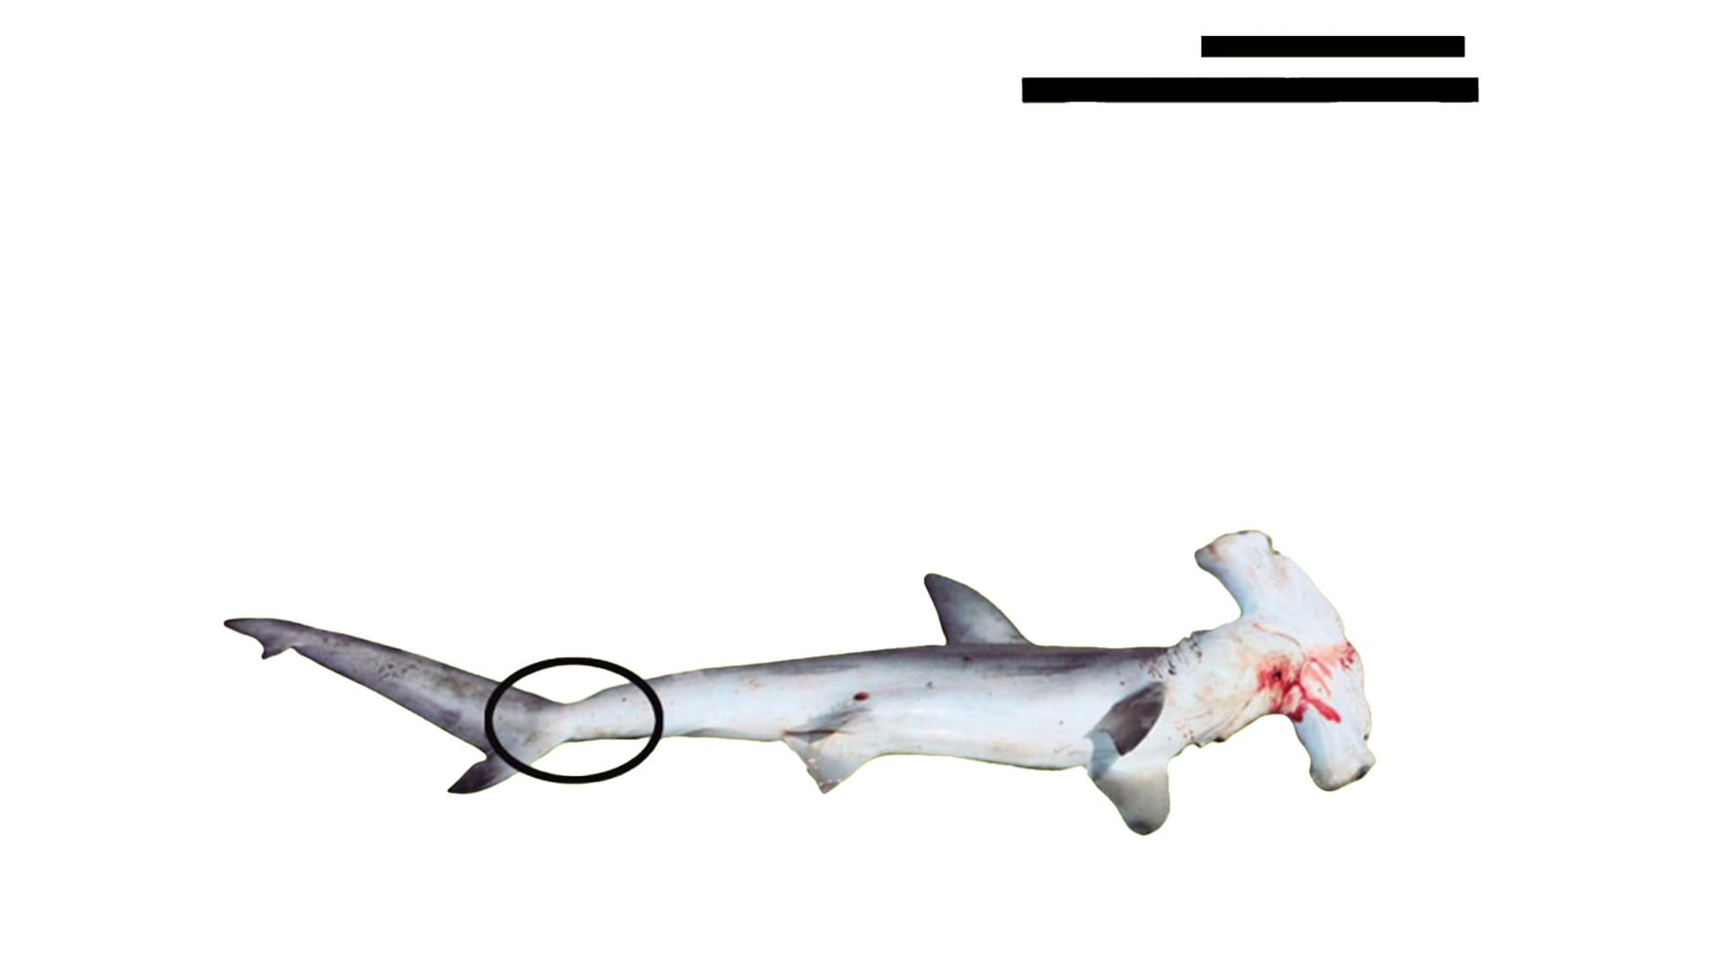
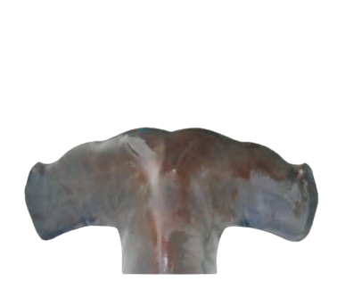
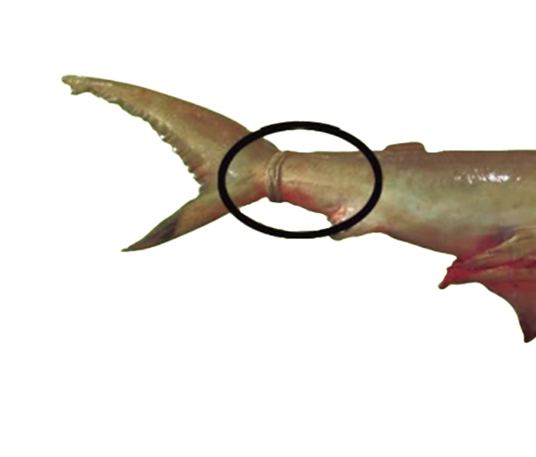
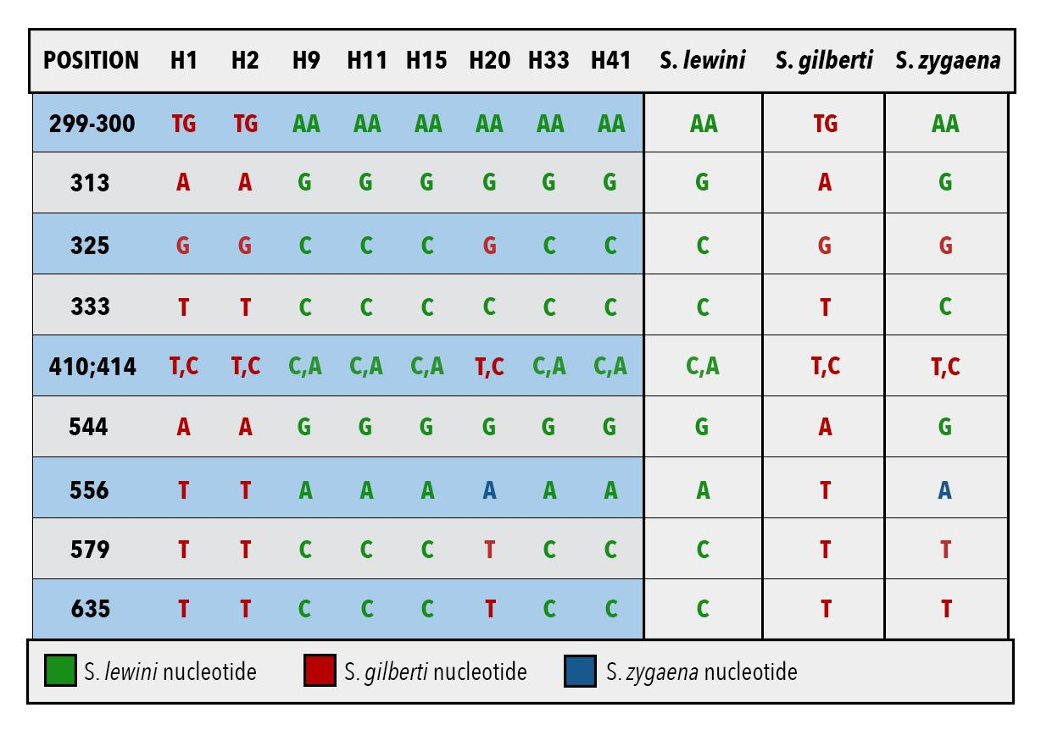
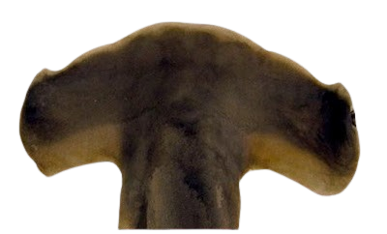
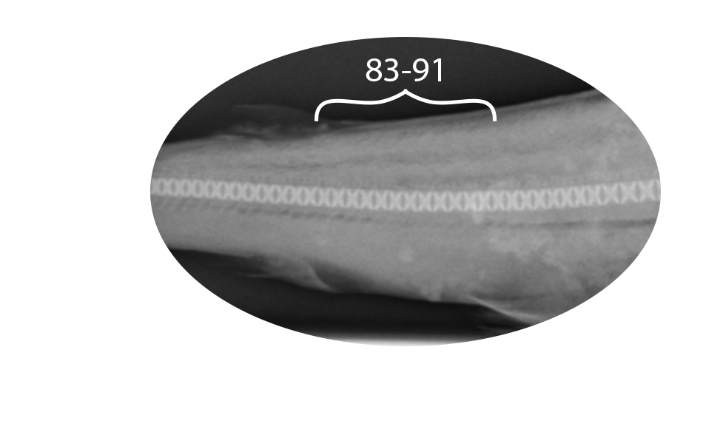
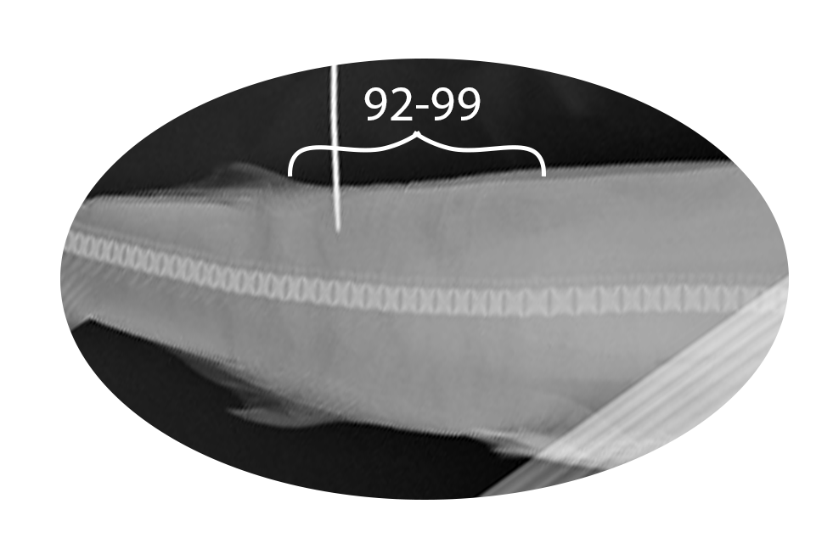
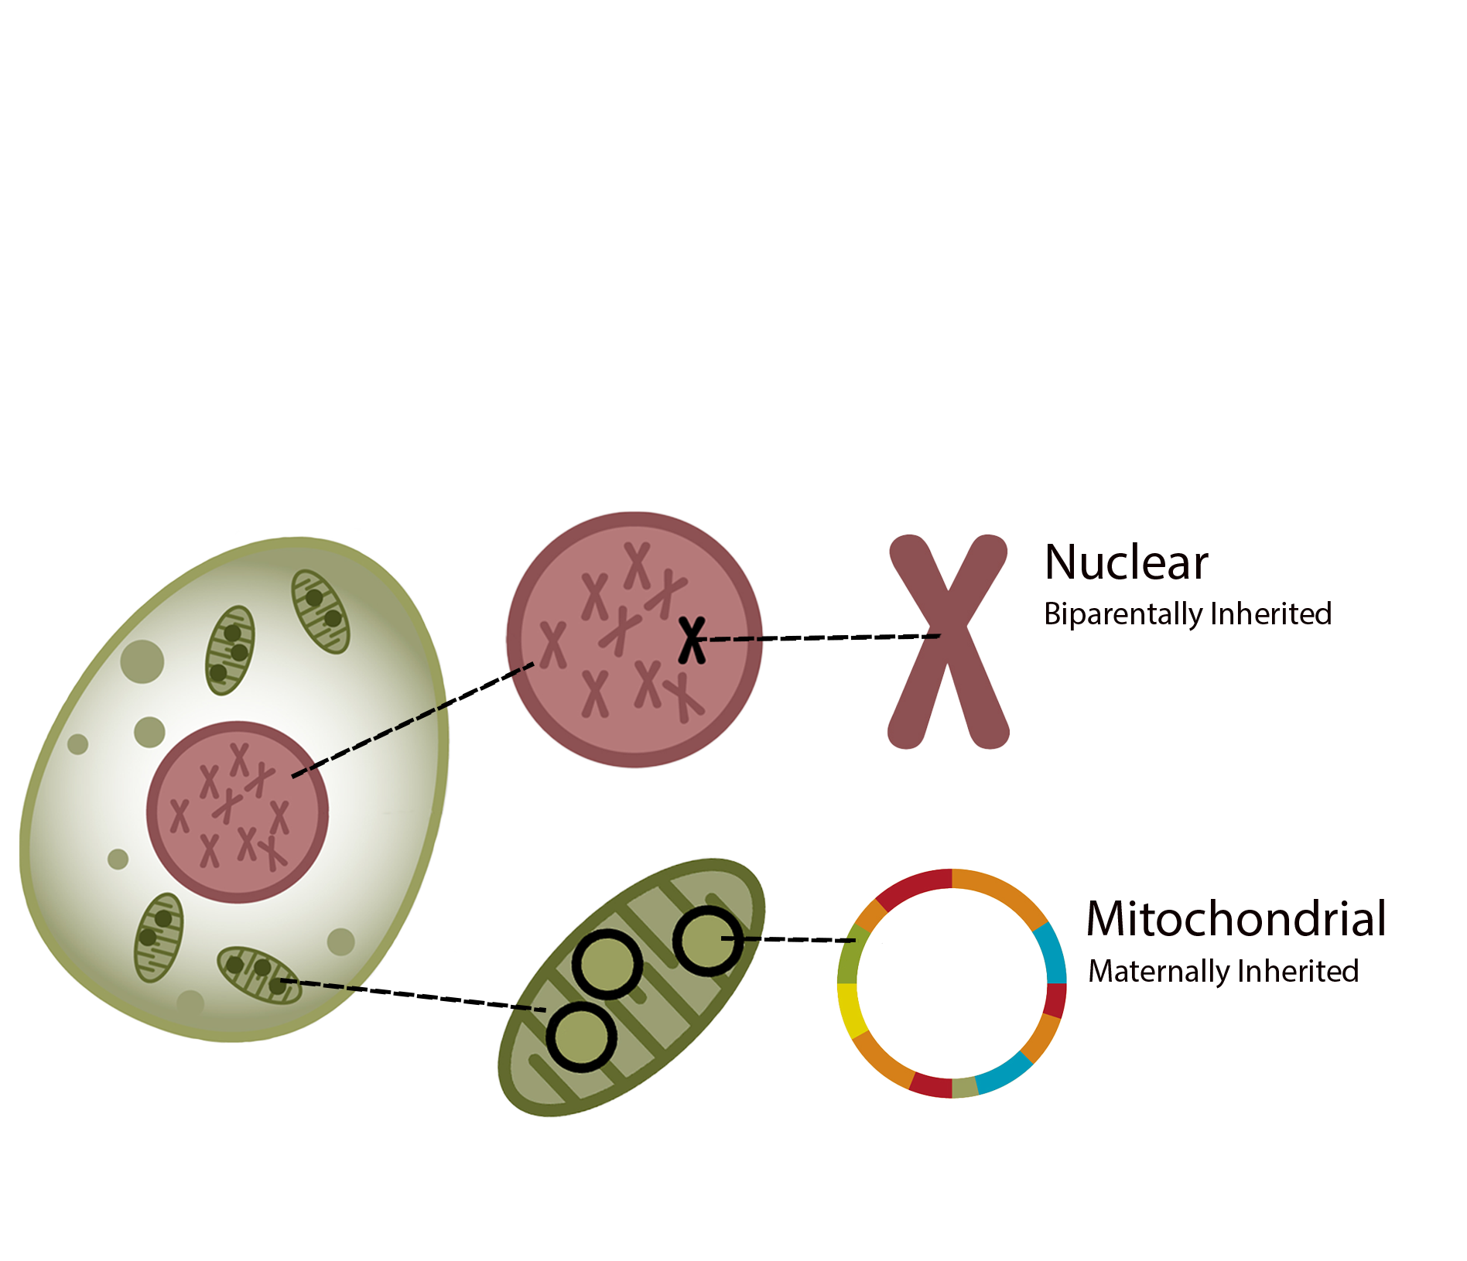
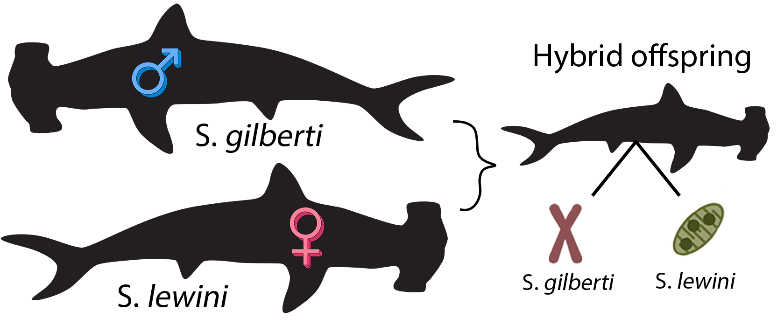

Hidden Hammerheads: Discovering Genetic Markers of Differentiation and Hybridization in Cryptic Shark Species
Kieran Stein, Rachel Schweppe, Abby Hesterhagen, Michelle Gargiulo
Faculty Advisor(s): Dr. Toby Daly-Engel, Dept. of Ocean Engineering and Marine Sciences, Florida Institute of Technology
Results
mtDNA identified 39 samples as S. lewini, two as S. gilberti, and one as S. zygaena. ITS2 analysis revealed two hybrids: H1 and H41. All other individuals were verified as pure S. lewini, S. gilberti, or S. zygaena.
Figure 5. Table showing diagnostic ITS2 positions.
Conclusion
This study is the first to identify hybridization between S. lewini and S. gilberti using mitonuclear discordance. It also reveals the frequency of misidentification and the limits of morphology-based species ID. By combining mtDNA and nuclear markers, we uncovered cryptic hybrids that would otherwise be missed. Given the endangered status of S. lewini and the limited data on S. gilberti, hybrid monitoring and accurate identification is essential for accurate assessments and effective management. These findings stress the importance of molecular tools in developing species-specific conservation strategies that accurately reflect genetic patterns.
Acknowledgements
Special thanks to Dr. James Sulikowski and the amazing people in the lab for making this project possible.
Citations:
Introduction
Scalloped hammerheads (Sphyrna lewini) are a globally endangered species whose life history traits make them vulnerable to fishing pressure^{1,2}. Conservation of the species has been complicated by the discovery of the cryptic Carolina hammerhead (Sphyrna gilberti), which overlaps in range and closely resembles S. lewini ³. The only consistent morphological difference, vertebrae count, is lethal to assess (Figures 1 & 2).
Few studies have jointly assessed S. gilberti and S. lewini populations, and only one has previously investigated potential hybridization⁴. This study is the first to develop a method for determining hybridization using a combination of the nuclear gene ITS2 and the mitochondrial control region (mtDNA). Because mtDNA is maternally inherited and nuclear DNA is inherited from both parents, a mismatch between them, known as mitonuclear discordance, can reveal hybridization (Figure 4). If the mtDNA indicates one species while the nuclear DNA indicates another, it suggests the individual had parents of different species and is therefore a hybrid. These tools provide an accessible, nonlethal method for detecting hybridization in cryptic elasmobranchs (sharks, skates, and rays), which is crucial for informing effective conservation strategies.
Materials and Methods
Fin clips were collected from 41 presumed S. lewini individuals, and DNA was extracted using a modified salting-out protocol. The following primers were used to assess species ID and detect hybridization:
mtDNA (~1200 bp): Pro-L, 282H⁵ ITS2 (~650 bp): FISH5.8SF, FISH28SR⁶
Species were identified via mtDNA sequences using the BLAST⁷ program. Sequences were aligned with MAFFT v7.388⁸, and diagnostic markers for species identification were identified. Hybridization was assessed manually, and samples with discordant mtDNA and nuclear identities were classified as hybrids.
Figure 4. Nuclear vs. mitochondrial DNA (a). Mitonuclear discordance in a S. lewini x S. gilberti hybrid (b).
Figure 5. Table of diagnostic ITS2 positions (a) and
chromatogram comparison of samples with species references.
a
b
a
b
Figure 1. S. gilberti precaudal region (a), cephalofoil (b) and vertebrae count (c).
Figure 2. S. lewini precaudal region (a), cephalofoil (b) and vertebrae count (c).
.
c
c
a
b

