Slide 1
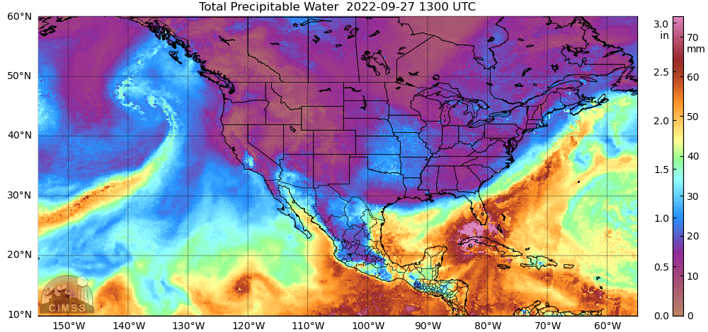

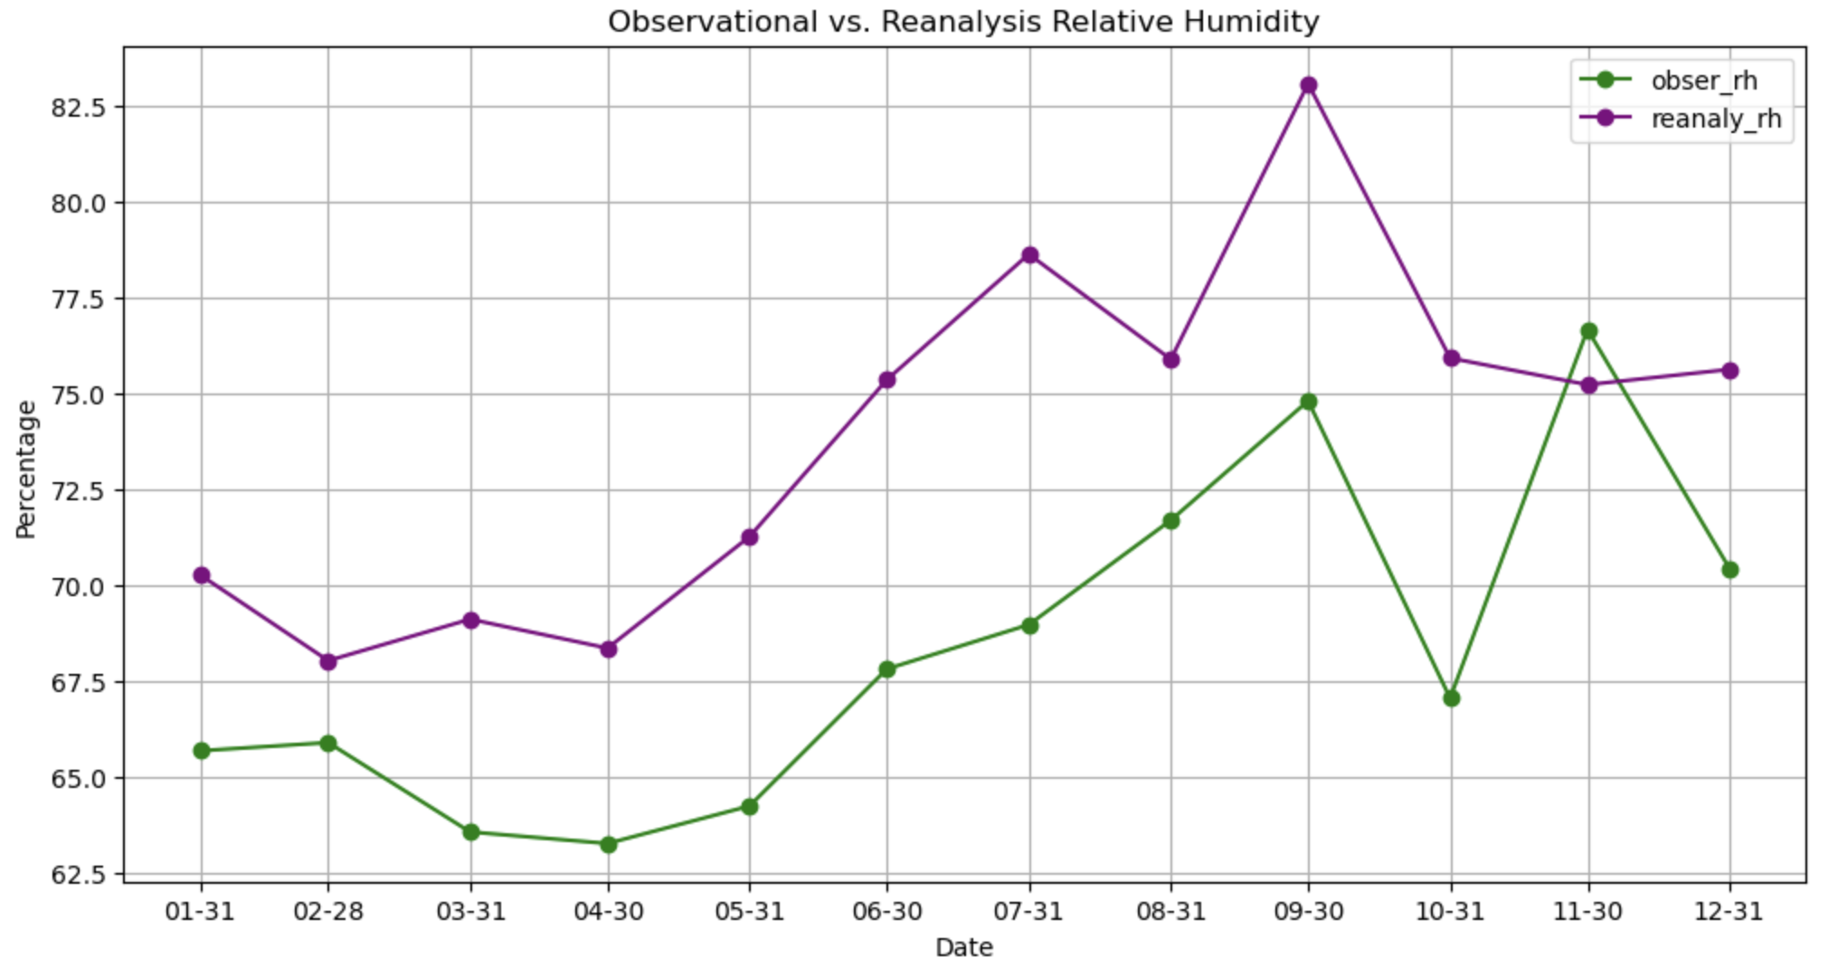

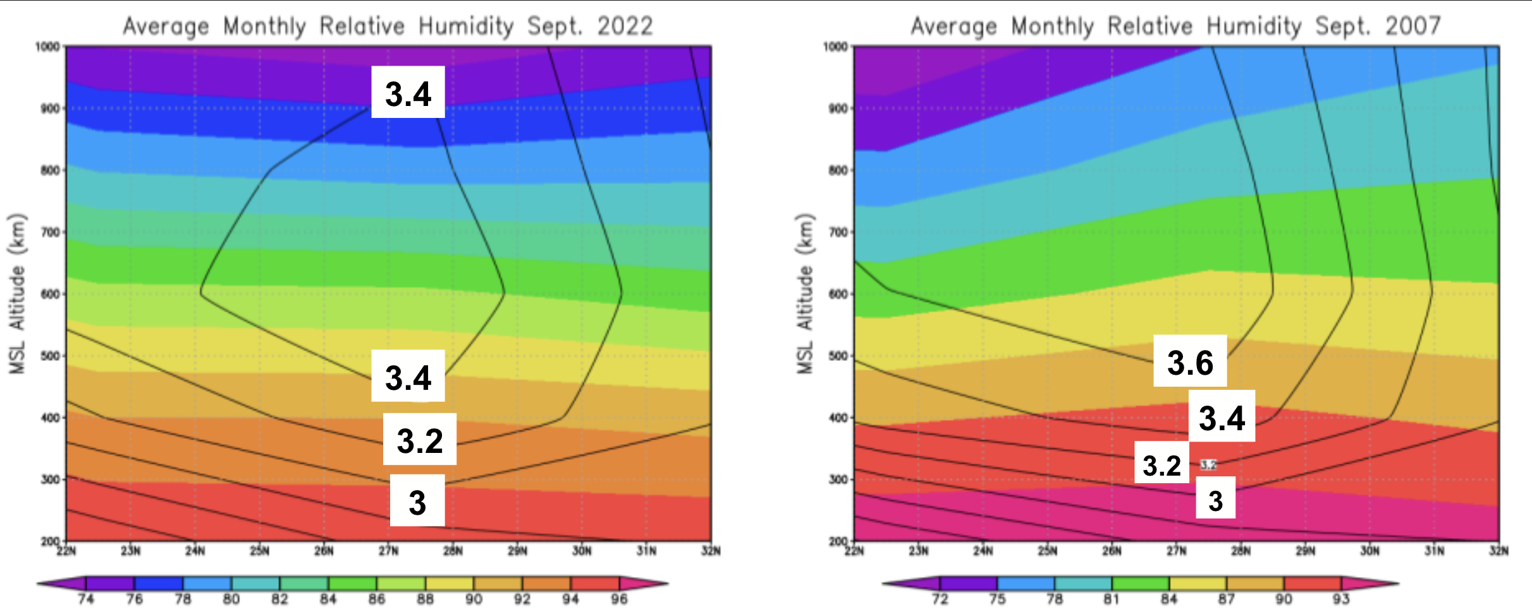
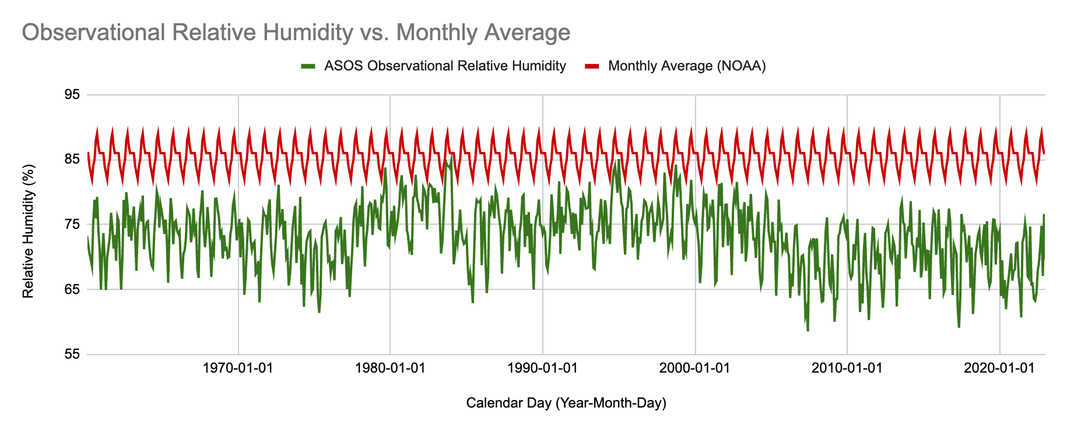
Variations and Inaccuracies in Observational and Reanalysis Atmospheric Water Content Data in Tampa, FL
Madisen F. Alvarez B.S. Meteorology
Faculty Advisor(s): Dr. Mila Costa, Melissa Zavaleta, Dept. of Ocean Engineering and Marine Sciences, Florida Institute of Technology
Abstract: Reanalysis data is one of many tools for meteorologists in the understanding of severe weather and forecasting. However, some weather parameters are more complicated to create accurate reanalysis models of than others. Two of these parameters are atmospheric water vapor and precipitable water content. Both parameters are crucial to studying and forecasting severe weather, but unfortunately, they are challenging to collect throughout the atmosphere as well as recreate accurate models of these variables. This study seeks to analyze observational and reanalysis data of atmospheric water vapor and precipitable water content and find solutions to the problems discovered.
Introduction: The reanalysis data creation process is still being improved for atmospheric water vapor and precipitable water content. Trends of El Niño-Southern Oscillation (ENSO) can be seen in observational data; however, reanalysis may not account for these trends. The observational data used comes from Tampa, Florida, (Latitude 27.95° N, Longitude 82.46° W, starred on the map, in figure 1).
Results:
ASOS vs. ERA5 Reanalysis Results:
  Maximum Temperature Correlation: ~71%
  Minimum Temperature Correlation: ~73%
  Relative Humidity Correlation: ~16%
ASOS vs. NOAA monthly relative humidity resulted in an average of 73.22% for the ASOS data, and 86% provided by NOAA. (Figure 3)
Figures 4 and 5 show the similarity in average standard deviation for 2022 was 3.25 and the standard deviation for 2007 was 3.3.
Data and Methodology:
Relative humidity reanalysis data was used through the ECMWF’s ERA5 product for 2022 to be compared to the observational data, from the Iowa Mesonet, for Tampa, FL in 2022 (Figure 2).
Relative humidity values from 1960 to 2023 for Tampa, FL was averaged and plotted monthly then yearly (Figure 3). The monthly data was compared to NOAA’s average monthly data for accuracy.
Data for the region 22N to 32N latitude was collected monthly from Sept. of 2022 and 2007 (Figures 4 & 5). These dates were chosen from the dataset to compare the events of Hurricane Ian (2022) and three tropical storms formed in the Gulf of Mexico (2007).
Figure 1: (Above) Using morphological compositing of the MIRS retrieval from several available operational microwave-frequency sensors, Total Precipitable Water is mapped for Hurricane Ian landfall.
Conclusions & Recommendations: Water vapor concentration model creation and reanalysis requires modification as more errors are becoming apparent. The effects of ENSO may have been overlooked when the ERA5 product created reanalysis data (Figure 2). Current satellite data like the MIMIC-TPW2 product can aid in the development of the solutions to the reanalysis inaccuracies.
Figure 2: (Below) Observational vs. reanalysis relative humidity data was averaged monthly for 2022. The purple line shows the monthly averaged relative humidity reanalysis data. The green line represents the monthly averaged relative humidity observational data.
References:
Figure 3: (Below)
Observational and monthly average relative humidity is plotted to compare the trends from 1960 to 2023. The monthly average is shown to be much higher than the calculated average from the observational data.
Figures 4&5: (Below) Using radiosonde data from the ECMWF, average specific humidity (g*kg) for September was plotted from 200 to 1000 m in the atmosphere for 2007 and 2022 along the latitudes 22° N and 32° N. Standard deviation of the specific humidity was also plotted on the charts (black lines and values).
Time Series

