Slide 1
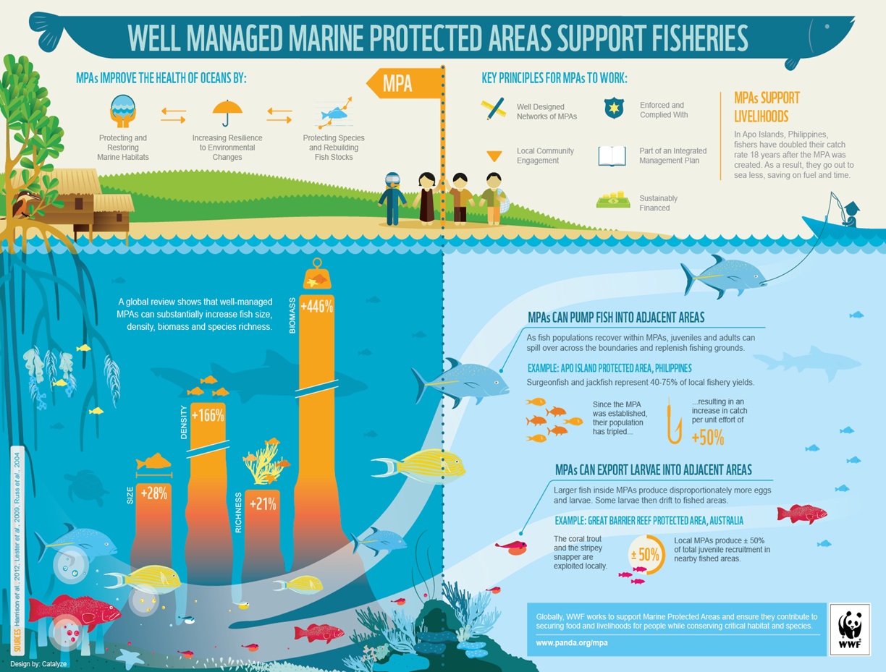
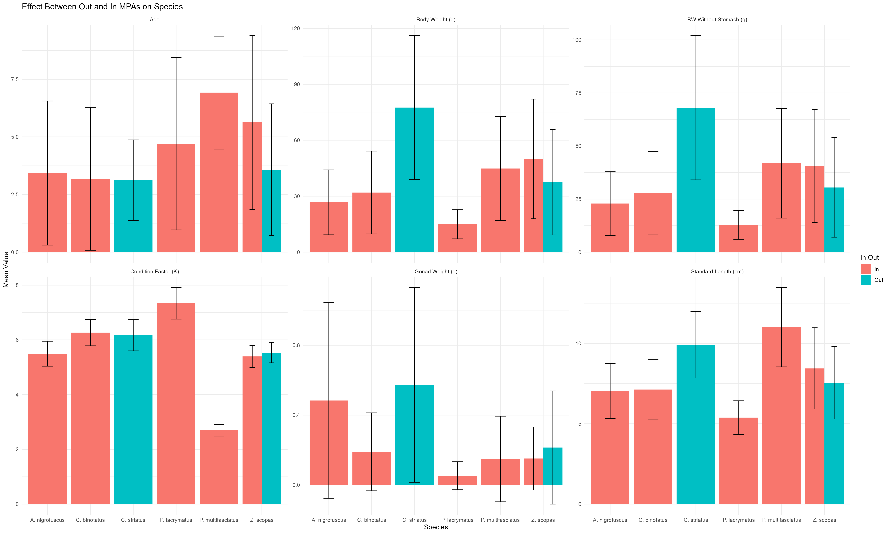
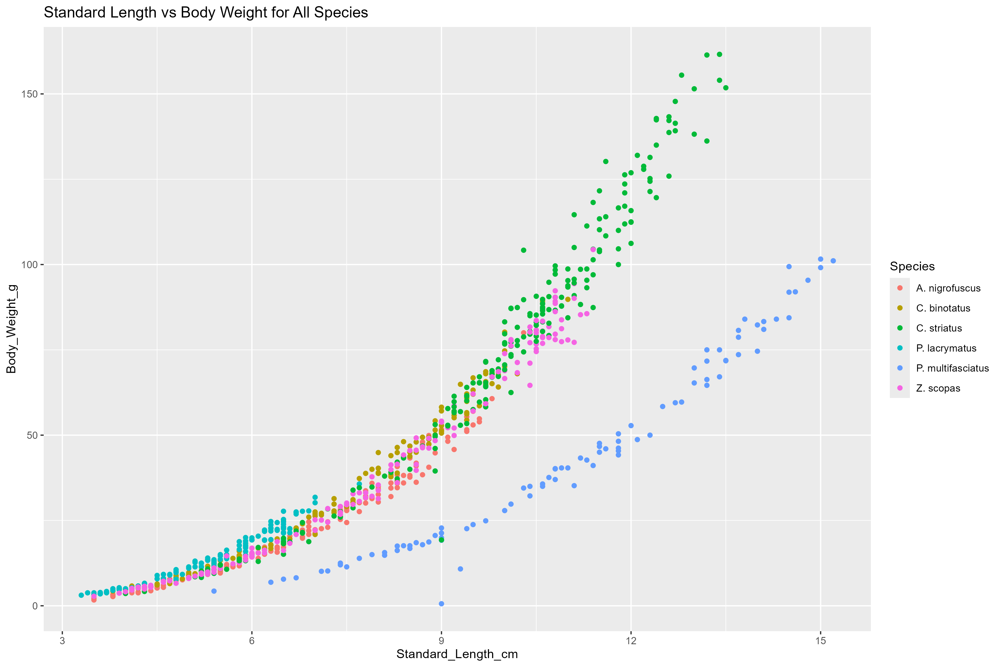
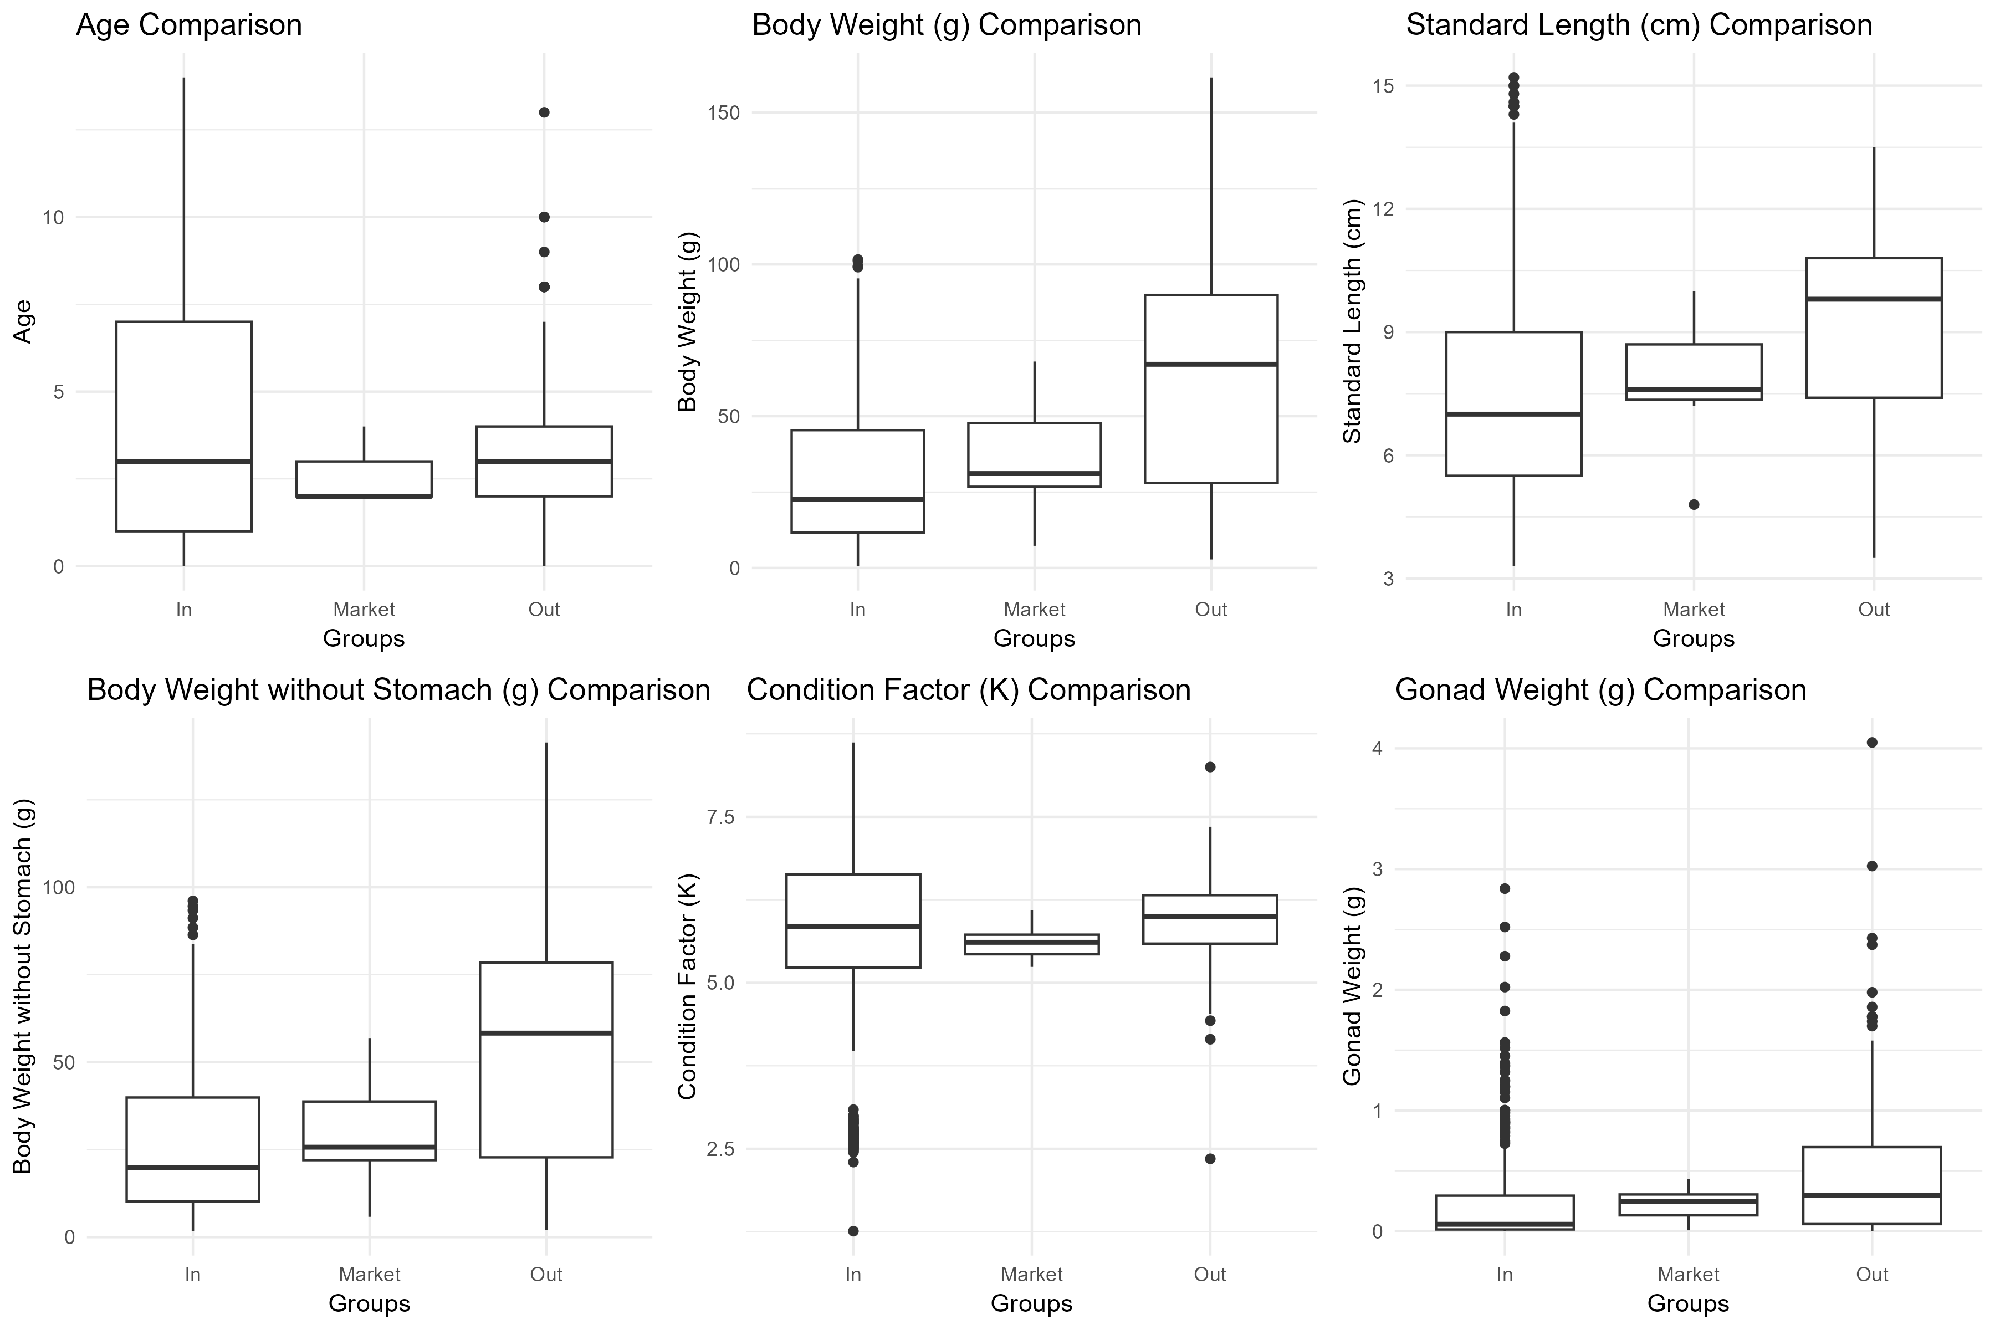
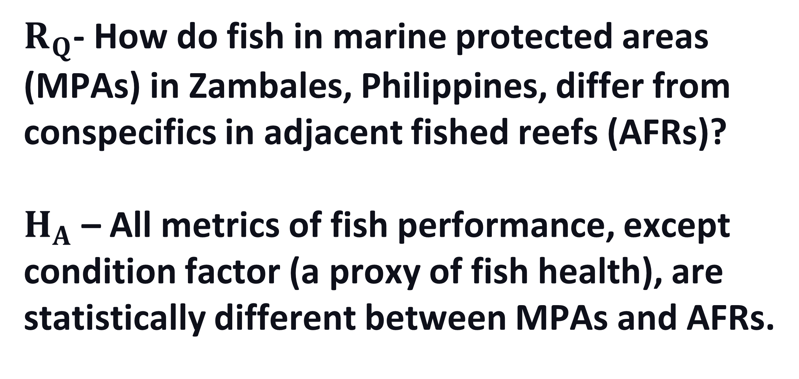
Response of Coral-Reef Fish to Fishing Pressure
Allyah Vega
Faculty Advisor: Dr. Ralph Turingan, Department of Ocean Engineering and Marine Sciences, Florida Institute of Technology
Background and Rationale
Marine protected areas (MPAs) are subsets of traditional fishing grounds that are typically closed to fishing, serving as a key component of fisheries management and sustainability programs worldwide. It is hypothesized that MPAs help sustain exploited stocks by one or both mechanisms: (1) larvae spawned in the MPAs recruit into the Adjacent Fished Reefs (AFRs), and (2) juveniles and adults migrate from MPAs into AFRs. Evidence shows that (1) while fish density is higher in MPAs than in AFRs during a specific sampling period, overall reef-wide fish density either increases or remains stable over time, and (2) large-bodied fish become more abundant in AFRs as time progresses. These results suggest that MPAs promote beneficial shifts in fish population structure across the entire reef systems after a few years of protection rather than simply maintaining stable populations within their borders.
In this study, six metrics of fish performance (e.g., growth and condition factor) were examined to provide further evidence that MPAs benefit AFRs through spill-over mechanisms.
Research Question & Hypothesis
Figure 2. Variation in fish performance metrics between MPA (in red) or AFR (teal).
$R_{Q}$- How do fish in marine protected areas (MPAs) in Zambales, Philippines, differ from conspecifics in adjacent fished reefs (AFRs)?
$H_{A}$ – All metrics of fish performance, except condition factor (a proxy of fish health), are statistically different between MPAs and AFRs.
Fish Growth and Diversity
Metric Comparison of Fish
Methods
Figure 3. Graphical comparison of growth (standard length vs body weight) for six fish species within MPAs and AFRs.
Conclusions and Implications
1. Age, body weight in grams (g), body weight without stomach (g), gonad weight (g), and standard length in centimeters (cm) for the six species are statistically different between MPA and AFR.
2. Fish health (Condition Factor) is statistically similar between MPA and AFR.
Acknowledgements
All data collection was done by Dr. Robert Fidler and the Fulbright Program.
Figure 1. Variation in fish performance metrics between MPAs, AFRs, and those found within Markets.

