Slide 1
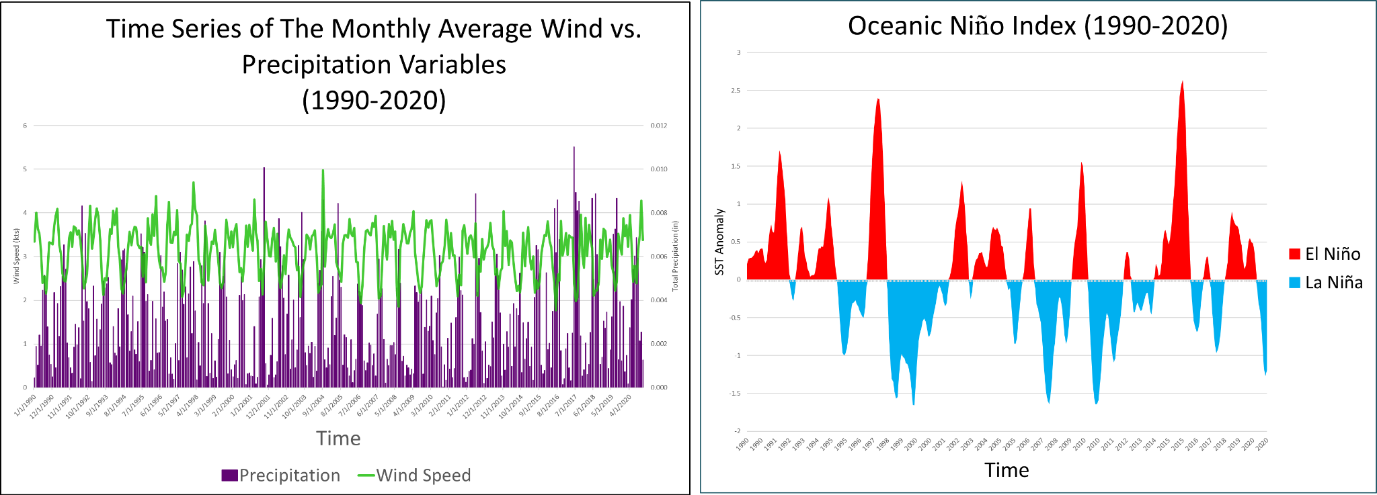
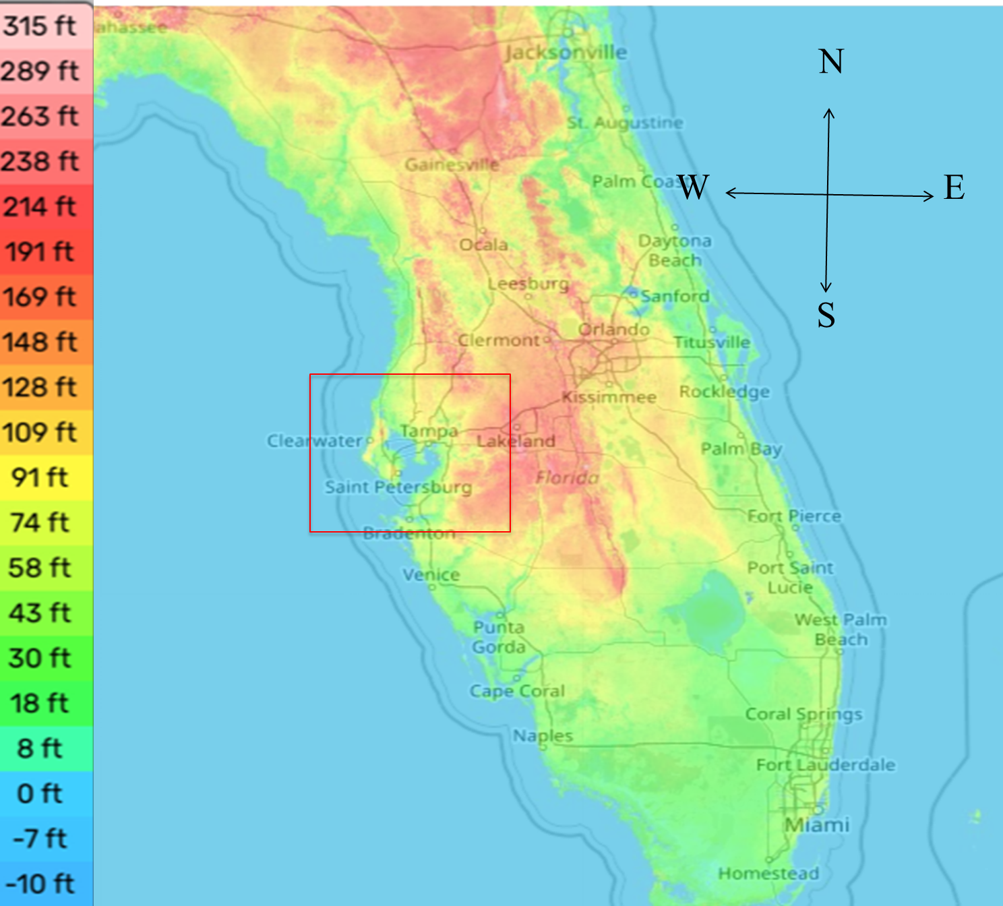
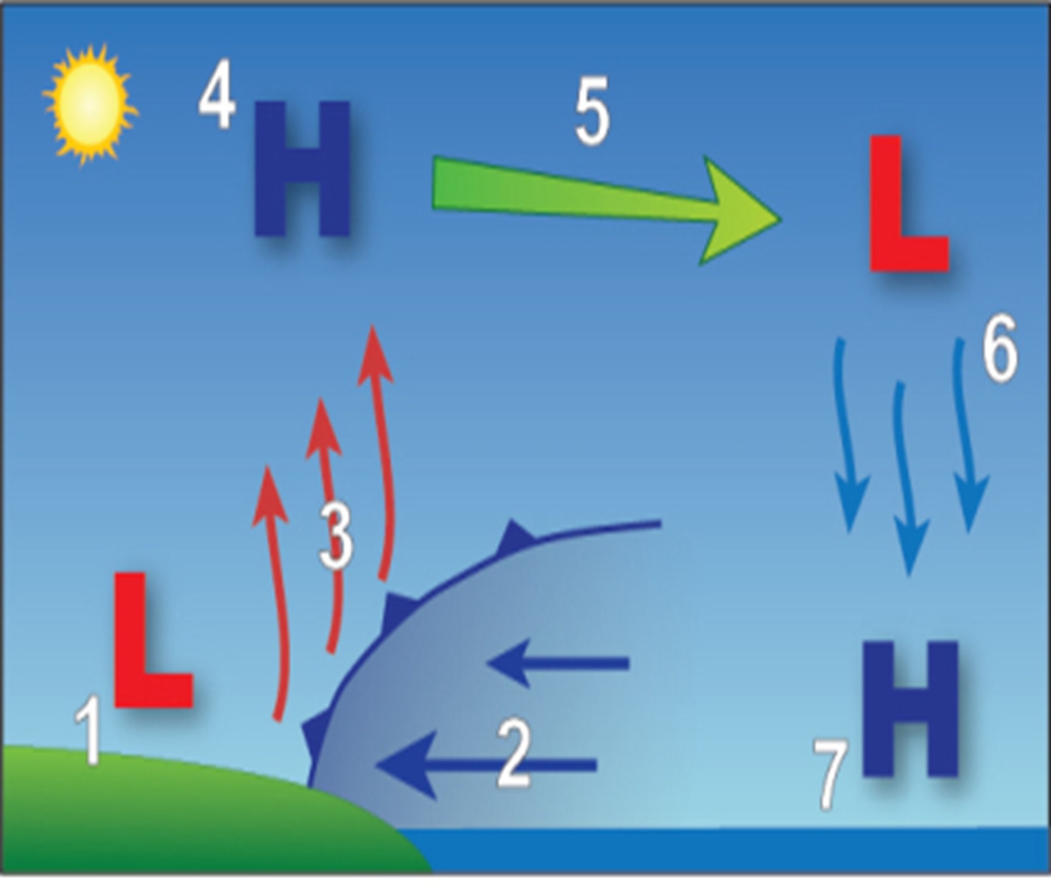
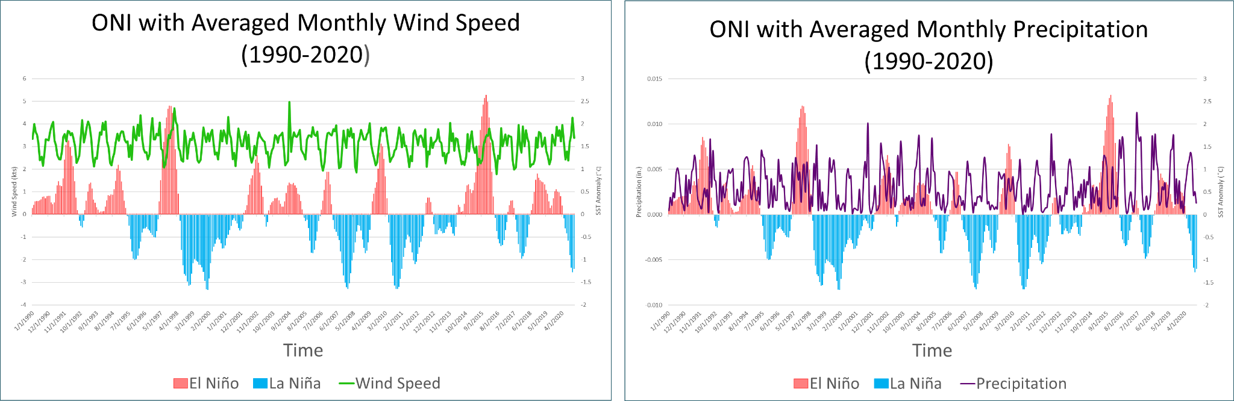

Investigating Sea Breeze Climatology In Tampa, Florida Using Reanalysis Data
Caitlin Neuman
Faculty Advisor(s): Dr. Milla Costa, Dept. of Meteorology, Florida Institute of Technology
Introduction:
•Tampa is a coastal city situated in the western central peninsula of Florida, this investigation is centered around Tampa International Airport (TPA) at coordinates 27.9 ͦ N and 82.5 ͦ W, with elevations ranging from 2 to 8 meters above sea level along the coast of Tampa Bay, gradually increasing inland.
•El Niño and La Niña: Planetary climate patterns that influence the sea breeze.
•Sea breeze: it is formed due to the temperature differences between the air over land and the ocean.
•The goal was to investigate sea breeze climatology with the use of reanalysis data.
Figure 3: A time series of precipitation (purple clustered columns) versus the wind speed (green line).
Figure 4: The Oceanic Niño Index (1990-2020).
Figure 1: Topographic map of Florida and Tampa area (Source: Topographic Maps, 2024).
Figure 2: Image of sea breeze flow process (Source: NOAA, 2024).
Figure 5: The ONI data (1990-2020) compared to wind speed values (green line).
Figure 6: The ONI data (1990-2020) compared to precipitation values (purple line).
Data/ Methodology:
Discussion:
•Surface observations from Iowa Environmental Mesonet ASOS at TPA were used to validate the reanalysis data set downloaded from the ECMWF ERA-5 single-level data set for 30 years, 1990-2020.
•Variables: 2-m max wind speed, precipitation.
•The surface observations from 2020 were used to validate the reanalysis data
•The correlations of the variables from the reanalysis data were calculated.
•NOAA’s Oceanic Niño Index (ONI) data was downloaded to compare patterns from 1990-2020.
•There is a -0.482 correlation between wind speed and precipitation for all months 1990-2020 (Table 1).
•There is an approximately zero (0.042) correlation between the variables for the months of July and August 1990-2020 (Table 1).
•Years with the strongest El Niño (red) occurred in 1997 and 2015. And the years with the strongest La Niña (blue) occurred in 1999, 2007, and 2010 (Figure 4).
•Peak maximums in wind speed occurred in 1998, and 2004 (Figure 3,5)
•Peak maximums in precipitation occurred in 2001,2012, and 2017. (Figure 3, 6).
Conclusion/ Future Recommendations:
Results:
•More analysis of the variables involved with the sea breeze needs to be done to create a full understanding of sea breeze climatology. And additional analysis using daily or hourly data.
 | Monthly (1990-2020) | Peak Wet Season: July and August (1990-2020)
Correlation | -0.482 | 0.042
References:
Table 1: Correlation between wind speed and precipitation from 1990-2020.

