Slide 1
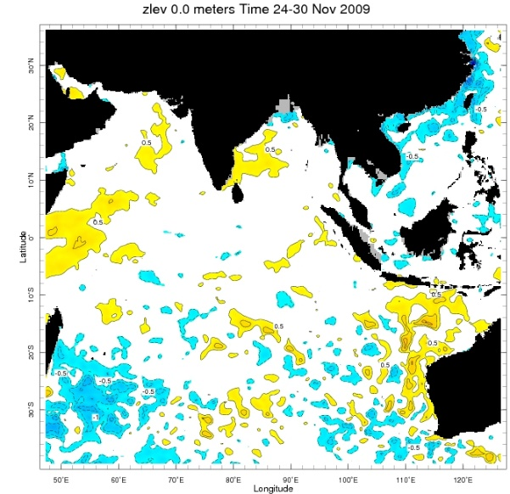
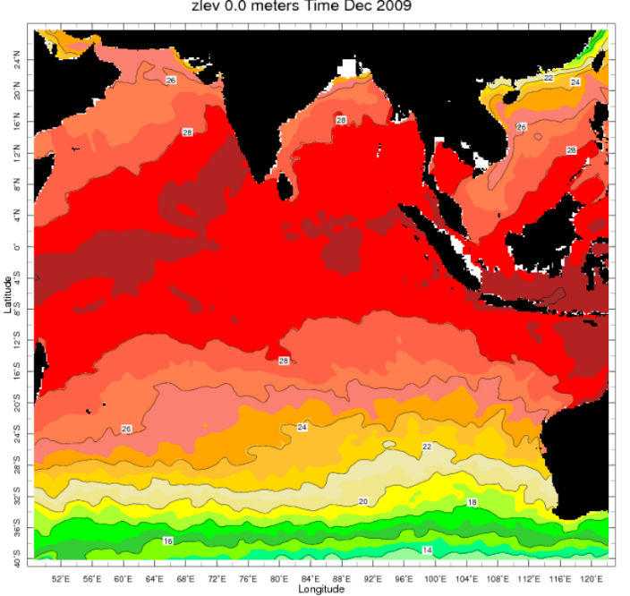
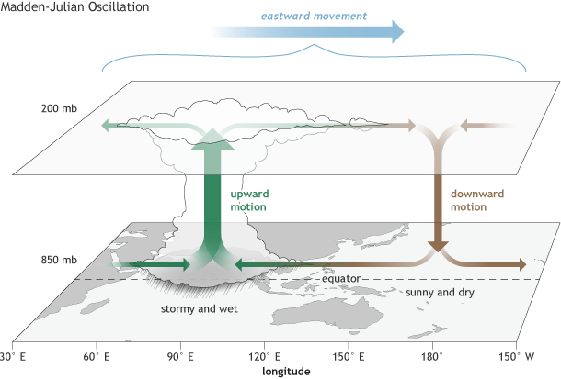
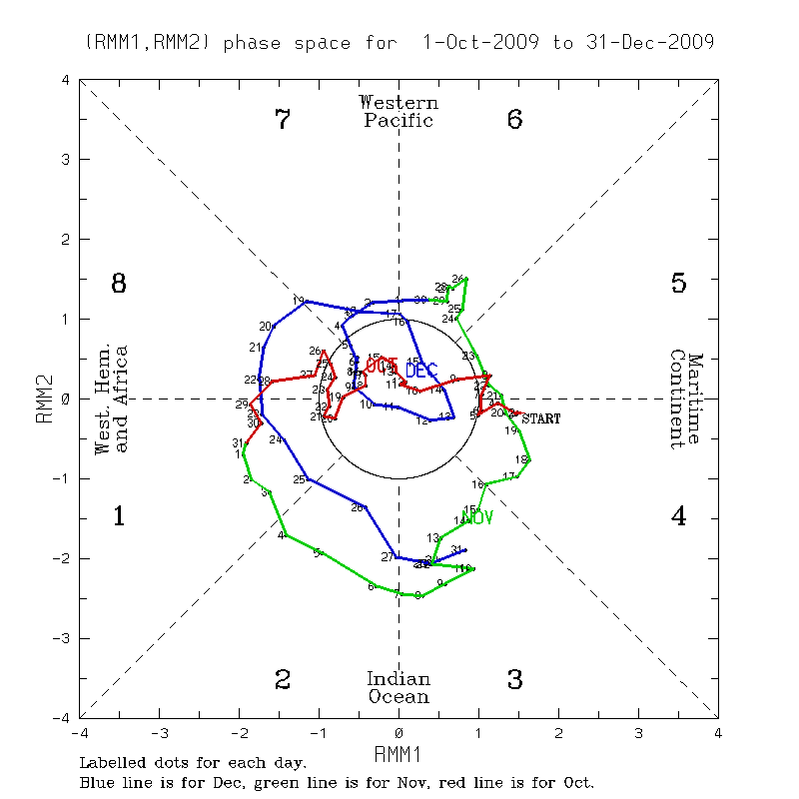
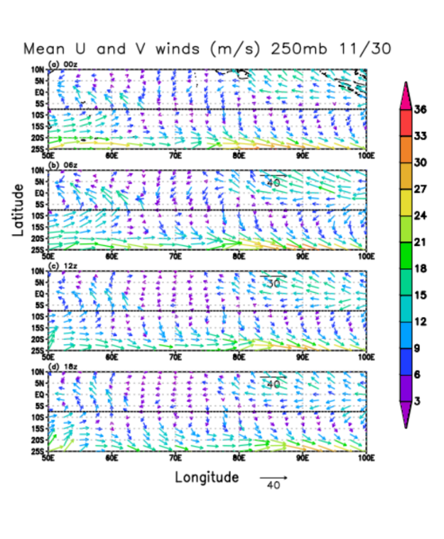
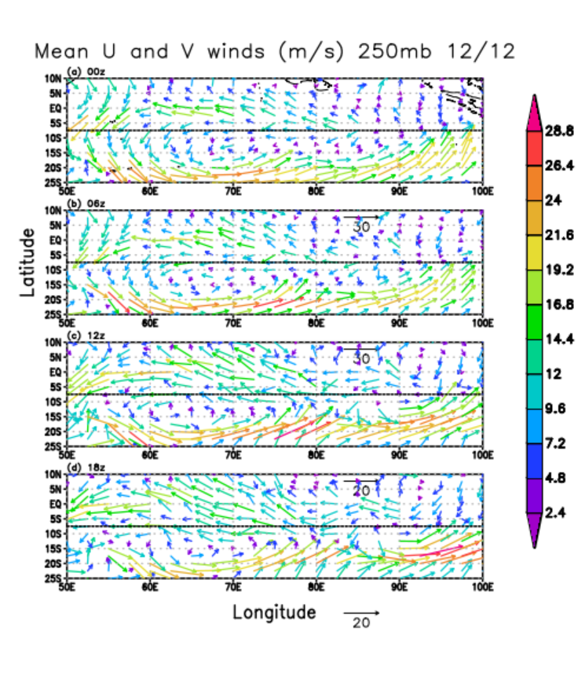
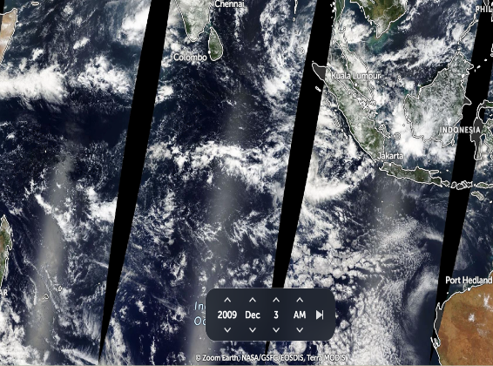
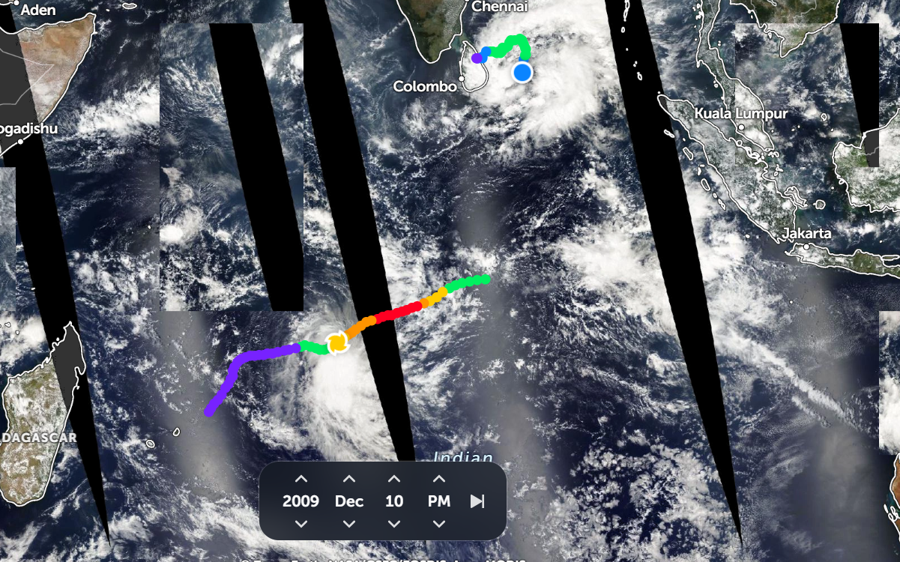
Mechanisms of Twin Cyclones in 2009 Without the Influence of the MJO
Seth Lee
Faculty Advisor(s): (Dr. Pallav Ray), Dept. of Ocean Engineering and Marine Science Florida Institute of Technology
Summary: This work examines the genesis of a twin cyclone event in December 2009 in the Indian Ocean during an inactive phase of the Madden-Julian oscillation (MJO). Our analysis of large-scale background conditions shows that this event was influenced by increased sea-surface temperatures, ideal upper-level wind, and increased moisture in the presence of strong El Niño conditions.
Results and Discussions
Despite lack of MJO, above normal SSTs were present (figures 5 and 6)
Ideal upper-level winds (figures 7 and 8) also played a role in the formation of the twin cyclones
Other atmospheric conditions such as high humidity, a strengthening El-Nino, and convective cloud activity (figure 3) contributed
Introduction
The Indian Ocean sees cyclone activity between May and December
Twin cyclones occur at same time, with MJO being the main driver (figure 1)
MJO was not present during this event (figure 2)
Cyclones studied were Ward in the north and Cleo in the south (figure 4)
Figure 5: Sea surface anomies in late November: Source: Columbia College
Figure 6: Sea surface temperatures in December: Source: Columbia College
Figure 1: Basic structure and movement of Madden-Julian Oscillation (MJO): Source: NOAA
Figure 2: MJO behavior from October to December 2009, with December being the blue line: Source: Australian Bureau of Meteorology
Methods
Utilized satellite imagery (figures 3 and 4), atmospheric data from IBTrACS,
oceanographic temperature, and state of El-Nino
Looked at atmospheric instability, wind shear levels and sea surface anomalies
Also studied the paths of each storm to see how they were affected
Figure 7: U and V winds at 250hPa on 11/30.
Figure 8: U and V winds at 250hPa on 12/12.
Conclusions
Twin cyclone event of December 2009 shows that MJO does not necessary
need to be active to see a twin cyclone event
The study shows that one should consider other influences beyond the MJO
when exploring twin cyclones
Future work would involve quantification of the role of cyclogenesis parameters.
References and Acknowledgements
HD satellite map. Zoom Earth. https://zoom.earth/maps/satellite-hd/#view=-7.1,88.3,4z/date=2009-12-01,pm
scheme=AGLSTERMS.AglsAgent; corporateName=Australian Government - Bureau of Meteorology. (2024). Tropical Monitoring and Outlooksmadden-Julian Oscillation (MJO). Madden-Julian Oscillation (MJO) monitoring. http://www.bom.gov.au/climate/mjo/#tabs=Monitoring
Science at our core. IRI. (n.d.). https://iri.columbia.edu/?bbox=bb%3A47.27%3A-39.40%3A126.60%3A36.15%3Abb
What is the MJO, and why do we care?. NOAA Climate.gov. https://www.climate.gov/news-features/blogs/enso/what-mjo-and-why-do-we-care
Thank you, Dr. Ray, for helping me out with this project.
Figure 3: Satellite image of the region before the cyclones both formed: Source: Zoom Earth
Figure 4: Satellite image of both cyclones on 12/10: Source: Zoom Earth

