Slide 1
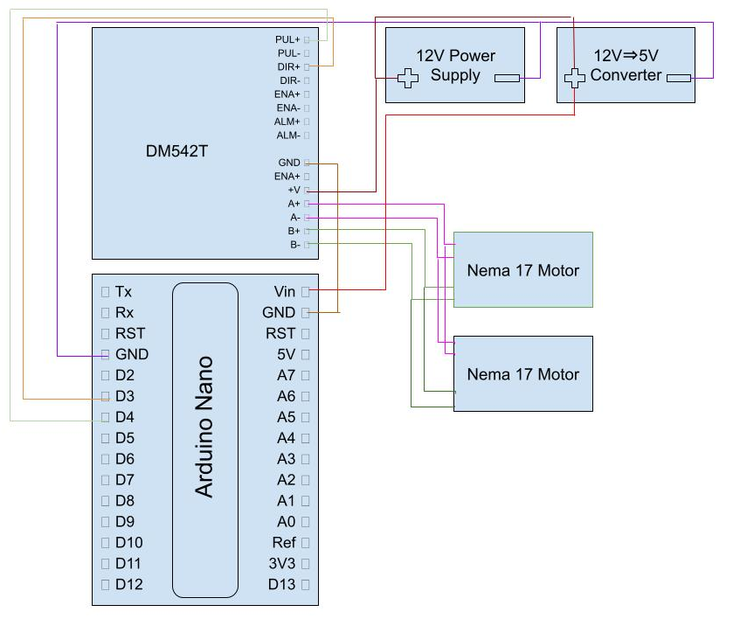
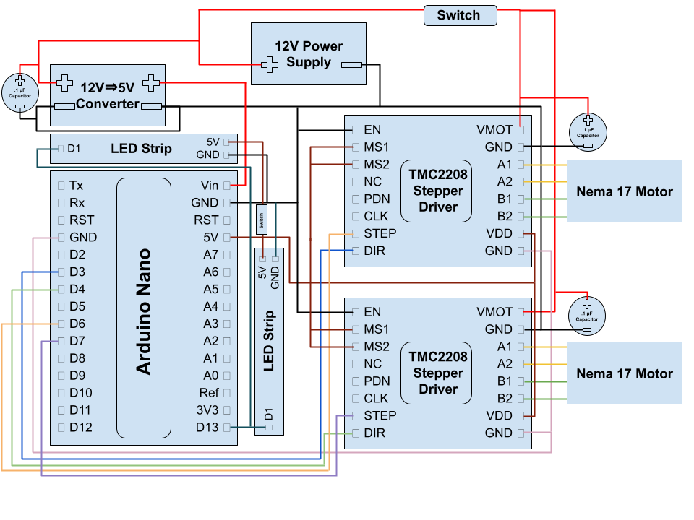
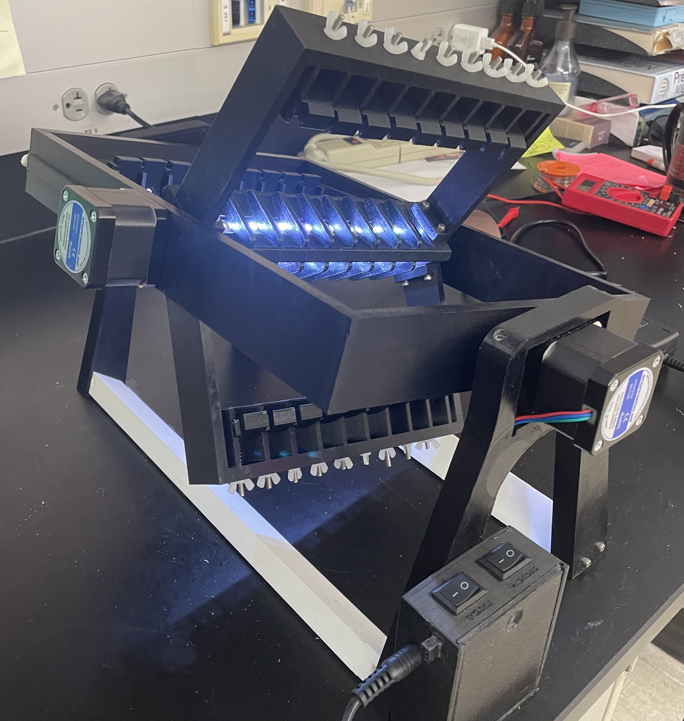
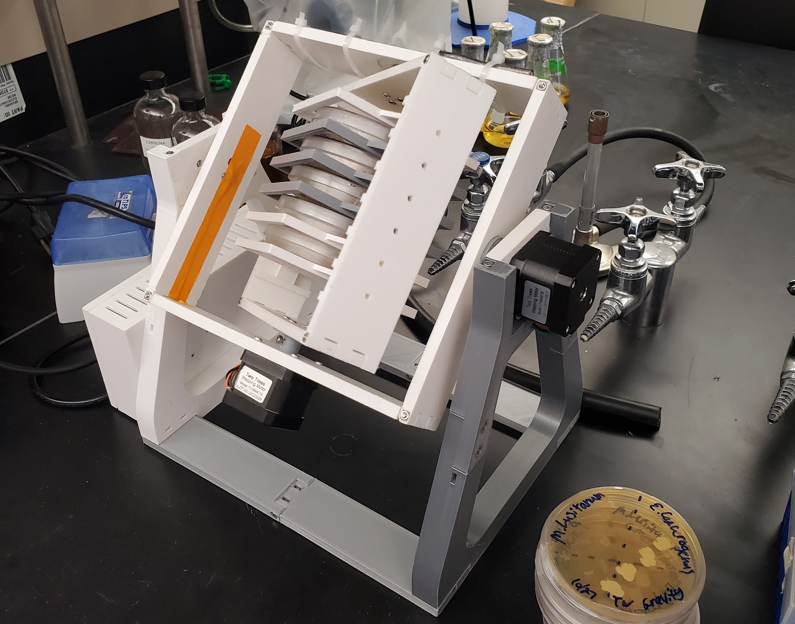
Microgravity Simulator: Random Positioning Machinery
Team Members: Vivienne Nipar², Ryoku Yamaguchi², David Handy¹
Faculty Advisor(s): Dr. Andrew G. Palmer¹, Dr. Edward L. Caraway², ¹Dept. Of Ocean Engineering and Marine Sciences, ²Dept. Of Computer and Electrical Engineering, Florida Institute of Technology
Background:
Structural:
CAD modeling was done to create the parts and then they were printed on 3D printers. Ball bearings were added for smoother rotations and support for more weight for the side opposite the motor. Springs were also added to secure the petri dishes/plates and for less while in motion. Due to plant growth testing being the primary focus of this iteration, a structure to hold the control group was also made.
The microgravity simulator is a random positioning machine that rotates along the x and y axis to simulate weightlessness in a three-dimensional pattern. The microgravity simulation is due to vector confusion that disrupts the gravity vector, negating the sense of "down" for biology specimens.
Problem Statement:
The main objective of this project is to create a device to rotate on 2 axes to simulate the effects of microgravity for bacteria and plant life. Experiments regarding microgravity on the ISS are costly and space limited so such a need exists for inexpensive microgravity simulators.
Iteration II:
Electrical:​
Nema 17 motors with 400 steps were used instead allowing for smoother rotations. A CNC board was used to help decrease space and make things more compact. A LED strip is used for the lights for the plants as well as switches to turn on/off motors and/or lights.
For the following iteration desired characteristics included:
An increased amount of petri plates to be tested a single time
Being able to support plant testing (requires a light source)
Smoother rotations
A more compact electrical system were implemented
Iteration I:
This iteration’s purpose was to test microgravity on bacteria. It is a basic version of the clinostat. A single stepper driver is used and wired to the motors in parallel as microgravity is simulated at a low speed, consistent on each axis.
Future Work:
Different arms to support more plate types holders to support other styles of equipment
Touch screen interaction

