Slide 1
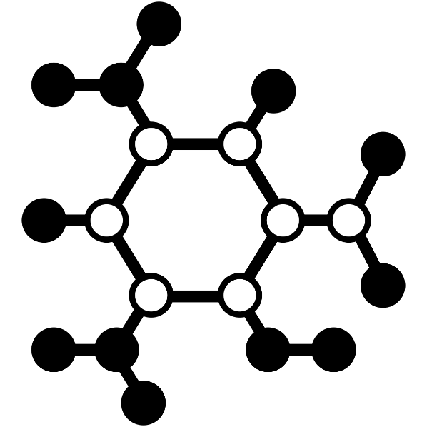
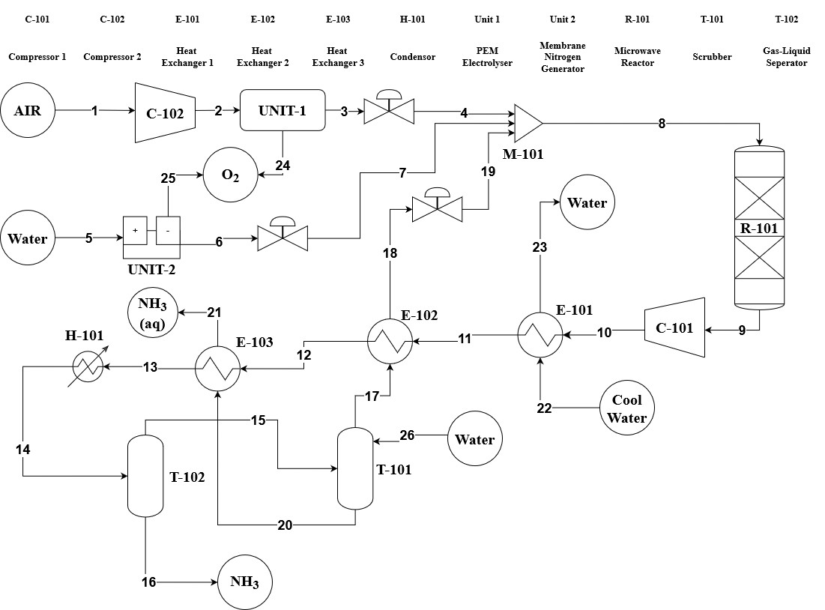
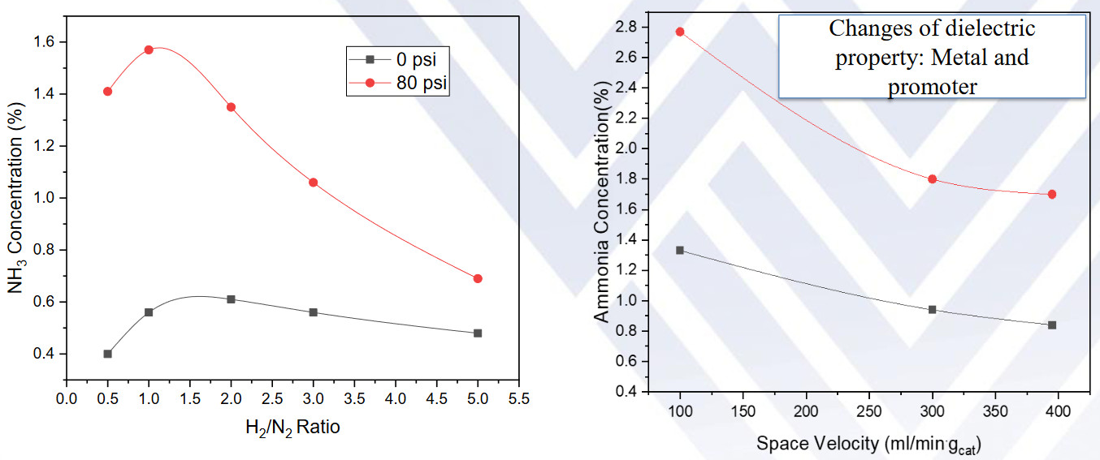
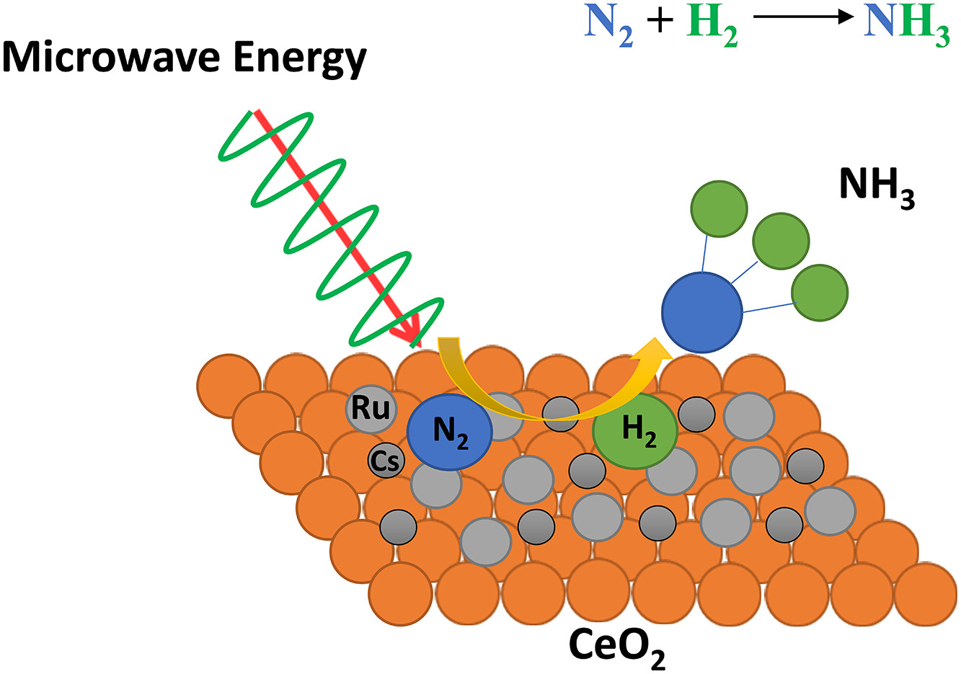
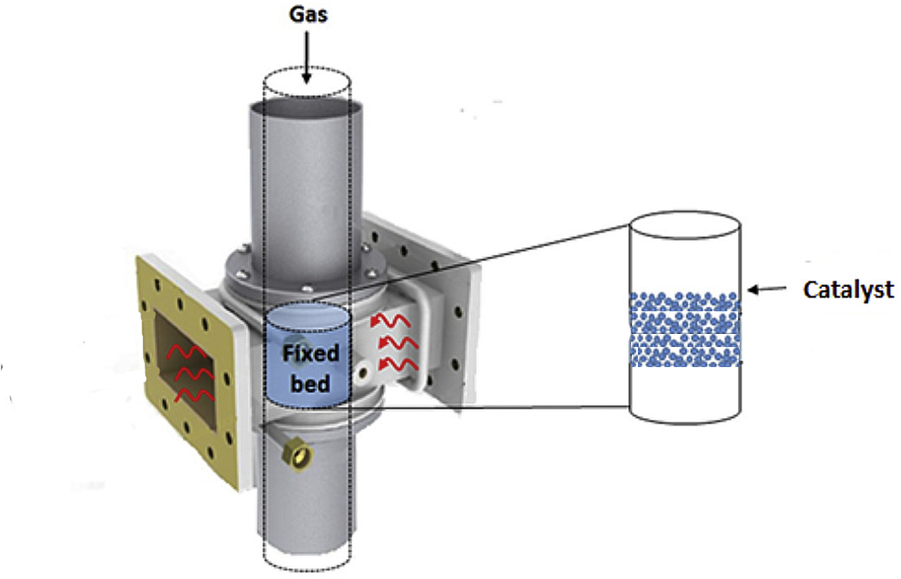
Ammonia Production Through Microwaves
Juan Loaiza, Mazen Alameer, Khalid Kabli
Faculty Advisor: Dr. Jonathan Whitlow, Dept. of Chemical Engineering, Florida Institute of Technology
Abstract
Process Flow Diagram
Growing importance of Ammonia in the energy transition, particularly as a storage option for renewable energy. Despite its primary use as fertilizer, new methods like microwave reactors offer more efficient and scalable alternatives to traditional synthesis processes like Haber Bosch. This approach supports green energy trends and promises significant production increases, with current rates of 10 tons/day projected to reach 100 tons/day upon scaling up.
Novelty
The microwave selectively heats the catalyst within the fixed bed reactor, contrasting with the Haber Bosch method, which necessitates heating the entire vessel.
This innovative technology promises to significantly reduce CO2 emissions, boasting efficiency and the capability to operate solely on renewable energy without needing a constant energy supply.
Microwave-enhanced ammonia synthesis represents a novel approach to hasten the hydrogen economy, leveraging hydrogen and air to generate liquid ammonia.
Microwave Catalyst
Reactions
Reactor Design
Production Rate
3319 ton/yr Ammonia at 99.7% Purity
13733 ton/yr Ammonia Liquor at 5% Concentration

